Slide 1
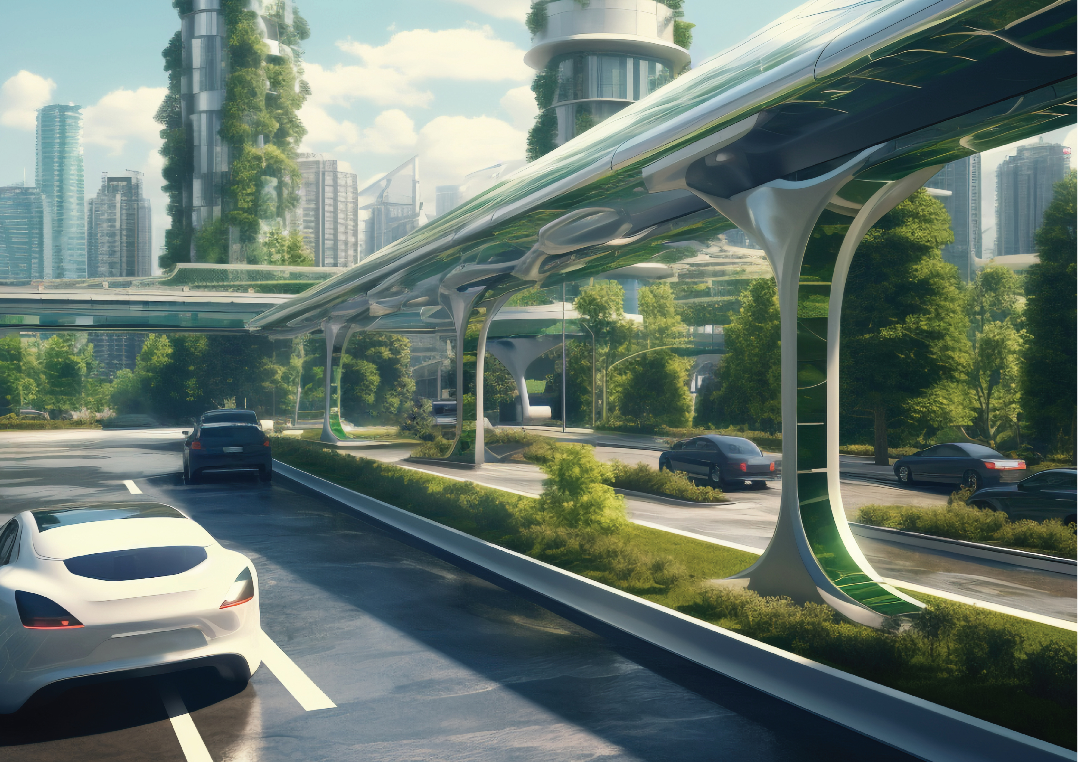



#UGDMN
Ultimate
Global
Disaster
Mitigation
Nexus
Advance Feasibility Study
&
Business Plan
Earth Climate and Geological Risks
From
Galactic Cosmic Rays (GCRs)
&
The Sun
by
:man:
of (know as)
: Phouthone: Siharath.
for
totrade.co
team@totrade.co
Latest
totrade.co/cr
Notes:
#UGDMN WORKING PAPER
#UGDMN means Ultimate Global Disaster Mitigation Nexus
It is Feasibility Study and Business Plan Earth Climate and Geological Risks
from Galactic Cosmic Rays (GCRs) and The Sun
Instead of Outdated Climate Hansenism which will be explained later at first.
by Phouthone Siharath
Totrade.co
team@totrade.co

Slide 2
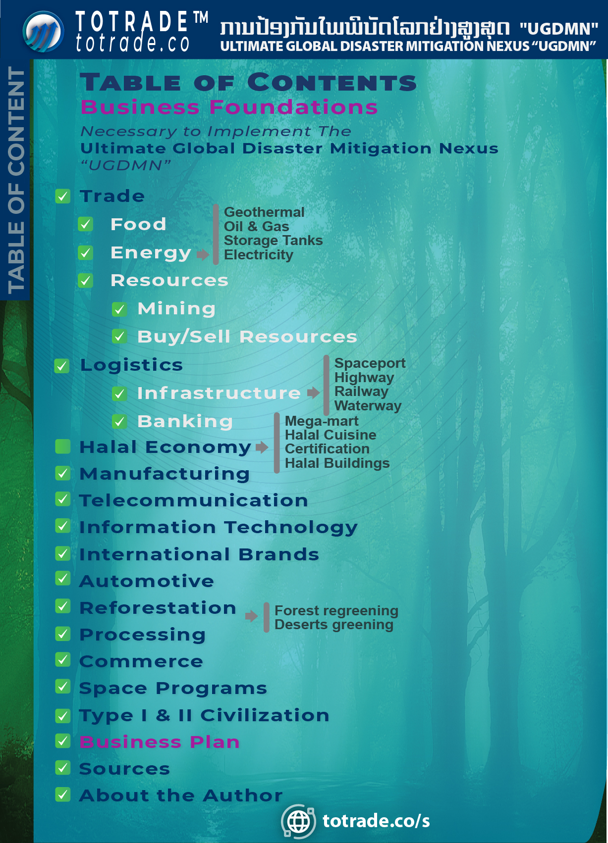

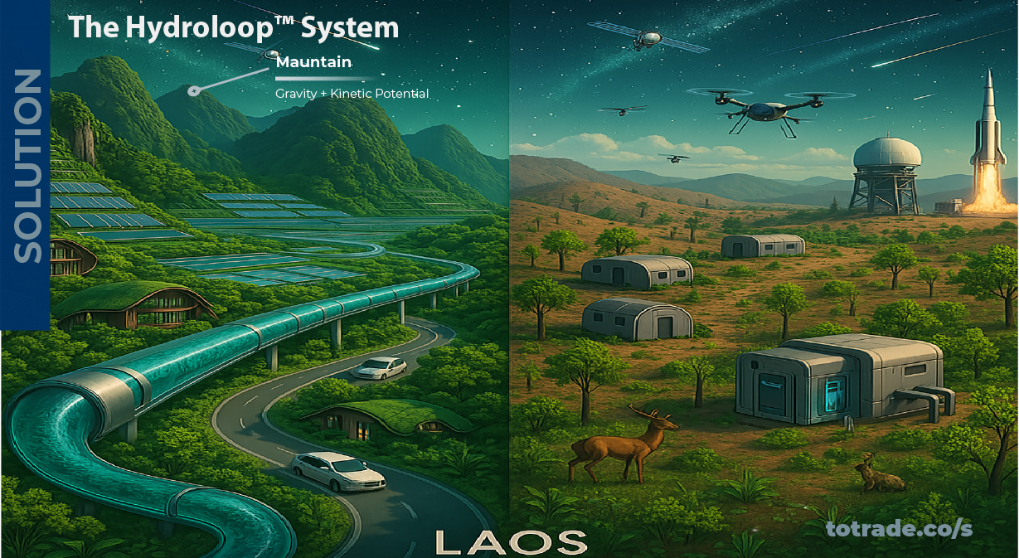





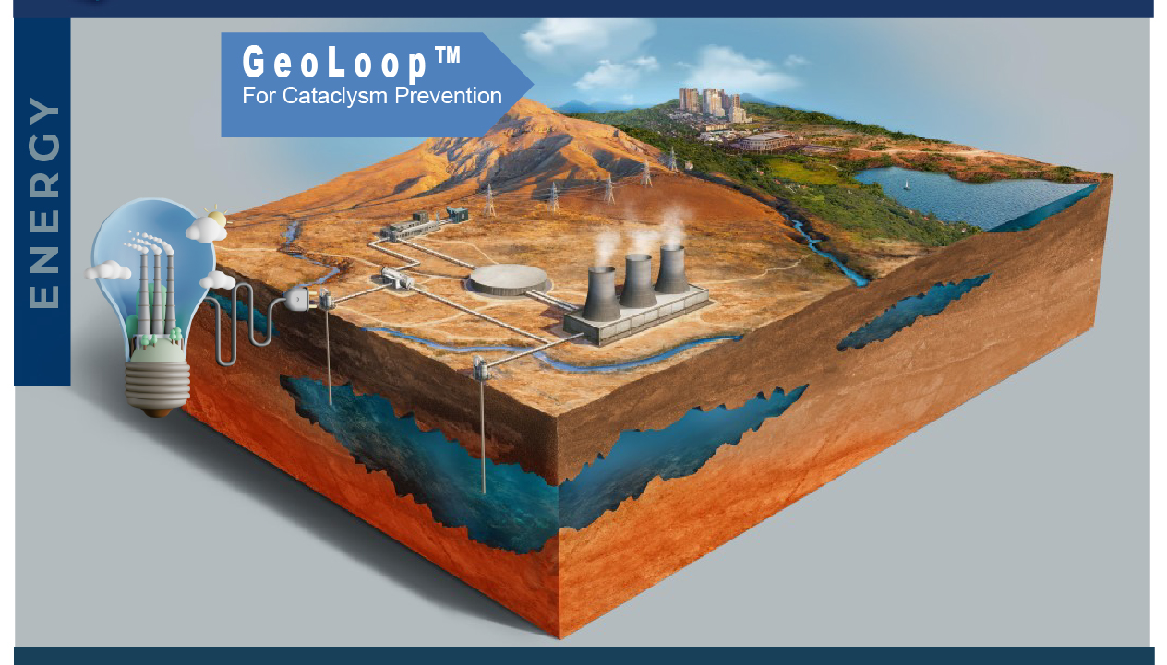
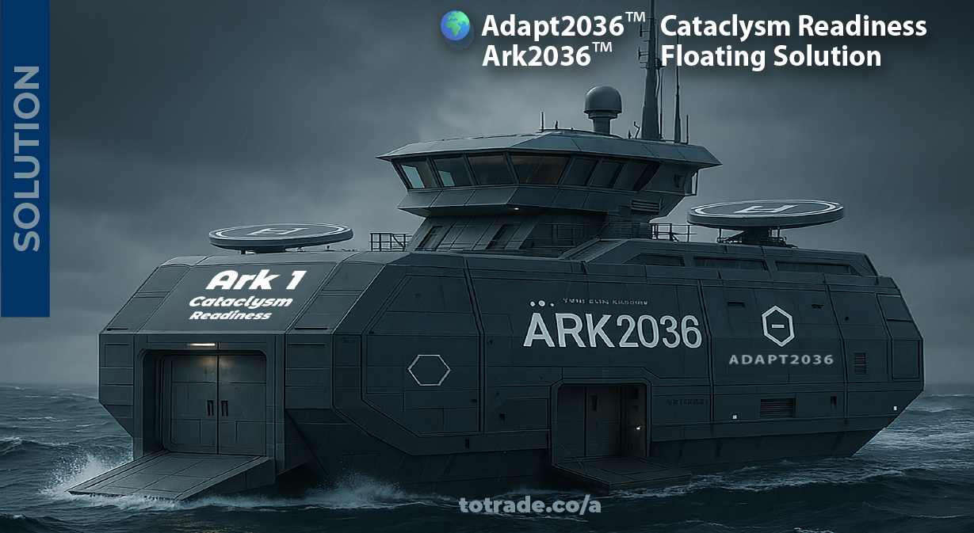


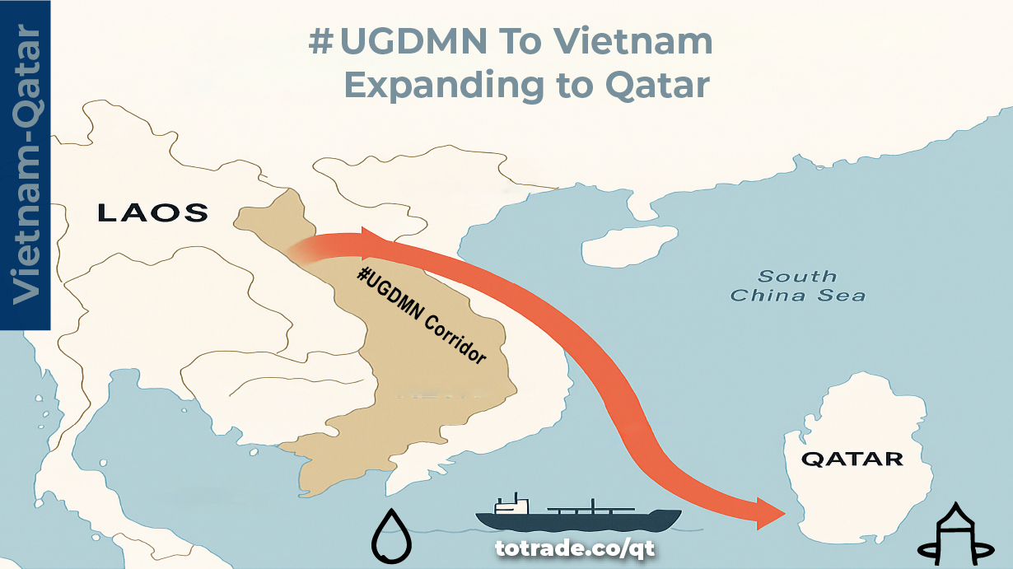
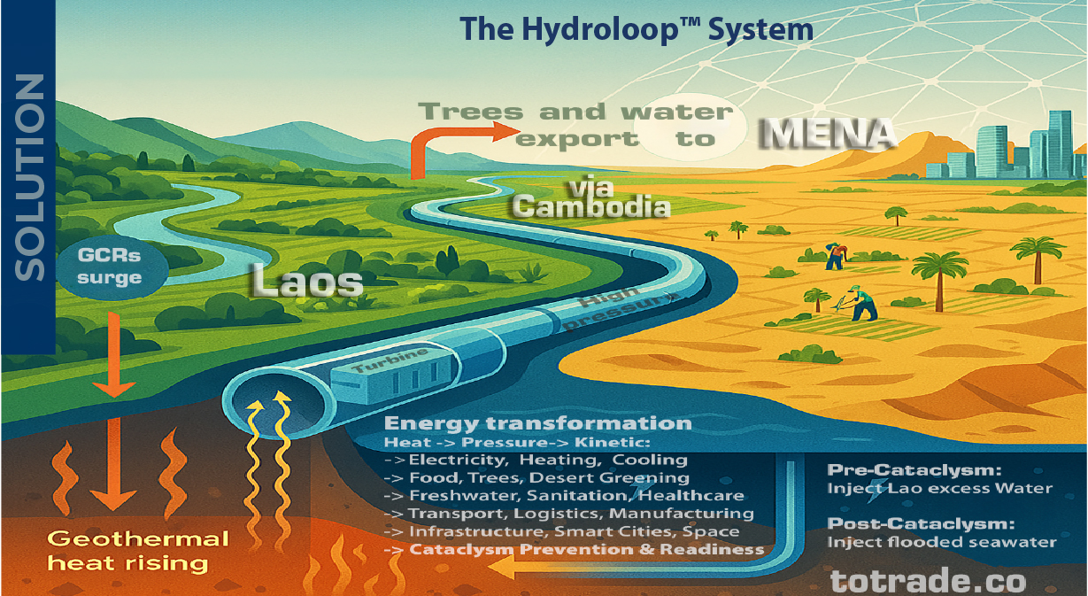
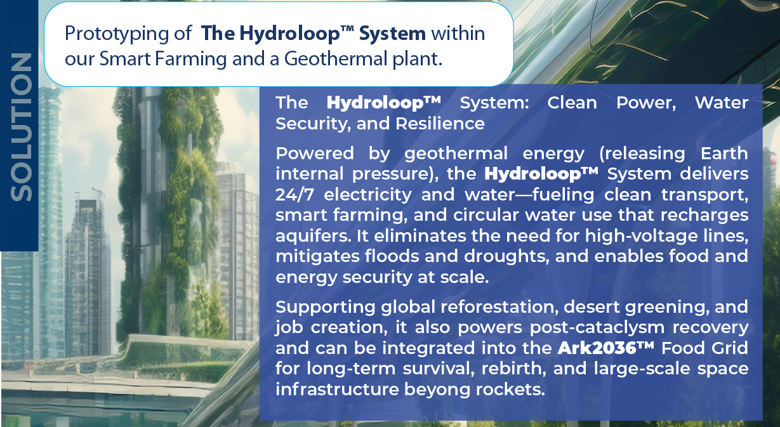


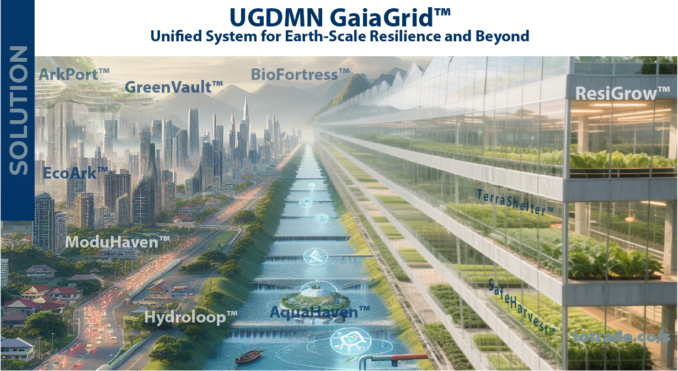
Notes:
Table of Contents:

Slide 3
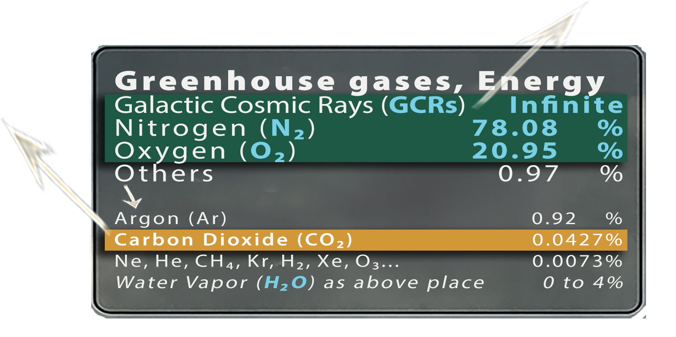
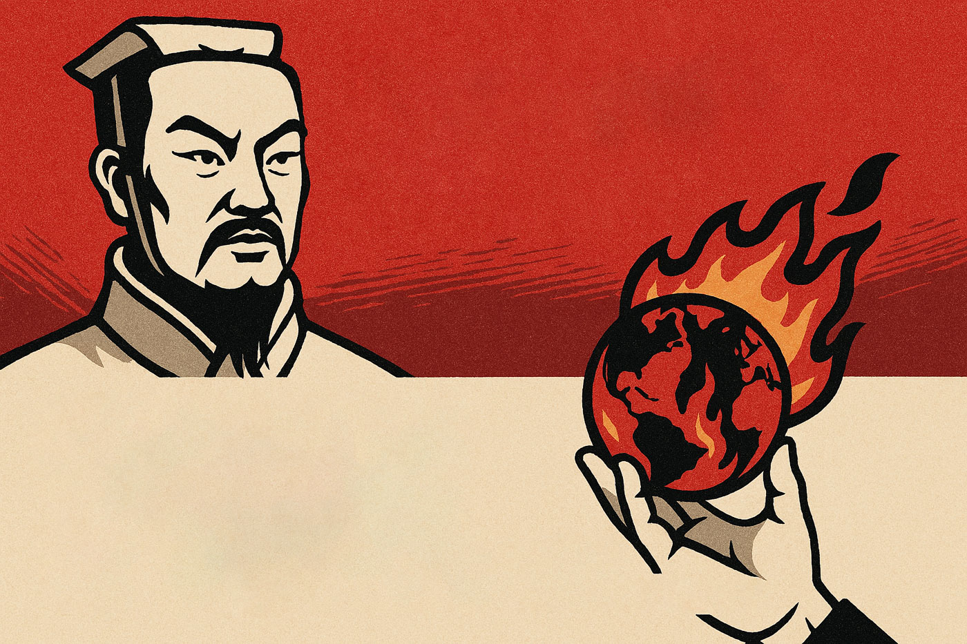
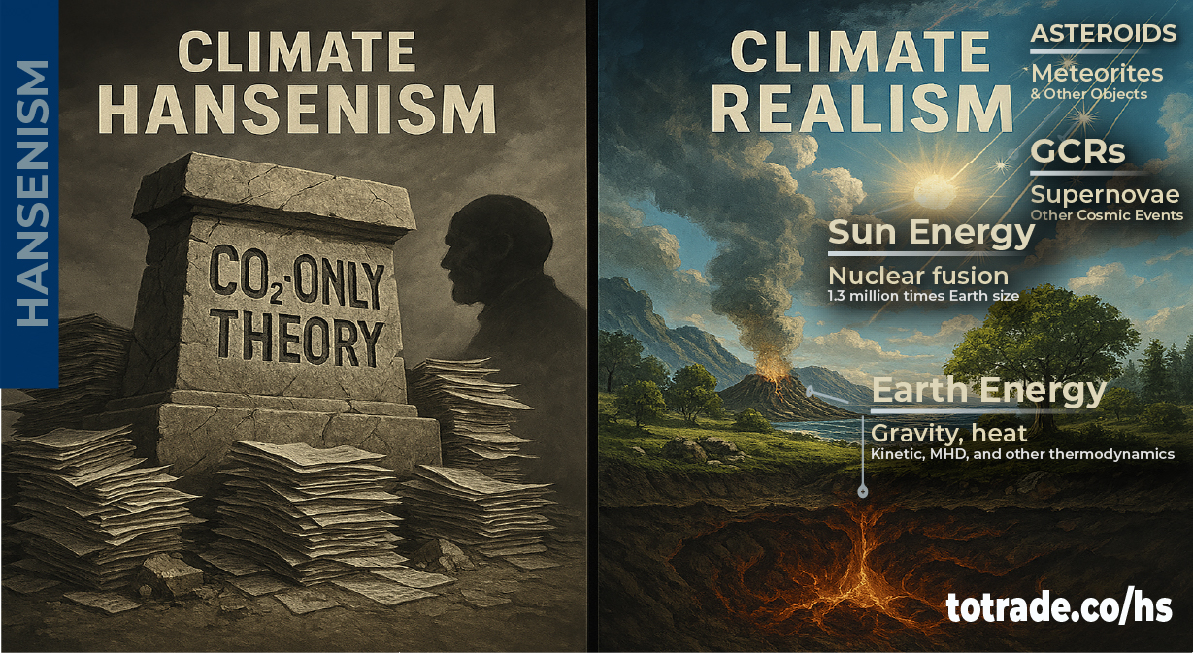
SUN TZU ART OF WAR
All warfare is based on deception
Framing information strategically manipulates perception and drives decision-making
Sun Tzu Art of War Rule #04/450
Notes:
SUN TZU ART OF WAR ( (Rule #4/450)
Sun Tzu said all warfare is based on deception.
Today, exaggerated climate alarmism shapes perception and policy. Coercive green ideology imposed on poor nations functions as corporate colonialism.
Through resource extraction, debt traps, land grabs, and by corrupting dictators under weak leadership, the affluent financial powers fund their corporate allies to exploit while framing humanity as its own enemy totrade.co/rome, deepen banking and corporate dependency, driving division, inequality, poverty, and conflict by pretending to save the planet.
EXAMPLES OF DATA MANIPULATION:
A. Tree-ring Natural Archive, youtu.be/K_8xd0LCeRQ?t=195
Chart based on tree-ring density data compiled by Keith Briffa and colleagues across the Northern Hemisphere reconstructed temperatures back to 1400. It showed:
• Large variability with no steady warming trend
• Peak warmth in the 1930s
• Cooling into the early 1990s, ending below the six-century average
B. Ice Core & Sediment Layers Natural Archives, youtube.com/jP8nz0cVbzQ&t=181s
Temperature reconstruction using ice core data from Greenland shown in orange, sediment layers from the tropical passer straight in Indonesia shown in black so it's not a regional thing.
The match is remarkably close and tell the same old story: rapid and abrupt warming after the end of last glaciation by cataclysm 7,000 Years Ago – Arctic Ocean Shift, Noah’s Flood, totrade.co/e, a peak about 6,000 years ago, then an overall decline since.
Let's wait how Climate Alarmism in the North Hemisphere will feel their Global Warming in winter.
The IPCC faced results that contradicted its warming narrative of Sun Tzu–style deceptive warfare and shifted to alternative methods more manipulable to favor alarmist claims.
Communication to Top Financial Powers:
If you believe your cataclysm preparedness is secure, think again.
Current strategies depend on fragile systems, misleading narratives, and hidden dependencies. True security demands funding solutions that protect people and resources, while enabling rapid post-cataclysm recovery and accelerating progress toward a Type I Civilization—without regressing to a Stone Age. Invest in #UGDMN to build resilience that is real, scalable, and rapid globally transformative.

Slide 4
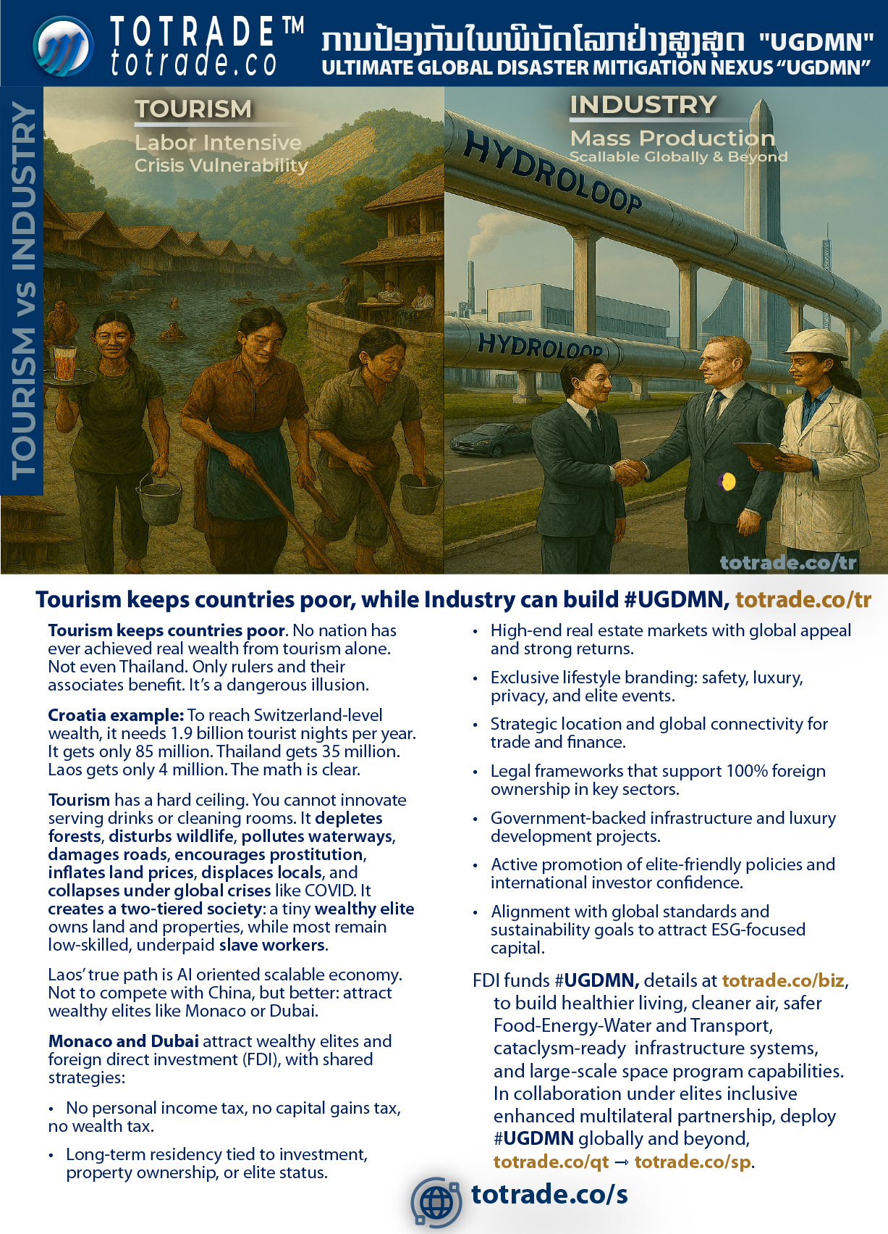

Notes:
🌌 Tourism vs Industry
Tourism keeps countries poor. No nation has ever achieved real wealth from tourism alone. Not even Thailand. Only rulers and their associates benefit. It’s a dangerous illusion.
Croatia example: To reach Switzerland-level wealth, it needs 1.9 billion tourist nights per year. It gets only 85 million. Thailand gets 35 million. Laos gets only 4 million. The math is clear.
Tourism has a hard ceiling. You cannot innovate serving drinks or cleaning rooms. It depletes forests, disturbs wildlife, pollutes waterways, damages roads, encourages prostitution, inflates land prices, displaces locals, and collapses under global crises like COVID. It creates a two-tiered society: a tiny wealthy elite owns land and properties, while most remain low-skilled, underpaid slave workers.
Laos’ true path is AI oriented scallable economy. Not to compete with China, but better: attract wealthy elites like Monaco or Dubai.
Monaco and Dubai attract wealthy elites and foreign direct investment (FDI), with shared strategies:
• No personal income tax, no capital gains tax, no wealth tax.
• Long-term residency tied to investment, property ownership, or elite status.
• High-end real estate markets with global appeal and strong returns.
• Exclusive lifestyle branding: safety, luxury, privacy, and elite events.
• Strategic location and global connectivity for trade and finance.
• Legal frameworks that support 100% foreign ownership in key sectors.
• Government-backed infrastructure and luxury development projects.
• Active promotion of elite-friendly policies and international investor confidence.
• Alignment with global standards and sustainability goals to attract ESG-focused capital.
FDI funds #UGDMN, details at totrade.co/biz, to build healthier living, cleaner air, safer Food-Energy-Water and Transport, cataclysm-ready infrastructure systems, and large-scale space program capabilities. In collaboration under elites inclusive enhanced multilateral partnership, deploy #UGDMN globally and beyond, totrade.co/qt ⇾ totrade.co/sp.

Slide 5
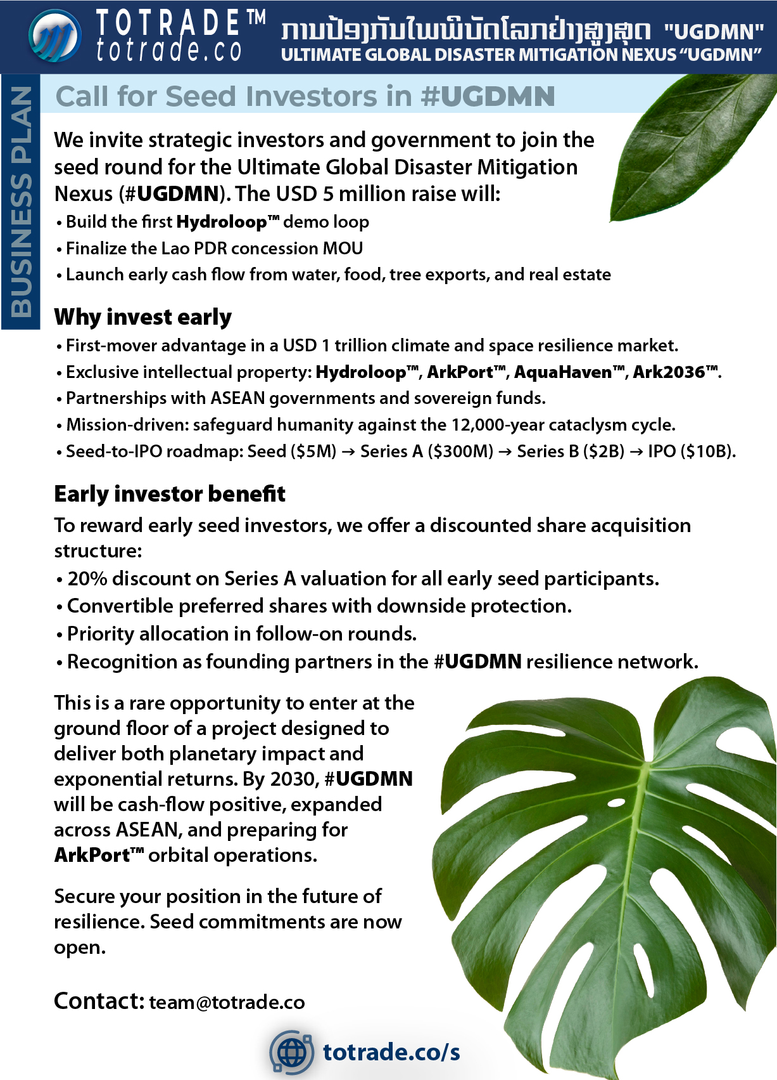

Slide 6
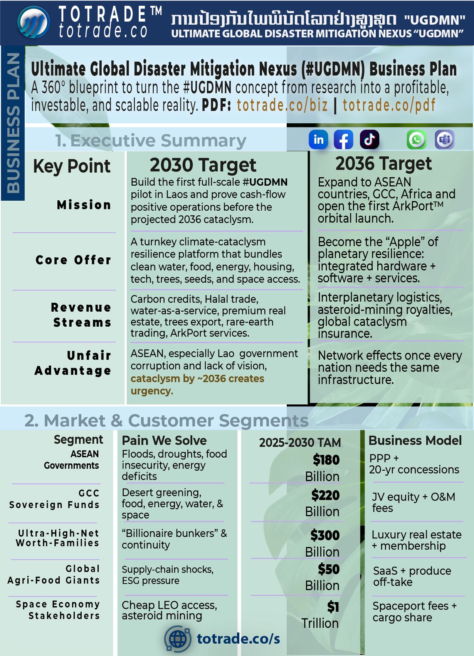

Slide 7
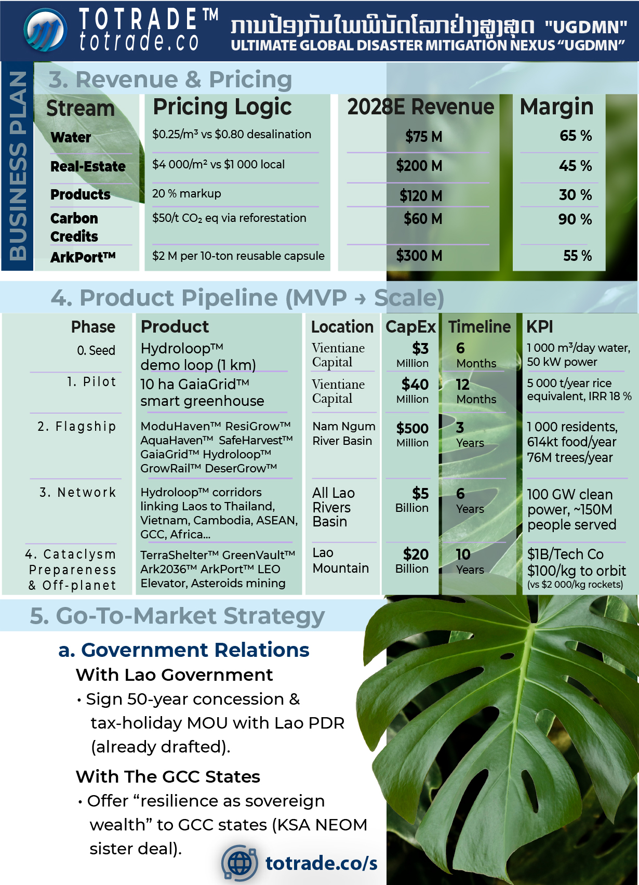

Slide 8
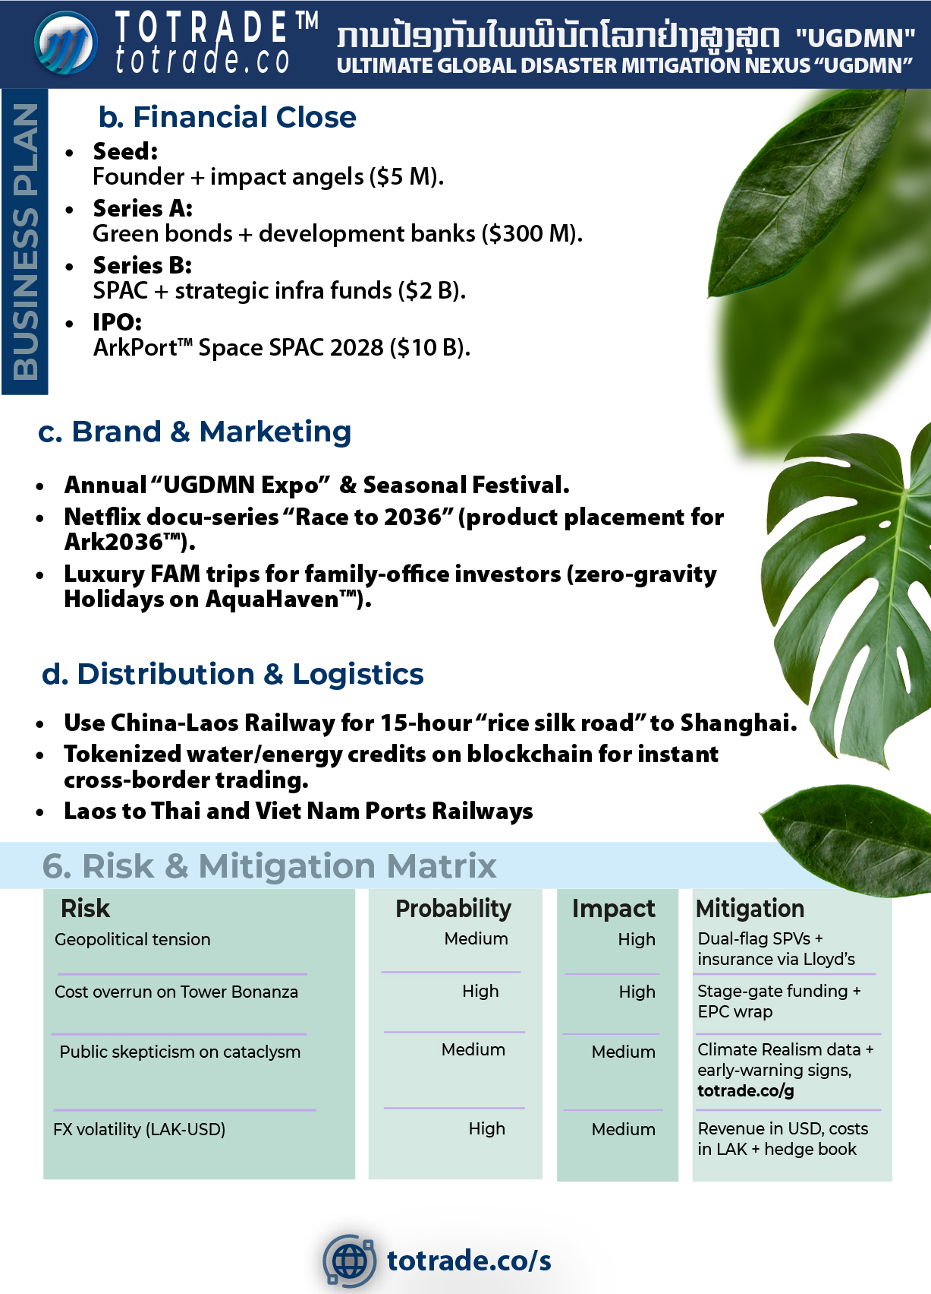

Slide 9
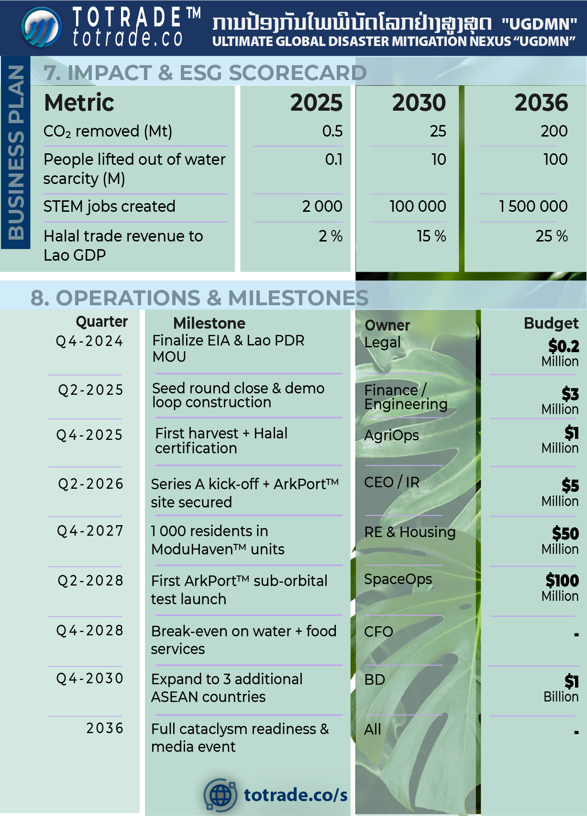

Slide 10
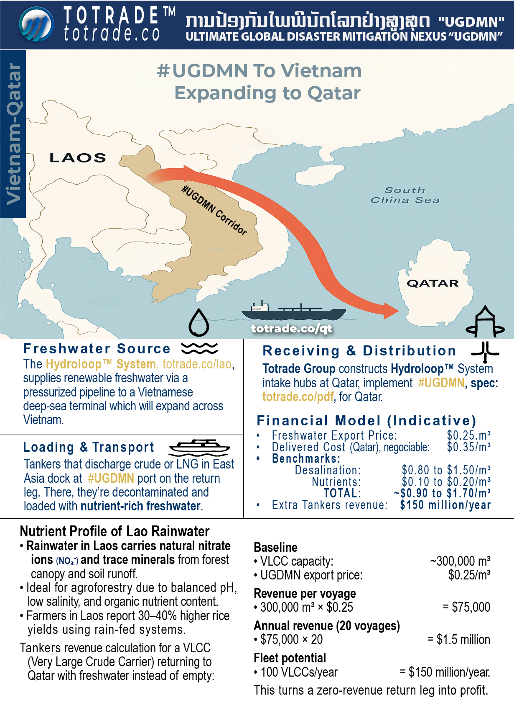


Slide 11
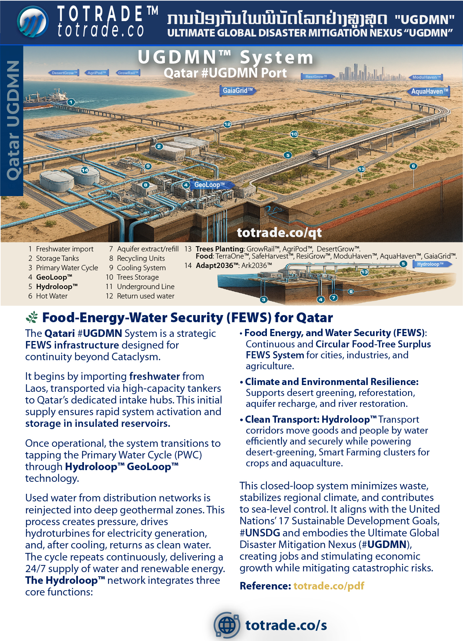

Slide 12
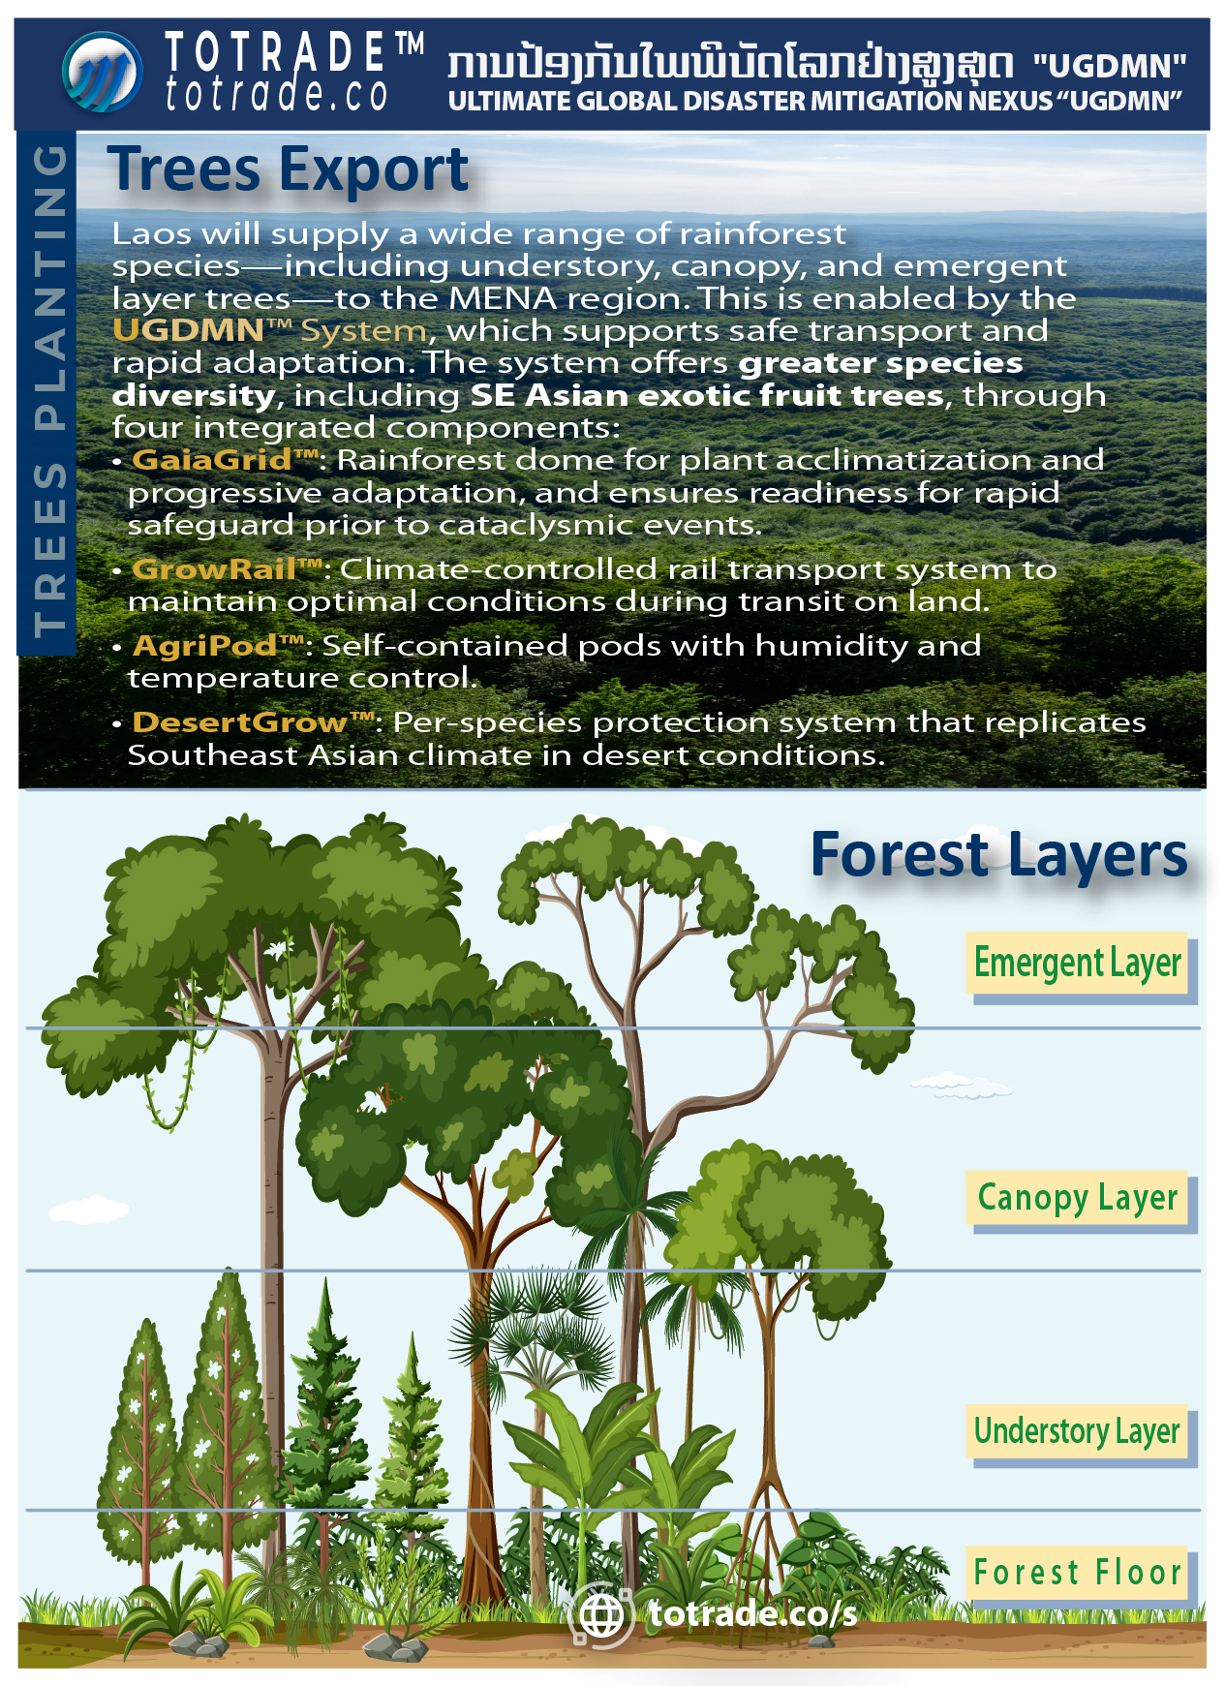

Slide 13
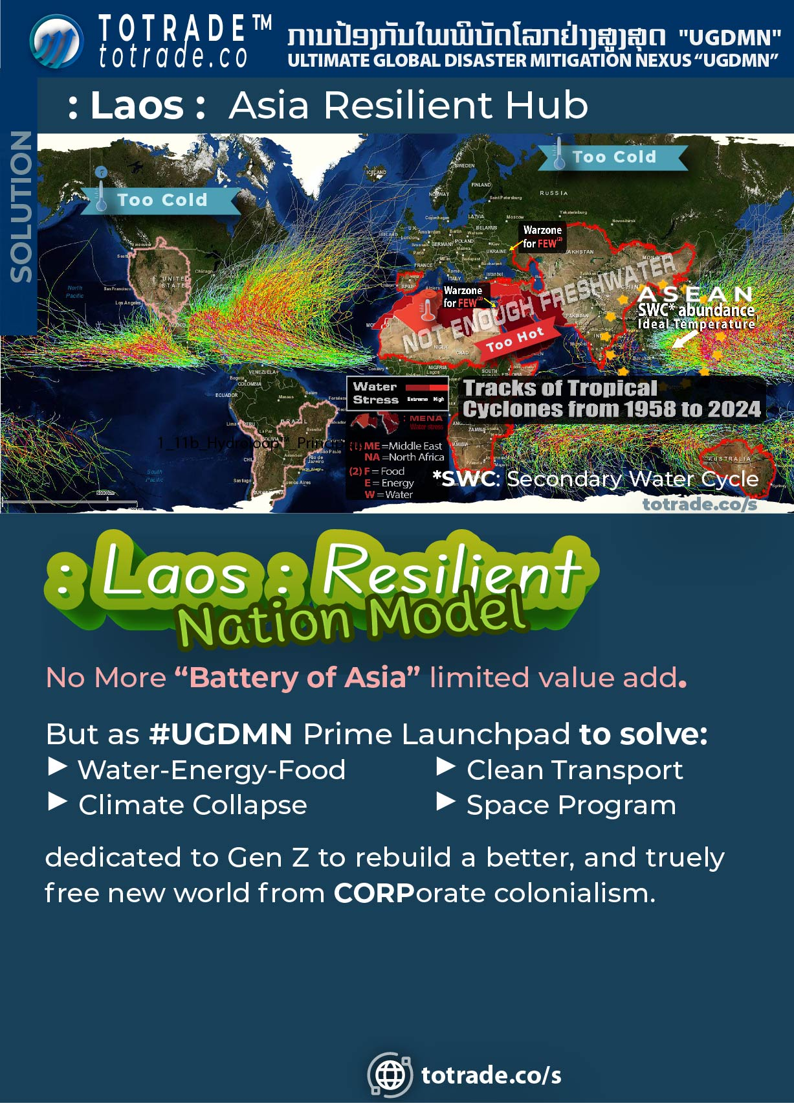
Notes:
RESOURCE CURSE PROBLEMS IN LAOS
• Mining creates short-term income but destroys land and water, leaving long-term poverty
• Cheap electricity exports trap Laos in “battery of Asia” dependence, with limited value-add
• Local communities get little benefit, profits flow abroad, and corruption deepens
• Debt to foreign investors reduces sovereignty and future flexibility
ALTERNATIVE PATHWAY WITH #UGDMN
• Redirect mining revenue into a sovereign resilience fund to support food, water, energy, housing, and healthcare security
• Replace the “Battery of Asia” with the “Asia Resilient Hub” by branding “: Laos : Resilient Nation Model” powered by freshwater systems combining microgrids (on land), floating living spaces (above water), and aquaponics (in water)
• Expand agroforestry and rainforest restoration through GrowRail™ and GaiaGrid™ to create jobs, and export green credits instead of raw minerals
• Position “: Laos :” as a biodiversity and clean-water capital, exporting genetic resources, medicinal plants, and knowledge systems rather than destructive bulk commodities
• Build cross-border resilience trade: trees for oil, water for transport, and clean food for energy partnerships with ASEAN, China, South-SW Asia, and Africa
STRATEGIC ACTIONS
• Stop signing new destructive mining concessions and redirect existing revenue into the transition fund
• Transform energy exports into value-added clean hydrogen, water-based cargo, and agro-processing instead of raw electricity
• Deploy UGDMN floating cities and agro-industrial domes to create skilled employment and self-reliant urban growth
• Promote “: Laos : Resilient Nation Model” to attract global climate funding seeking systemic long-term global solutions instead of quick profit seeking only foreign investors
The #UGDMN project is the center of this transformation. It moves “: Laos :” away from CORPorate exploitation for cheap resources and toward global recognition as a climate resilience pioneer and a truly free nation.

Slide 14
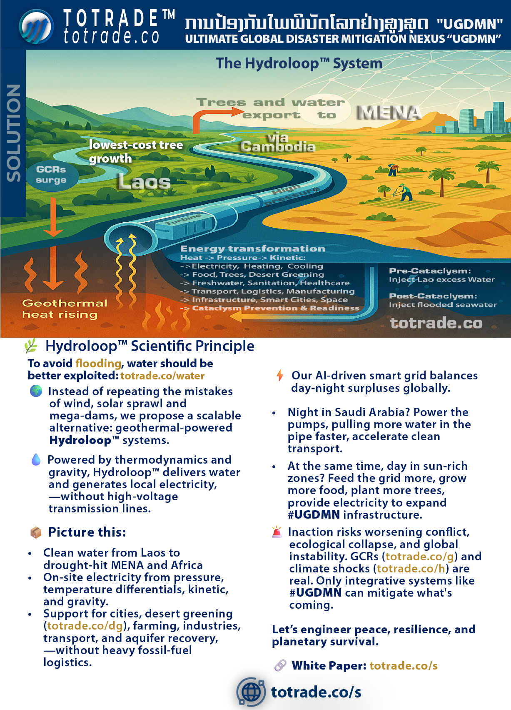

Slide 15
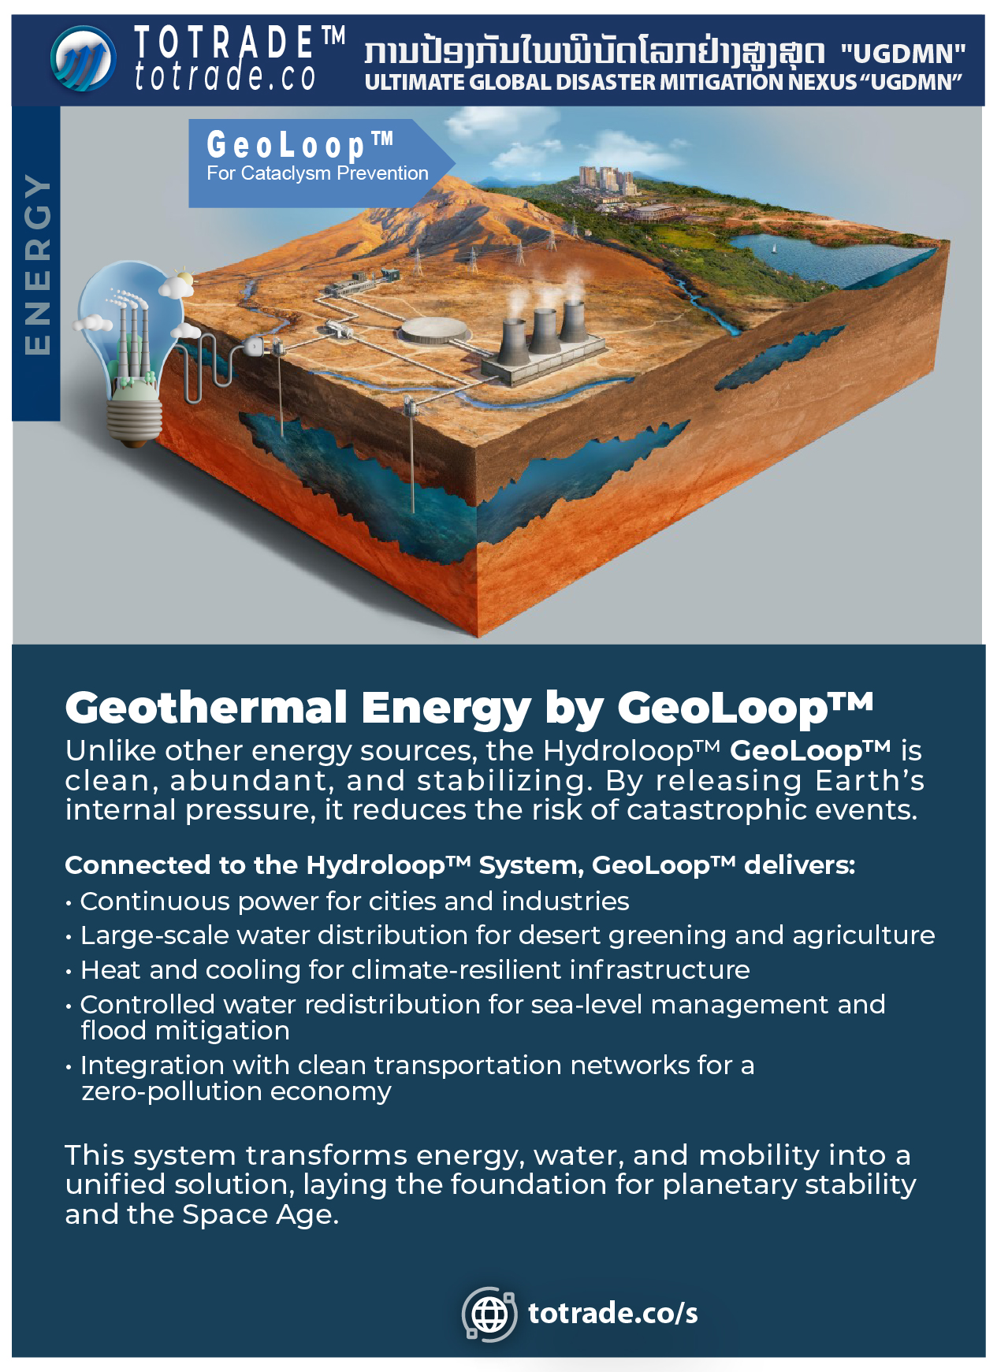

Slide 16
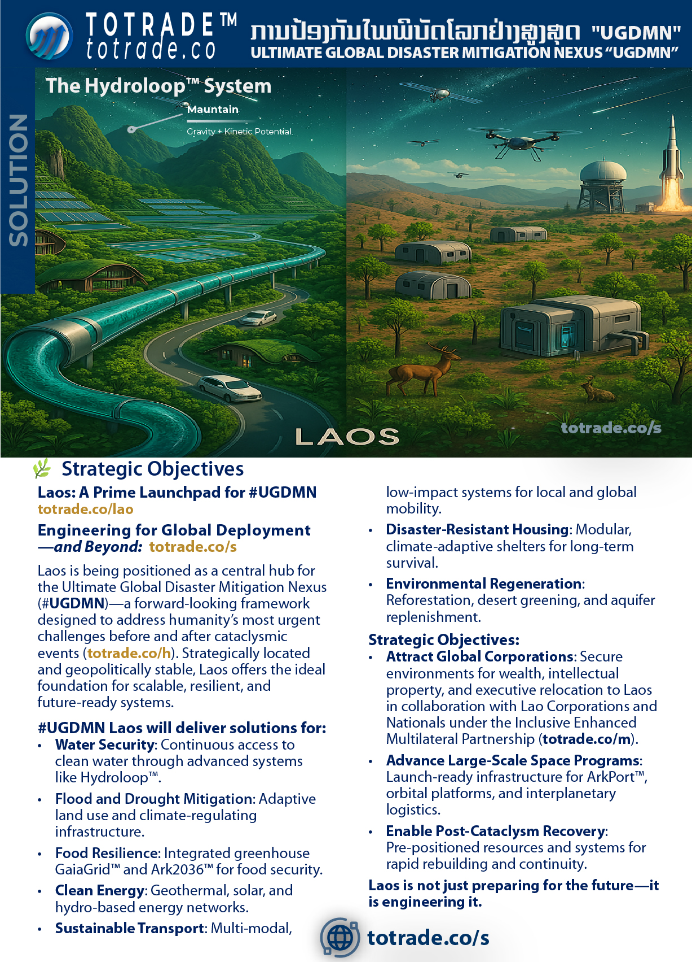

Slide 17
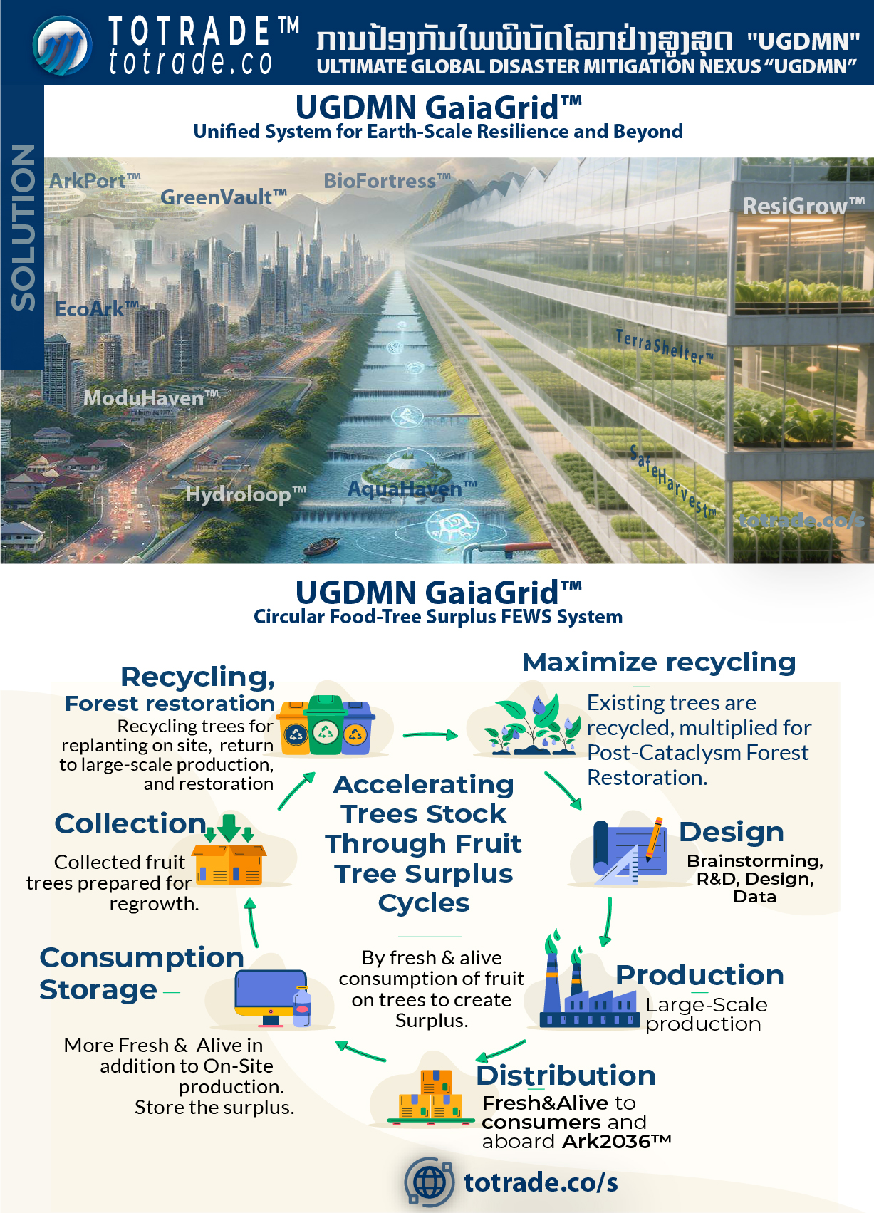

Slide 18
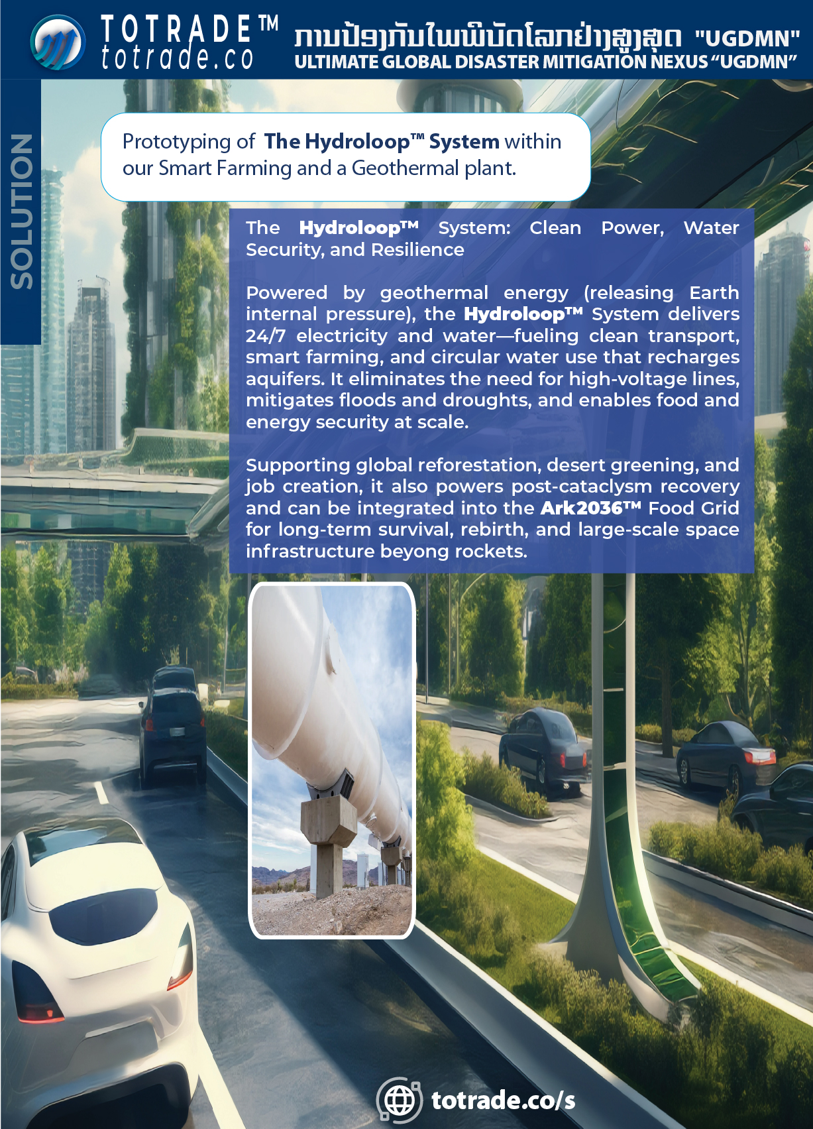

Slide 19
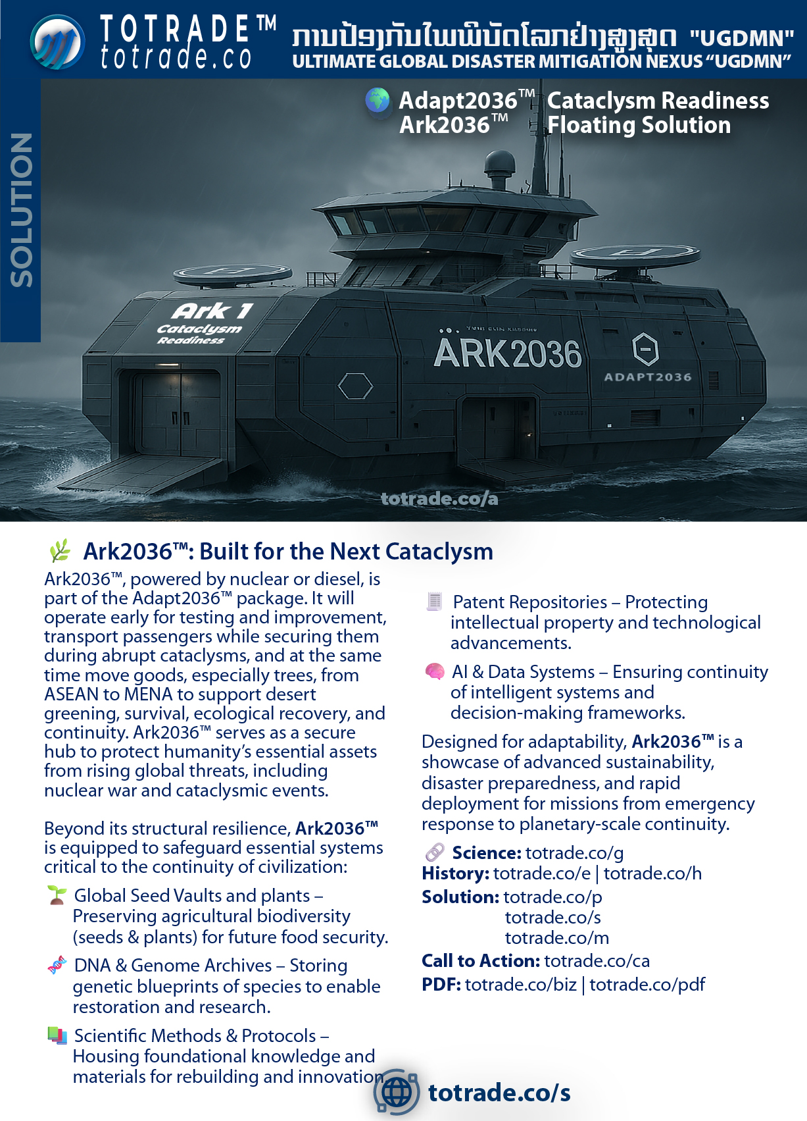

Slide 20
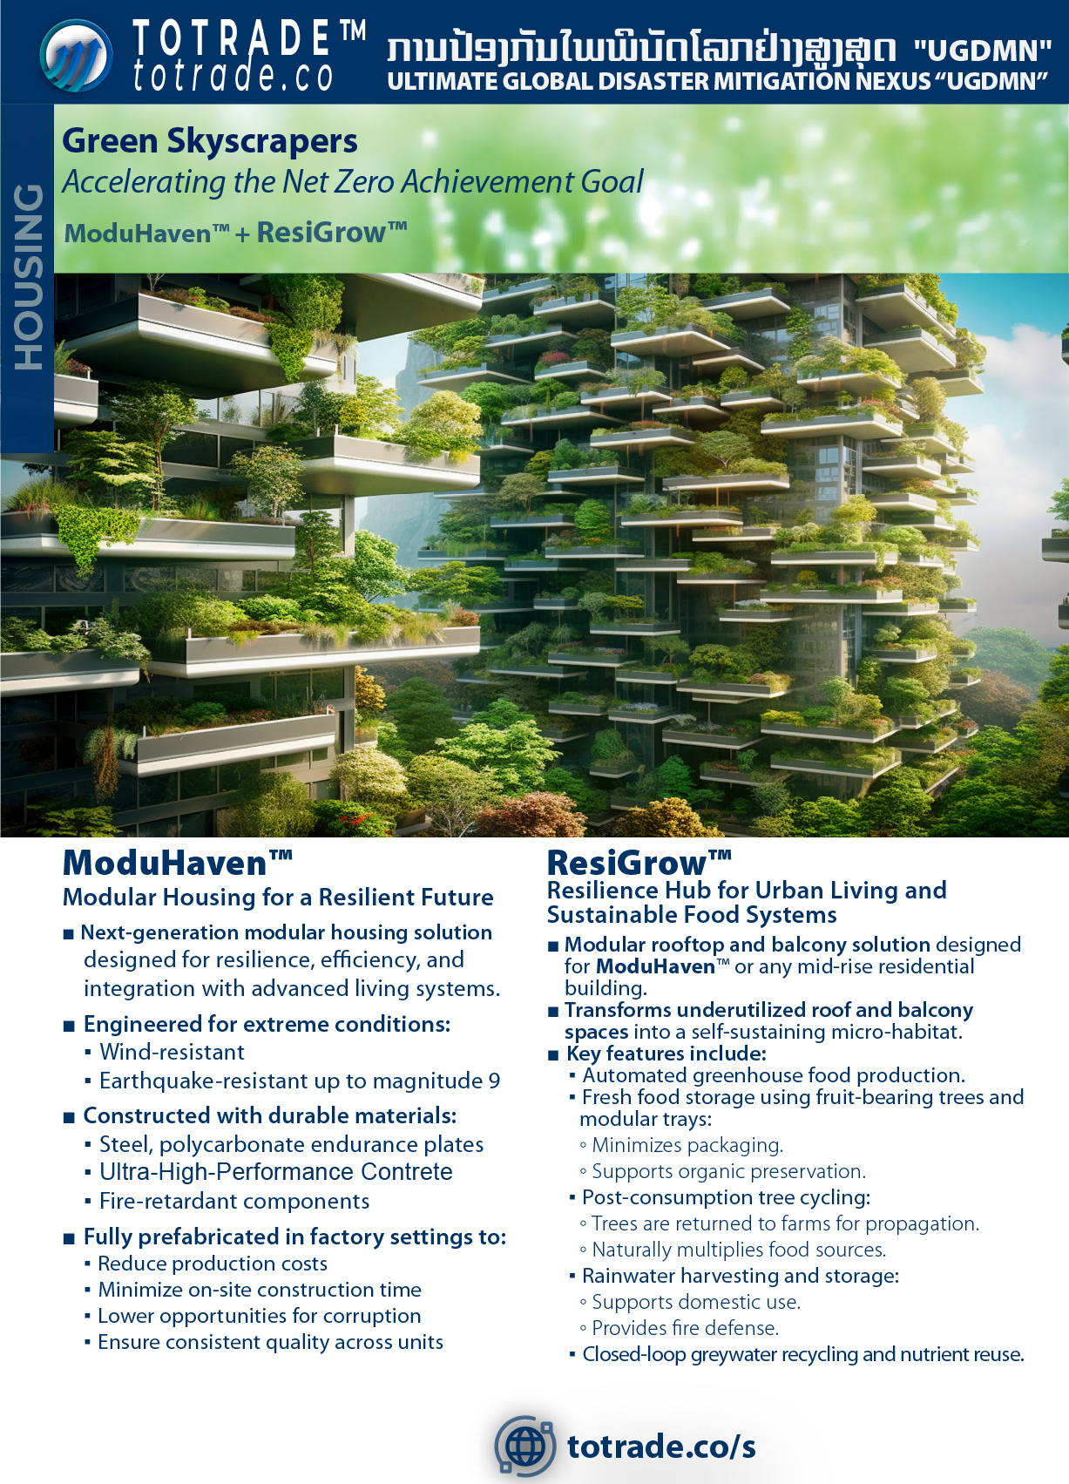

Slide 21
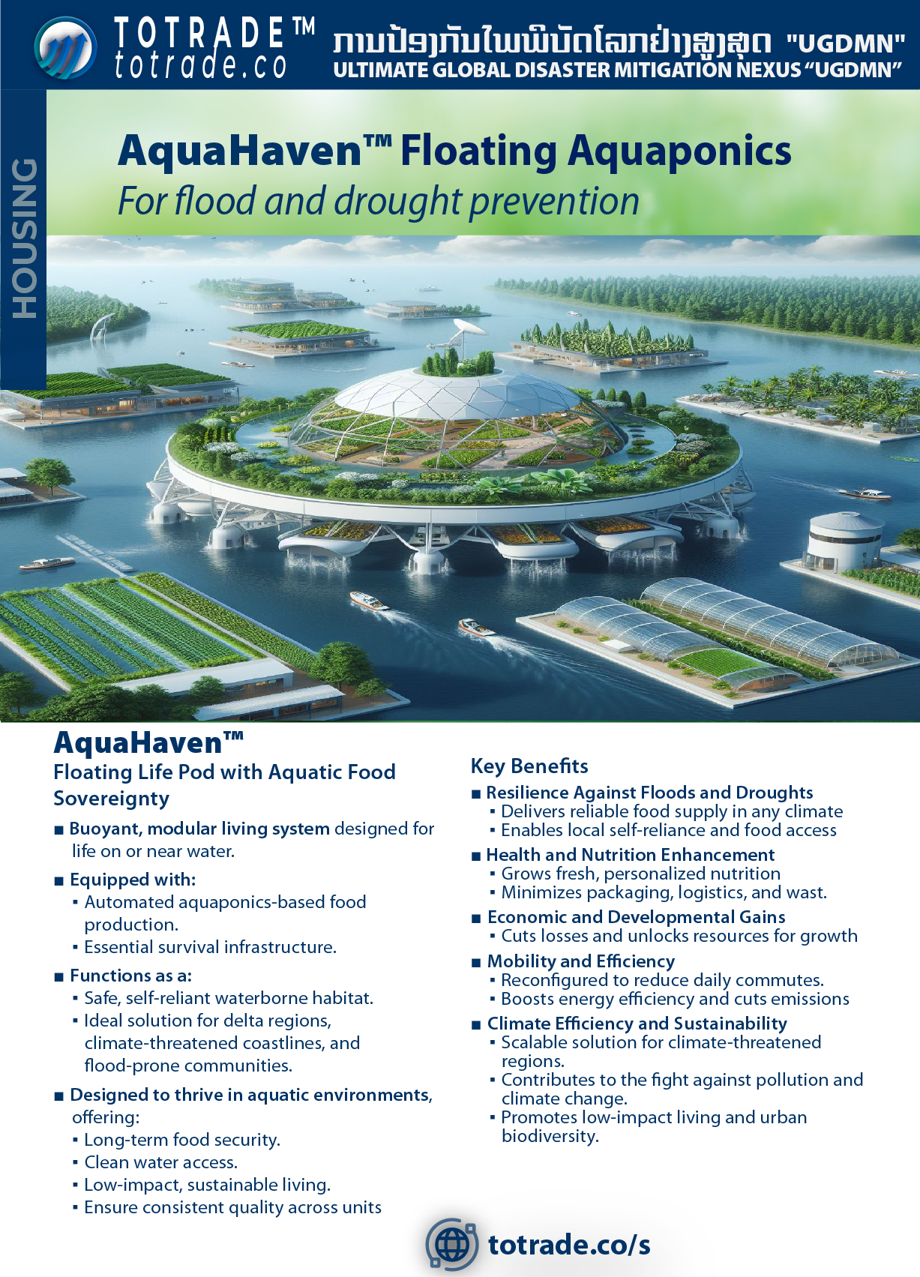

Slide 22
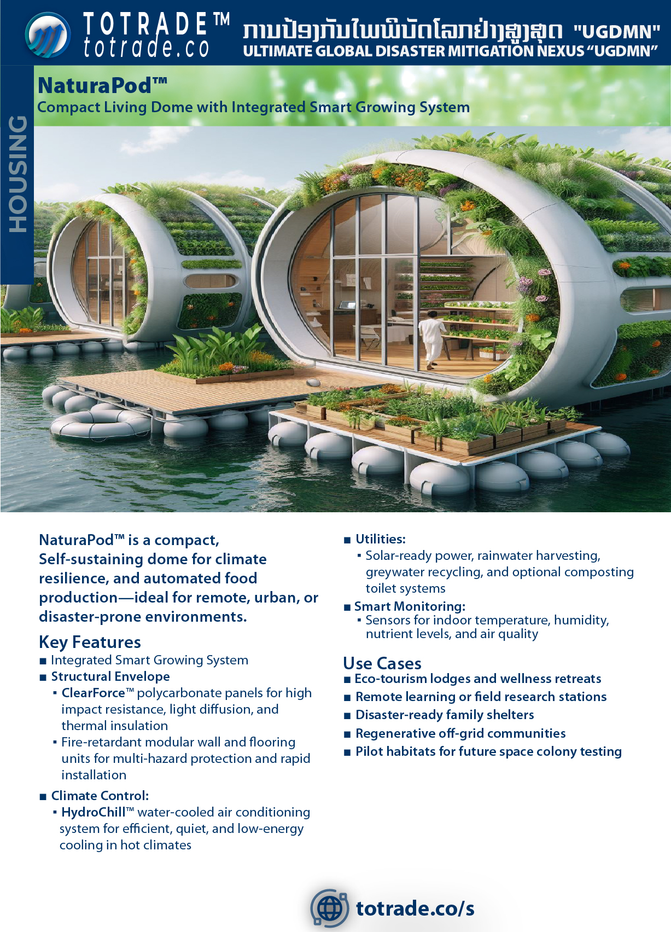

Slide 23
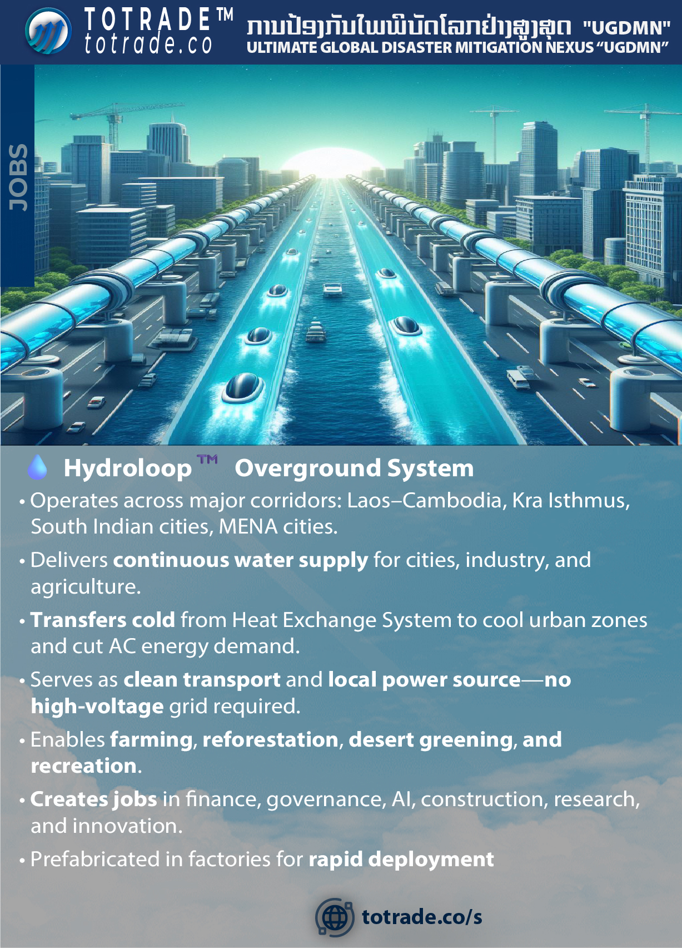

Slide 24
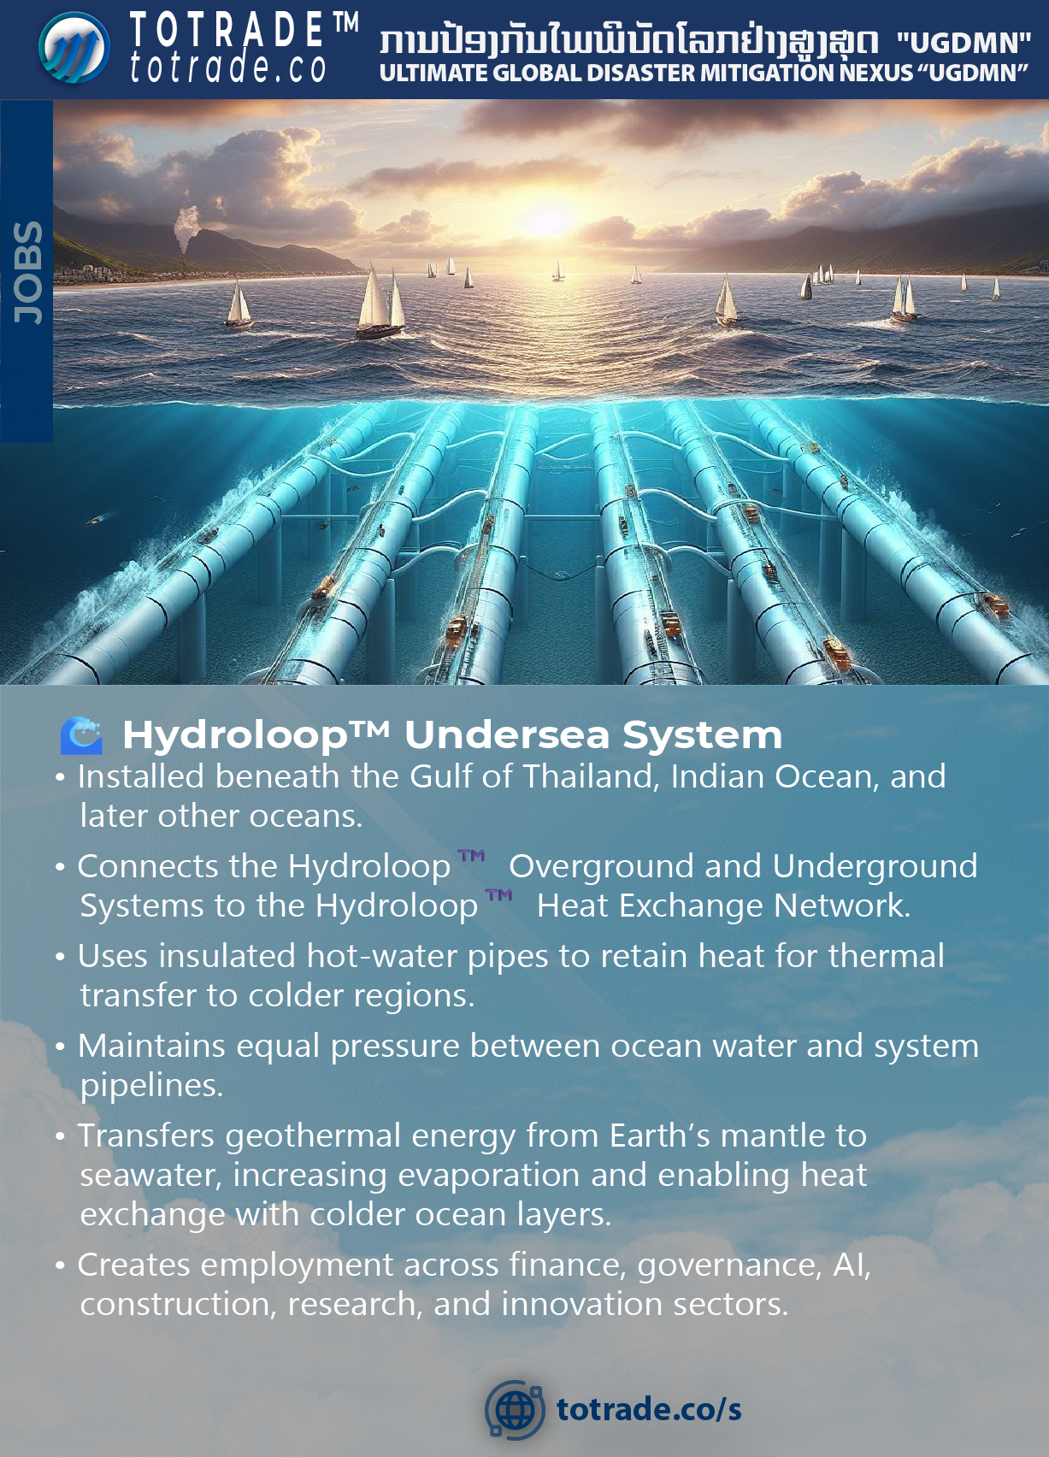

Slide 25
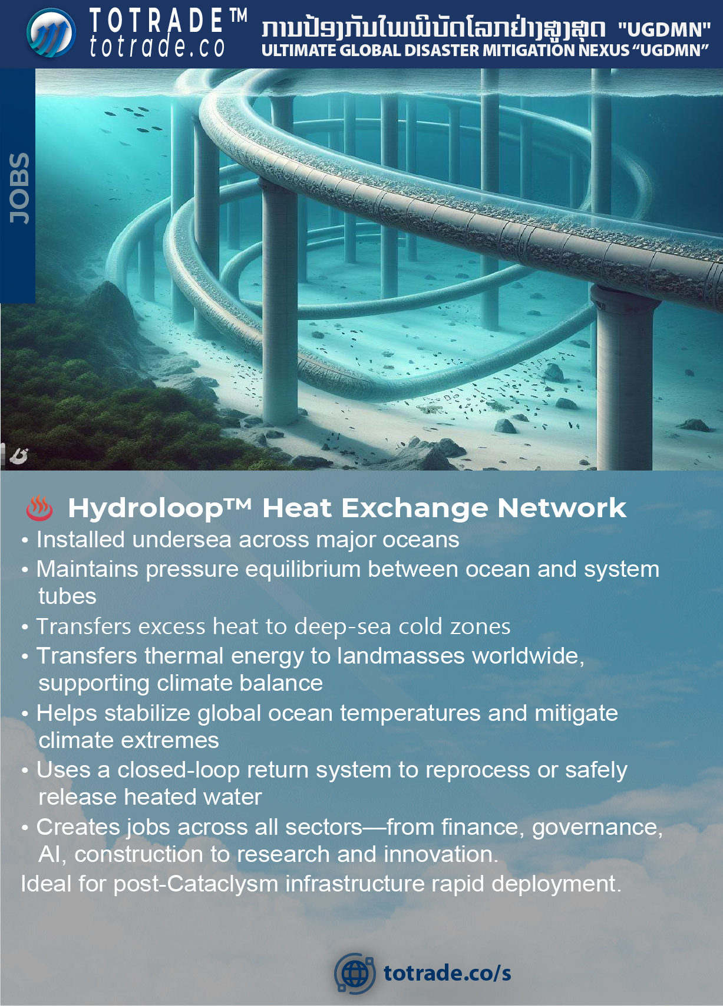

Slide 26
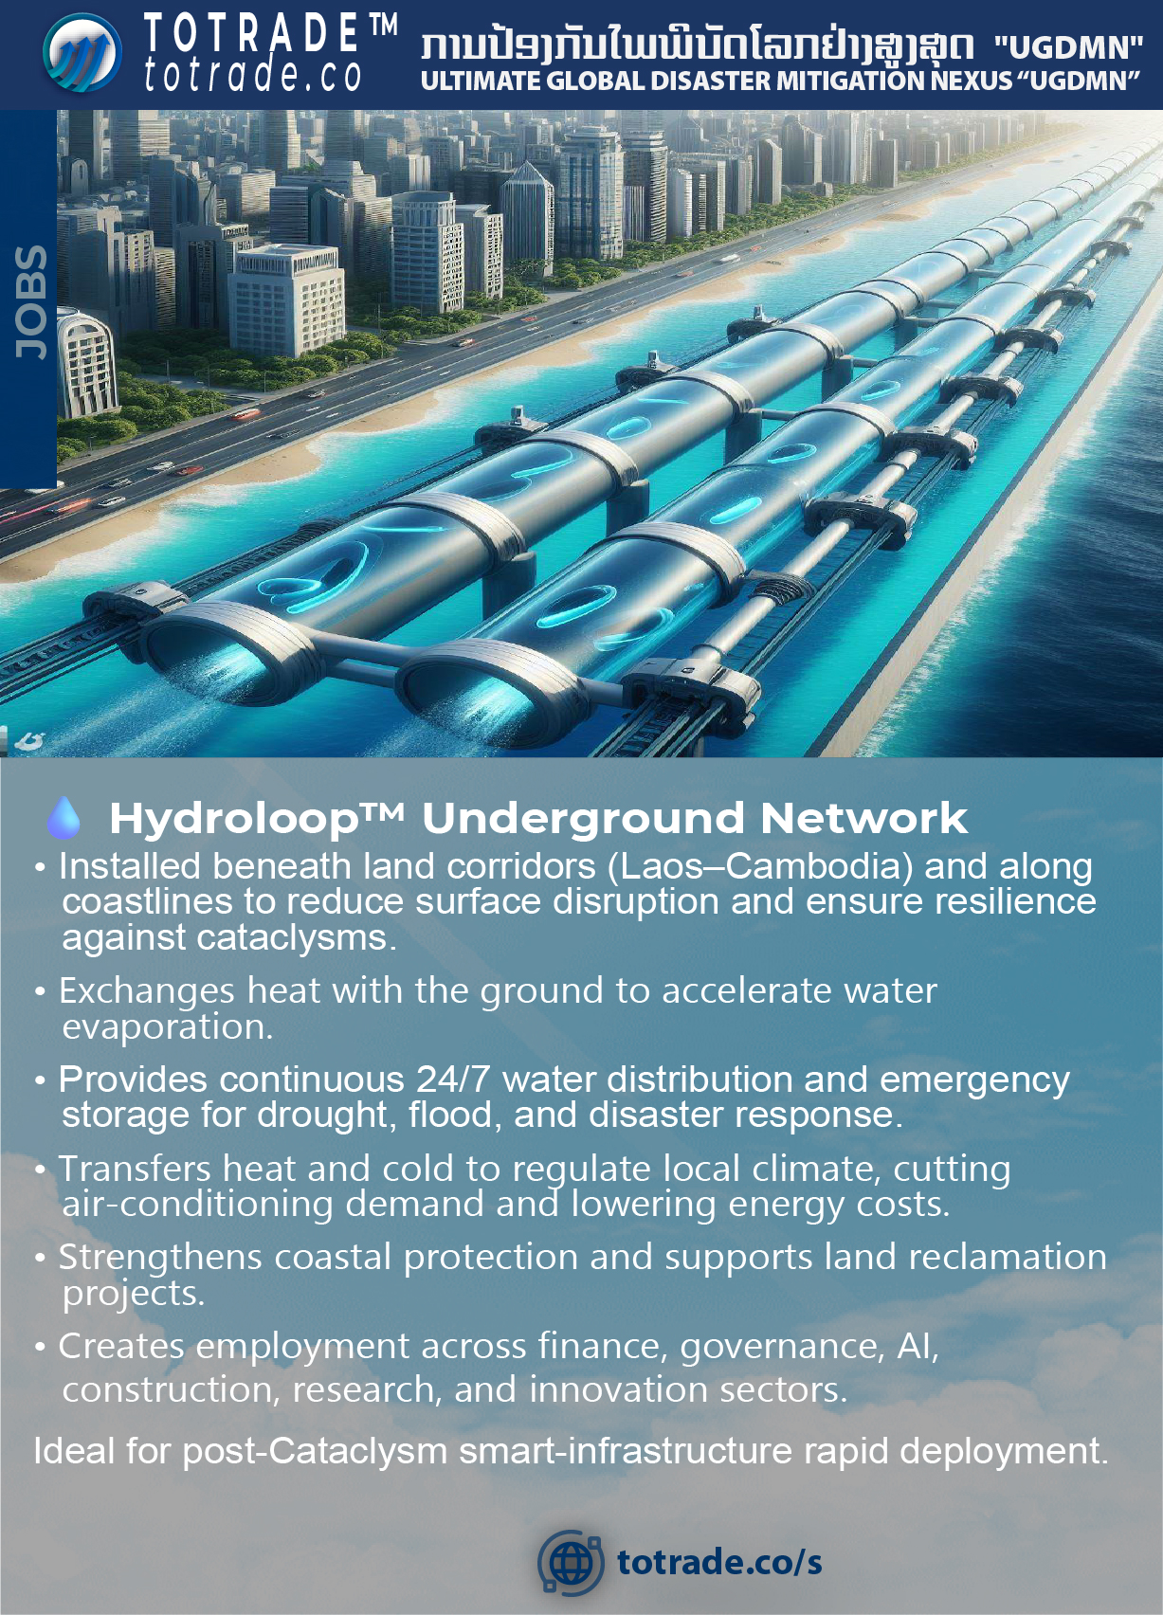

Slide 27
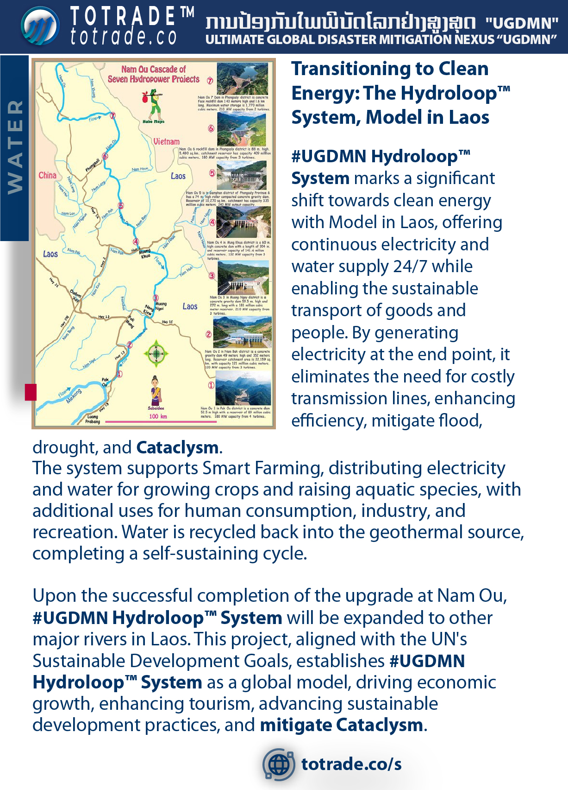

Slide 28
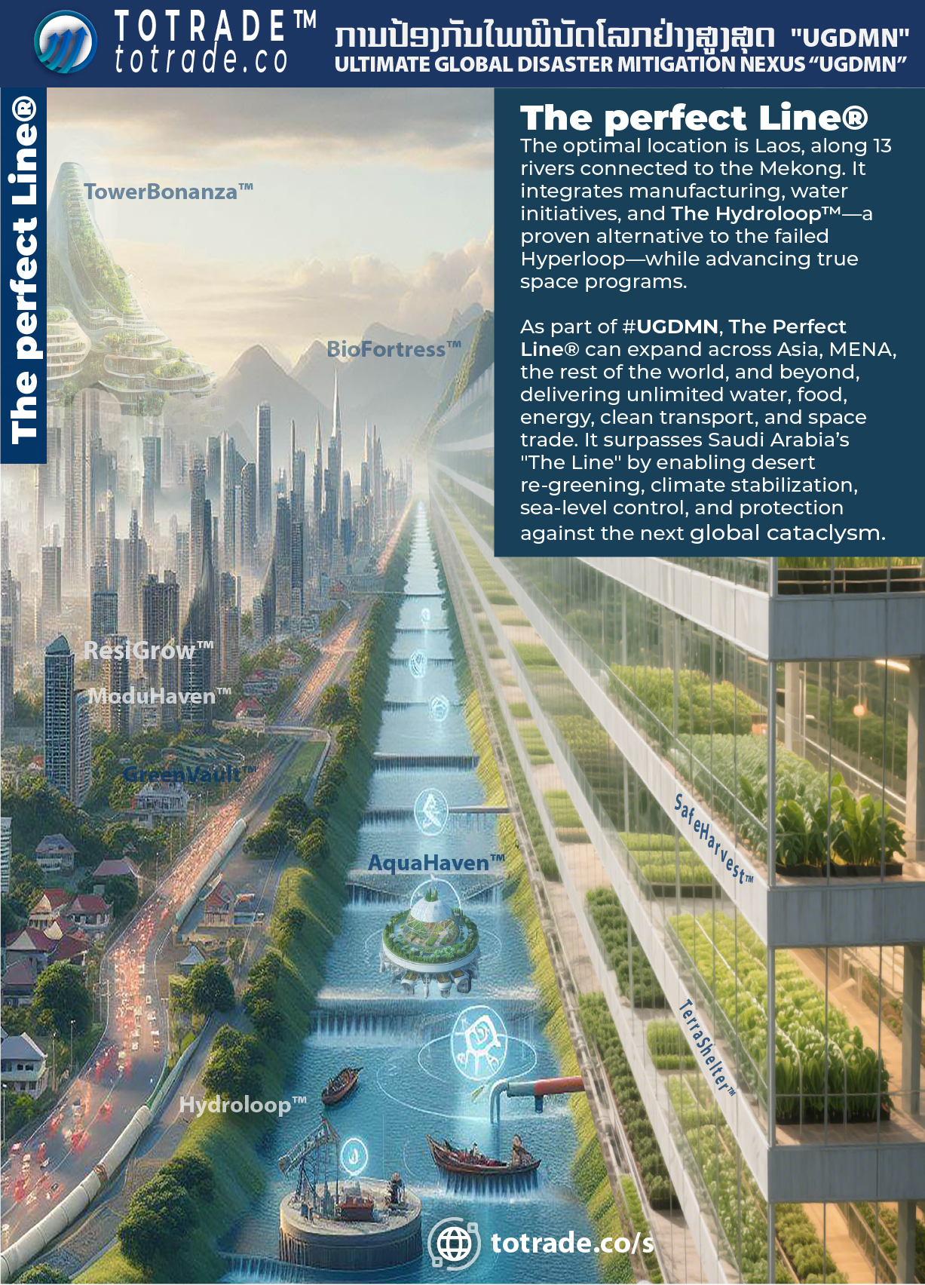

Slide 29
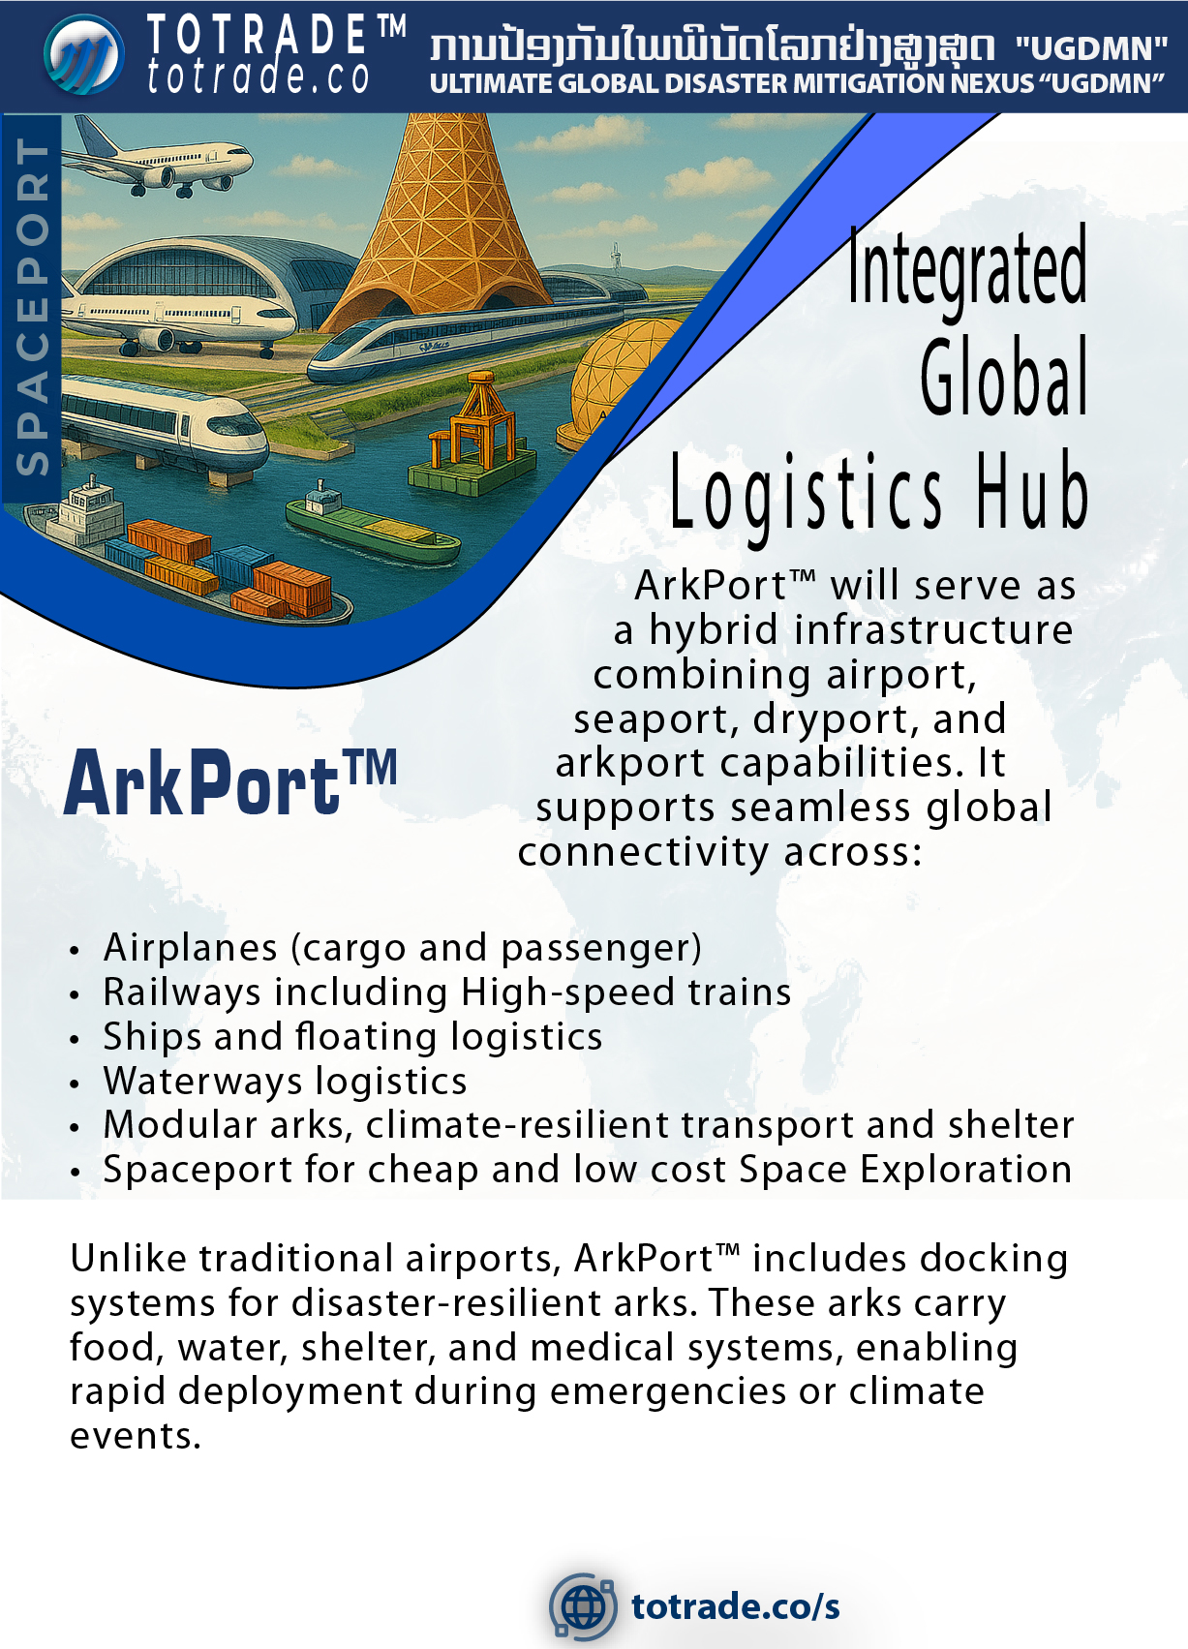

Slide 30
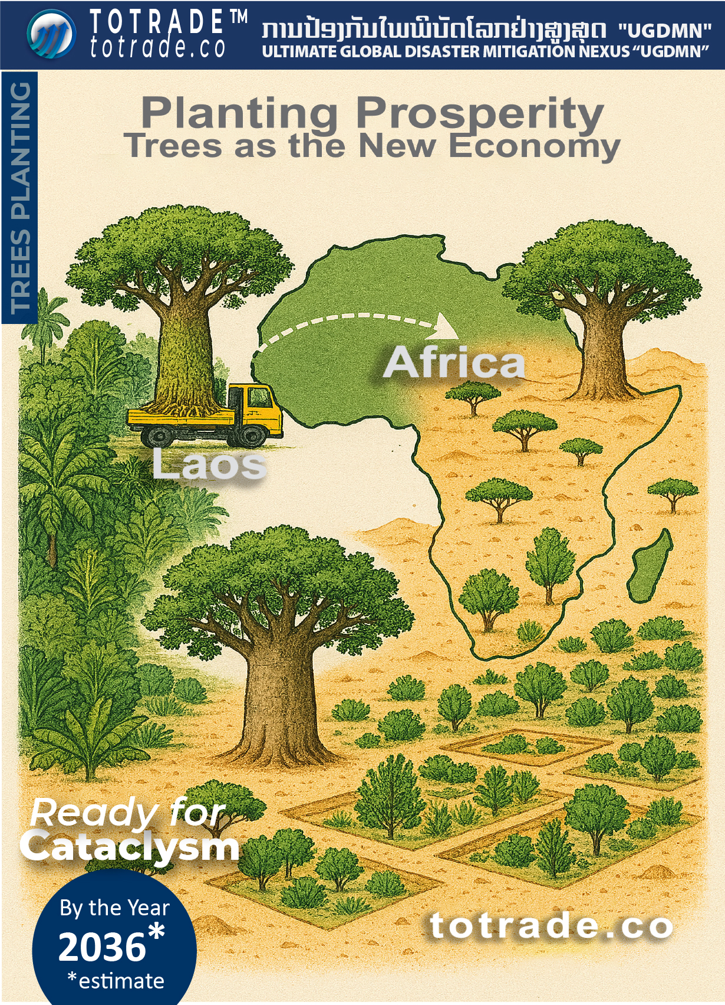

Slide 31
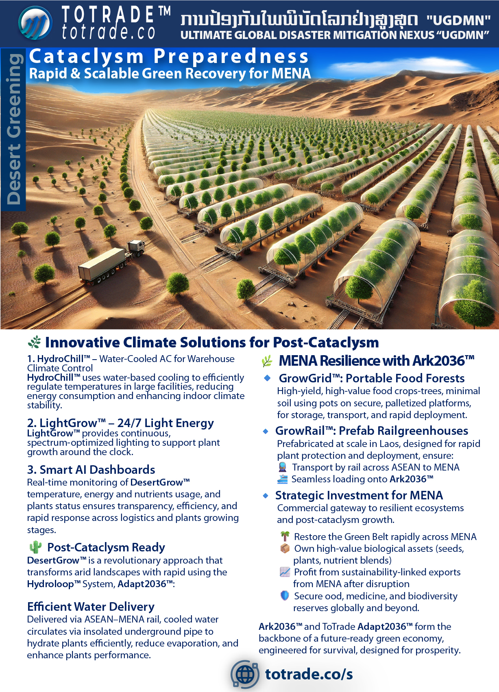

Slide 32
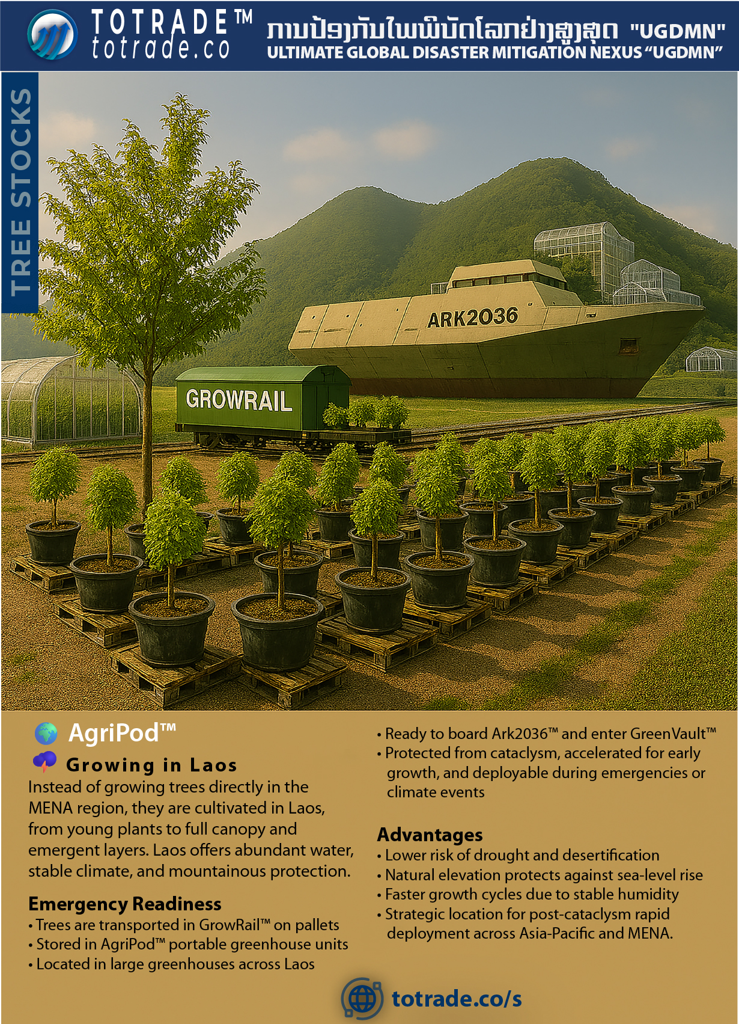

Slide 33
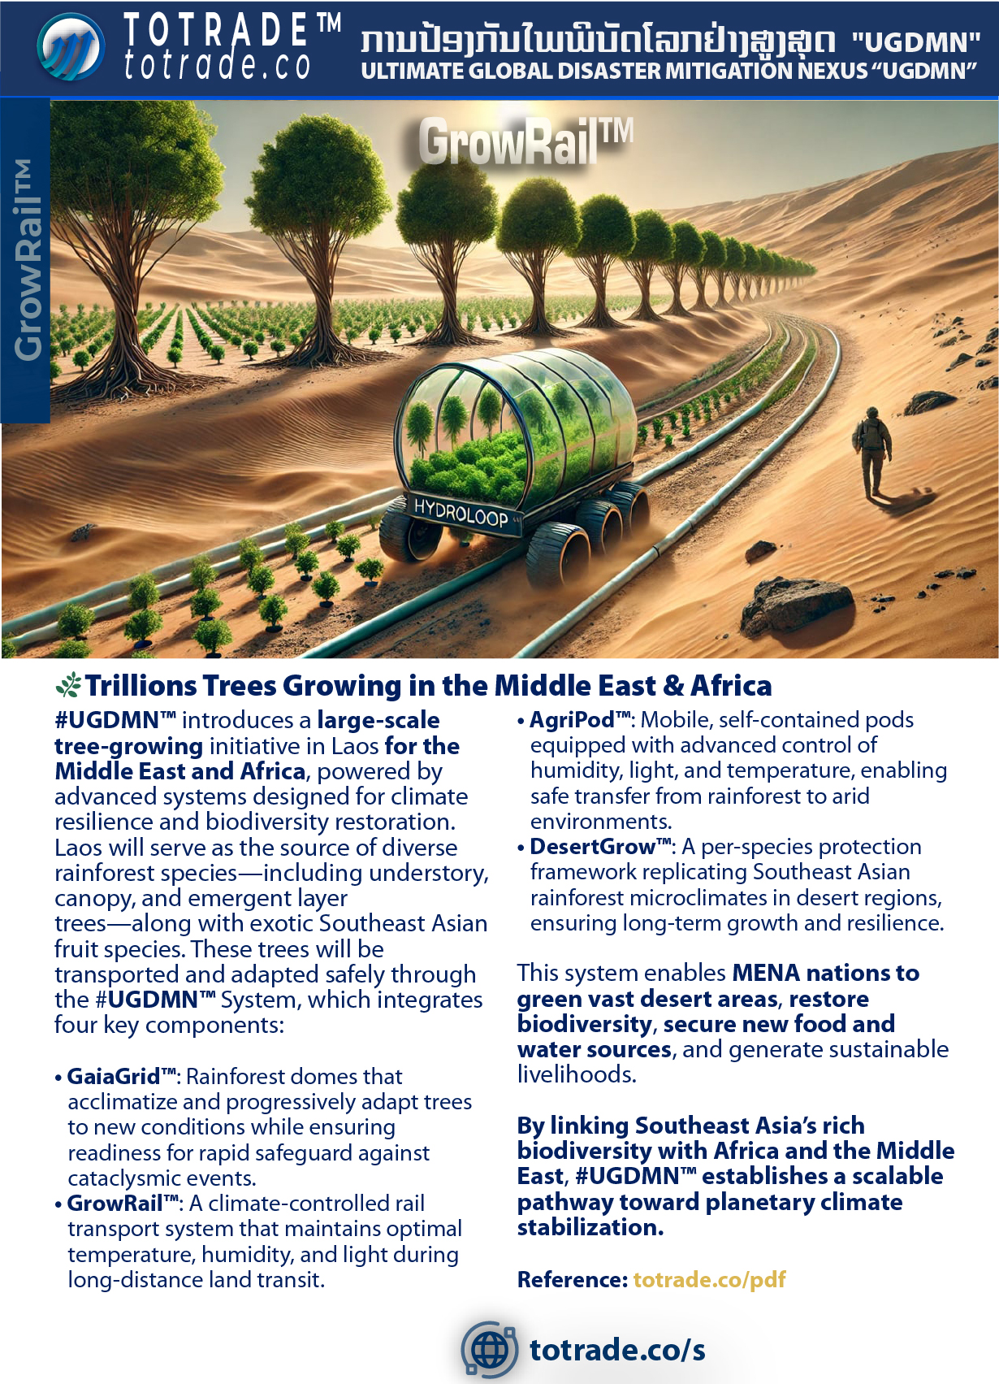

Slide 34
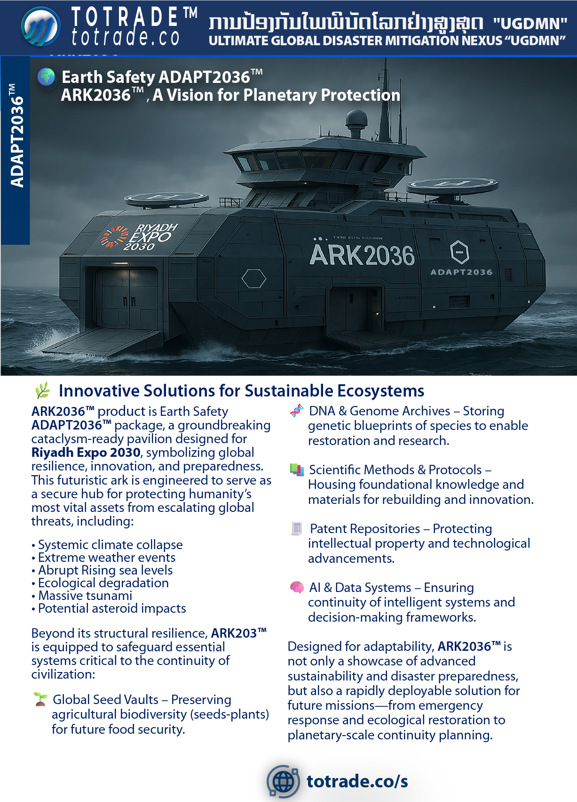

Slide 35
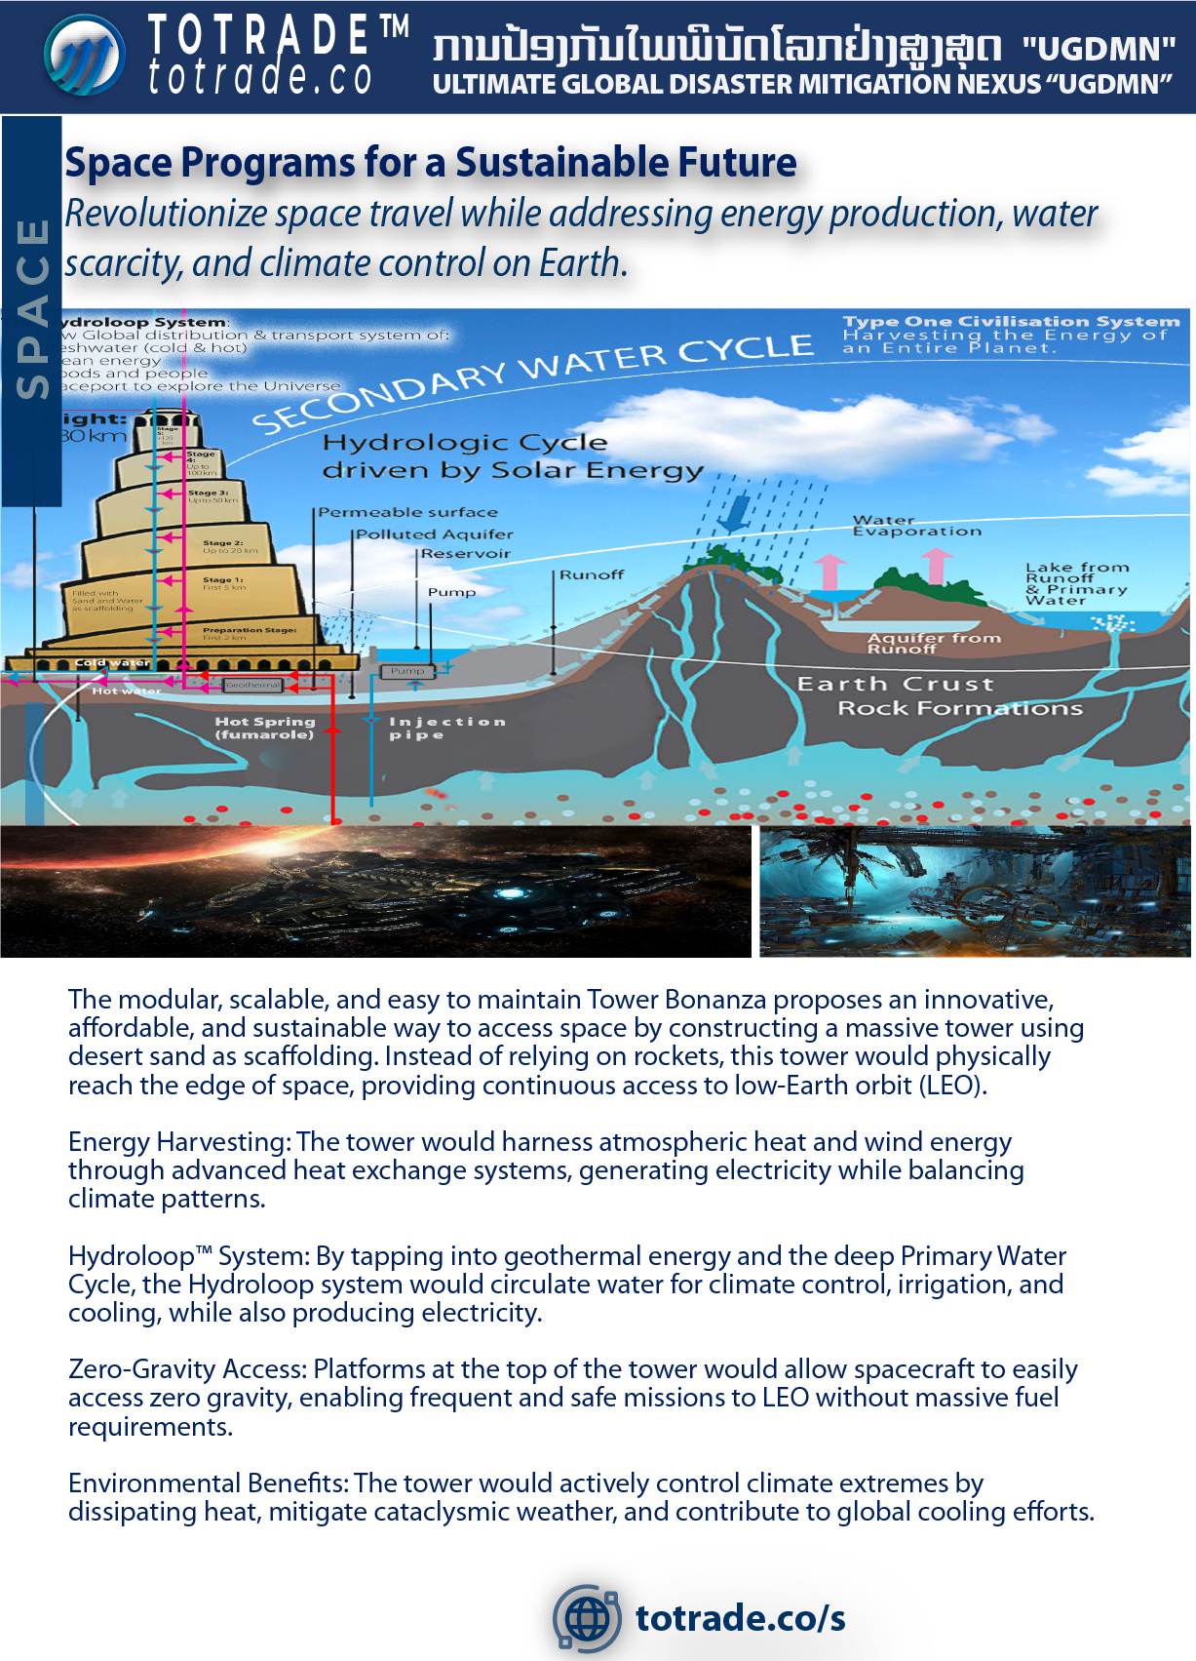

Slide 36
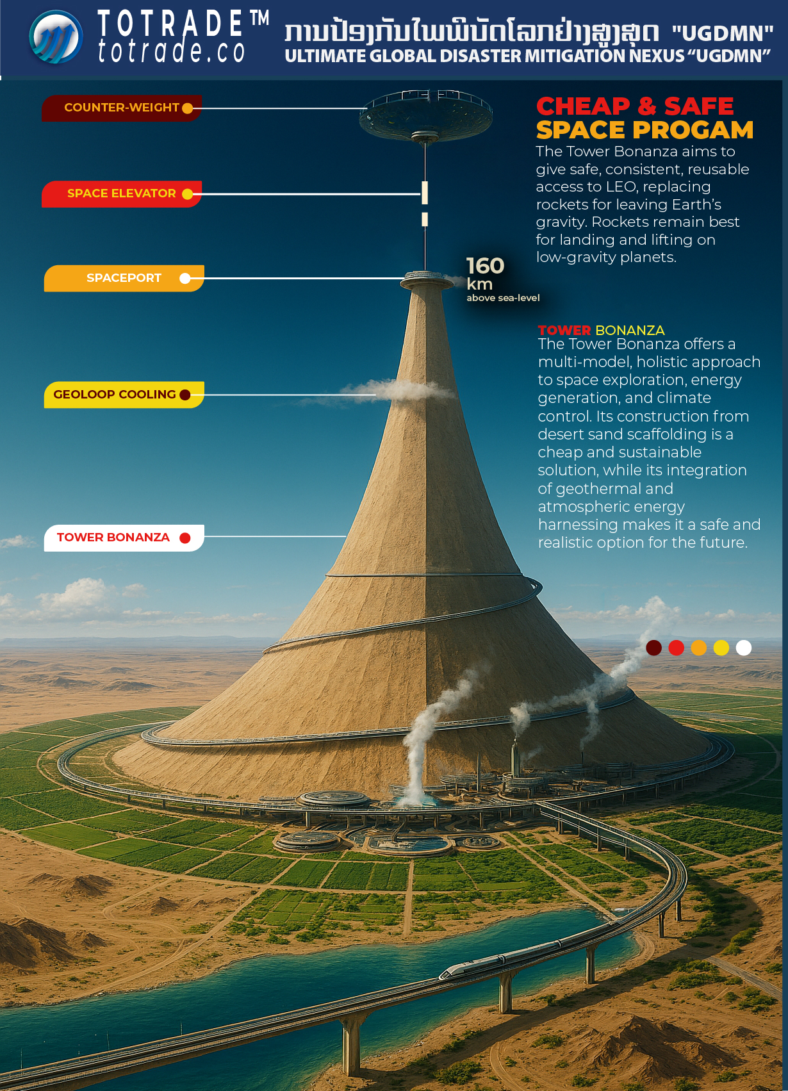
Notes:
Tower Bonanza to Stratosphere and Beyond
Visual Structure:
Base Level (Ground Floor)
• Circular base, 200km diameter, built from desert sand scaffolded by inclined cement-hemp walls
• GeoLoop™ geothermal system pushes hot water upward
• Staged reservoirs filled with cooled water from stratosphere for heavy transport
• Water-based cargo lifts and industrial platforms
• Mag-lev train spirals around the tower
Mid-Level (Stratosphere to LEO)
• Tower narrows into a cone, reaching ~160km height
• Diameter reduces to 10km at the top
• Hot water released at ~100km (Kármán line) for cooling and energy conversion
• Hydrogen-fuel factory and storage for space missions
LEO Platform (~160km)
• Launch pads, research stations, and orbital infrastructure
• Space elevator begins here, connecting to Higher Earth Orbit
HEO Platform
• Counterweight structure balances gravitational force
• Space station hub for interplanetary missions
• Energy conversion systems using gravity and kinetic forces
Surrounding Environment
• Desert transformed by cooled water into green zones
• Sea-level management infrastructure
• Zero-emission transport networks
Mission Statement:
#UGDMN™ accelerates humanity to Type I civilization. This structure replaces rockets with scalable, safe, and permanent access to space.

Slide 37
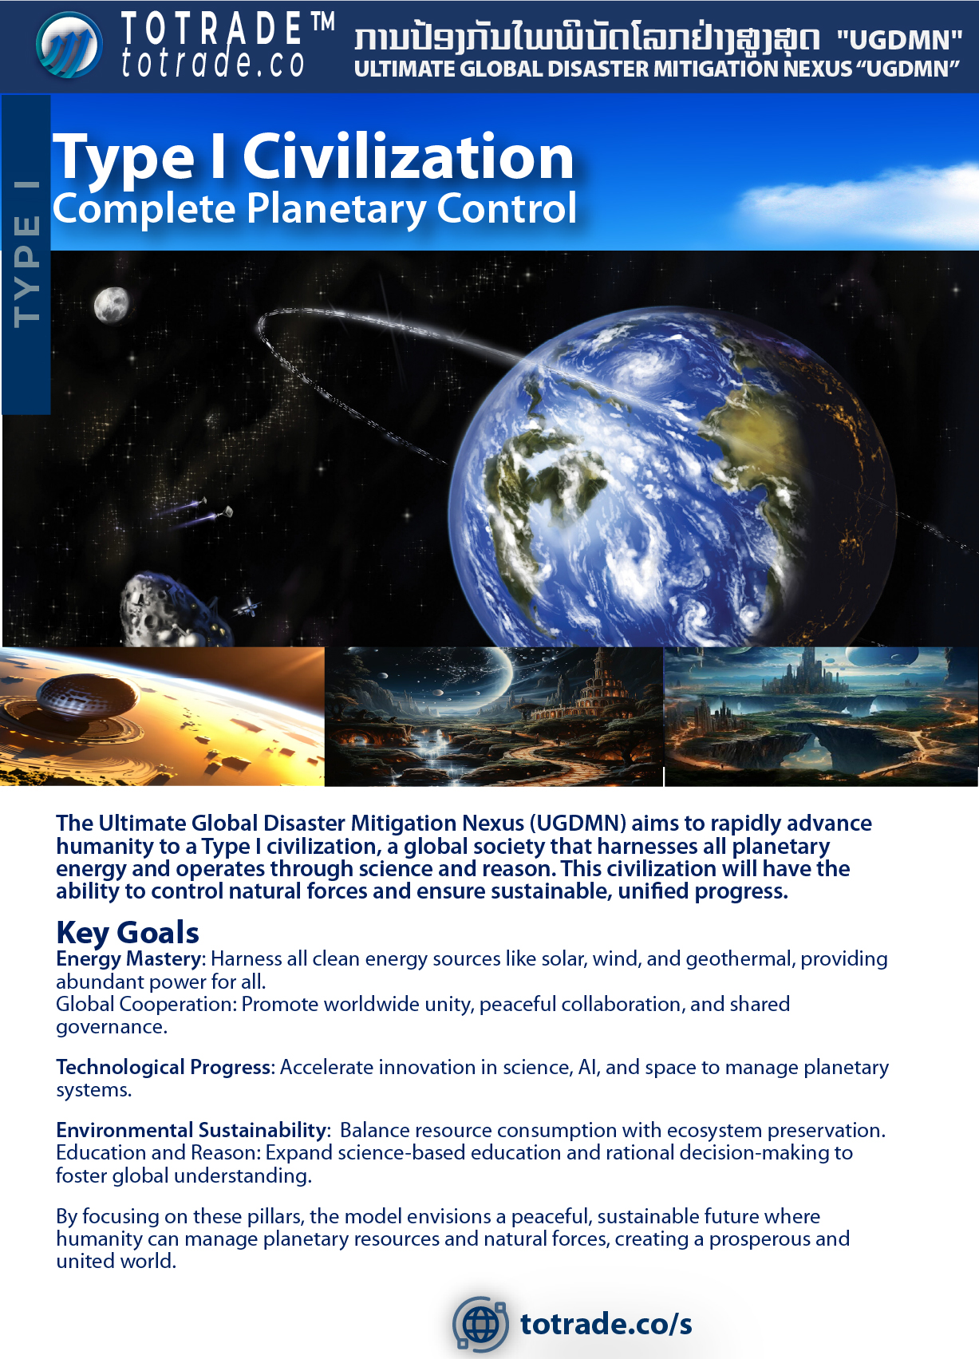

Slide 38
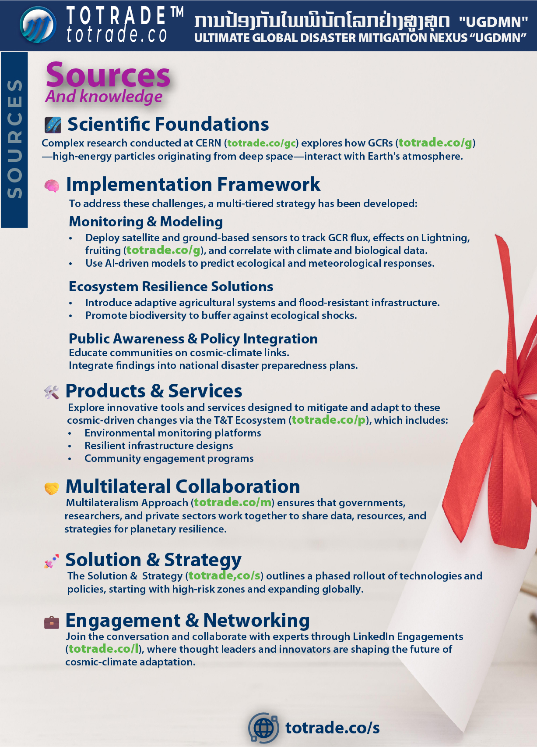

Slide 39
