Slide 1
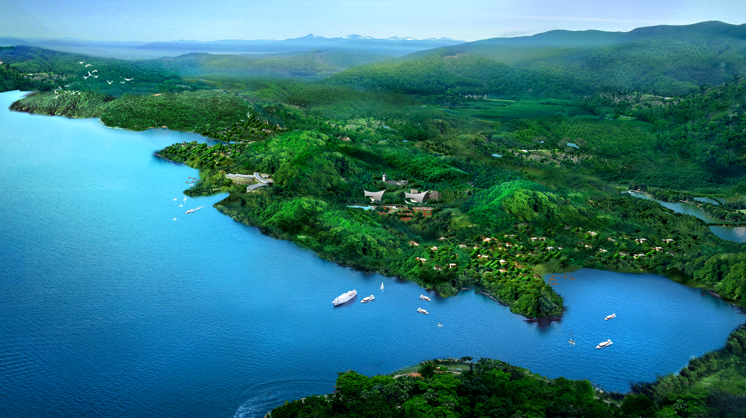




#UGDMN
Ultimate
Global
Disaster
Mitigation
Nexus
Advance Feasibility Study
&
Business Plan
Earth Climate and Geological Risks
From
Galactic Cosmic Rays (GCRs)
&
The Sun
by
:man:
of (know as)
: Phouthone: Siharath.
for
totrade.co
team@totrade.co
Latest
totrade.co/cr
Notes:
UGDMN WORKING PAPER
#UGDMN means Ultimate Global Disaster Mitigation Nexus
It is an advanced Feasibility Study and Business Plan Earth Climate and Geological Risks
from Galactic Cosmic Rays (GCRs) and The Sun
Instead of Outdated Climate Hansenism which will be explained later at first.
by Phouthone Siharath
Totrade.co
team@totrade.co

Slide 2
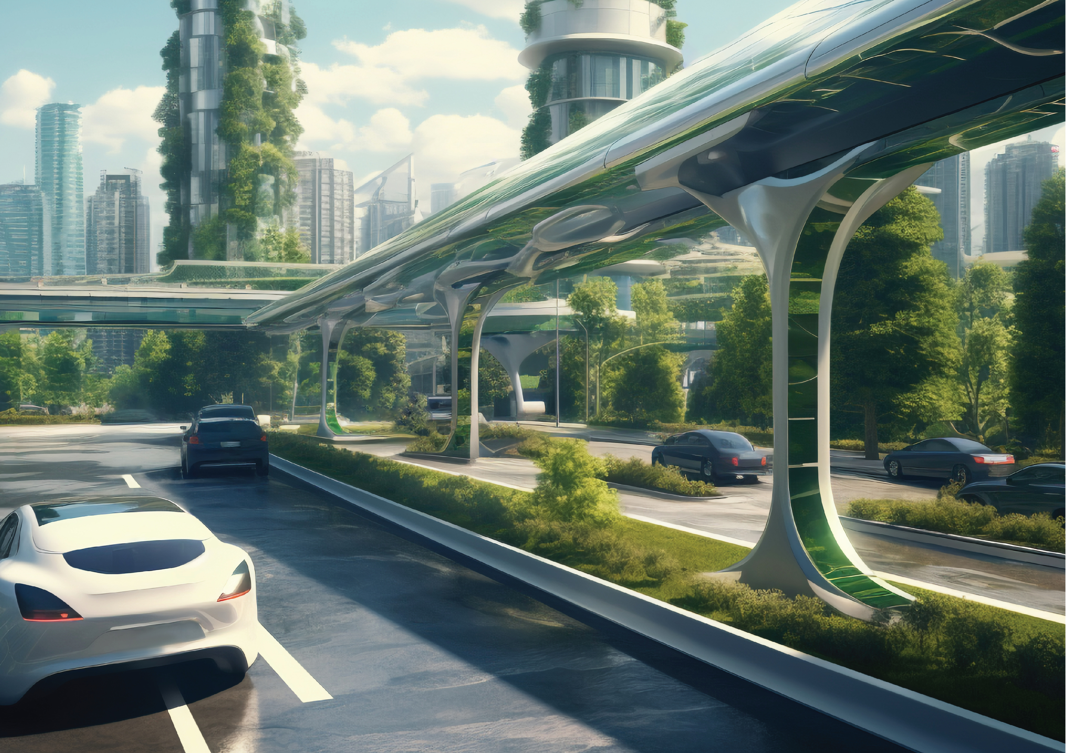

Table of Contents [ToC]
Climate Hensenism 4
Climate Realism 5
Galactic Cosmic Rays (GCRs) 7
GCRs Multi-Millenia Wavelength 9
GCRs Surge Effects on Lightning 10
GCRs Surge increase Fruit 11
GCRs Surge: Effects on Earth Interior 12
GCRs Triggered Next Cataclysm 14
Notes:
Table of Contents:
Climate Hensenism 4
Climate Realism 5
Galactic Cosmic Rays (GCRs) 7
GCRs Multi-Millenia Wavelength 9
GCRs Surge Effects on Lightning 10
GCRs Surge increase Fruit 11
GCRs Surge: Effects on Earth Interior 12
GCRs Triggered Next Cataclysm 14

Slide 3
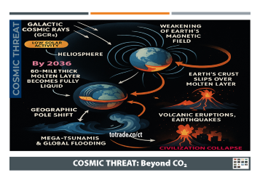
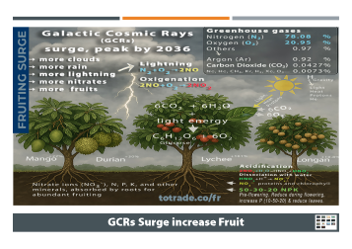
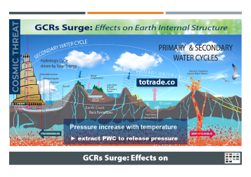
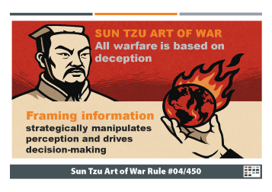
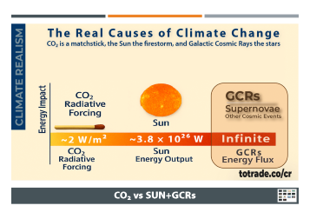
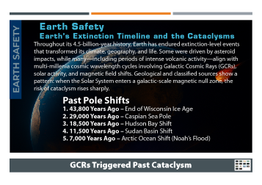

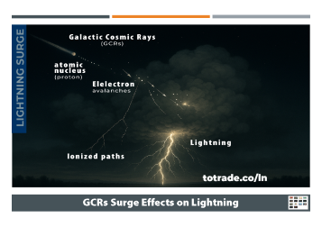

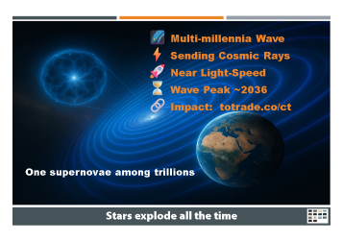
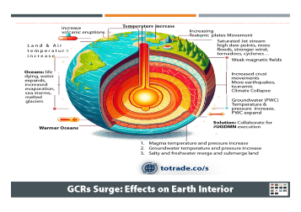
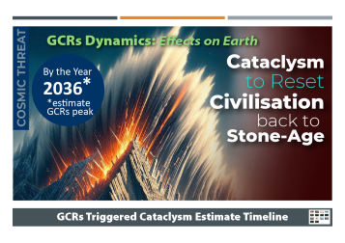
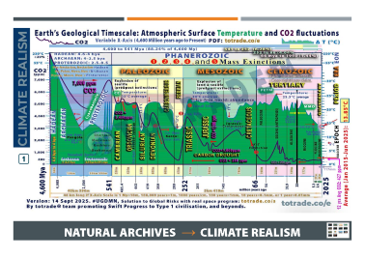
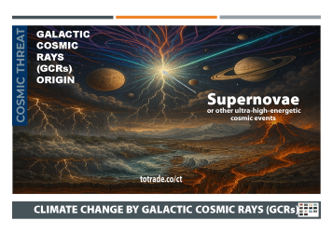

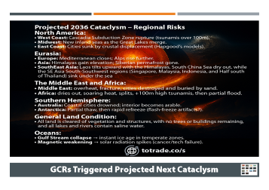



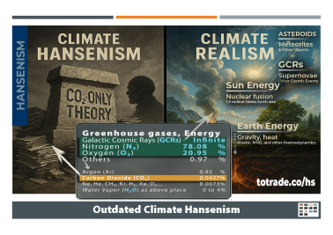
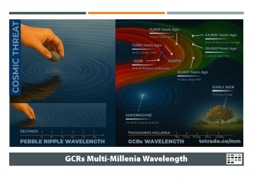





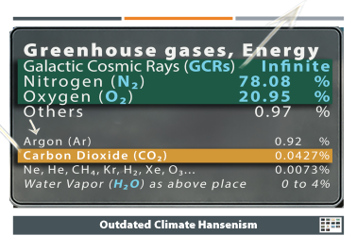
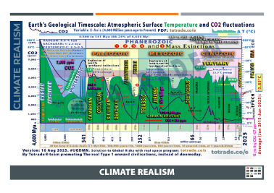
Notes:
Slides
Just 12 slides to reload the fresh knowledge about Climate Risks.
1. Hensenism
2. Climate Realism
3. GCRs origins
4. GCRs Effects
5. GCRs Wavelength
6. GCRs on Lightning
7. GCRs on Trees
8. GCRs on Earth Interior
9. Consequences

Slide 4
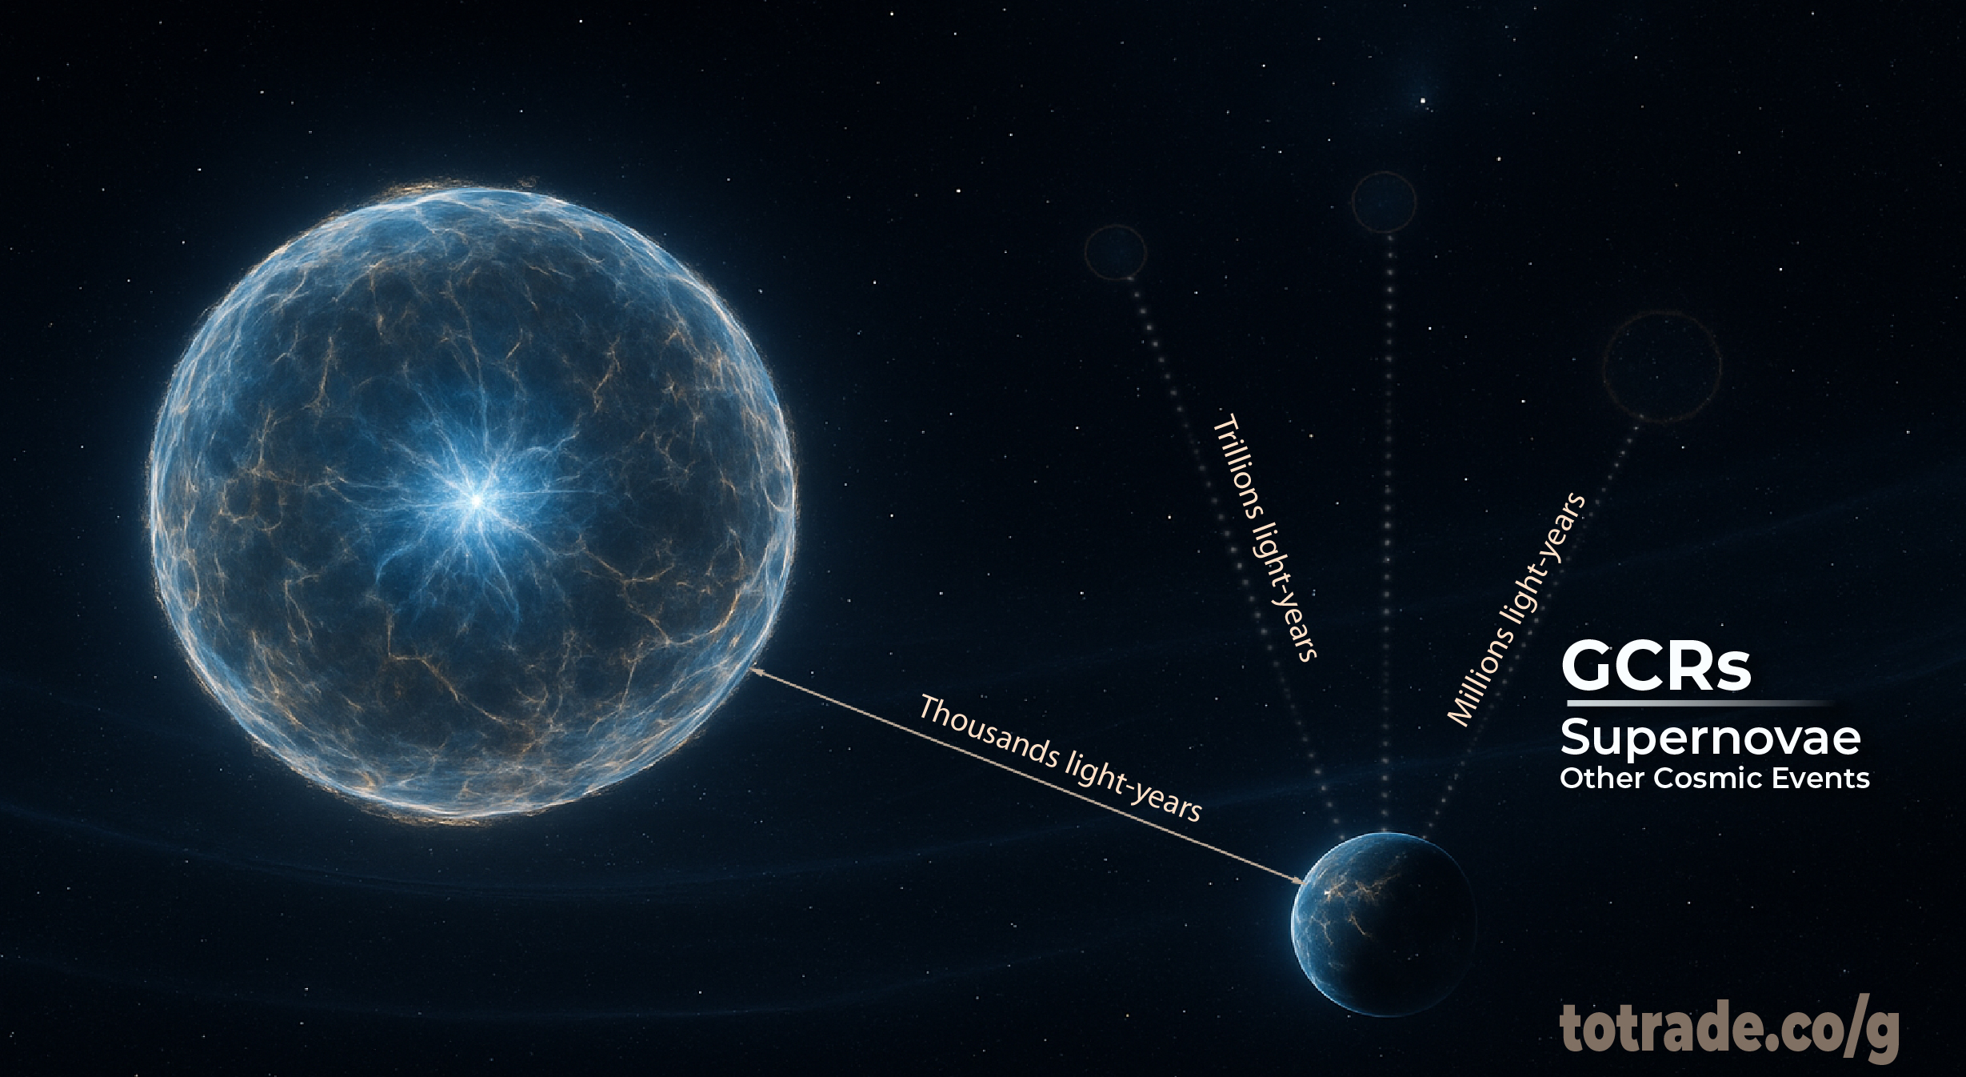

🌌 2B stars in Milky Way
⚡ 2T galaxies
🚀 1/s Supernovae
⏳ Sending Cosmic Rays
🔗 Near Light-Speed
One supernovae among trillions
Stars explode all the time
Notes:
Tower Bonanza 160 km concept under #UGDMN:
The universe holds 3.2 trillion planets in our galaxy, 200 billion stars in the Milky Way, and 2 trillion galaxies in the observable cosmos. These numbers show both our smallness and the infinite opportunities ahead.
The Tower Bonanza 160 km, part of #UGDMN, is the most realistic investment to bridge Earth with these resources. It is designed as a vertical launch, research, and trade hub—linking orbital infrastructure, space mining, energy transfer, and planetary-scale logistics. Unlike speculative projects, it combines proven engineering with scalable economic returns, creating a direct gateway from our planet to the cosmos.
By building such a system, humanity moves from dependency on finite Earth resources to participation in the universe’s abundance. This is not science fiction—it is survival, prosperity, and continuity for civilization.

Slide 5
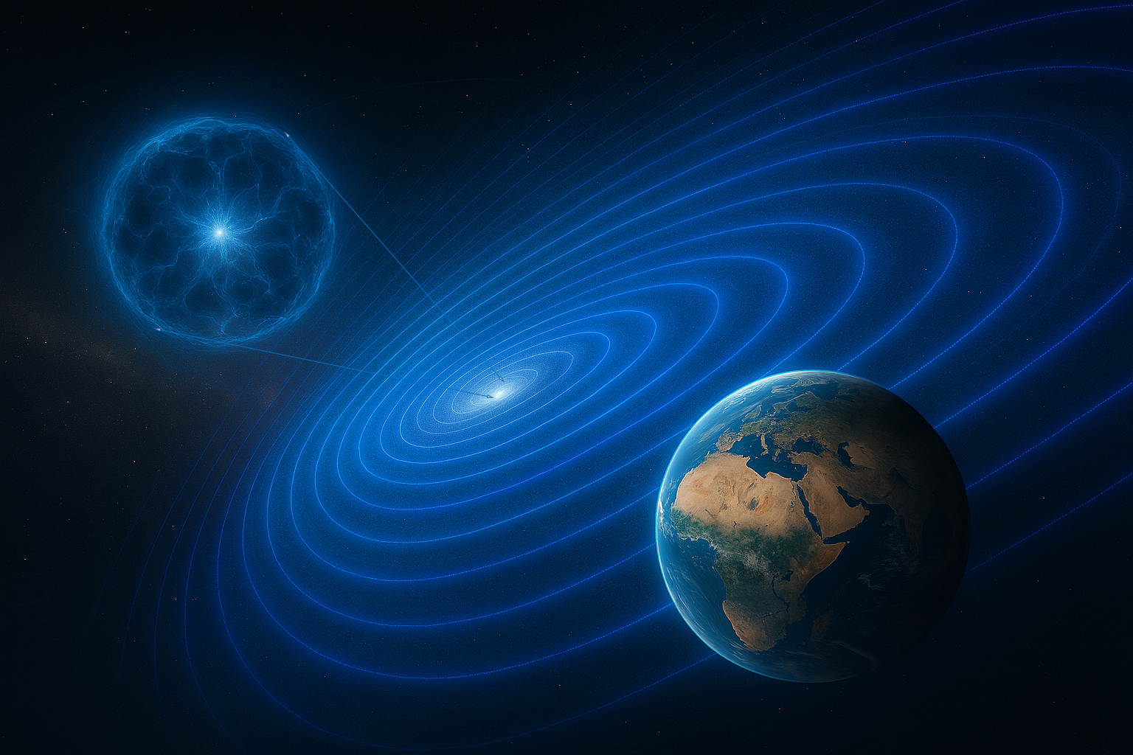

🌌 Multi-millennia Wave
⚡ Sending Cosmic Rays
🚀 Near Light-Speed
⏳ Wave Peak ~2036
🔗 Impact: totrade.co/ct
One supernovae among trillions
Stars explode all the time
Notes:
Countless stars have exploded across cosmic time, each sending ultra-high-energy waves GCRs through the galaxy. These waves, as they merge, arrive in multi-millennial sequences, stacking energy crests thousands of millennia apart. We are entering one of those crests now.
The Milky Way holds 100–400 billion stars, forming at 1–3 solar masses per year. About 1–3 supernovae occur each century, totalling 10,000–30,000 per million years. Across the observable universe, a supernova explodes roughly once every second, releasing immense energy into space.
Each supernova sends Galactic Cosmic Rays (GCRs) racing toward Earth at near light speed. These particles, with energies up to 10²⁰ eV, are organized over multi-millennia wavelengths by galactic magnetic fields and spiral arm structures. Their intensity fluctuates with solar system oscillations through the galactic plane (~30–35 Myr), spiral arm crossings (~100–150 Myr), and local supernova clusters.
Models project a major GCR crest around 2036 as Earth enters a galactic magnetic null zone (totrade.co/gn). Combined with a sharp drop in solar activity (totrade.co/sm), this surge in GCR flux (totrade.co/gc) is driving a cyclical climate collapse (totrade.co/sg), amplifying extreme events worldwide.

Slide 6
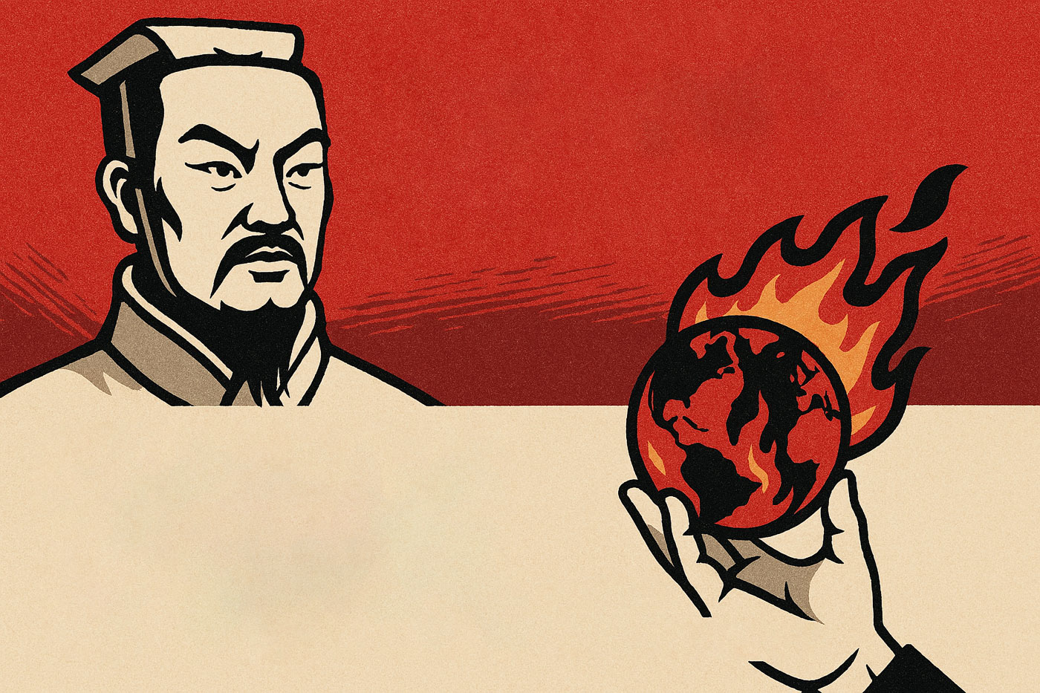

SUN TZU ART OF WAR
All warfare is based on deception
Framing information strategically manipulates perception and drives decision-making
Sun Tzu Art of War Rule #04/450
Notes:
SUN TZU ART OF WAR ( (Rule #4/450)
Sun Tzu said all warfare is based on deception.
Today, exaggerated climate alarmism shapes perception and policy. Coercive green ideology imposed on poor nations functions as corporate colonialism.
Through resource extraction, debt traps, land grabs, and by corrupting dictators under weak leadership, the affluent financial powers fund their corporate allies to exploit while framing humanity as its own enemy totrade.co/rome, deepen banking and corporate dependency, driving division, inequality, poverty, and conflict by pretending to save the planet.
EXAMPLES OF DATA MANIPULATION:
A. Tree-ring Natural Archive, youtu.be/K_8xd0LCeRQ?t=195
Chart based on tree-ring density data compiled by Keith Briffa and colleagues across the Northern Hemisphere reconstructed temperatures back to 1400. It showed:
• Large variability with no steady warming trend
• Peak warmth in the 1930s
• Cooling into the early 1990s, ending below the six-century average
B. Ice Core & Sediment Layers Natural Archives, youtube.com/jP8nz0cVbzQ&t=181s
Temperature reconstruction using ice core data from Greenland shown in orange, sediment layers from the tropical passer straight in Indonesia shown in black so it's not a regional thing.
The match is remarkably close and tell the same old story: rapid and abrupt warming after the end of last glaciation by cataclysm 7,000 Years Ago – Arctic Ocean Shift, Noah’s Flood, totrade.co/e, a peak about 6,000 years ago, then an overall decline since.
Let's wait how Climate Alarmism in the North Hemisphere will feel their Global Warming in winter.
The IPCC faced results that contradicted its warming narrative of Sun Tzu–style deceptive warfare and shifted to alternative methods more manipulable to favor alarmist claims.
Communication to Top Financial Powers:
If you believe your cataclysm preparedness is secure, think again.
Current strategies depend on fragile systems, misleading narratives, and hidden dependencies. True security demands funding solutions that protect people and resources, while enabling rapid post-cataclysm recovery and accelerating progress toward a Type I Civilization—without regressing to a Stone Age. Invest in #UGDMN to build resilience that is real, scalable, and rapid globally transformative.

Slide 7
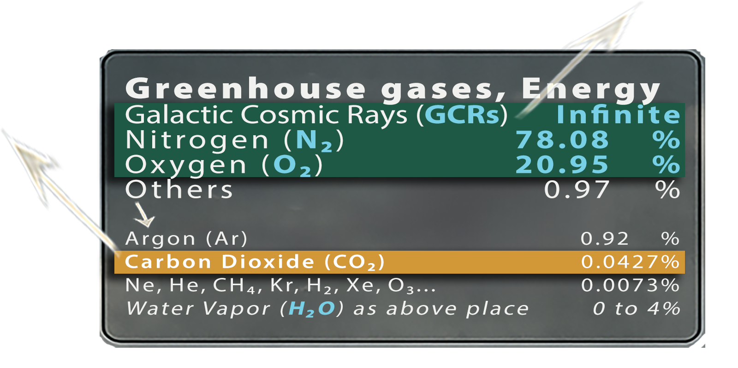
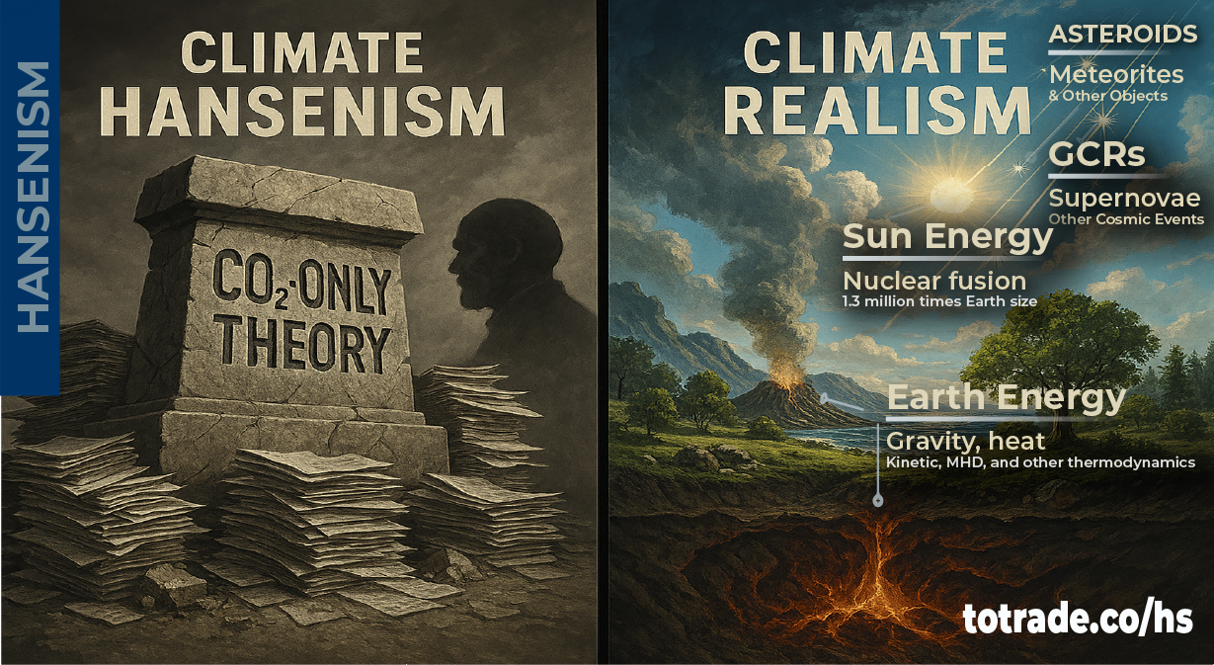

Outdated Climate Hansenism
Notes:
EXAMPLE OF FRAMING INFORMATION
Climate Hansenism refers to the school of thought linked to James Hansen, the former NASA pseudo-climate scientist who became one of the most prominent advocates framing the information by the idea that CO2 is the primary driver of global warming and climate change.
In practice, Hansenism is characterized by:
• Heavy focus on CO2 as the main cause of climate change.
• Policy emphasis on reducing fossil fuel use through carbon taxes and emission caps.
• Downplaying or excluding other potential climate drivers such as Galactic Cosmic Rays, totrade.co/ga; the periodic Solar System entering a galactic-scale magnetic null zone—where magnetic fields are weak, chaotic, or reversed, totrade.co/gn; solar variability, totrade.co/sm; or tectonic-geothermal influences.
• Financing through government grants, climate-linked research funds, NGO sponsorships, and corporate “green” investment programs tied to carbon markets.
• Integration into education systems through school curricula, university programs, and teacher training materials that promote CO2-centric narratives as settled science.
• Monetization via carbon credit schemes, renewable energy subsidies, ESG-linked funds, and consultancy services that depend on maintaining CO2 alarmism.
• Critics use the term to describe a narrow, CO2-centric view of climate science that ignores or dismisses alternative mechanisms while serving as both a political and financial framework.
Galactic Cosmic Rays (GCRs) are high-energy particles from outside the solar system. They interact with Earth's atmosphere, totrade.co/gc, which is mostly Nitrogen, N₂ (~78%), Oxygen, O₂ (~21%), (Water Vapor, H₂O ~0 to 4%, as other gases place), and Argon, Ar (~0.92%), but not trace of CO₂.
Carbon dioxide (CO₂) makes up only ~0.04% of the atmosphere. It is inert, odorless, colorless, and serves as plant food—the only context in which CO₂ directly performs work at Earth atmosphere.
CO₂ at 0.04% of the atmosphere is about 420 ppm. Its energy contribution is negligible compared to the forces driving cataclysms. Here’s a real-life comparison:
• Volume analogy: 0.04% is like 4 drops of ink in 10 liters of water.
• Energy analogy: The latent heat in one major hurricane exceeds the total annual radiative forcing attributed to CO₂.
• Cosmic scale: A single surge of Galactic Cosmic Rays (GCRs) delivers energy that dwarfs all CO₂ effects combined. GCRs penetrate deep into Earth, destabilizing the magnetohydrodynamic layer and triggering tectonic shifts—something CO₂ cannot do.
• Practical analogy: Trying to prove CO₂ as the primary driver of global warming is like blaming a matchstick for melting an icecap while ignoring the volcano erupting beneath it.
• CO₂-centric Hensenism models fail to explain abrupt cataclysms

Slide 8
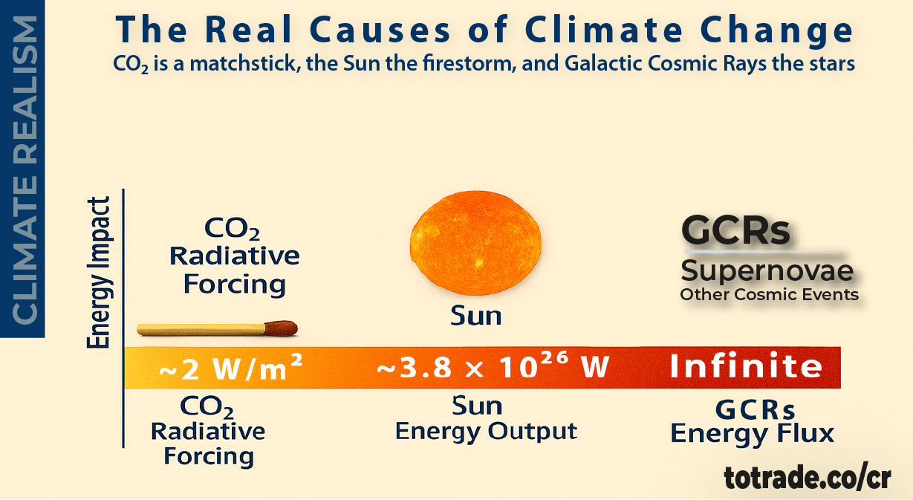
CO₂ vs SUN+GCRs
Notes:
The real causes of Climate Change aren’t what you’ve been told.
CO₂ is only 0.04% of the atmosphere—an inert trace gas.
The real drivers are solar and infinite cosmic forces shaping Earth’s climate and interior.
Order of Influences:
• CO₂: Plant Photosynthesis.
• Sun: Plant Photosynthesis. ➙ Lightning ➙ Planets (Atmosphere & Interior) ➙ Solar System.
• GCRs: Plant Grow ➙ Lightning ➙ Planets (Atmosphere & Interior) ➙ Solar System ➙ Galaxies➙ Universe…
In comparison for boiling 10 liters of water:
• Using CO₂ is like using a matchstick.
• The Sun is like using a firestorm.
• GCRs are like using all nuclear bombs and the Sun combined.
Energy Comparison
• CO₂ Radiative Forcing: ~2 W/m² (nearly invisible on Sun Energy scale)
• Sun Energy Output: ~3.8 × 10²⁶ W (nearly invisible on GCRs Energy scale)
• GCRs Energy Flux: Infinite orders of magnitude beyond CO₂ and even the Sun, influencing entire galaxies and the Universe...
Science: totrade.co/g
History: totrade.co/e | totrade.co/h
Solution: totrade.co/p | totrade.co/s | totrade.co/m
Call to Action: totrade.co/ca
PDF: totrade.co/biz | totrade.co/pdf
PowerPoint: Climate Realism, totrade.co/cr
#UGDMN #ClimateRealism #Cataclysm #GCR #SunEnergy

Slide 9
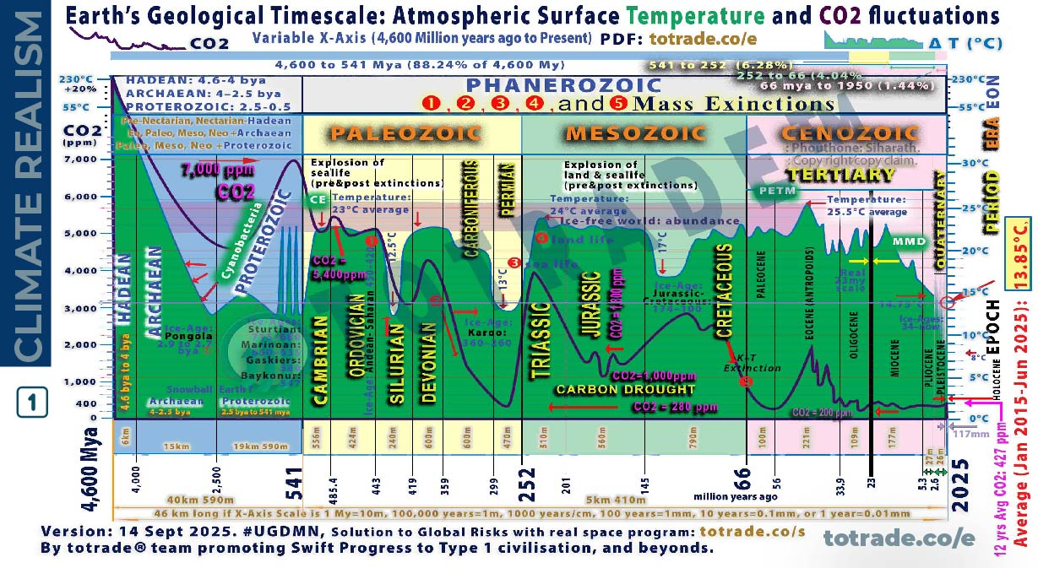
NATURAL ARCHIVES → CLIMATE REALISM
Notes:
This X-Axis variable graph is the combination of past climate studies by experts in their fields using natural archives through:
• Tree rings: Show temperature, rainfall, and drought cycles (dendroclimatologists)
• Sea sediment: Track ocean temperature, salinity, and biological activity (paleoceanographers).
• Ice cores: Record greenhouse gases, volcanic ash, and temperature shifts (glaciologists and palaeoclimatologists).
• Rock layers: Reveal long-term climate patterns and major events (stratigraphers and geologists).
• Lake sediment: Preserve pollen, charcoal, and minerals. Reflect vegetation and fire history (paleolimnologists).
• Speleothems: Cave formations record rainfall and temperature through isotopes (biologists and geochemists).
• Coral reefs: Growth bands and isotopes show sea surface temperature and salinity (marine biologists and geochemists).
• Historical documents: Include harvest records, ship logs, and diaries. Indicate past climate (historical climatologists).
• Glacier extent: Maps and photos show retreat or advance. Reflect temperature and precipitation (glaciologists and geomorphologists).
• Pollen analysis: From soil or sediment. Reveal past plant life and climate zones (palynologists).
• Charcoal layers: Indicate wildfires. Help track droughts and vegetation changes (paleo ecologists).
• Packrat middens: Preserve seeds and bones. Show local climate and ecosystem shifts (paleo ecologists and archaeologists).
Combining these studies, these archives confirm Earth is still in an Ice Age. For most of the last 550 million years, Earth was warmer, supporting vast forests and abundant life. Today’s cooler phase is part of a long-term cooling cycle.
Many geological, archaeological, and historical mysteries remain unresolved without acknowledging abrupt cataclysmic events as key drivers:
• Mammoths frozen with food in their mouths.
• Cities buried under miles of sediment.
• Fossil layers laid down in hours, not centuries.
• Ancient civilizations erased in a single day.
• Global myths of floods, fire, and sudden darkness.
• Polar shifts and crustal displacement every few thousand years.
These events explain sudden extinctions, lost continents, and resets in human progress. Ignoring them collapses timelines and creates contradictions in CO2-centric Hensenism evidence, totrade.co/hs
Accepting cataclysms as central to Earth’s history is essential to understand the past, prepare for the future, and solve mysteries that defy conventional models.
Ignoring natural cycles while pushing false climate narratives, like exaggerated heat records and cyclone claims, undermines credibility. The IPCC’s Climategate is a warning.
Imposing green ideology on poor nations through coercive climate policy is eco-colonialism. It forces decisions that harm people and economies to satisfy the environmental agenda of the affluent West.

Slide 10
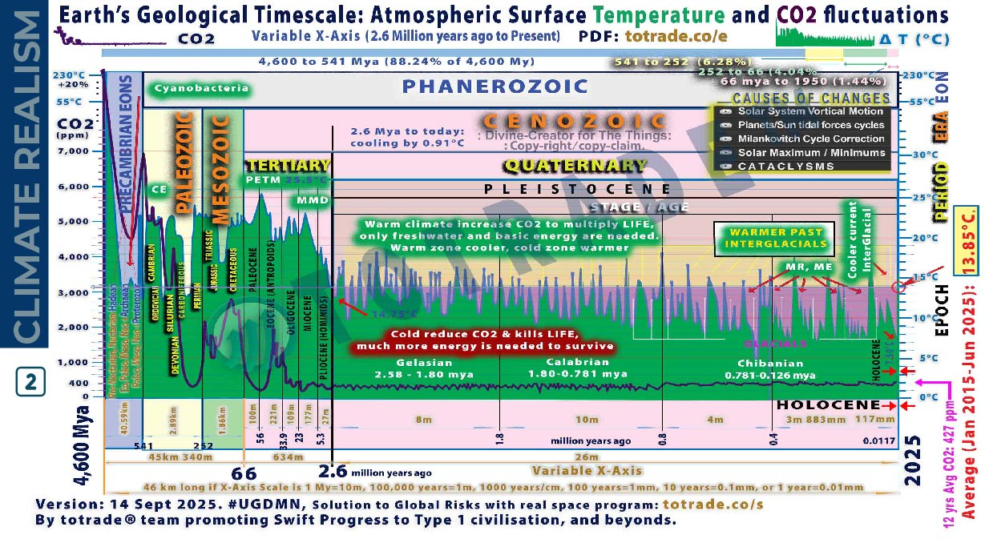



NATURAL ARCHIVES → CLIMATE REALISM
Notes:
This graph combines evidence from multiple natural archives as previous slides but between 2.6 Mya to 11,700 ya
Earth’s climate change from 2.6 million years ago to the Holocene, integrating natural archives and cataclysmic events.
Natural archives show gradual shifts:
Tree rings, ice cores, lake and sea sediments, speleothems, coral reefs, pollen, charcoal, and rock layers confirm glacial–interglacial cycles. These cycles were driven by orbital changes (Milankovitch cycles), solar activity, and abrupt Galactic Cosmic Rays flux (GCRs). Temperature fluctuated ±5°C globally.
Cataclysmic events caused abrupt shifts:
The lithosphere rotated over the mantle in 6–12 hours. This repositioned poles to the Torrid Zone. Oceans and atmosphere continued rotating eastward at 1,037 mph. Supersonic winds and floods buried continents. Ice caps melted. New ones formed. Entire civilizations vanished. Fossil records show sudden extinctions. Mammoths froze instantly. Sedimentary layers show rapid deposition. Tiahuanaco was buried and later uplifted 12,500 feet.
Key transitions:
• 2.6 million years ago: Start of Pleistocene. Ice sheets expanded.
• 29,000 years ago: End of Wisconsin glaciation.
• 18,500 years ago: Hudson Bay polar shift.
• 11,500 years ago: Laurentian ice cap collapse. Global flood. Start of Holocene.
• 7,000 years ago: Noah’s flood. Arctic Ocean moved to North Pole.
• Today: Arctic era continues. Next shift expected ~2036.
Conclusion:
Natural archives show patterns. Cataclysms explain abrupt transitions. Climate change is not linear. It’s cyclical, sudden, and global. We must prepare.
📄 PDF: totrade.co/biz | totrade.co/pdf
📊 PowerPoint:
• Climate Realism: totrade.co/cr
• Business Plan: totrade.co/bp

Slide 11
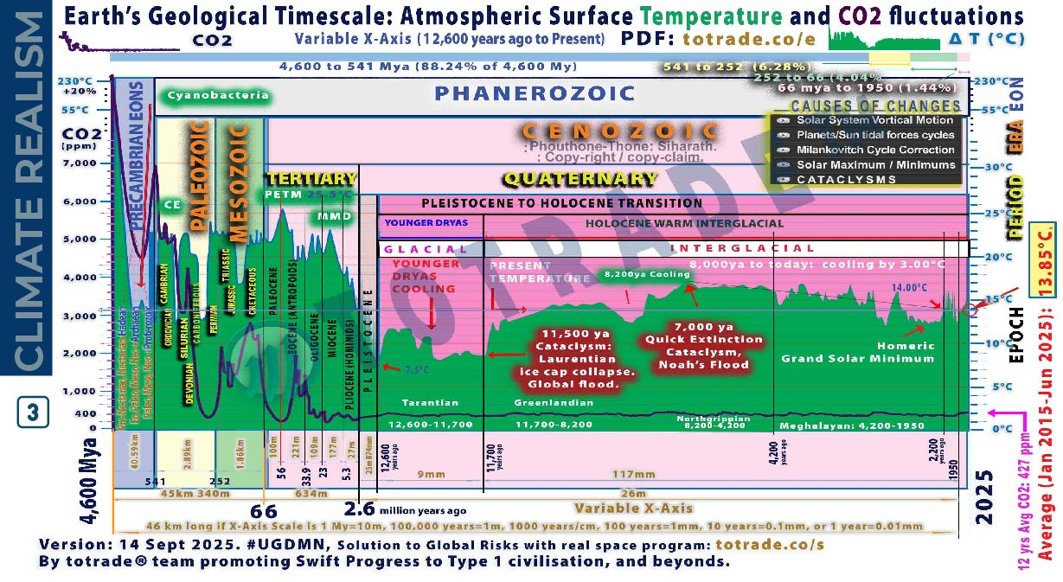
NATURAL ARCHIVES → CLIMATE REALISM
Notes:
This graph shows climate shifts from 11.7kya to 4.2kya, with abrupt and gradual phases confirmed by natural archives and cataclysmic evidence.
Younger Dryas Cooling
• Sudden return to glacial conditions around 12,900 years ago
• Caused by freshwater influx disrupting ocean currents
• Ended ~11,700 years ago with rapid warming
11,500 ya: Laurentian Ice Cap Collapse
• Triggered global flood
• Massive crustal shift repositioned poles
• Sudden climate reset marked start of Holocene
Holocene Climatic Optimum
(11,700–8,200 years ago)
• Warm, stable climate
• Forests expanded
• Agriculture began
8,200 years ago Cooling
• Abrupt drop in temperature
• Linked to meltwater pulse and ocean disruption
• Affected early civilizations
7,000 years ago: Noah’s Flood
• Arctic Ocean moved to North Pole
• Crust shifted again
• Global inundation and tectonic upheaval
• Less than 1% of life survived
Homeric Grand Solar Minimum
• Occurred during late Holocene
• Reduced solar activity
• Contributed to cooling trend
8,000 years ago to today: 3°C Cooling
• Gradual decline in global temperature
• Driven by orbital cycles and solar variation
• Stabilized ecosystems and enabled civilization growth
This period shows how cataclysms and cosmic forces shaped climate more than CO₂.
Conclusion:
Natural archives show patterns. Cataclysms explain abrupt transitions. Climate change is not linear. It’s cyclical, sudden, and global. We must prepare.
📄 PDF: totrade.co/biz | totrade.co/pdf
📊 PowerPoint:
• Climate Realism: totrade.co/cr
• Business Plan: totrade.co/bp

Slide 12
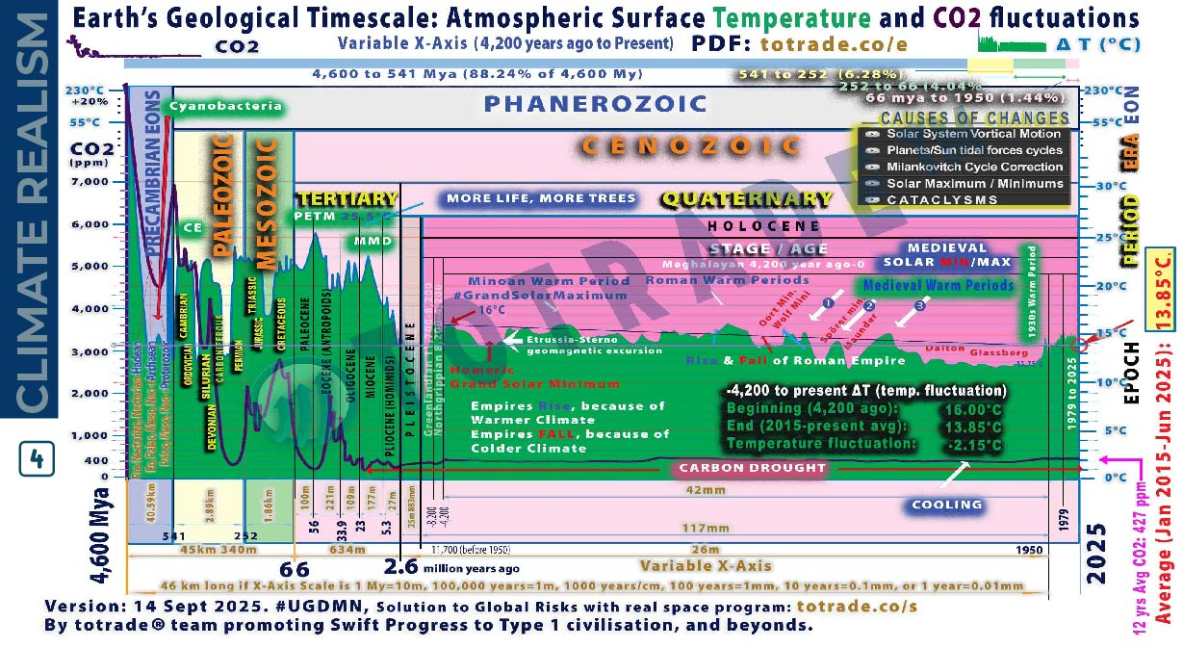
NATURAL ARCHIVES → CLIMATE REALISM
Notes:
This graph 4 shows climate shifts between 4200 years ago and 1950, Earth’s climate shifted through solar cycles and abrupt cooling events. Natural archives and historical records confirm this.
• Homeric Grand Solar Minimum (~2800–2600 BCE)
Solar output dropped. Tree rings and ice cores show cooling. Crop failures and societal stress in Mesopotamia and Egypt. Linked to the 4.200year ago event that collapsed Akkadian and Old Kingdom Egypt.
• Roman Warm Period (~250 BCE–400 CE)
Global temperature rose ~+1°C above Holocene average. Confirmed by grape cultivation in Britain and Alpine glacier retreat. Enabled Roman expansion, trade, and population growth.
• Medieval Warm Period (~950–1250 CE)
Temperature rose +0.5 to +1.0°C. Tree rings and lake sediments confirm warming in Europe, Greenland, and parts of Asia. Norse settled Greenland. Vineyards expanded north. Monsoon patterns shifted.
• Oort Minimum (~1040–1080 CE)
Solar activity dropped. Cooling resumed. Tree rings show reduced growth. Glaciers advanced in Europe.
• Wolf Minimum (~1280–1350 CE)
Marked start of Little Ice Age. Cooling intensified. Crop yields fell. Famines spread across Europe and Asia.
• Spörer Minimum (~1460–1550 CE)
One of the coldest periods. Tree rings and ice cores show sharp cooling. Glaciers expanded. Harsh winters. Population decline in some regions.
• Maunder Minimum (~1645–1715 CE)
Deepest cold of Little Ice Age. Sunspot records show near-zero activity. Europe saw frozen rivers, failed harvests, and mass starvation. ΔT ~ -1.0°C.
• Dalton Minimum (~1790–1830 CE)
Solar activity dropped again. Cooling ~ -0.5°C. Tambora eruption (1815) amplified effects.
“Year Without a Summer” (1816). Global crop failures.
• Glassberg Minimum (~1870–1900 CE)
Final cooling phase before modern warming. Confirmed by glacier advance and tree ring contraction. Cold winters in Europe and North America.
• 1930s Warm Period
Global temperature rose ~+0.3°C. Dust Bowl in US. Arctic ice retreated. Confirmed by instrumental records and historical observations.
Conclusion:
Natural archives show patterns. Cataclysms explain abrupt transitions. Climate change is not linear. It’s cyclical, sudden, and global. We must prepare.
🔗 Science: totrade.co/g
📜 History: totrade.co/e | totrade.co/h
📄 PDF: totrade.co/biz | totrade.co/pdf
📊 PowerPoint:
• Climate Realism: totrade.co/cr
• Business Plan: totrade.co/bp

Slide 13
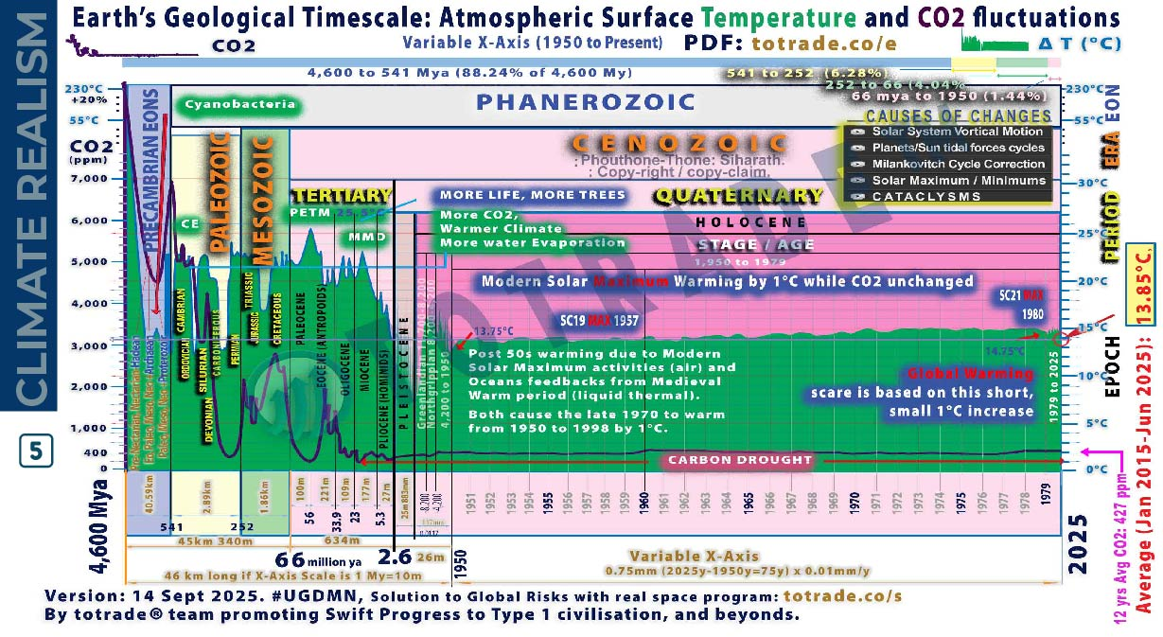
NATURAL ARCHIVES → CLIMATE REALISM
Notes:
This graph 5 shows climate shifts between 1950 and 1979, Earth’s climate shifted through solar cycles. Natural archives and historical records confirm this.
“Climate Change” between 1950 and 1979, now incorporating the surge in Galactic Cosmic Rays (GCRs) and lightning observations:
• Modern Solar Maximum Warming by 1°C while CO₂ unchanged.
Solar activity peaked. Sunspot counts rose. Earth warmed ~1°C. CO₂ remained near 315 ppm. Warming was solar-driven, not CO₂-induced.
• Warmer Climate, More Water Evaporation, releasing More CO₂,
CO₂ began rising slowly. Warmer air held more moisture. Evaporation increased. Cloud formation and precipitation patterns shifted. Oceans retained more heat.
• Post-50s Warming: Air and Ocean Feedback
Air warmed from solar maximum. Oceans released stored heat from Medieval Warm Period. Liquid thermal inertia amplified warming. Combined feedback raised global temperature.
• GCRs Start to Surge
NASA research confirmed GCRs influence lightning frequency. Chronis found increased lightning linked to cosmic ray flux. GCRs electrify the atmosphere, triggering more discharges. This marks a shift in Earth’s electrical environment.
• 1950–1998 Warming: +1°C
Late 1970s marked acceleration. Solar and ocean feedbacks caused ~1°C rise. No tipping point. No CO₂ spike. No cataclysm.
• Global Warming Scare
Based on short-term data. Graph shows only 0.75mm X-axis out of 46km total scale. Misleading scale exaggerates impact. Real climate change spans millions of years.
Conclusion:
Natural archives show patterns. Cataclysms explain abrupt transitions. Climate change is not linear. It’s cyclical, sudden, and global. We must prepare.

Slide 14
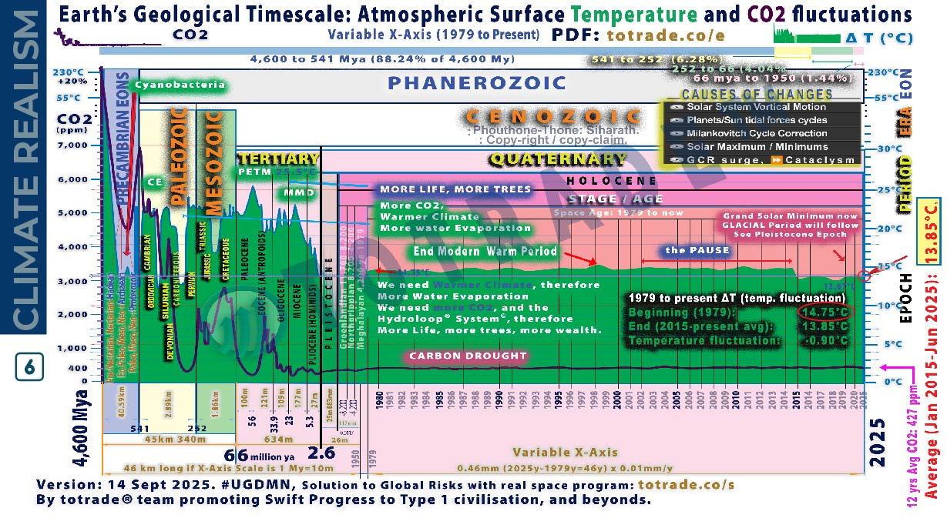
NATURAL ARCHIVES → CLIMATE REALISM
Notes:
This graph 6 shows climate shifts between 1976 and 2025, Earth’s climate shifted through solar cycles. Natural archives and historical records confirm this.
Between 1979 and 2025, Earth’s climate shifted under declining solar activity and rising cosmic influences:
• Solar activity declined. See totrade.co/sm.
Japan universities linked this to increased lightning. See totrade.co/ln5.
• Galactic Cosmic Rays surged.
GCRs triggered cloud formation.
CERN CLOUD confirmed. See totrade.co/gc.
GCRs also increased lightning. Confirmed by NASA Earthdata (totrade.co/gcr1),
Frontiers in Physics (totrade.co/gcr2),
Climate Cosmos (totrade.co/ln1),
The Weather Network (totrade.co/gcr3),
and Yale Environment 360 (totrade.co/gcr4).
• Lightning spikes marked the surge.
Atmospheric ionization increased. Electrical storms intensified.
• IPCC manipulated data to hide the decline.
Climategate exposed suppression of cooling trends.
• The pause between 2002–2014
Global temperature stabilized. No warming. CO₂ continued rising.
• 2014–2018: Temperature declined by 0.90°C
Confirmed by satellite and ocean data. Cooling trend ignored in mainstream reports.
• 2018–2025: Continued cooling
UAH January 2025 report shows global temperature anomaly at +0.46°C, down from +0.62°C in December 2024.
• 2025: Unusual fruiting surge: GCR surge → more clouds → cooler upper atmosphere (La Niña) → more rain → more lightning → more nitrates → stronger plant growth and fruiting, totrade.co/fr, Proof: vt.tiktok.com/ZSBPFd8er
Trend since 1978: +0.15°C per decade. But recent years show decline due to La Niña and reduced solar activity.
Datagraver confirms monthly anomalies and 10-year moving average show cooling since 2016, totrade.co/dg.
Conclusion:
Natural archives show patterns. Cataclysms explain abrupt transitions. Climate change is not linear. It’s cyclical, sudden, and global. We must prepare.

Slide 15
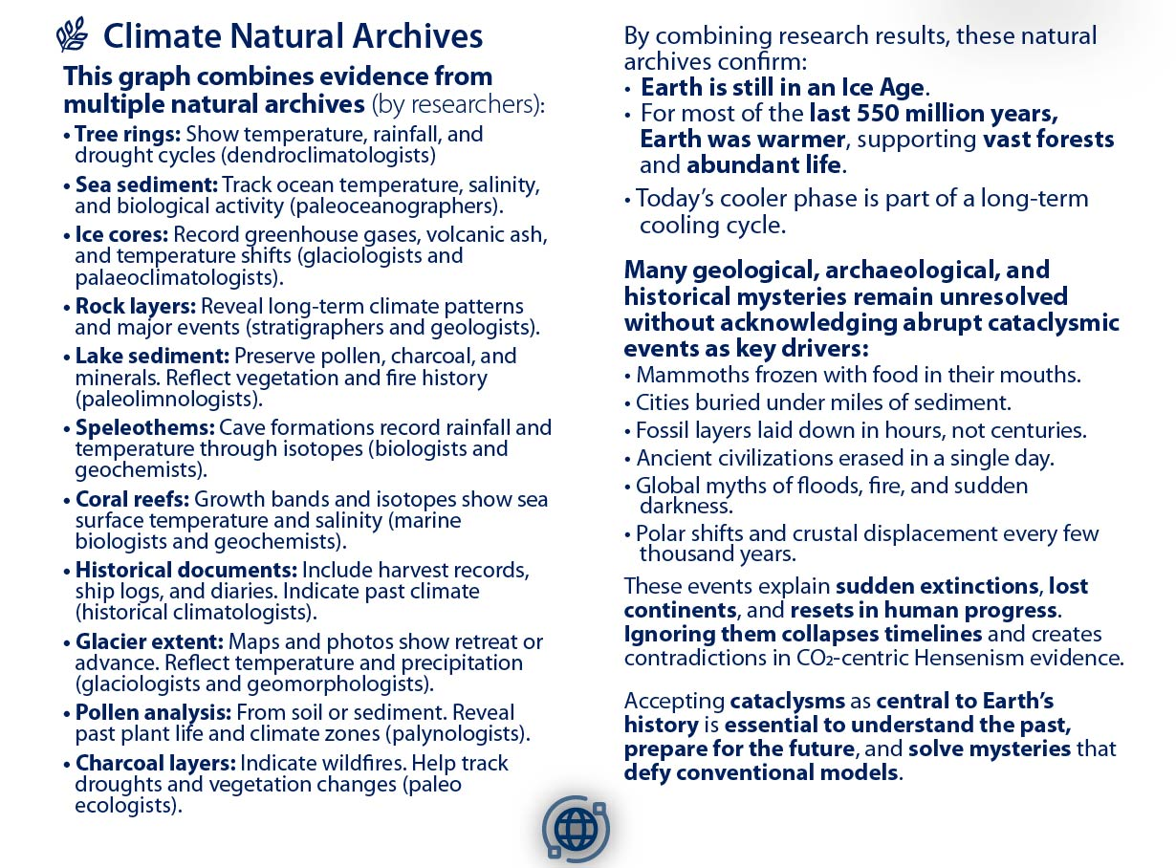

NATURAL ARCHIVES → CLIMATE REALISM
Notes:
This X-Axis variable graph is the combination of past climate studies by experts in their fields using natural archives through:
• Tree rings: Show temperature, rainfall, and drought cycles (dendroclimatologists)
• Sea sediment: Track ocean temperature, salinity, and biological activity (paleoceanographers).
• Ice cores: Record greenhouse gases, volcanic ash, and temperature shifts (glaciologists and palaeoclimatologists).
• Rock layers: Reveal long-term climate patterns and major events (stratigraphers and geologists).
• Lake sediment: Preserve pollen, charcoal, and minerals. Reflect vegetation and fire history (paleolimnologists).
• Speleothems: Cave formations record rainfall and temperature through isotopes (biologists and geochemists).
• Coral reefs: Growth bands and isotopes show sea surface temperature and salinity (marine biologists and geochemists).
• Historical documents: Include harvest records, ship logs, and diaries. Indicate past climate (historical climatologists).
• Glacier extent: Maps and photos show retreat or advance. Reflect temperature and precipitation (glaciologists and geomorphologists).
• Pollen analysis: From soil or sediment. Reveal past plant life and climate zones (palynologists).
• Charcoal layers: Indicate wildfires. Help track droughts and vegetation changes (paleo ecologists).
• Packrat middens: Preserve seeds and bones. Show local climate and ecosystem shifts (paleo ecologists and archaeologists).
Combining these studies, these archives confirm Earth is still in an Ice Age. For most of the last 550 million years, Earth was warmer, supporting vast forests and abundant life. Today’s cooler phase is part of a long-term cooling cycle.
Many geological, archaeological, and historical mysteries remain unresolved without acknowledging abrupt cataclysmic events as key drivers:
• Mammoths frozen with food in their mouths.
• Cities buried under miles of sediment.
• Fossil layers laid down in hours, not centuries.
• Ancient civilizations erased in a single day.
• Global myths of floods, fire, and sudden darkness.
• Polar shifts and crustal displacement every few thousand years.
These events explain sudden extinctions, lost continents, and resets in human progress. Ignoring them collapses timelines and creates contradictions in CO2-centric Hensenism evidence, totrade.co/hs
Accepting cataclysms as central to Earth’s history is essential to understand the past, prepare for the future, and solve mysteries that defy conventional models.
Ignoring natural cycles while pushing false climate narratives, like exaggerated heat records and cyclone claims, undermines credibility. The IPCC’s Climategate is a warning.
Imposing green ideology on poor nations through coercive climate policy is eco-colonialism. It forces decisions that harm people and economies to satisfy the environmental agenda of the affluent West.

Slide 16
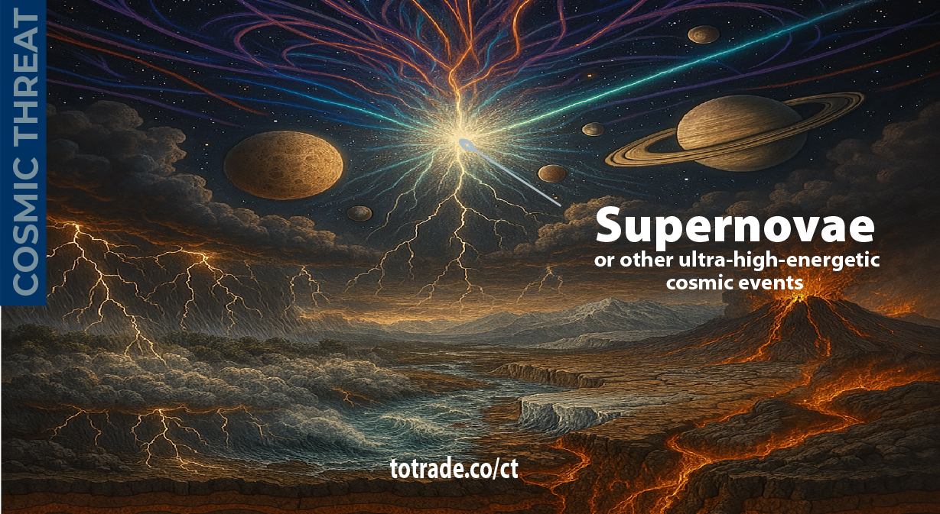
GALACTIC
COSMIC
RAYS
(GCRs)
ORIGIN
CLIMATE CHANGE BY GALACTIC COSMIC RAYS (GCRs)
Notes:
Origin of Ultra-High-Energetic Galactic Cosmic Rays (GCRs)
Galactic Cosmic Rays (GCRs) are ultra high-energy particles from supernovae or other cosmic events traveling at nearly the speed of light, arriving in massive waves with wavelengths measured in millennia. (totrade.co/g). Their periodicity, distance between the waves, ranges from 5,000 to 35,000 years apart, with each crest about 22 years thick and an 11-year peak before fading (totrade.co/e).
Our Solar System is entering a galactic magnetic null zone (totrade.co/gn), a cyclical event tied to our orbit through the Galactic Plane region where magnetic fields are weak, chaotic, or reversed. This travers weakens the Sun’s activity (totrade.co/sm). Lower Solar activity weakens Earth’s magnetic field, collapsing our shielding against surging GCRs, peak by ~2036.
Result:
• Increased atmospheric ionization → extreme storms, lightning, climate disruption
• Internal Geodynamo instability → magnetic anomalies, excursions, and reversals.
• Mantle stress → megaquakes, supervolcanoes, crust shifts → mega tsunamis.
Result:
• Increased atmospheric ionization → extreme storms, lightning, climate disruption
• Internal Geodynamo instability → magnetic anomalies, excursions, and reversals.
• Mantle stress → megaquakes, supervolcanoes, crust shifts → mega tsunamis
🔗 Science: totrade.co/g
📜 History: totrade.co/e | totrade.co/h
💡 Solution: totrade.co/p totrade.co/s totrade.co/m
Call to Action: totrade.co/ca
PDF: totrade.co/biz
totrade.co/pdf

Slide 17
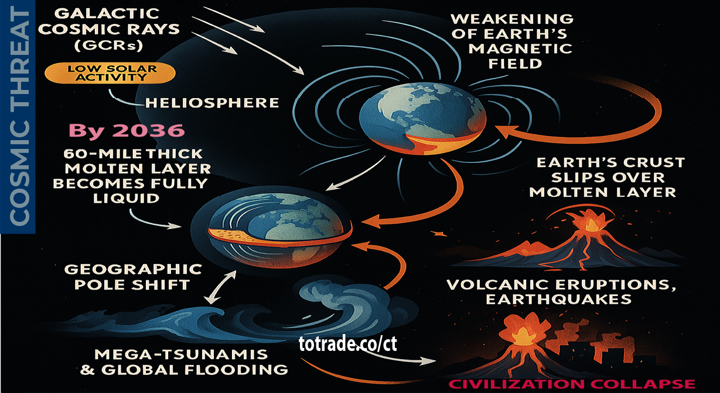
COSMIC THREAT: Beyond CO₂
Notes:
COSMIC THREAT: Beyond CO₂
The real climate driver and future cataclysms is Galactic Cosmic Rays (GCRs), not any greenhouse gases, especially not CO₂
As the Solar System enters a galactic magnetic null zone, solar activity drops, solar system heliosphere and Earth’s magnetic shield weakens. This opens the door for extreme GCR influx, energy levels far beyond anything on Earth.
Result:
• Molten layer beneath the crust liquefies
• The Crust slip → pole shift → megaquakes, supervolcanoes, mega-tsunamis
• Civilization collapse before global glaciation

Slide 18
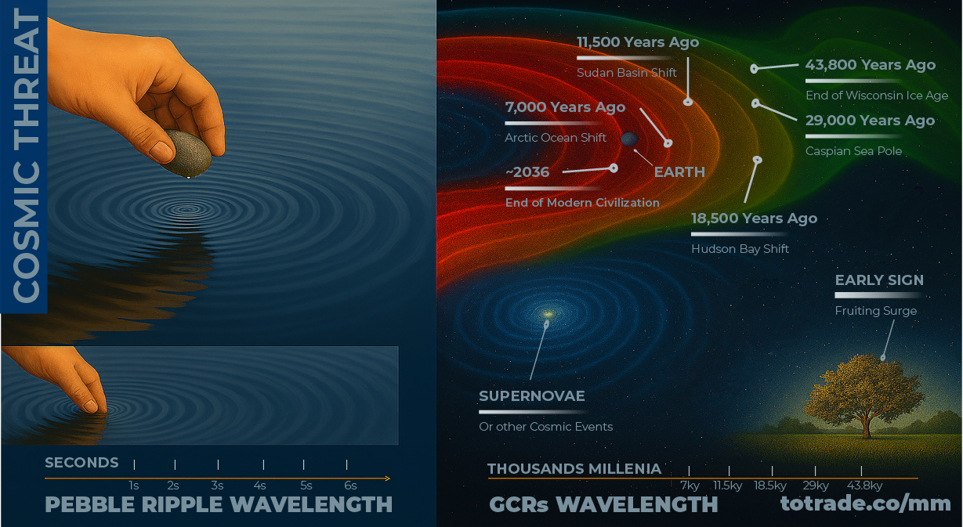
GCRs Multi-Millenia Wavelength
Notes:
Galactic Cosmic Rays (GCRs) are ultra high-energy particles from supernovae and other cosmic events, moving near light speed. They arrive in waves thousands of years apart, with cycles lasting 5,000 to 35,000 years. Each wave spans about 22 years, peaking around the middle. These surges align with Earth events such as major volcanic eruptions, pole shifts, mega tsunamis, rapid ice melt, crustal movement, and continent-altering floods.
Geological and historical evidence outlines a spread order of major events:
7,000 Years Ago – Arctic Ocean Shift (red);
11,500 Years Ago – Sudan Basin Shift (red-orange);
18,500 Years Ago – Hudson Bay Shift (orange);
29,000 Years Ago – Caspian Sea Pole (orange-green);
43,800 Years Ago – End of Wisconsin Ice Age (green).
Historical records show nature often signals GCR surges with unusual plant reproduction and heavy fruiting, driven by atmospheric shifts from rising GCR intensity.
Visual models depict overlapping wavefronts moving through space for millennia, each linked to past cataclysms.
Understanding their cycle offers a tool for long-range forecasting and planetary defense, critical before the next crest, expected around 2036.

Slide 19
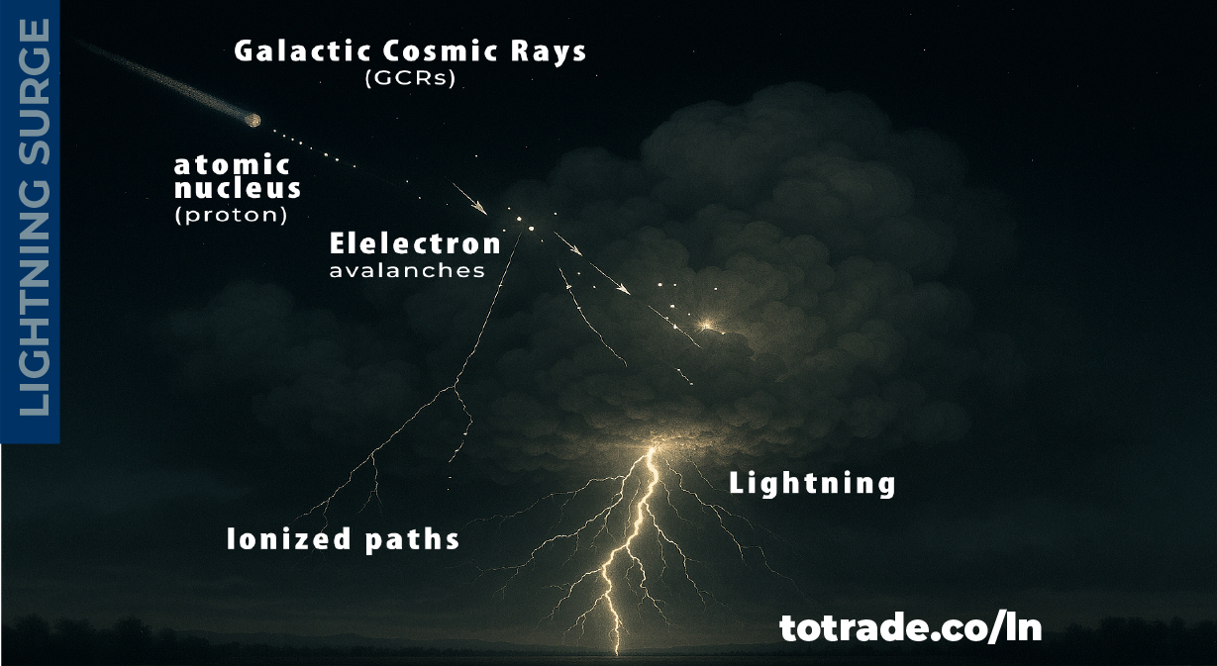
GCRs Surge Effects on Lightning
Notes:
🌿 GCRs Surge Effects on Lightning
Lightning triggered by Galactic Cosmic Rays (GCRs) involves high-energy particles from space hitting Earth’s atmosphere.
• GCRs are fast-moving atomic nuclei from beyond the solar system
• They collide with air molecules, creating particle showers
• These showers ionize the air, boosting conductivity
• Thunderclouds build strong electric fields
• Ionized paths help start electron avalanches
• Avalanches form stepped leaders, lightning channels
• Once channels connect charges, lightning strikes
This is the runaway breakdown model. It shows lightning can form in weaker fields than expected.
Galactic Cosmic Rays (GCR) Impact Briefing
1. Mechanism Summary
• GCRs are high-energy atomic nuclei from beyond the solar system
• GCRs collide with air molecules, creating particle showers
• GCRs Showers ionize the atmosphere, increasing conductivity
• Thunderclouds develop strong electric fields
• Ionized paths enable electron avalanches
• Avalanches form stepped leaders and lightning channels
• When channels connect charges, lightning strikes
2. Key Indicators
• Arctic lightning frequency surge
• Tropical fruiting anomalies
• Increased storm intensity and irregular precipitation
3. Timeline of Observed Changes
• Early 2010s: Arctic lightning ~100 strikes/year
• 2021: Arctic lightning >7,000 strikes/year
• 2025: Tropical regions show fruiting surges linked to GCR influence
4. Risk Implications
• Agriculture: Disrupted fruiting cycles, yield instability
• Climate: Increased lightning, storm volatility
• Ecosystems: Stress on species adaptation
Key Scientific Findings on Lightning and GCRs
[1] Lightning on the Rise: The Surprising Climate Link to More GCRs, totrade.co/ln1
[2] #UGDMN_Business_Plan, totrade.co/biz
[3] Damaging Lightning-Caused Wildfires Likely to Increase in a Few Years ...: totrade.co/ln2
[4] NASA Earthdata – “Cosmic Charges”
o Researchers found that Galactic Cosmic Rays (GCRs) play a significant role in triggering lightning by ionizing the atmosphere.
o Using data from the National Lightning Detection Network, a positive correlation was observed between cosmic ray intensity and lightning frequency. Read the full article: totrade.co/gcr1
[5] Frontiers in Physics – “Short-Term Lightning Response to Ground Level Enhancements”
o This peer-reviewed study analyzed three major cosmic ray events (GLEs) and found a statistically significant increase in global lightning activity within 20 minutes of each event. Read the study PDF: totrade.co/gcr2
[6] The Weather Network – “Mystery of Lightning’s Initial Spark”
o High-energy cosmic rays are helping initiate lightning discharges by overcoming the insulating properties of air. Read the article: totrade.co/gcr3
[7] Yale Environment 360 – “Lightning Strikes the Arctic”
o Reports a dramatic increase in lightning in the Arctic, from ~100 strikes/year in the early 2010s to over 7,000 in 2021 — a region that historically had almost none.
o Read more: totrade.co/gcr4, or totrade.co/ln3

Slide 20
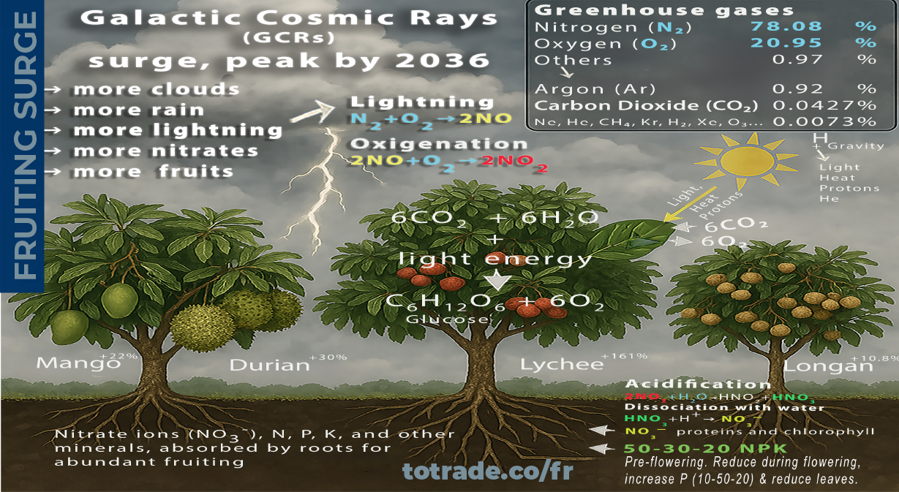
GCRs Surge increase Fruit
Notes:
🌿 GCRs Effects on Atmosphere
The surge of Galactic Cosmic Rays (GCRs), peak by 2036, enhance aerosol formation (cloud seeding), especially in the mid-troposphere, where cooler temperatures prevail.
More clouds increase rainfalls, totrade.co/fl, and lightning that converts atmospheric abundant nitrogen (N₂) and oxygen (O₂) into nitrate ions (NO₃¯).
The nitrate ions are used by plants to synthesize the building blocks of proteins, essential for various functions, including growth, development, fruiting, and defense against diseases, totrade.co/fr.
Enhanced rainfall and lightning often accompany storms, increasing atmospheric moisture, soil hydration, humidity levels, and lower surface temperature.
🔁 GCRs and N₂ Mechanism
Elemental nitrogen refers to the atom N, which is part of many biological molecules.
In nature, nitrogen exists as diatomic gas (N₂) , making up ~78% of Earth's atmosphere.
• Plants cannot use atmospheric N₂ directly.
• GCRs, H₂O convert N₂ into NO₃-, essential for:
• Amino acids (building blocks of proteins)
• Nucleic acids (DNA, RNA)
• Chlorophyll (photosynthesis pigment)
• Plant hormones (like cytokinin)
🔁 The Consequence
Durian yields up 30%, lychee up 161%, longan up 10.8%, mango up 22%, rambutan also up, and many fruits are also thriving such as lime, Papaya, Banana, Jackfruit, Mangosteen, Guava, Pomelo, Starfruit (Carambola), Dragon fruit (Pitaya), Passion fruit, Custard apple (Annona), Sapodilla (Chikoo), Coconut...
In rural Lao villages, fruit trees are flourishing without any human intervention. Locals often discard or sell fruits at steep discounts due to oversupply.
📽️ Proof: vt.tiktok.com/ZSBPFd8er

Slide 21
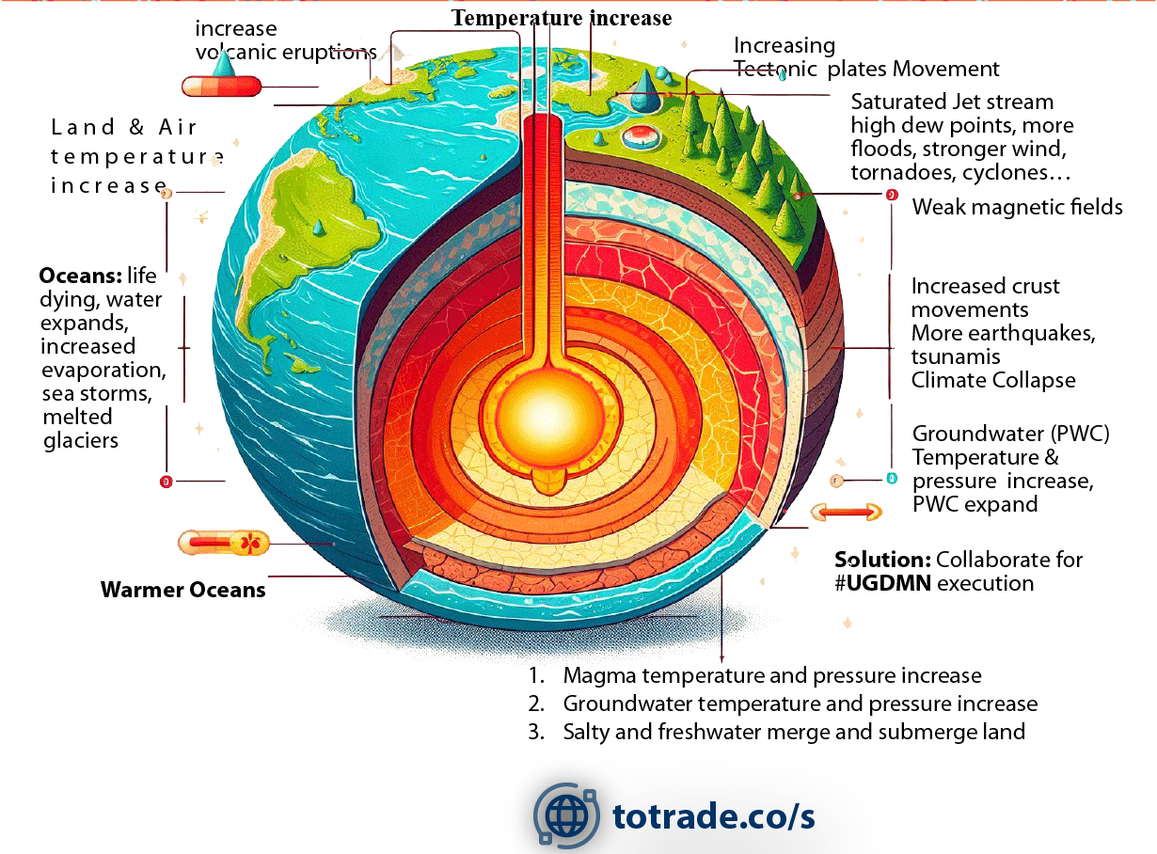
GCRs Surge: Effects on Earth Interior
Notes:
Galactic Cosmic Rays (GCRs) influence Earth’s interior and related systems:
• Magma heats up and pressure rises, increasing volcanic activity.
• Groundwater temperature and pressure rise, destabilizing subsurface systems.
• Salty and freshwater layers mix, submerging land areas.
• Tectonic plates move faster, raising earthquake and tsunami risks.
• Weakening magnetic fields reduce Earth’s shielding, amplifying GCR effects.
• Crust movements intensify, driving seismic instability.
Linked surface impacts:
• Warmer oceans expand, melt glaciers, and fuel stronger storms.
• Jet stream saturation raises dew points, causing floods, tornadoes, and cyclones.
• Combined effects push toward climate collapse.

Slide 22
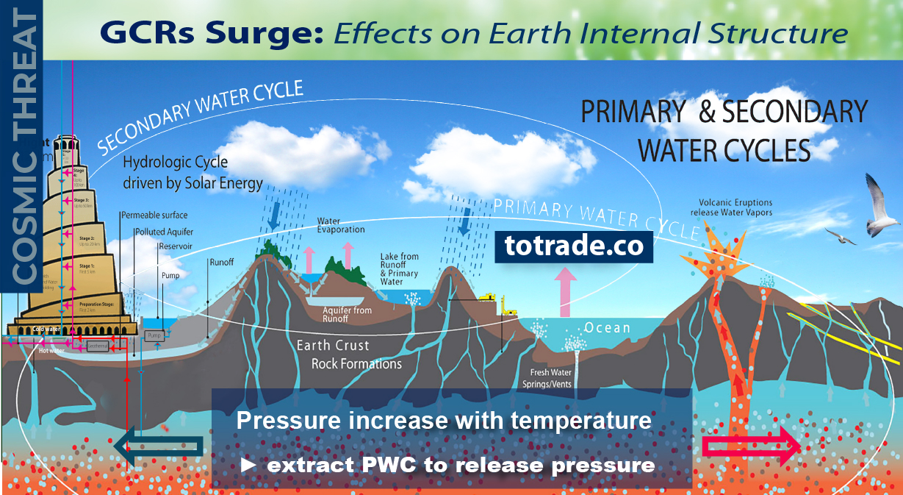
GCRs Surge: Effects on
Notes:
Galactic Cosmic Rays (GCRs) influence Earth’s interior and related systems:
• Magma heats up and pressure rises, increasing volcanic activity.
• Groundwater temperature and pressure rise, destabilizing subsurface systems.
• Salty and freshwater layers mix, submerging land areas.
• Tectonic plates move faster, raising earthquake and tsunami risks.
• Weakening magnetic fields reduce Earth’s shielding, amplifying GCR effects.
• Crust movements intensify, driving seismic instability.
Linked surface impacts:
• Warmer oceans expand, melt glaciers, and fuel stronger storms.
• Jet stream saturation raises dew points, causing floods, tornadoes, and cyclones.
• Combined effects push toward climate collapse.
The image also mentions UGDMN execution as a mitigation strategy.

Slide 23
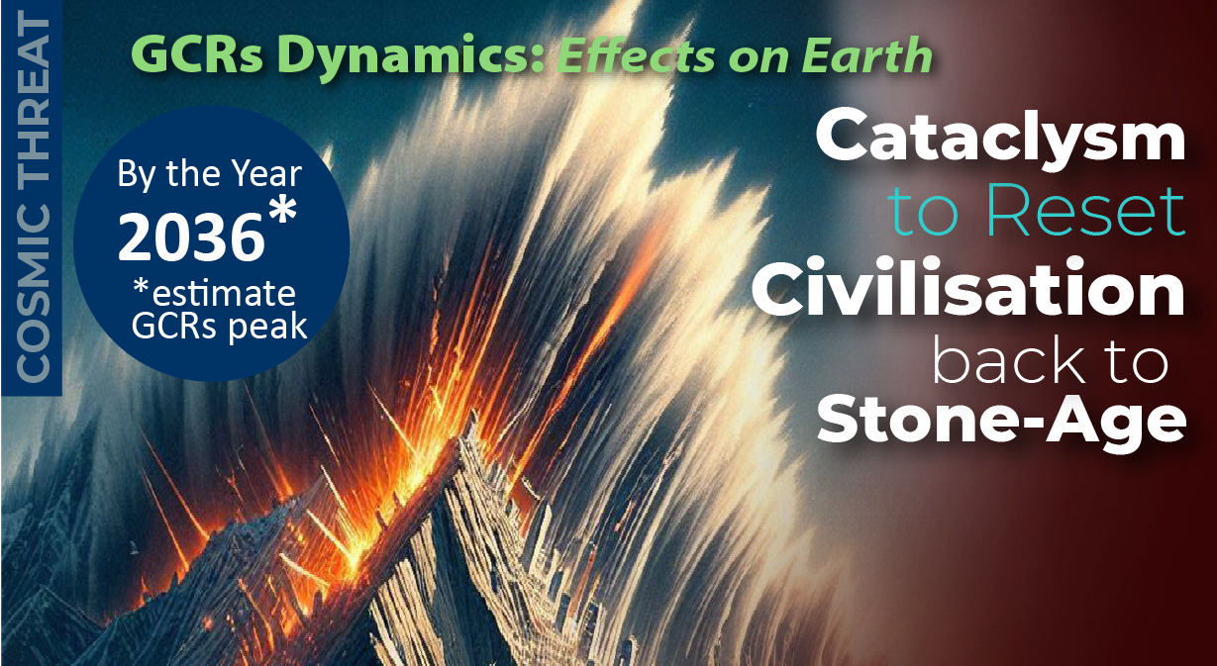
GCRs Triggered Cataclysm Estimate Timeline
Notes:
Global Risk Assessment & Feasibility Studies
Beyond CO₂: Galactic Cosmic Rays and Cataclysms
• Recent extreme rainfall anomalies (bit.ly/ttfloods) signal deeper drivers beyond CO₂.
• CERN’s CLOUD experiment shows GCRs influence aerosol formation and cloud seeding, altering climate systems.
• Rising Galactic Cosmic Rays (GCRs), on multi-millennial cycles, are peaking toward ~2036, linked to solar activity decline.
• Mainstream focus on CO₂ masks the real risk: GCR-driven atmospheric and geophysical instability.
Why it matters:
• GCR surge destabilizes Earth’s interior → pressure buildup → supervolcanoes, megaquakes, crust slippage.
• Consequences: continent-scale floods, infrastructure collapse, cultural and technological loss, followed by global glaciation.
Cyclic cataclysms from Earth’s crustal displacement:
Mechanism
• A semi-molten layer 60–120 miles deep acts as lubricant.
• Off-axis ice caps build centrifugal stress.
• Magnetic and electrical disruption lets the crust slip.
• Poles shift into the Torrid Zone within hours, triggering upheaval.
Effects
• Supersonic winds over 1,500 km/h shred life and structures.
• Oceans race inland as walls of water miles high.
• Quakes split continents; molten rock floods lowlands.
• Flash-freezing locks life and mud in place.
Global Reach
• Americas drowned, burned, frozen.
• Europe and Asia devastated by sea, wind, quakes.
• Africa partly spared, split in half, and shaken.
• Antarctica and Greenland shift to equator; melting raises seas 150+ m.
• Survivors hide in mountains; civilization erased.
Parallels
• Myths of Noah, Vishnu, Osiris, Utnapishtim reflect earlier resets.
• Cuvier (1812) noted sudden global catastrophes.
• Later scholars tied legends, fossils, geology to recurring events.
Evidence
• Alaska, Siberia, North America bone beds show sudden freezing.
• Grand Canyon and Badlands strata record repeated floods.
• Ice cap growth drives instability.
Pattern
• Cycle repeats every few thousand years.
• Last five mapped over 35,000+ years.
• Next shift near 2036, tied to solar-cosmic change.
Outcome
• Oceans lay new mud layers.
• ASEAN and Australia emerge temperate refuges.
• Civilization resets to Stone Age.
This synthesis of geology, myth, and cataclysmology shows civilization ends in cycles of crustal displacement.

Slide 24
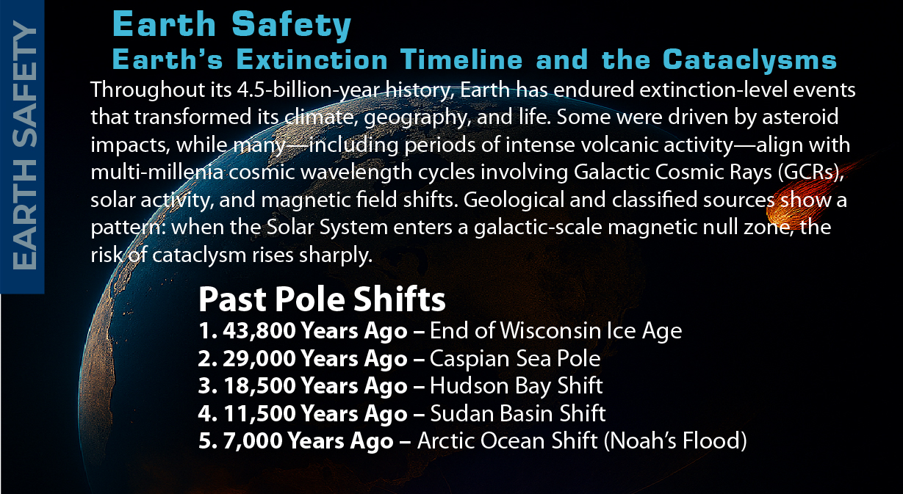
GCRs Triggered Past Cataclysm
Notes:
Global Risk Assessment & Feasibility Studies
Beyond CO₂: Galactic Cosmic Rays and Cataclysms
By studying world history of cataclysms, we see that mega projects not built to withstand them signal failed leadership—and will drive citizens into collapse. totrade.co/ct
The Americans, more strategic, use the petrodollar—exchanging cheap paper for OPEC oil—to build sanctuaries and shield their citizens. totrade.co/ug1
• Recent extreme rainfall anomalies (bit.ly/ttfloods) signal deeper drivers beyond CO₂.
• CERN’s CLOUD experiment shows GCRs influence aerosol formation and cloud seeding, altering climate systems.
• Rising Galactic Cosmic Rays (GCRs), on multi-millennial cycles, are peaking toward ~2036, linked to solar activity decline.
• Mainstream focus on CO₂ masks the real risk: GCR-driven atmospheric and geophysical instability.
Why it matters:
• GCR surge destabilizes Earth’s interior → pressure buildup → supervolcanoes, megaquakes, crust slippage.
• Consequences: continent-scale floods, infrastructure collapse, cultural and technological loss, followed by global glaciation.
Cyclic cataclysms from Earth’s crustal displacement:
Mechanism
• A semi-molten layer 60–120 miles deep acts as lubricant.
• Off-axis ice caps build centrifugal stress.
• Magnetic and electrical disruption lets the crust slip.
• Poles shift into the Torrid Zone within hours, triggering upheaval.
Effects
• Supersonic winds over 1,500 km/h shred life and structures.
• Oceans race inland as walls of water miles high.
• Quakes split continents; molten rock floods lowlands.
• Flash-freezing locks life and mud in place.
Global Reach
• Americas drowned, burned, frozen.
• Europe and Asia devastated by sea, wind, quakes.
• Africa partly spared, split in half, and shaken.
• Antarctica and Greenland shift to equator; melting raises seas 150+ m.
• Survivors hide in mountains; civilization erased.
Parallels
• Myths of Noah, Vishnu, Osiris, Utnapishtim reflect earlier resets.
• Cuvier (1812) noted sudden global catastrophes.
• Later scholars tied legends, fossils, geology to recurring events.
Evidence
• Alaska, Siberia, North America bone beds show sudden freezing.
• Grand Canyon and Badlands strata record repeated floods.
• Ice cap growth drives instability.
Pattern
• Cycle repeats every few thousand years.
• Last five mapped over 35,000+ years.
• Next shift near 2036, tied to solar-cosmic change.
Outcome
• Oceans lay new mud layers.
• ASEAN and Australia emerge temperate refuges.
• Civilization resets to Stone Age.
This synthesis of geology, myth, and cataclysmology shows civilization ends in cycles of crustal displacement.

Slide 25
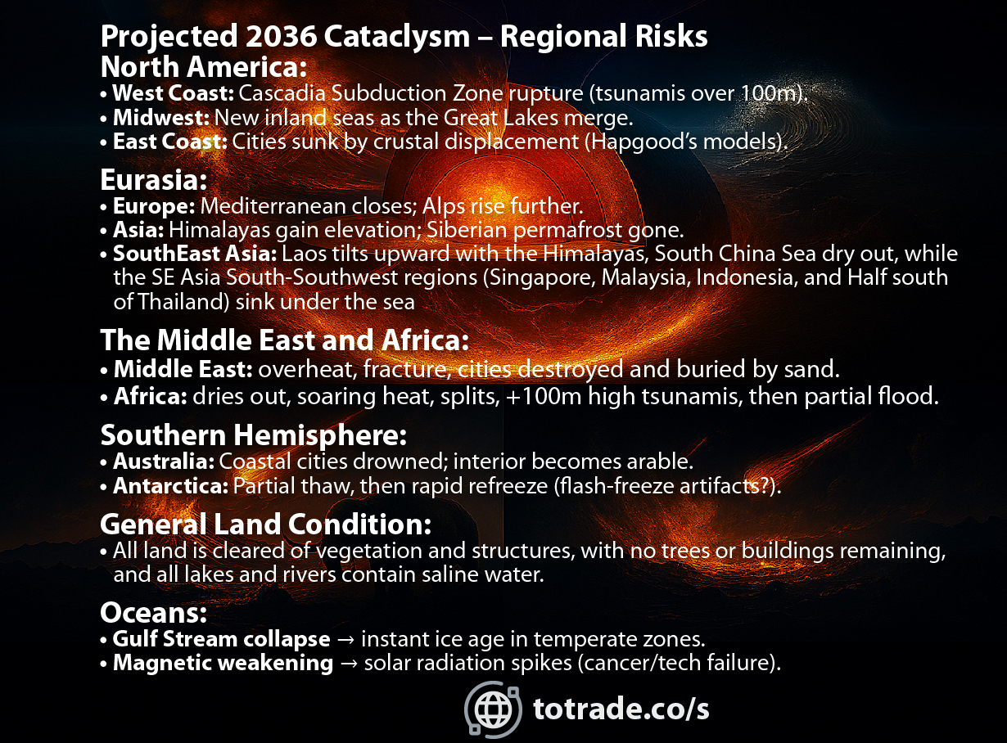
GCRs Triggered Projected Next Cataclysm
Notes:
Global Risk Assessment & Feasibility Studies
Beyond CO₂: Galactic Cosmic Rays and Cataclysms
• Recent extreme rainfall anomalies (bit.ly/ttfloods) signal deeper drivers beyond CO₂.
• CERN’s CLOUD experiment shows GCRs influence aerosol formation and cloud seeding, altering climate systems.
• Rising Galactic Cosmic Rays (GCRs), on multi-millennial cycles, are peaking toward ~2036, linked to solar activity decline.
• Mainstream focus on CO₂ masks the real risk: GCR-driven atmospheric and geophysical instability.
Why it matters:
• GCR surge destabilizes Earth’s interior → pressure buildup → supervolcanoes, megaquakes, crust slippage.
• Consequences: continent-scale floods, infrastructure collapse, cultural and technological loss, followed by global glaciation.
Cyclic cataclysms from Earth’s crustal displacement:
Mechanism
• A semi-molten layer 60–120 miles deep acts as lubricant.
• Off-axis ice caps build centrifugal stress.
• Magnetic and electrical disruption lets the crust slip.
• Poles shift into the Torrid Zone within hours, triggering upheaval.
Effects
• Supersonic winds over 1,500 km/h shred life and structures.
• Oceans race inland as walls of water miles high.
• Quakes split continents; molten rock floods lowlands.
• Flash-freezing locks life and mud in place.
Global Reach
• Americas drowned, burned, frozen.
• Europe and Asia devastated by sea, wind, quakes.
• Africa partly spared, split in half, and shaken.
• Antarctica and Greenland shift to equator; melting raises seas 150+ m.
• Survivors hide in mountains; civilization erased.
Parallels
• Myths of Noah, Vishnu, Osiris, Utnapishtim reflect earlier resets.
• Cuvier (1812) noted sudden global catastrophes.
• Later scholars tied legends, fossils, geology to recurring events.
Evidence
• Alaska, Siberia, North America bone beds show sudden freezing.
• Grand Canyon and Badlands strata record repeated floods.
• Ice cap growth drives instability.
Pattern
• Cycle repeats every few thousand years.
• Last five mapped over 35,000+ years.
• Next shift near 2036, tied to solar-cosmic change.
Outcome
• Oceans lay new mud layers.
• ASEAN and Australia emerge temperate refuges.
• Civilization resets to Stone Age.
This synthesis of geology, myth, and cataclysmology shows civilization ends in cycles of crustal displacement.

Slide 26
GCRs → Galaxies
Null Zone: totrade.co/gn
NASA: totrade.co/ns1
GCRs → Solar Activity
SILSO, Sunspots: totrade.co/sm
GCRs → Lightning:
NASA Earthdata: totrade.co/gcr1
Frontiers in Physics: totrade.co/gcr2
Climate Cosmos: totrade.co/ln1
The Weather Network: totrade.co/gcr3
Yale Environment 360: totrade.co/gcr4
GCRs → Cloud Formation:
CERN CLOUD: totrade.co/gc
SUN → Lightning:
Japan Universities: totrade.co/ln5
CIA Classified → Cataclysm:
Sanitized Video: totrade.co/cia1
Sanitized Doc: totrade.co/cia3
Unclassified → Cataclysm:
Full History:
totrade.co/ct | totrade.co/h
Earth Temperature & CO₂ Graph:
totrade.co/e
References
Notes:
All files are online and regularly updated
This Documentation
Climate Realism: totrade.co/cr
Supplements
Website: totrade.co

Slide 27

Natural Archives→ Earth History
[1] Columbia University: Dinosaurs survived when CO2 was extremely high, why can't humans: totrade.co/co2a
[2] PHYS: Dinosaurs survived CO2 extremely high: totrade.co/co2b
[3] Oxygen and CO2 level during Mesozoic Jurassic-Triassic Cretaceous: totrade.co/co2c
[4] Middle Miocene disruption: totrade.co/co2d
[5] Middle Miocene Climate Optimum: totrade.co/co2e
[6] What Pliocene Epoch Teach us about future warming Earth: totrade.co/co2f
[7] From The Roman Empire: Warm during the Rise of Roman Empire: totrade.co/co2g
References
Notes:
All files are online and regularly updated
This Documentation
Climate Realism: totrade.co/cr
Supplements
Website: totrade.co

Slide 28
Feasibility Study & Business Plan
🔗 SCIENCE: GCRs, Lightning, Fruiting: totrade.co/g
📜 HISTORY: Earth: totrade.co/e | Cataclysm: totrade.co/h
💡 SOLUTION
#UGDMN: totrade.co/s
Products: totrade.co/p
Multilateral Partnership: totrade.co/m
✅ Call to Action: totrade.co/ca
📄 PDF: totrade.co/biz | totrade.co/pdf
Presentation
Climate Realism: totrade.co/cr (This file)
Business Plan: totrade.co/bp
Documentation
Notes:
All files are online and regularly updated
Feasibility Study & Business Plan
🔗 SCIENCE: GCRs, Lightning, Fruiting: totrade.co/g
📜 HISTORY: Earth: totrade.co/e | Cataclysm: totrade.co/h
💡 SOLUTION
#UGDMN: totrade.co/s
Products: totrade.co/p
Multilateral Partnership: totrade.co/m
✅ Call to Action: totrade.co/ca
📄 PDF: totrade.co/biz | totrade.co/pdf
Presentation
Climate Realism: totrade.co/cr (This file)
Business Plan: totrade.co/bp

