Slide 1
Humanity’s Last Hope
GREENDIGITALEVOLUTION
Scan for Latest Update
totrade.co/solution
totrade.co team
team@totrade.co
Team: Totrade.co/chart
V06
Notes:
Humanity’s Last Hope, GREENDIGITALEVOLUTION
Within these pages lies a blueprint for change—a collective vision that unites the brightest minds in pursuit of a sustainable, equitable future. Join us as we embark on this pivotal journey to transform the world’s problems into opportunities for growth and harmony with nature.

Slide 2
Table of Contents [Toc]
ASEAN Smart Farming, fresh and alive
Large-Scale farming supplying 28
Intermediary scale farming, supplying 30
Farming along the rivers and on the reservoirs 31
City Vertical Farming 33
Yearly Exposition, supplied by the above 35
Reducing Global Risks
New Clean Transport System, The HydroloopTM 38
Heat/Coldness Exchange System 42
Space Exploration supply 45
Solution for MENA and the rest 46
Logistics for desert greening and reforestation 47
Enhanced multilateral cooperation 48
totrade.co prototype 49
Recycling system 50
Hydrogen (H2) affordability 52
Documents/Links 53
Workshops, MS365 datacentres
totrade.co for Enterprises, 54
Government, financiers, investors…
Cataclysm: the trigger 3
Brink of Global climate Crisis 6
Available Options 7
Solutions
Not using Water, effects and causes 8
Using water to prevent cataclysm 9
GDP & Water Usage
Water usage for 1kg product 12
Water usage for 1 product 13
Water usage by the US, EU and Laos
US water consumption 14
Europe water consumption 15
Laos water consumption 16
LAO PDR GDP 17
How to increase Global GDP exponentially 18
ASEAN Mainland, Humanity’s Last Hope 19
Global Tropical Cyclones 21
ASEAN Mainland, “Humanity’s Last Hope” 23
Lao rivers development as model 26
Notes:
Table of Contents:
- Page number are clickable
- On each page, there is the clickable button to return to this Table of Content

Slide 3
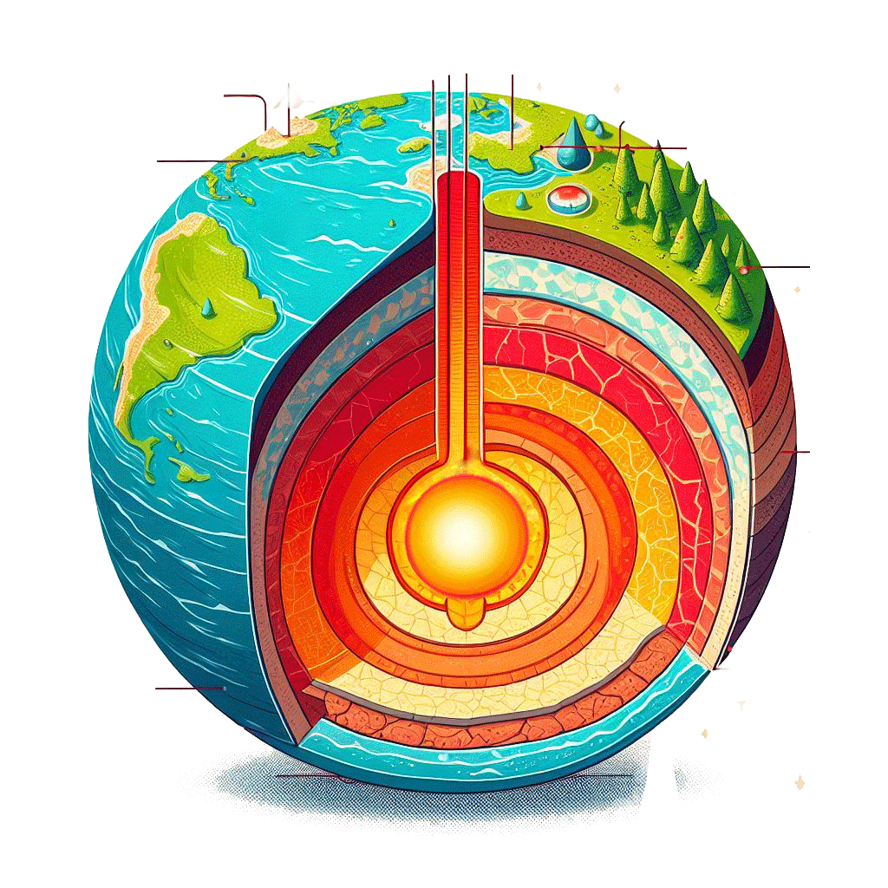
Increasing Core temperature
Increasing
External Forces
Tectonic plates Movement : uplift and displacement.
increase
volcanic eruptions
Saturated Jet stream
high dew points, more floods, stronger wind, tornadoes, cyclones…
More Frost points: snowstorm, Hailstorms
Land & Air temperature increase
Crust
Groundwater (PWC)
Increased crust movements
More earthquakes, tsunamis
These are Climate Collapse
Oceans: life dying, water expands, increased evaporation, sea storms, melted glaciers
Warmer mantles
Weak magnetic fields
heated
Core
Groundwater (PWC)
Temperature & pressure increase, PWC expand
Magma temp. & pressure increase
Groundwater (PWC) temp & pressure increase
Salty and freshwater to merge & submerging large landmasses with saltier water
Warmer Oceans
Solution: collaborate for
Humanity’s Last Hope
Buildup to The Next Cataclysm
ToC
Notes:
Look at the cross-section of the Earth. The first layer is the Crust to the Lithosphere, just a thin layer visible if to scale, rigid, rocky outer layer of the Earth, consisting of the crust and below it, the solid outermost layer of the Upper Mantle with huge stock of Primary Water Cycle. It extends to a depth of about 60 miles (100 km).
The important one is the thin molten layer, the asthenosphere, the zone of Earth’s Mantle lying beneath the lithosphere and believed to be much hotter and more fluid than the lithosphere. The asthenosphere extends from about 100 km (60 miles) to about 700 km (450 miles) below Earth’s surface.
The thick, deep molten layer, starting 1800 mile down at the bottom of the Mantle, and extending 1300 miles deeper, is the Outer Core.
Both molten layers are liquid; however, the inner magnetic and electric structure of the earth makes these layers act as if they are near solid, or plastic to hold the shell of the Earth in place as long as the magnetic and electrical structure maintains its axis in a normal manner.
The growing ice caps-Antarctica and Greenland- are not centred on the Earth's axis; and, because they rotate around the poles, are trying to swing down to the equator. The only way they could do it would be to pull the whole 60-mile thick shell around with them. As long as the shallow molten layers stays plastic, the shell won't shift; but once every few thousand years, the magnetic and electrical orderliness inside the Earth is disrupted, which it was all the time anyway. It then serves as a lubricant for the ice caps to pull the shell of the Earth around the inside.
Saturated Jet stream
High Dew point temperature reached. The dew point is the temperature at which a given body of air must be cooled to become saturated with water vapor. When the air is cooled below the dew point, its moisture capacity decreases, and airborne water vapor condenses to form liquid water, commonly known as dew. This phenomenon occurs when the air comes into contact with a colder surface, resulting in dew formation on that surface¹.
The dew point depends on the air’s humidity. The more moisture the air contains, the higher its dew point. If the temperature falls below the freezing point of water, the dew point is referred to as the frost point, as frost forms through deposition rather than condensation. In liquids, the analogous concept to the dew point is the cloud point¹.
For most people, a comfortable dew-point temperature is around 60 degrees Fahrenheit (16 degrees Celsius) or lower. When the dew point is higher, such as around 70°F (21°C), it can feel more humid and less comfortable².
In technical terms, the dew point represents the temperature at which water vapor in a sample of air at constant barometric pressure condenses into liquid water at the same rate at which it evaporates. When the temperature is below the dew point, condensation occurs more rapidly than evaporation, resulting in the formation of liquid water (dew) or frost¹.
Knowing the dew point has several practical applications:
Weather Forecasting: Meteorologists use the dew point to predict weather patterns¹. It helps in forecasting the likelihood of precipitation, fog, and dew².
Comfort Index: The dew point gives us a sense of how comfortable or uncomfortable the warm air will feel². When the dew point is below 60°F (16°C), most people find the air comfortable. Between 60°F and 70°F (16°C and 21°C), it starts feeling more humid. Above 70°F (21°C), it feels uncomfortable or oppressive¹.
Piloting: Pilots use the dew point to predict the height of the cloud base and the risk of fog and carburetor icing¹.
HVAC Systems: In heating, ventilation, and air conditioning (HVAC) systems, knowing the dew point helps control indoor humidity levels. This provides comfortable environments and prevents condensation, which can damage the infrastructure¹.
Industrial Processes: Various industrial processes (e.g., painting, coating, or drying) are sensitive to humidity and dew point to ensure quality and efficiency¹.
Outdoor Activities: It can help plan outdoor activities based on humidity levels³.
Health Impact: Higher dew points can affect health, as it can make the air feel muggy and increase the risk of heat exhaustion and heat stroke¹.
Understanding the science behind the dew point can help us make better decisions for ourselves and for the planet².
Remember that the dew point varies based on the amount of water vapor present in the air. Dry air with fewer water molecules will have a lower dew point, while humid air with more water molecules will have a higher dew point¹.
Uplift of Earth’s crust due to

Slide 4
Mariana Trench *
Suboceanic super volcanic eruption
No action: 99.9% of lives could vanish
Preparedness: 5% could survive
Prevention: most could survive & swift progress to Type I Civilization
* Where, Why?
Any thin Earth Crust
Huge energy transfer
* When?
Unpredictable, but
Sooner than we think
The Next Cataclysm
Notes:
In the Mariana Trench, or anywhere else under the sea can cause a super volcanic eruption. The bigger the interval, the stronger the energy transfer for a potential suboceanic super volcanic eruption. See: totrade.co/cataclysm
If no action is taken, it could result in the disappearance of 99.9% of the population.
However, with adequate preparedness, there’s a chance for 5% of the population to survive.
The ultimate prevention strategy would be to advance to a Type I Civilization.

Slide 5
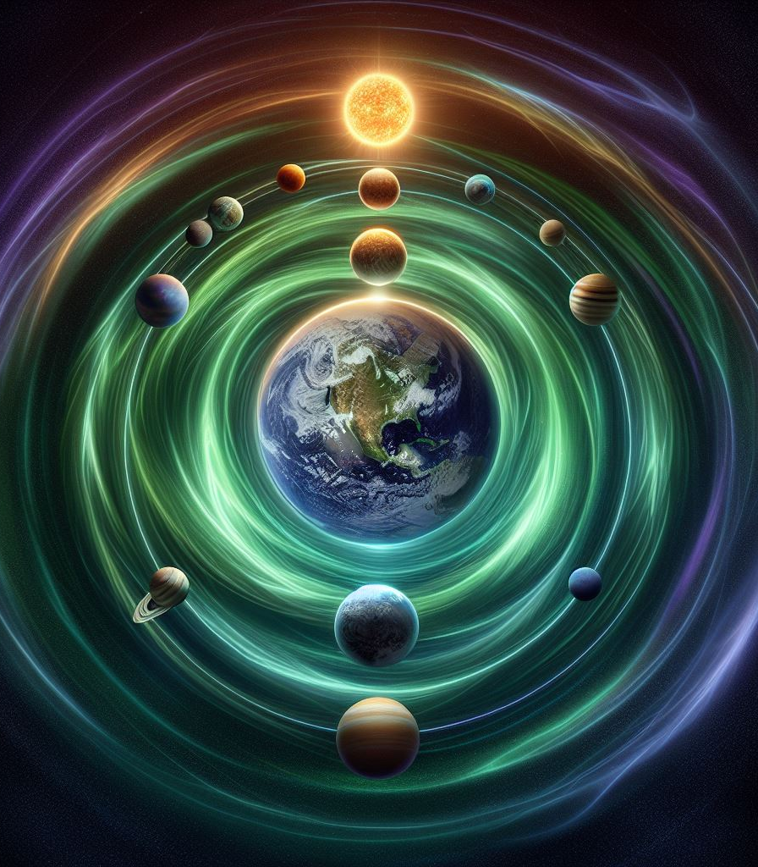
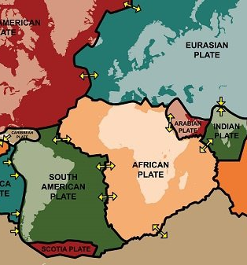
Tectonic plates pivot and displacement
Extreme Climate Events and Their Impact on the Water Cycles:
From floods, snowstorms, extreme heat, fires, hailstorms, windstorms, tornadoes, earthquakes, volcanic eruptions, tsunami, to cataclysm mixing freshwater and seawater.
By 1st Law Thermodynamics
Conservation of Energy
Brink of Global climate Crisis
ToC
Notes:
วิกฤตสภาพภูมิอากาศโลก ວິກິດການ ສະພາບອາກາດທົ່ວໂລກ
Caused by external force of Planetary alignment: https://vt.tiktok.com/ZSFqYbtfC/
RE: TOTRADE, first with Thailand, through Carbon-Negative global initiatives for a swift progress towards a Type I Civilization.
Global Crisis: The Earth is experiencing Climate collapse characterized by more extreme weather including intense floods, snowstorms, extreme heat, fires, hailstorms, windstorms, tornadoes, earthquakes, volcanic eruptions, and tsunami... impacting numerous regions with the potential for global effects.
Links with Facts:
Cataclysm: https://vt.tiktok.com/ZSFxJCAjv/
Intense floods: https://vt.tiktok.com/ZSFqsSXhW/
Snowstorms: https://vt.tiktok.com/ZSFqG64Ds/
Extreme heat, fires: https://vt.tiktok.com/ZSFqGx3d7/
Hailstorms: https://vt.tiktok.com/ZSFqGMoVx/
Windstorms: https://vt.tiktok.com/ZSFqGYE5Y/
Tornadoes: https://vt.tiktok.com/ZSFqGJv8t/
Earthquakes: https://vt.tiktok.com/ZSFqs1nTm/
Volcanic eruptions: https://vt.tiktok.com/ZSFqp7d2m/
Tsunami: https://vt.tiktok.com/ZSFqGjqjq/
Sources: Dr. A. Egon Cholakian:
Earth Save Science Collaborative: https://earthsavesciencecollaborative.com/ LinkedIn (bio): https://www.linkedin.com/in/a-egon-cholakian-11256b4
John Ahn PhD, MBA:
Youtube: https://www.youtube.com/@creative_society
TikTok: https://www.tiktok.com/@creativesociety369?_t=8kc1FxTdBl2&_r=1
and other scientists,
The billionaires,
NASA
web: https://www.nasa.gov/missions/icon/nasa-researchers-track-slowly-splitting-dent-in-earths-magnetic-field/
YouTube: https://www.youtube.com/watch?v=QLQk8lGcHsc
pole shift: https://www.ncei.noaa.gov/maps/historical_declination/
The CIA
Book: https://www.tiktok.com/@c0nspiracycrusader/video/7338989028039085354
who know how The Earth will end: https://vt.tiktok.com/ZSFxJCAjv/
Time: within the next 10 years: https://vt.tiktok.com/ZSFxJCAjv/
Well-renowned Scientists, such as Dr. A. Egon Cholakian (LinkedIn, Youtube), John Ahn PhD MBA and others, billionaires, NASA, (web, YouTube, pole shift) and The CIA know how The Earth will end (within the next 10 years) if we don’t implement the following solution.
Solution: ASEAN Mainland (with partners, collaborators, investors…) as a beacon of hope for addressing these critical global challenges: latest updates: https://bit.ly/LAisSolution.
The North Hemisphere cooling effect has slowly begun to exit 12,000 years cycle after the increase in extreme weather events in the Tropics:
Most of North European farming will start to get growing difficulties due to severe climatic shifts and will slowly go offline and uninhabitable in 300 years. The same for North America, Russian Federation, Mongolia, and North China.
The Trigger of Real Mass-Extinction Cataclysm
This cosmic rays from exploding stars that increase solar activity is rapidly heating our magnetosphere allowing more cosmic rays continuous penetration deep into Earth interior. The long-term consequence is the disruption of the magnetic and electrical orderliness inside the Earth causing mass-extinction event.
Correlation of the data between the "earth" science in stratigraphy, archaeology, anthropology, palaeontology, radiology, oceanography, seismology, glaciology, and many other fields gave the answer: there is enough data in each science to indicate that these cataclysms happen.
There is now enough to prove the concept; between-science correlation showed indeed that the concept was true. Not only it did verify that the events have happened, but disclosed when the last five cataclysms were, and what positions the shell of the Earth has been in for the last 35,000 years.
So, after years of research, beginning in 1949, Cuvier's challenge had an answer: Yes, indeed the cataclysms do happen. And the last one, 6,500 years ago!
Cataclysm Cycles Crisis
In 1/4 to 1/2 a day, the poles move almost to the equator, and all hell lets loose. The atmosphere and oceans don't shift with the shell- they just keep on rotating West to East- and at the equator that speed is 1000 miles per hour. It has to be, normally, to make one rotation per day. So, while the shell shifts with the poles going toward the equator, the winds and oceans go eastward, blowing across the face of the Earth with supersonic speeds, inundating continents with water miles deep.
It's nature's ordinary structure, which disrupts the Earth's inner electrical and magnetic structure whenever it happens.
We once thought that only severe Sunspots could be the only cause, because they do disrupt the Earth's inner electrical and magnetic structure; but we may be wrong. It's all the planets, the "moon", stars, and galaxies forces combined.
We found out that "nature's power plant" is a motor-generator system exiting in many different magnitudes. It's a basic structure of the universe. The energy structure of an atom is identical to a rotating planet; to a blue-white star; to a galaxy; to a supergalaxy; to all levels of supergalaxies including a universe and even more.
As a neutron which has escaped from its parent atom's neutral zone will separate into particles, a star-through a sunspot- gives off neutral matter which explodes as it becomes energized; so a galaxy gives birth to an exploding star when a "dead" star escapes from its neutral zone in the centre; and as a "dead" galaxy explodes when it escapes from the central neutral zone of its parent supergalaxy. A planet, therefore, must act the same at its energy level.
So, apparently once every few thousand years, neutral matter escapes from the 860-miles-radius inner core into the 1300-mile thick molten outer core, and there is a literal atomic explosion inside the Earth. The explosion in the high energy layer of the outer core disrupts completely the electrical and magnetic structure in both the molten outer core and the outer 60-mile thick molten layer. Finally the ice caps are allowed to pull the shell of the earth around the interior, which the shallow molten layer lubricating the shift all the way.
You can see, then, that ice ages are not a matter of advancing and retreating ice; it's simply that different areas of the Earth are in polar regions at different times, for different durations of time, with the changes between positions taking place in a fraction of a day.
The story around the world gives a silent testimony:
The Beresovka mammoth, frozen in mud, with buttercups in his mouth;
The age of the gorges below Niagara Falls and St. Anthony's Fall, both about 6,500 years;
The sudden end of the Laurentian Basin ice cap in Canada, about 11,500 years ago;
The uninterrupted years of evolution on the Galapagos, over 11,000 ya;
The geological datings in the Murrumbidgee River Basin system in Australia, showing the end of an ice age cap there about 11,500 years ago;
The age of fossil bones taken from the Wilshire Boulevard tar pits, over 11,000 years;
The sudden end of all work in the prehistoric city of Tiahuanaco, Peru, 9,550 BC, or 11,500 years ago;
Leonard Woolley's great work in the Holy Land, dating Noah's flood at about 6,000 years ago;
The end of the Wisconsin ice cap, about 29,000 years ago;
The sudden 200-foot rise of the oceans all over the world 6,000 to 7,000 years ago;
The sudden rise of the St. Laurence River bed 6,500 years ago;
The changing levels of the shoreline in the Hudson Bay;
The granite blocks from the Alps, sitting on the eastern slopes of the Jura mountains, at 4,000 feet above sea level;
The Pejark Marsh in Australia, which shows a quick extinction of a civilization 11,500 years ago;
The Piri Reis map, showing the North Pole in the Sudan Basin;
The Egyptian water-clock, showing agreement with the Piri Reis map;
Granite on top of the mountains around Death Valley in California;
The great stratifications of the Grand Canyon, Painted Desert, and Badlands, each layer homogenous, showing it to be deposited there suddenly by fantastic amounts of water;
The computable age of the Antarctic and Greenland ice caps, about 6,500 years;
The present growth of the Antarctic ice cap, about 293 cubic miles per year; (except West Antarctica)
The legends from primitive man in Tierra del Fuego at the southern tip of South America of the day the Sun set in the wrong direction;
The legends from primitive man in Peru of the day the Sun stood still;
The legends from Malayan and Sumatran aborigines of the long night;
The varve (earth strata) counts in Wrenshall, Minnesota and Hackensack, New Jersey, which agree;
The prevalence of jade in the Orient, which is material heaved up from the mantle, near equatorial pivot points during a tumble;
The fantastic evidence of a burgeoning tropical population in Arctic Siberia and Alaska, completely wiped out in a fraction of a day;
The similarity of languages the world over, from Polynesian to Greek, to Egyptian, to Mayan, to Eskimo, to Yakut, to Oriental, and more;
The correlation of ice ages and quick extinctions the world over;
The survival of primitive life at equatorial pivot points-the last two being the Malay Peninsula and the Galapagos, now rife with lizards;
The existence of a coral reef on the floor of the Arctic Ocean dating 6,500ya;
And more, and more, and more, and more, give us a historical picture of the Earth's shell during the past 35,000 years.
The overwhelming evidence, when put in order, gives a dramatic picture of which areas have been at the North Pole, when they moved to the pole, and how long they were there:
Wisconsin: at North pole: 35,000ya, duration: 6,000y to be replaced by:
Caspian Sea: at North pole: 29,000ya, duration: 10,500y to be replaced by:
Hudson Bay: at North pole: 18,500ya, duration: 7,000y to be replaced by:
Sudan Basin: at North pole: 11,500ya, duration: 5,000y to be replaced by:
Arctic Ocean including Greenland and Svalbard: moved to North pole 6,500ya causing Noah's Flood, duration: still there.
The Bigger Global Risks
Now Causing:
Climate Crisis around the world
Stronger Earthquakes
Food production zone shift
Soon:
Big Super Volcanic Eruptions
Biblical flood, mega tsunami
6th Extinction event
Apparently, according to the CIA highly sanitized declassified book, “The Adam And Eve Story – The History of Cataclysms, once every few thousand years: between 6,500, 12,000, 24,000, and 35,000 years, neutral matter escapes from the 860-miles-radius inner core into the 1300-mile thick molten outer core, and there is a literal atomic explosion inside the Earth. The explosion in the high energy layer of the outer core disrupts completely the electrical and magnetic structure in both the molten outer core and the outer 60-mile-thick molten layer. Finally, the ice caps are allowed to pull the shell of the earth around the interior, which the shallow molten layer lubricating the shift all the way.
The Ice Ages are not a matter of advancing and retreating ice; it's simply that different areas of the Earth are in polar regions at different times, for different durations of time, with the changes between positions taking place in a fraction of a day.
We once thought that only severe Sunspots could be the only cause, because they do disrupt the Earth's inner electrical and magnetic structure; but we may be wrong. It's all the planets, the "moon", stars, and galaxies forces combined.
All right. So, they happen; what is it that happens each time? The challenge was really two-folds: find the process - what happens in a cataclysm; and the trigger - what causes a cataclysm to start. Apollo programs were initiated to find out. JFK speech "to do the other thing" means to find out what caused previous cataclysms and especially how to avoid it.

Slide 6
By the Year
2036*
*estimate
Cataclysm = abrupt event
Cyclical
Climate
Collapse
From the book:
History of Cataclysm
In less than one day, the Earth undergoes tectonic plate displacement occurring at intervals between ±5,000 and ±35,000 years. The larger the interval, the stronger the destructive forces. We are at the end of a ±12,000 years buildup. This Cataclysmic event could end most human life.
Buildup Characteristics:
Intense flooding
Earthquakes
Extreme heat and wildfire
Strong winds and tornadoes
Hailstorms and Snowstorms
Volcanic Eruptions
Concluding with MegaTsunami…
Lao
Notes:
As we approach intervals spanning from ±5,000 to ±35,000 years(1), the Earth experiences a cyclical buildup of Climate Collapse, culminating in a Cataclysm that extinguishes most life in less than a day. Let’s prepare and prevent it.
ທຸກໆ ±5,000 ຫາ ±35,000 ປີ ໂລກປະເຊີນຫນ້າກັບການລົ້ມລະລາຍຂອງດິນຟ້າອາກາດ ແບບທໍາລາຍຊີວິດສ່ວນໃຫຍ່ ຮູ້ກັນໃນຊື່: ໂລກພັງທະລາຍ ພາຍໃນຫນຶ່ງມື້.
⁽¹⁾ The Intervals: (5 000, 6 000, 6 500, 7 000, 10 500, 11 500, 18 500, 29 000, 35 000) By the overwhelming evidences, when put in order, gives a dramatic picture of which areas have been at the North Pole, when they moved to the pole, and how long they were there:
Wisconsin: at North pole: 35,000ya, duration: 6,000y to be replaced by:
Caspian Sea: at North pole: 29,000ya, duration: 10,500y to be replaced by:
Hudson Bay: at North pole: 18,500ya, duration: 7,000y to be replaced by:
Sudan Basin: at North pole: 11,500ya, duration: 5,000y to be replaced by:
Arctic Ocean including Greenland and Svalbard: moved to North pole 6,500ya causing Noah's Flood, duration: still there.
The average of a set of numbers is calculated by adding all the numbers together and then dividing by the count of the numbers.
So, for the numbers you provided: 5 000, 6 000, 6 500, 7 000, 10 500, 11 500, 18 500, 29 000, 35 000, we can calculate the average as follows:
Average=95000+6000+6500+7000+10500+11500+18500+29000+35000​
Let’s calculate that:
\text{Average} = \frac{129 000}{9} = 14 333.33 Average=9129000​=14333.33
So, the average of the intervals above is approximately 14 333.33.
The overwhelming evidence, when put in order, gives a dramatic picture of which areas have been at the North Pole, when they moved to the pole, and how long they were there:
Wisconsin: at North pole: 35,000ya, duration: 6,000y to be replaced by:
Caspian Sea: at North pole: 29,000ya, duration: 10,500y to be replaced by:
Hudson Bay: at North pole: 18,500ya, duration: 7,000y to be replaced by:
Sudan Basin: at North pole: 11,500ya, duration: 5,000y to be replaced by:
Arctic Ocean including Greenland and Svalbard (Tropics): moved to North pole 6,500ya causing Noah's Flood, duration: still there.
In summary, as we examine intervals ranging from ±5,000 to ±35,000 years, we observe a cyclical pattern of climate collapse on Earth. These cycles reached its peak with a cataclysmic event that eradicated most life in less than a day. As the interval increased, there was a corresponding increase in the buildup of potential energy, leading to a more powerful, widespread, and abrupt energy transfers.

Slide 7
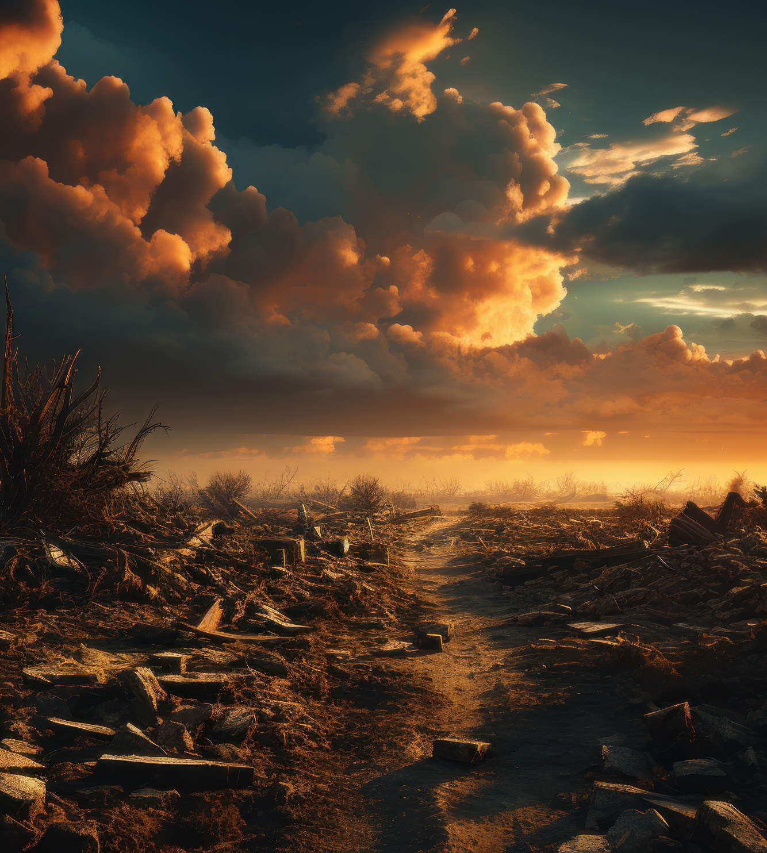
Cataclysm
Nothing survives
ໂລກພັງທະລາຍ
ບໍ່ມີສິ່ງໃດລອດ
3 available options
ມີ 3 ທາງເລືອກ
Wait for 99.9% cataclysm fate
ລໍຖ້າໂຊກຮ້າຍດິນຟ້າທໍາລາຍຕາຍ 99.9%
Cataclysm Preparedness
ກະກຽມຮັບໄພພິບັດ ລອດ 5%
ລັກສະນະ ຈະເກີດ ໂລກພັງທະລາຍ
ນໍ້າຖ້ວມ ຫນັກຂຶ້ນ
ແຜ່ນດິນໄຫວຫຼາຍຂຶ້ນ
ອາກາດຮ້ອນ, ໄຟໄຫມ້ຫຼາຍຂຶ້ນ
ລົມພາຍຸ, ຕອກນາໂດ້ ແຮງຂຶ້ນ
ຫມາກເຫັບ ພາຍຸຫິມະ ຫຼາຍຂຶ້ນ
ພູເຂົາໄຟລະເບີດແຮງຂຶ້ນ
ຕອນທ້າຍ ສຸນາມິ ຟອງຍັກຂຶ້ນ…
Prevent to survive & Prosper
ປ້ອງກັນ ລອດໄພ ແລະ ພັດທະນາ:
TYPE I CIVILISATION
A Beacon of Abundance and Prosperity
Eng
Cyclical
Climate
Collapse
ທຸກໆ⁽¹⁾ ±5,000 ຫາ ±35,000 ປີ ໂລກປະເຊີນຫນ້າກັບການລົ້ມລະລາຍຂອງດິນຟ້າອາກາດ ແບບທໍາລາຍຊີວິດສ່ວນໃຫຍ່ ຮູ້ກັນໃນຊື່: ໂລກພັງທະລາຍ ພາຍໃນຫນຶ່ງມື້. ຈະແລຶອກ u,v ຫຼື w
V06
Notes:
ທຸກໆ ±5,000 ຫາ ±35,000 ປີ ໂລກປະເຊີນຫນ້າກັບການລົ້ມລະລາຍຂອງດິນຟ້າອາກາດ ແບບທໍາລາຍຊີວິດສ່ວນໃຫຍ່ ຮູ້ກັນໃນຊື່: ໂລກພັງທະລາຍ ພາຍໃນຫນຶ່ງມື້.ຈະແລຶອກ 1,2 ຫຼື 3 As we approach intervals spanning from ±5,000 to ±35,000 years, the Earth experiences a cyclical buildup of Climate Collapse, culminating in a Cataclysm that extinguishes most life in less than a day. Let’s prepare and prevent it.
⁽¹⁾ The Intervals: (5 000, 6 000, 6 500, 7 000, 10 500, 11 500, 18 500, 29 000, 35 000) By the overwhelming evidences, when put in order, gives a dramatic picture of which areas have been at the North Pole, when they moved to the pole, and how long they were there:
Wisconsin: at North pole: 35,000ya, duration: 6,000y to be replaced by:
Caspian Sea: at North pole: 29,000ya, duration: 10,500y to be replaced by:
Hudson Bay: at North pole: 18,500ya, duration: 7,000y to be replaced by:
Sudan Basin: at North pole: 11,500ya, duration: 5,000y to be replaced by:
Arctic Ocean including Greenland and Svalbard: moved to North pole 6,500ya causing Noah's Flood, duration: still there.
The average of a set of numbers is calculated by adding all the numbers together and then dividing by the count of the numbers.
So, for the numbers you provided: 5 000, 6 000, 6 500, 7 000, 10 500, 11 500, 18 500, 29 000, 35 000, we can calculate the average as follows:
Average=95000+6000+6500+7000+10500+11500+18500+29000+35000​
Let’s calculate that:
Average of 9129000/9​=14333.33
So, the average of the intervals above is approximately 14 333.33.
The overwhelming evidence, when put in order, gives a dramatic picture of which areas have been at the North Pole, when they moved to the pole, and how long they were there:
Wisconsin: at North pole: 35,000ya, duration: 6,000y to be replaced by:
Caspian Sea: at North pole: 29,000ya, duration: 10,500y to be replaced by:
Hudson Bay: at North pole: 18,500ya, duration: 7,000y to be replaced by:
Sudan Basin: at North pole: 11,500ya, duration: 5,000y to be replaced by:
Arctic Ocean including Greenland and Svalbard (with previous position in the tropics): moved to North pole 6,500ya causing Noah's Flood, duration: still there.
In summary, as we examine intervals ranging from ±5,000 to ±35,000 years, we observe a cyclical pattern of climate collapse on Earth. These cycles reached its peak with a cataclysmic event that eradicated most life in less than a day. As the interval increased, there was a corresponding increase in the buildup of potential energy, leading to a more powerful, widespread, and abrupt energy transfers.

Slide 8
The Trigger
Pressure increases with temperature: Earth crust uplift & displacement.
PWC: up to 5 times more water than SWC
Use Secondary Water Cycle (SWC)
Top up with Primary Water Cycle (PWC), ±5 x more than SWC
Spread water across Earth Crust, lakes, trees, & atmosphere
If not sufficient, export to lower space, spaceships, and beyond
Solutions to prevent cataclysm
ToC
Notes:
Harnessing both Primary and Secondary Water Cycles:
What we just explained is the exploration of The Secondary Water Cycle. Primary Water Cycle
Primary Hydrologic Cycle is created underneath the Earth’s crust. Under tremendous pressure from Earth's internal heat, hydrogen and oxygen are fusing together, became hot steam and forced upward through rock fissures (weakest areas of Earth's crust) becoming liquid as it cools. Primary Water is forced upward.
Secondary Water Cycle
The secondary Hydrologic Cycle is driven by Solar and cosmic Energy and is subject to gravitational energy and flows downward.
The Primary Water Cycle
Holds a volume of water that is up to five times greater than that of the Secondary Water Cycle. When pressure is applied, this Primary Water moves up e.g in Laos forming Lake Anouvong while in MENA, it’s the finite hydrocarbon that is moving up. That is until the introduction of geothermal energy by The Hydroloop System, which can significantly multiply the transfer of water and energy for maximum efficiency and capacity hence “Humanity’s Last Hope”.
Toward Type One Civilization, 类型一文明
Through the strategic transfer of Primary Water Cycle resources (1st Law of Thermodynamics) Energy Transfer, we can alleviate pressure and ensure abundant water availability on a global scale and beyond. The region with lots of desert sand, to plant big trees, soil with 50/50 sand and clay mix are needed. Therefore, desert sand can be relocated across the world to mix with soil. Another application is using a solar-powered 3D printer that sinters sand into solid structures¹ to build the Tower of Babel of 120km high to access to lower orbit. The dual funnel design improves cross-ventilation and collect water condensation from the Typhoons and Pacific evaporation to store coldness from the Mesoshere addressing the thermosphere and exosphere’s extreme heat and use sand and water (movement allowed) as scaffoldings protected by layers of hempcrete, attached by light cables.
This will allow to export large amounts of materials, water, hydrogen, oxygen, helium, sand, and other materials for space exploration.
This critical step contributes to our journey toward achieving a Type I civilization, where our capacity to harness and manage planetary resources propels us into a new era of sustainable prosperity.

Slide 9
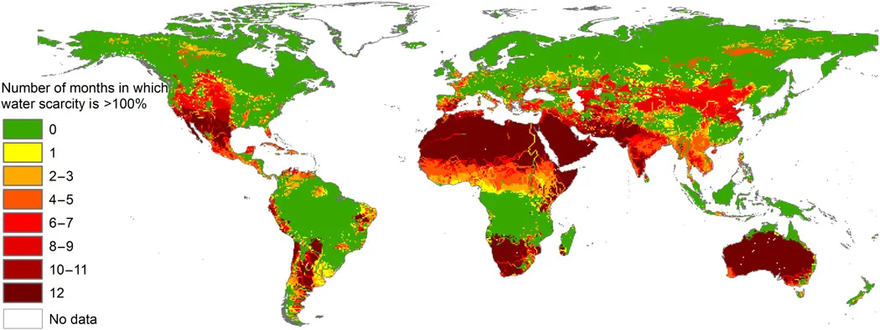
Solution: Distribute water, 24/7, 365 days/year. Store it across world landmass and air, before 2036
Cataclysm: 100% Water Crisis
Freshwater scarce regions / month
N&S Africa
SW & South Asia, East & North China, and Mongolia
South America, Australia, US West Coast
South Europe + Belgium!
Bad Freshwater & resources management
Water for cheap electricity, but lack for developments
Resource curse victim, heavily indebted to foreigners
Rampant corruption, import high-value goods…
ToC
Notes:
Even with lots of floods across many regions, flood water is not drinkable and too much water kills and destroy crops and trees.
Explain Freshwater Scarce regions.
According to the UN World Water Development Report 2023, globally, 2 billion people (26% of the population) do not have safe drinking water and 3.6 billion (46%) lack access to safely managed sanitation
I will explain what are the lines later.
Bad Freshwater & resources management
The countries classified as Poor Freshwater and resource management.
While there is a focus on producing inexpensive electricity, there is a significant lack of water for other use. The region is a victim of the resource curse, finding itself in debt to foreign entities. Corruption is rampant, and there is a high import rate for valuable goods.

Slide 10
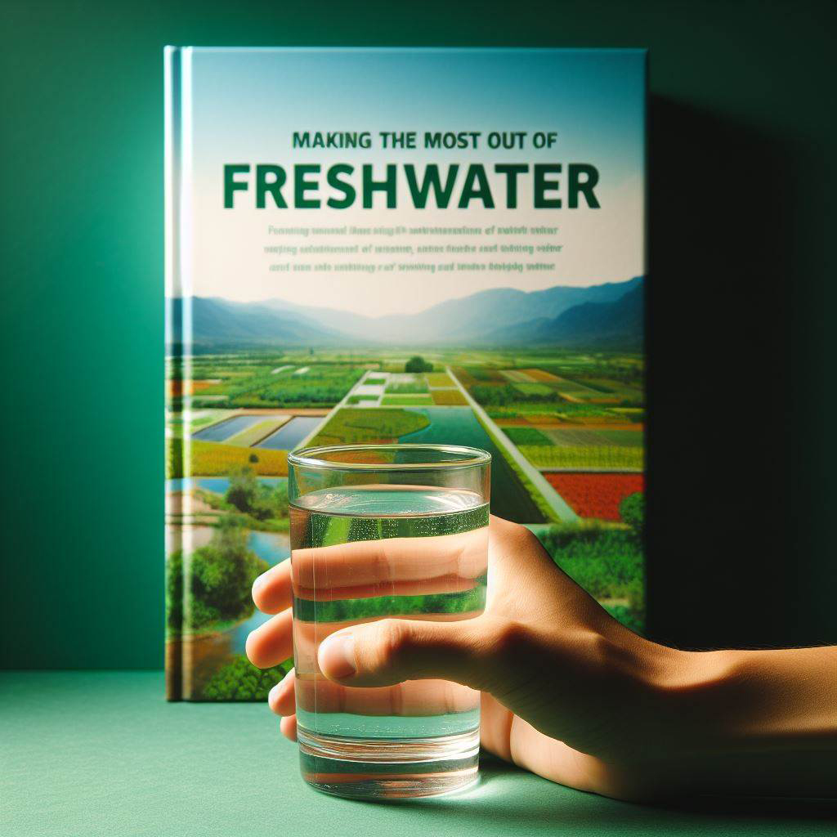
Optimizing even* Global Freshwater Distribution:
Public water supply
Irrigation
Thermo/Hydro power
Industrial use, recreation
Domestic use
Mining
Livestock, Aquaculture
H₂ & O₂ production
Transportation
Food, energy, and water security & mitigate Global Risks.
Etc…
* = constant water distribution
ToC
Notes:
Making the most out of freshwater: Freshwater is essential for life, and humans use it for various purposes. According to the U.S. Environmental Protection Agency, the order of importance of freshwater use in the United States is as follows:
Public supply: This refers to the water that is delivered to homes, businesses, and institutions for domestic, commercial, and industrial uses. Public supply accounted for about 12 percent of total freshwater withdrawals in 2015¹.
Irrigation: This refers to the water that is applied to crops and pastures to support agriculture. Irrigation accounted for about 42 percent of total freshwater withdrawals in 2015¹, and is the largest use of freshwater globally².
Thermoelectric power: This refers to the water that is used to cool power plants that generate electricity from fossil fuels, nuclear energy, or geothermal energy. Thermoelectric power accounted for about 41 percent of total freshwater withdrawals in 2015¹, but most of this water is returned to the source after use.
Industrial: This refers to the water that is used for manufacturing, processing, washing, and cooling in various industries. Industrial water use accounted for about 4 percent of total freshwater withdrawals in 2015¹.
Domestic: This refers to the water that is self-supplied by households for drinking, cooking, bathing, and other indoor and outdoor uses. Domestic water use accounted for about 1 percent of total freshwater withdrawals in 2015¹.
Mining: This refers to the water that is used for extracting minerals, ores, and fuels from the ground. Mining water use accounted for about 1 percent of total freshwater withdrawals in 2015¹.
Livestock: This refers to the water that is used for watering animals, cleaning and cooling animal facilities, and processing animal products. Livestock water use accounted for less than 1 percent of total freshwater withdrawals in 2015¹.
Aquaculture: This refers to the water that is used for raising fish and other aquatic organisms for food, recreation, or restoration. Aquaculture water use accounted for less than 1 percent of total freshwater withdrawals in 2015¹.
The order of importance of freshwater use may vary in different regions and countries, depending on the availability, demand, and management of water resources. For example, in some arid and semi-arid regions, irrigation may be the most important use of freshwater, while in some industrialized and urbanized regions, public supply and thermoelectric power may be more important. Therefore, it is important to consider the local context and the trade-offs involved in allocating freshwater among different uses. 💧

Slide 11
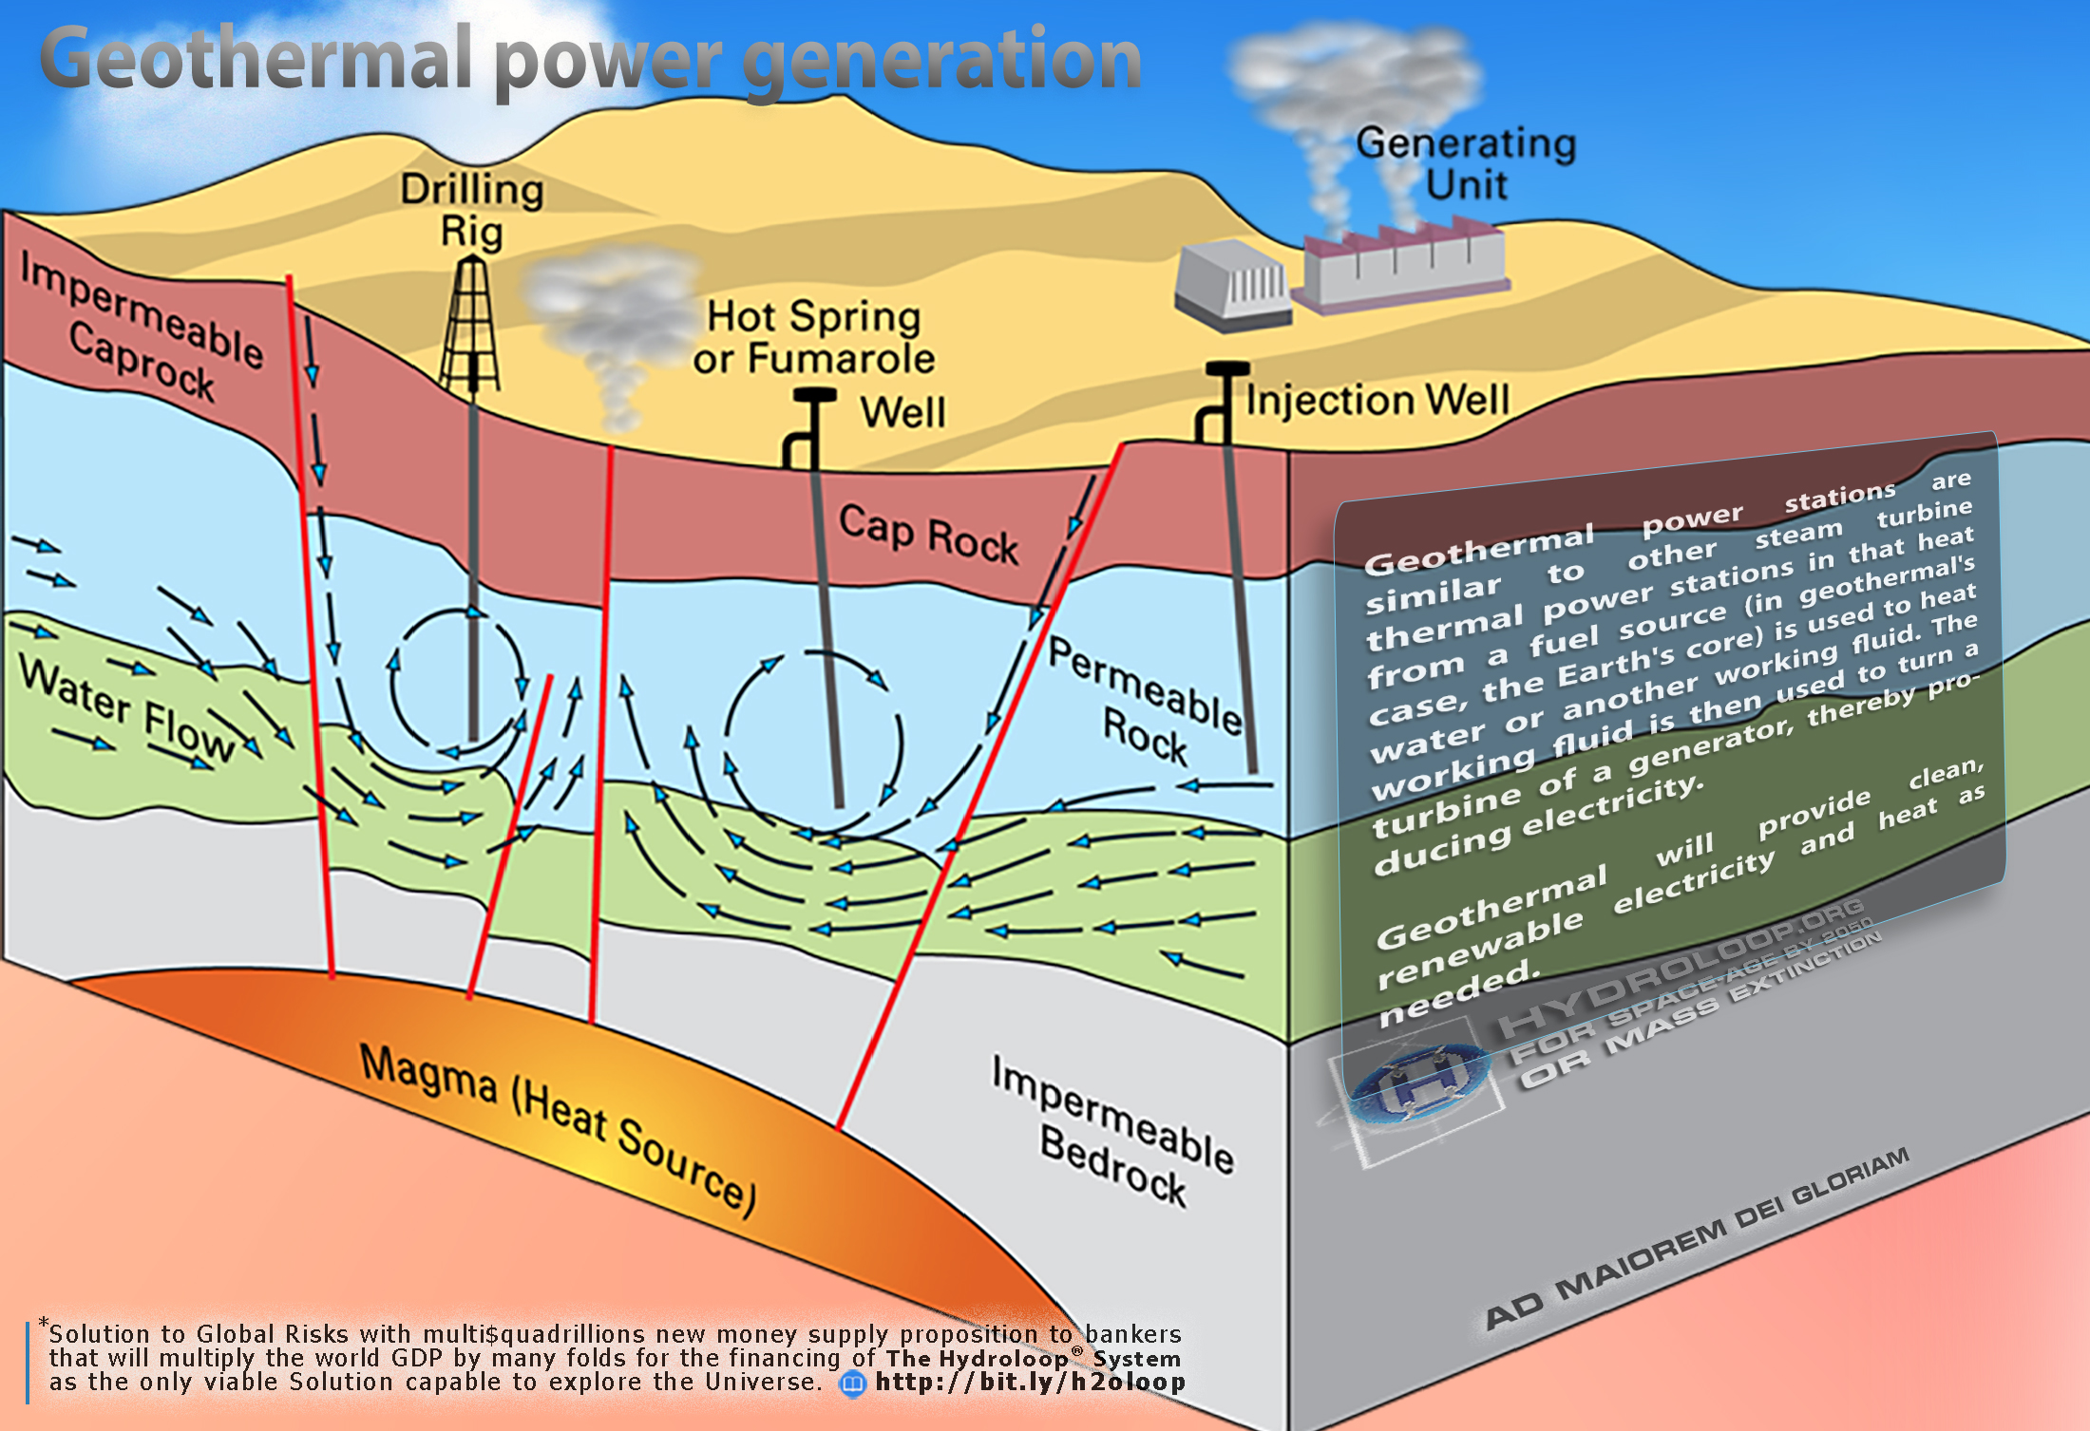
Remove Primary Water Cycle (PWC)
Problem: PWC temperature & pressure increases
Solution: Release PWC pressure.
ToC
Notes:
Harnessing both Primary and Secondary Water Cycles:
What we just explained is the exploration of The Secondary Water Cycle.
The Primary Water Cycle
Holds a volume of water that is five times greater than that of the Secondary Water Cycle. When pressure is applied, this Primary Water moves up e.g in Laos forming Lake Anouvong while in MENA, it’s the finite hydrocarbon that is moving up. That is until the introduction of geothermal energy in The Hydroloop System, which can significantly multiply the transfer of water and energy for maximum efficiency and capacity hence “The World Solution”.

Slide 12
Use
5 415
litres water
1kg Meat
1kg Nuts
1kg Sheep/Goat
1kg Pig
1kg Chicken
1kg Eggs
1kg Cereals
1kg Milk
1kg Fruits
1kg Vegetables
9 063
litres water
8 763
litres
5 988
litres
4 325
litres
To decrease water wastage
Store freshwater cleanly
Avoid evaporation
Transfer via pipelines
Recycle it
Reuse it again from 1.
3 265
litres
1 644
litres
1 020
litres
962
litres
322
litres
Drought impact
Water usage for 1kg product
ToC
Notes:
Here’s a list of various products and their associated water footprints, which reflect the total volume of water used in their production:
Household Items:
Car: 52,000–83,000 liters
Leather Shoes: 8,000 liters
Smartphone: 12,760 liters
Jeans (cotton): 10,850 liters
Bed Sheet (cotton): 9,750 liters
T-shirt (cotton): 2,720 liters
Paper (1 piece; A4): 5.1 liters
Food:
Chocolate: 17,200 liters²
Beef: 15,400 liters²
Sheep Meat: 10,400 liters²
Pork: 6,000 liters²
Avocado: 2,000 liters²
Almonds, Cashews, Pistachios, Lamb and Mutton, Walnuts, Prunes (dried plums), Goat³
Industrial Products:
Automobiles: The water footprint varies depending on the size and complexity of the vehicle but is generally significant due to the metal, plastic, and other materials required.
Factories: Industrial processes can have a large water footprint, especially in sectors like textiles, paper, and chemicals.
These figures illustrate the hidden water that goes into everyday products, emphasizing the importance of water conservation and efficient usage across all sectors. Remember, the water footprint includes not just the direct water used in manufacturing but also the indirect water used in the entire production chain.

Slide 13
Boosting World GDP
by optimizing Water distribution
Water usage per product
Airport
High speed train
Airplane
Car
Phone
Jeans (cotton)
Bed sheet (cotton)
Leather Shoes
T-shirt
Paper (1xA4)
2B-10B
litres
5M-20M
litres
1M-10M
litres
52k-83k
litres
12 760
litres
10 850
litres
To increase quantity
Store freshwater cleanly
Avoid evaporation
Transfer via pipelines
Recycle it
Reuse it again from 1
9 750
litres
8 000
litres
2 720
litres
5.1
litres
ToC
Notes:
Here’s a list of various products and their associated water footprints, which reflect the total volume of water used in their production:
Household Items:
Car: 52,000–83,000 liters
Leather Shoes: 8,000 liters
Smartphone: 12,760 liters
Jeans (cotton): 10,850 liters
Bed Sheet (cotton): 9,750 liters
T-shirt (cotton): 2,720 liters
Paper (1 piece; A4): 5.1 liters
Food:
Chocolate: 17,200 liters²
Beef: 15,400 liters²
Sheep Meat: 10,400 liters²
Pork: 6,000 liters²
Avocado: 2,000 liters²
Almonds, Cashews, Pistachios, Lamb and Mutton, Walnuts, Prunes (dried plums), Goat³
Industrial Products:
Automobiles: The water footprint varies depending on the size and complexity of the vehicle but is generally significant due to the metal, plastic, and other materials required.
Factories: Industrial processes can have a large water footprint, especially in sectors like textiles, paper, and chemicals.
These figures illustrate the hidden water that goes into everyday products, emphasizing the importance of water conservation and efficient usage across all sectors. Remember, the water footprint includes not just the direct water used in manufacturing but also the indirect water used in the entire production chain.

Slide 14
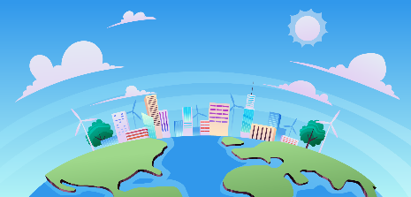
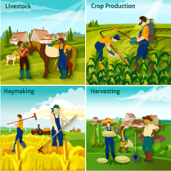
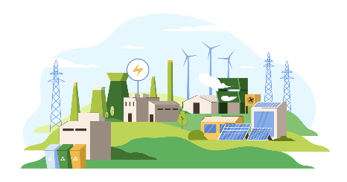
Average Water usage in the US is 388 505 km³ / year
Domestic and public supply
54 271 km³
Farming
43 065 km³
* excludes water used by dams, which is released back into the rivers.
Industries*
291 169 km³
US water usage, therefore high GDP
ToC
Notes:
The fundamental resource you need to build an empire is food and water. If you actually want artisans to build temples, you want soldiers to go off and fight wars for you, you have to be able to feed them and to water them. If you can ensure and protect your food supply and your water supply for all of your people, then you can start to build a large civilization, but resilient to climate collapse and cataclysm to avoid it from falling.
ทรัพยากรพื้นฐานที่คุณต้องใช้ ในการสร้างอาณาจักรคืออาหารและน้ำ หากคุณต้องการให้ช่างฝีมือสร้างวัดจริง คุณต้องการให้ทหารออกไปทำสงครามแทนคุณ คุณต้องสามารถให้อาหารและรดน้ำให้พวกเขาได้ หากคุณสามารถรับรองและปกป้องแหล่งอาหารและน้ำ สำหรับประชากรทั้งหมดของคุณ จากนั้นคุณสามารถเริ่มสร้างอารยธรรมขนาดใหญ่ได้ ทนต่อการล่มสลายของสภาพอากาศและความหายนะ
https://www.youtube.com/watch?v=PYxBLexQ3Yc The total freshwater usage in the United States was estimated to be about 388,505 cubic kilometers (km³) per year.
Freshwater usage in the United States for the categories you mentioned:
Domestic and Public Supply: In 2015, total withdrawals for public supply were about 54,271 km³ per year. This includes water supplied to homes, offices, and public places.
Farming: According to a U.S. Geological Survey report, irrigation accounted for 42% of the Nation’s total freshwater withdrawals in 2015². This equates to approximately 163,142 km³ per year.
Industry: The total freshwater exacted for industrial use in the United States is 291,169 km³ per year exclude used by dams.
Please note that these are approximate values and actual water usage can vary based on a variety of factors including climate, population density, and specific local circumstances. Also, the data might have changed after 2015, the year from which the latest data is available.
There are several reasons why the United States uses more freshwater compared to Europe:
Industrial and Agricultural Use: Global water usage is driven by industrial and agricultural water use¹². The United States and China are two countries that withdraw the most water for industrial uses¹. More industrialized countries tend to use more water². In the United States, agricultural irrigation alone uses 38% of all freshwater³. Thermoelectric-power generation also accounts for 38% of freshwater use, but it is typically returned to the water supply—making it far more sustainable³.
Availability of Water: In North America, there’s more water per person than in Europe⁴. This abundance of water might lead to higher usage due to the perception that this resource is never-ending⁴.
Consumption Habits: The water footprints vary between countries because they’re based on consumption habits of people within each country, as well as that country’s climate and water-use practices².
Population and Living Standards: The main drivers of water usage in Europe are growing urban populations and higher living standards coupled with reduced water availability due to pollution and drought⁵. In contrast, the United States has a larger land area and more abundant water resources, which could contribute to higher water usage.
Please note that these are general factors and the actual water usage can vary based on a variety of other factors including specific local circumstances, policies, and conservation efforts. Also, the data might have changed after the latest available data.

Slide 15
Average Water usage in Europe is 286 km³ / year
Domestic and public supply
90 km³
Farming
68 km³
* excludes water used by dams, which is released back into the rivers.
Industries* 128 km³
EU water usage, medium GDP
ToC
Notes:
The total water usage in Europe is approximately 286 km³ per year¹. However, the distribution of this water usage across different sectors varies. Here’s a breakdown based on the information available:
Communal Use (homes, offices, tourism, etc.): The average household consumption of water in Europe is 53 m³ per person per year². However, the total communal water usage isn’t explicitly stated in the sources.
Industries: In Europe, industry is the biggest user of water, utilizing about 45% of the total water used³. This would equate to approximately 128.7 km³ per year.
Agriculture (including greenhouses and aquaponics): Agriculture uses about 24% of all water abstracted in the EU⁴. This would equate to approximately 68.64 km³ per year. However, this percentage can go up to 80% in southern Europe⁵.
Please note that these are approximate values and actual water usage can vary based on a variety of factors including climate, population density, and specific local circumstances. Also, the data might have changed after 2021, the year from which the latest data is available.
The total water usage in the United States is approximately 388,505 km³ per year (2015). The more the GDP, the bigger is freshwater usage. Source: usgs.gov.
The water footprint refers to the total volume of freshwater used directly or indirectly to produce a product, service, or activity. It encompasses both the water consumed during the production process and the water required for the growth of raw materials. Here are some key points about water footprints:
Types of Water Footprints:
Blue Water Footprint: This represents the volume of surface and groundwater used for irrigation, industrial processes, and domestic purposes.
Green Water Footprint: It refers to the amount of rainwater consumed by crops and vegetation during their growth.
Grey Water Footprint: This accounts for the volume of freshwater needed to dilute pollutants (e.g., from industrial processes) to meet water quality standards.
Factors Influencing Water Footprints:
Diet: The type of food we consume significantly impacts our water footprint. For example, meat production tends to have a higher water footprint compared to plant-based foods.
Geographical Location: Water availability varies across regions, affecting the local water footprint.
Industrial Processes: Industries that rely heavily on water (e.g., textiles, paper, and chemicals) contribute to water footprints.
Virtual Water: Imported goods also carry a hidden water footprint, as water was used in their production elsewhere.
Calculating Water Footprints:
Researchers and organizations use life cycle assessment (LCA) to estimate water footprints. LCAs consider all stages of a product’s life, from raw material extraction to disposal.
Water footprint assessments provide insights into sustainable water management and help identify areas for improvement.
Reducing Water Footprints:
Efficient Irrigation: Implementing water-efficient irrigation techniques can reduce agricultural water use.
Consumer Choices: Opt for products with lower water footprints (e.g., seasonal and locally grown produce).
Industry Practices: Industries can adopt water-saving technologies and reuse/recycle water.
Awareness: Educating consumers and businesses about water conservation is crucial.
Remember that understanding and addressing water footprints are essential for sustainable water management and ensuring water availability for future generations.
Statistics: The Earth’s Secondary Water Cycle is distributed across various reservoirs. Here’s an estimate of the Secondary water Cycle volume in different places:
Oceans (Saline):
Oceans hold about 96.5% of all Earth’s water.
Estimated volume: 1,338,000,000 cubic kilometers (km³).
Ice Caps and Glaciers (Fresh):
Ice caps and glaciers contain freshwater.
Estimated volume: 24,064,000 km³.
Groundwater (Fresh and Saline):
Water stored in aquifers and underground that are not all of Primary Water Cycle.
Estimated volume: 23,400,000 km³.
Streams, Lakes, and Swamps (Fresh):
Surface freshwater sources.
Estimated volume: 104,590 km³.
Lakes (Saline):
Saline lakes.
Estimated volume: 85,400 km³.
In total, Earth’s water content is approximately 1.39 billion cubic kilometers (331 million cubic miles). The majority of this water is in the oceans, followed by ice caps and glaciers. Freshwater sources are relatively small but crucial for sustaining life.
Planetary alignment: https://vt.tiktok.com/ZSFqYbtfC/
RE: TOTRADE, first with Thailand, through Carbon-Negative global initiatives for a swift progress towards a Type I Civilization.
Global Crisis: The Earth is experiencing Climate collapse characterized by more extreme weather including intense floods, snowstorms, extreme heat, fires, hailstorms, windstorms, tornadoes, earthquakes, volcanic eruptions, and tsunami... impacting numerous regions with the potential for global effects.
Links with Facts:
Cataclysm: https://vt.tiktok.com/ZSFxJCAjv/
Intense floods: https://vt.tiktok.com/ZSFqsSXhW/
Snowstorms: https://vt.tiktok.com/ZSFqG64Ds/
Extreme heat, fires: https://vt.tiktok.com/ZSFqGx3d7/
Hailstorms: https://vt.tiktok.com/ZSFqGMoVx/
Windstorms: https://vt.tiktok.com/ZSFqGYE5Y/
Tornadoes: https://vt.tiktok.com/ZSFqGJv8t/
Earthquakes: https://vt.tiktok.com/ZSFqs1nTm/
Volcanic eruptions: https://vt.tiktok.com/ZSFqp7d2m/
Tsunami: https://vt.tiktok.com/ZSFqGjqjq/
Sources: Dr. A. Egon Cholakian:
Earth Save Science Collaborative: https://earthsavesciencecollaborative.com/ LinkedIn (bio): https://www.linkedin.com/in/a-egon-cholakian-11256b4
John Ahn PhD, MBA:
Youtube: https://www.youtube.com/@creative_society
TikTok: https://www.tiktok.com/@creativesociety369?_t=8kc1FxTdBl2&_r=1
and other scientists,
The billionaires,
NASA
web: https://www.nasa.gov/missions/icon/nasa-researchers-track-slowly-splitting-dent-in-earths-magnetic-field/
YouTube: https://www.youtube.com/watch?v=QLQk8lGcHsc
pole shift: https://www.ncei.noaa.gov/maps/historical_declination/
The CIA
Book: https://www.tiktok.com/@c0nspiracycrusader/video/7338989028039085354
who know how The Earth will end: https://vt.tiktok.com/ZSFxJCAjv/
Time: within the next 10 years: https://vt.tiktok.com/ZSFxJCAjv/
Well-renowned Scientists, such as Dr. A. Egon Cholakian (LinkedIn, Youtube), John Ahn PhD MBA and others, billionaires, NASA, (web, YouTube, pole shift) and The CIA know how The Earth will end (within the next 10 years) if we don’t implement the following solution.
Solution: ASEAN Mainland (with partners, collaborators, investors…) as a beacon of hope for addressing these critical global challenges: latest updates: https://bit.ly/LAisSolution.
The Real cooling effect has slowly begun to exit 12,000 years cycle after the increase in extreme weather events:
Most of North European farming will start to get growing difficulties due to severe climatic shifts and will slowly go offline and uninhabitable in 300 years. The same for North America, Russian Federation, Mongolia, and North China.
The Trigger of Real Mass-Extinction Cataclysm
This cosmic rays that increase solar activity is rapidly heating our magnetosphere allowing more cosmic rays continuous penetration deep into Earth interior. The long-term consequence is the disruption of the magnetic and electrical orderliness inside the Earth causing mass-extinction event.
Correlation of the data between the "earth" science in stratigraphy, archaeology, anthropology, palaeontology, radiology, oceanography, seismology, glaciology, and many other fields gave the answer: there is enough data in each science to indicate that these cataclysms happen.
There is now enough to prove the concept; between-science correlation showed indeed that the concept was true. Not only it did verify that the events have happened, but disclosed when the last five cataclysms were, and what positions the shell of the Earth has been in for the last 35,000 years.
So, after years of research, beginning in 1949, Cuvier's challenge had an answer: Yes, indeed the cataclysms do happen. And the last one, 6,500 years ago, was Noah's Flood!
All right. So, they happen; what is it that happens each time? The challenge was really two-folds: find the process - what happens in a cataclysm; and the trigger - what causes a cataclysm to start. Apollo programs were initiated to find out. JFK speech "to do the other thing" means to find out what caused previous cataclysms and especially how to avoid it.

Slide 16
Average Water usage in Laos is 0.75 km³ / year
Domestic and public supply
0.03 km³
Farming
0.705 km³
Industries*
0.015 km³
* excludes water used by dams, which is released back into the rivers.
LAO tiny Water Usage
ToC
Notes:
The total freshwater usage in Laos is approximately 0.75 km³ per year. Here’s a breakdown based on the information available:
Domestic and Public Supply: Approximately 4% of the total water withdrawals are for domestic purposes¹. This equates to approximately 0.03 km³ per year.
Farming: About 94% of the total water withdrawals are for agricultural purposes¹. This equates to approximately 0.705 km³ per year.
Industries: The industrial sector uses about 2% of the total water withdrawals¹. This equates to approximately 0.015 km³ per year.
Please note that these are approximate values and actual water usage can vary based on a variety of factors including climate, population density, and specific local circumstances. Also, the data might have changed after the latest available data.

Slide 17
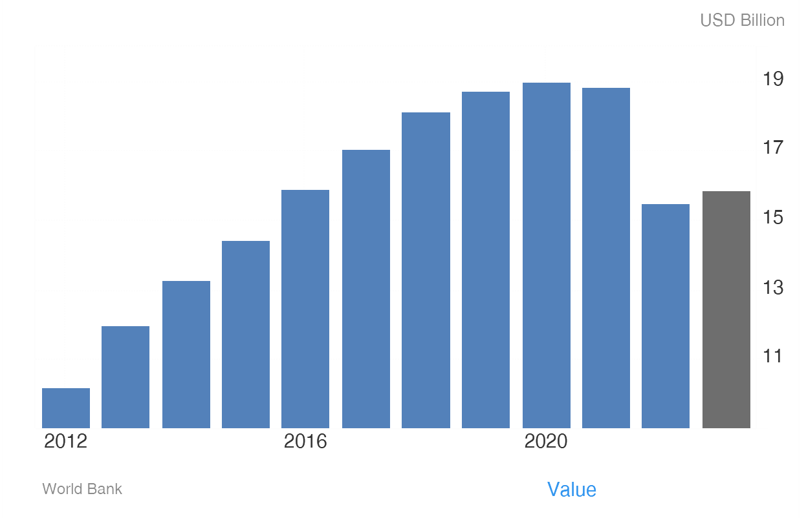
LAO PDR GDP
0.01%
World GDP
Therefore, low in GDP
ToC
Notes:
The Gross Domestic Product (GDP) in Laos was worth 15.47 billion US dollars in 2022, according to official data from the World Bank. The GDP value of Laos represents 0.01 percent of the world economy. source: World Bank.

Slide 18
GDP
increase
Financial services*
Loans, ipo (+securities) fees
ASEAN:
From 39 to +51% of world GDP
ASEAN PPP is 47.5% of the world PPP
Infrastructure & buildings*
Depreciation, maintenance
Wages*
Admin, earnings, professional fees…
+51 % world
economy
=
Increased GDP of participing Countries
Education*
Schools, R&D…
Healthcare & wellbeing*
Clothing, food, save productive life
Raw material & Energy*
Mining, petroleum, electricity, food, water
Machinery & communication*
+ tools, internet, phones
* Approximates
global effects
All sectors turnover
Other expenditure*
Defense, leaks, miscellaneous
Products & Services*
Food, energy, water, clean and sustainable systems, know-how for export.
This is our “Humanity’s Last Hope” for GDP increases in other parts of the world
Increasing GDP by high water consumption
ToC
Notes:
The Gross Domestic Product (GDP) of the Association of Southeast Asian Nations (ASEAN) collectively was approximately US$5.02 trillion at current prices in 2021¹. This makes ASEAN the sixth-largest economy in the world. Let’s break down some key points:
GDP at Current Prices:
ASEAN’s GDP at current prices was US$5.02 trillion in 2021.
The individual GDP figures for ASEAN member states vary. For instance:
Brunei Darussalam: US$13.92 billion
Indonesia: US$1.19 trillion
Malaysia: US$372.77 billion
Philippines: US$393.61 billion
Thailand: US$505.89 billion
GDP Per Capita:
The GDP per capita (average income per person) in ASEAN was US$10,316 in 2021.
Notably, Singapore has the highest GDP per capita in the region, standing at US$82,807.
Growth Rate of GDP:
The economic growth rate of ASEAN countries at constant prices (adjusted for inflation) has been positive over the years.
In 2021, the growth rate was 3.4%.
ASEAN’s Share of World GDP:
In nominal terms, ASEAN’s GDP accounted for 39% of the world GDP in 2021.
When considering purchasing power parity (PPP), which adjusts for price differences between countries, ASEAN’s share goes up to 47.5% of the world’s total GDP².
Services Sector Contribution:
The services sector plays a significant role in ASEAN economies. On average, it contributes 42.8% to the region’s GDP.
Urbanization and Labor Force Participation:
Over the past 55 years, ASEAN has experienced strong urbanization. Currently, approximately half of the population lives in cities, compared to only 21% in 1967.
The labor force participation rate for both sexes in ASEAN was 68.1% in 2016¹.
In summary, ASEAN’s economic strength continues to grow, and its collective GDP ranks among the top globally. The region’s diverse economies contribute significantly to global economic activity³. If you have any more questions or need further details, feel free to ask! 😊
LAOS The Gross Domestic Product (GDP) in Laos was worth 15.47 billion US dollars in 2022, according to official data from the World Bank. The GDP value of Laos represents 0.01 percent of the world economy. source: World Bank.
Let’s explore the expenditure related to development across various sectors:
Infrastructure:
Developing countries need to allocate about 4.5% of their GDP annually to fund basic improvements in infrastructure. This includes energy, transport, digital connectivity, and other essential sectors¹.
Education:
Investment in education is crucial for societal well-being. Governments spend on school buildings, IT systems, and other educational infrastructure to enhance productivity and promote economic growth².
Healthcare:
The Islamic Development Bank (IsDB) recently approved projects to strengthen healthcare systems in member countries. For instance:
In Indonesia, IsDB is contributing to the “Strengthening Indonesia’s Health Care Referral Network Project” to improve access to quality healthcare services across districts and provinces.
Other countries like Burkina Faso, Uganda, Mali, Chad, and Togo also received funding for health-related projects³.
Energy:
Investment in energy infrastructure is essential for economic development. Projects like modernizing electricity transmission grids contribute to sustainable growth³.
Transport:
Transport infrastructure, including highways and bridges, plays a vital role in connecting regions and promoting economic integration. IsDB approved projects in countries like Morocco, Uganda, and Djibouti to enhance transport sectors³.
Morocco received financing for the “Construction of Guercif-Nador Highway Project,” enhancing connectivity in the Oriental region and the Nador West Med port complex.

Slide 19
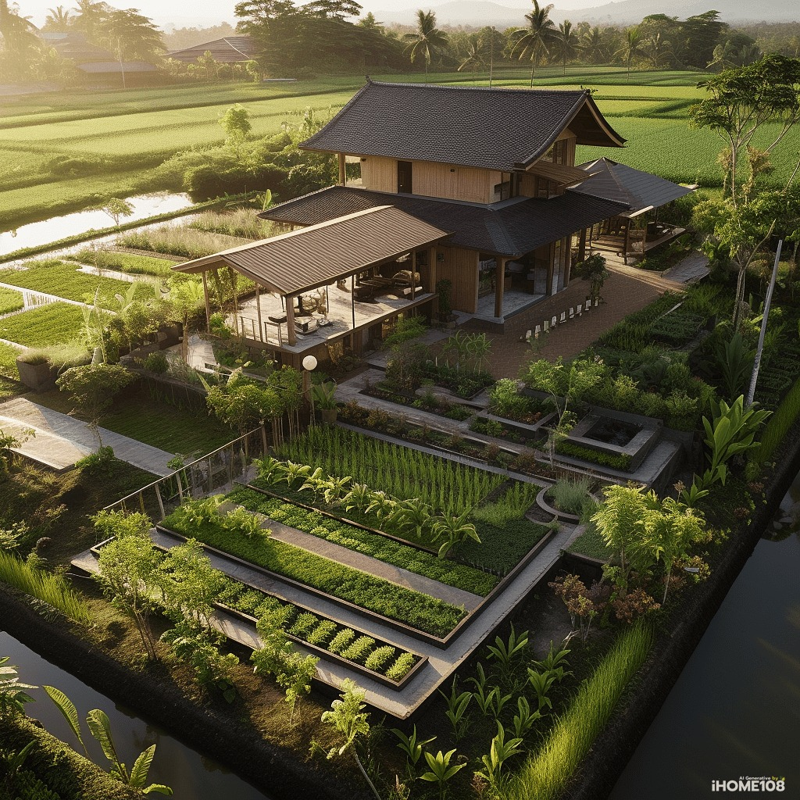
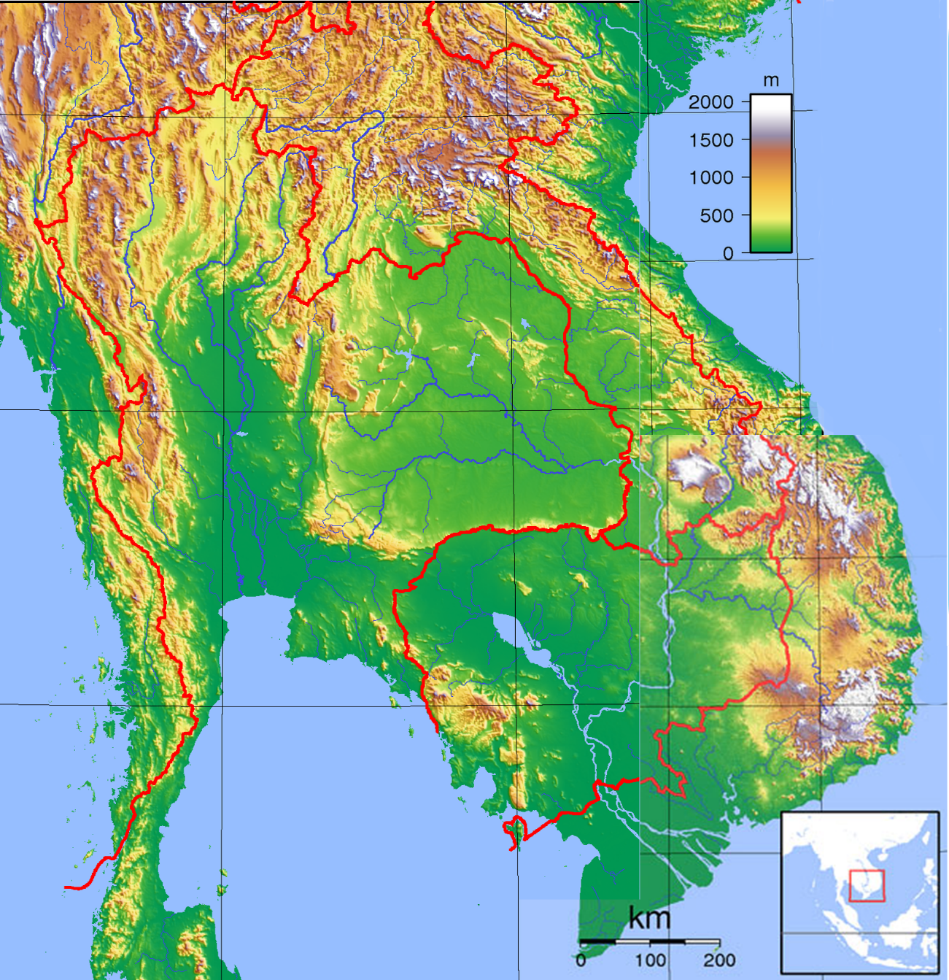
China
Political Region: ASEAN
Land Area: 4.5 million km²
Population: >600 million
Climate: Tropical
50% Rainy: May-October
50% Dry: November-April
Freshwater Reserve:
Secondary Water Cycle (SWC)
Laos’ rainfall 2000 mm/year avg.
Primary Water Cycle (PWC)
ASEAN ± 500 km³/year avg.
World ≤ 5 times SWC.
Myanmar
Laos
South
China
Sea
->Pacific
ASEAN
(mainland)
Thailand
Cambodia
Andaman sea
Indian Ocean
Viet Nam
Gulf
Of
Thailand
Development project Proposed to: LNCCI, ASEAN, AICCI, GCC, KIA, World Bank, City of London, UN… See: totrade.co/solcom
Malaysia
Singapore…
China
ASEAN
PowerPoint: totrade.co/pwp
ASEAN Mainland, Humanity’s Last Hope
ToC
Notes:
Also presented to: Solution for Africa and The World is “Humanity’s Last Hope”: totrade.co
AICCI: African International Chamber of Commerce & Industry GCC: GCC stands for Gulf Cooperation Council, which is a political and economic union of six Middle Eastern countries: Bahrain, Kuwait, Oman, Qatar, Saudi Arabia, and the United Arab Emirates ¹². The GCC was established in Riyadh, Saudi Arabia in May 1981 ². Ports: Vietnam and Thailand have several deep seaports. Here are some of them:
Vietnam:
Hai Phong Port: One of the largest and most important seaports of Northern Vietnam¹.
Cai Lan: A major port in Vietnam².
Cai Mep: Another significant port in the country.
Vung Ang Port (Lao-Viet Port): The closest deep seaport to Vientiane, Laos². Web: Trang chủ - CÔNG TY CP CẢNG QUỐC TẾ LÀO - VIỆT (vungangport.com). This is Lao Port given to Laos by Vietnam.
Thailand:
Laem Chabang: Thailand’s most important marine port since it first opened in 1991.
Bangkok Port: The 2nd busiest port in Thailand.
Phuket Port: Governed by the Harbour Department of Thailand.
Chiang Saen: A port located alongside the Mekong River in Chiang Saen District, Chiangrai Province.
These ports play a crucial role in the maritime commercial activities of both countries. Please note that this is not an exhaustive list and there are several other ports in both countries.
There are numerous reasons why the world needs to focus on developing this area, as it will subsequently facilitate the progress of other regions that also require development.

Slide 20
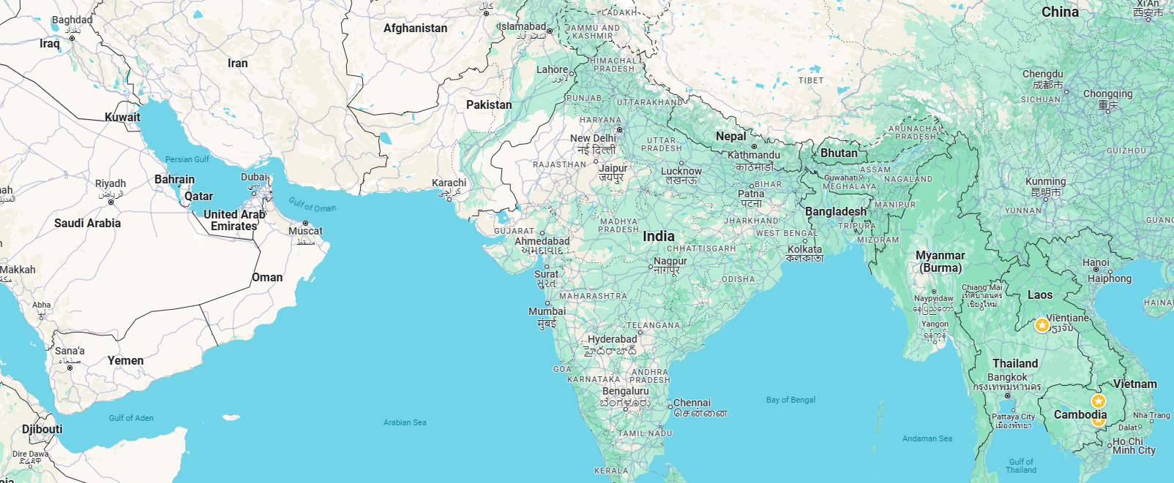
Finite Hydrocarbon
South Asia
Same latitude
Renewable
Freshwater
SW
freshwater Abundance
H₂O
Drought
C_{n}H2_{n}+2
SE
ASEAN
(mainland)
Hydrocarbon & freshwater statistic
Sustainable transition to clean energy and transportation
Building “Humanity’s Last Hope”
With a clean transport system prototype in ASEAN Mainland
Global supply of fresh water and energy to geothermal plants, farming, industries
Before hydrocarbon becomes scarce.
Grow trees with 20% hemp.
Transport desert sand and hemp back to ASEAN Mainland
To expand water storage capacity to grow more trees, and food
And for mass Space Exploration this century by sending out billions of people
ToC
Notes:
South Asia Regions of the same latitudes
Without a Hot water pipeline:
Completing the Hydroloop prototypes would mean the possibility of cheap water, electricity, and goods delivery around ASEAN mainland, build new centres for food production, factories, recreation, and sustainable cities in ASEAN Mainland Those countries are Laos, Thailand, Cambodia, Myanmar, Malaysia, and Viet Nam.

Slide 21
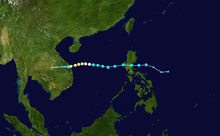
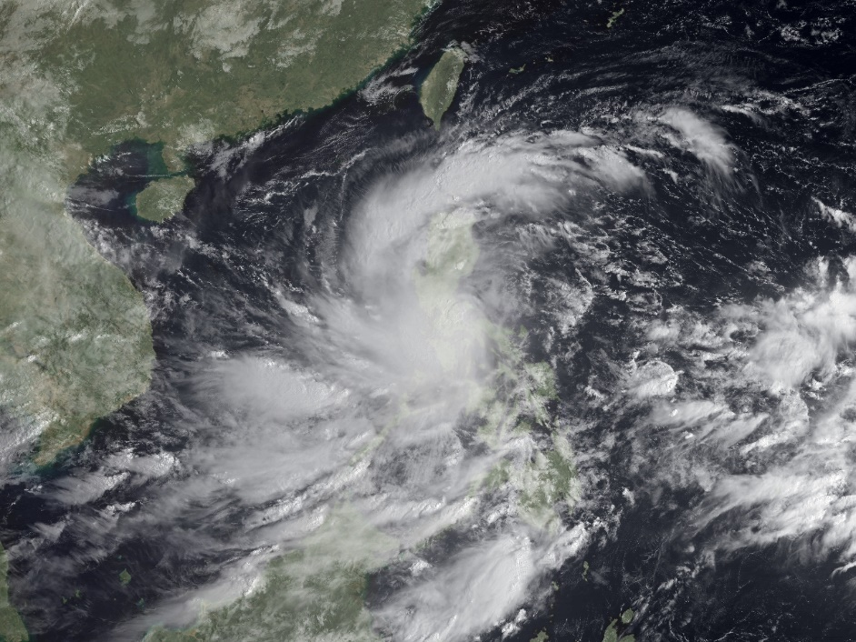
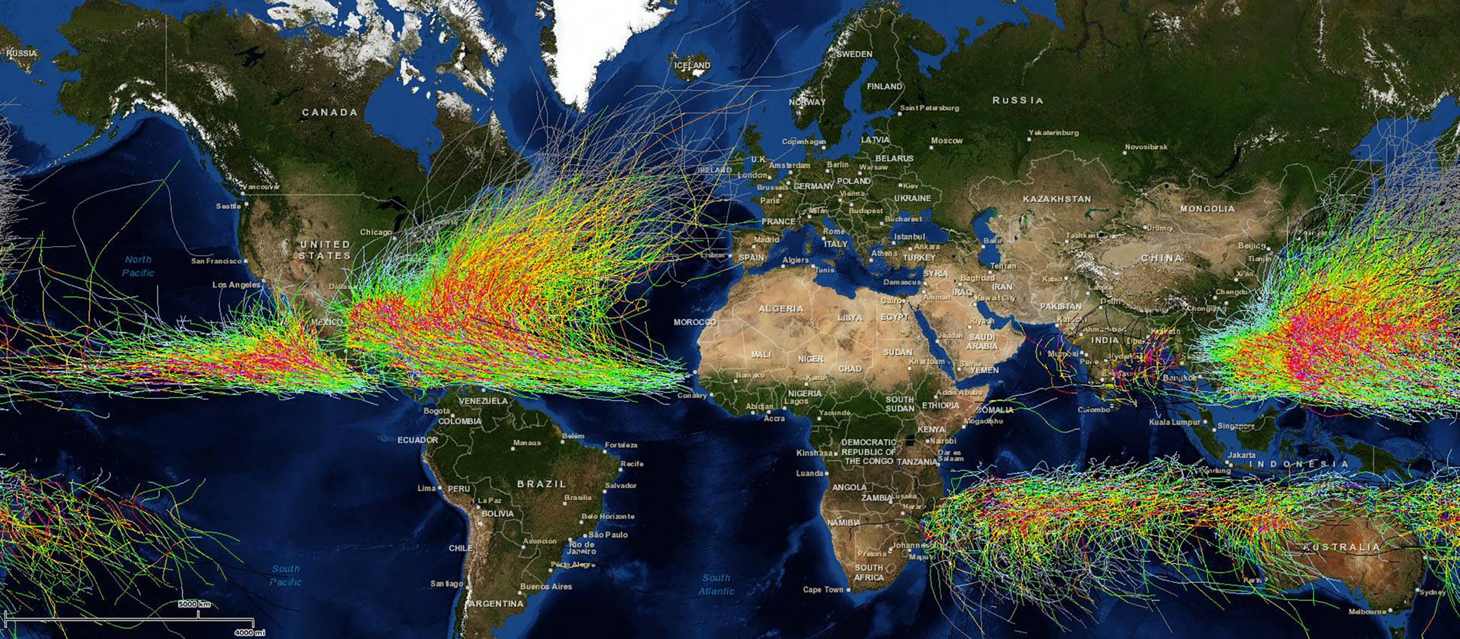
Second Water Cycle:
Typhoons form every year
1 among many
Satellite picture
Typhoon Ketsana
ASEAN
(mainland)
2009 Typhoons
1842 and 2013 Typhoons
Ketsana
ASEAN
(mainland)
ToC
Notes:
The Hydroloop™ System
24/7 Smart Solutions for Transport, Water Delivery, and Energy Production
The Hydroloop™ System is a sustainable energy and water distribution solution that leverages geothermal energy to supply electricity and water constantly. It also aids in the transportation of goods and people. The system generates electricity and distributes water to Smart Farming operations, which cultivate a variety of produce and aquatic life, and for human consumption. The used water is then recycled and directed back to the geothermal power source to energize the Hydroloop™ System, thus completing the cycle and preparing it to start again. This project aligns with the United Nations’ 17 Sustainable Development Goals (UNSDG) making it The World Solution.

Slide 22
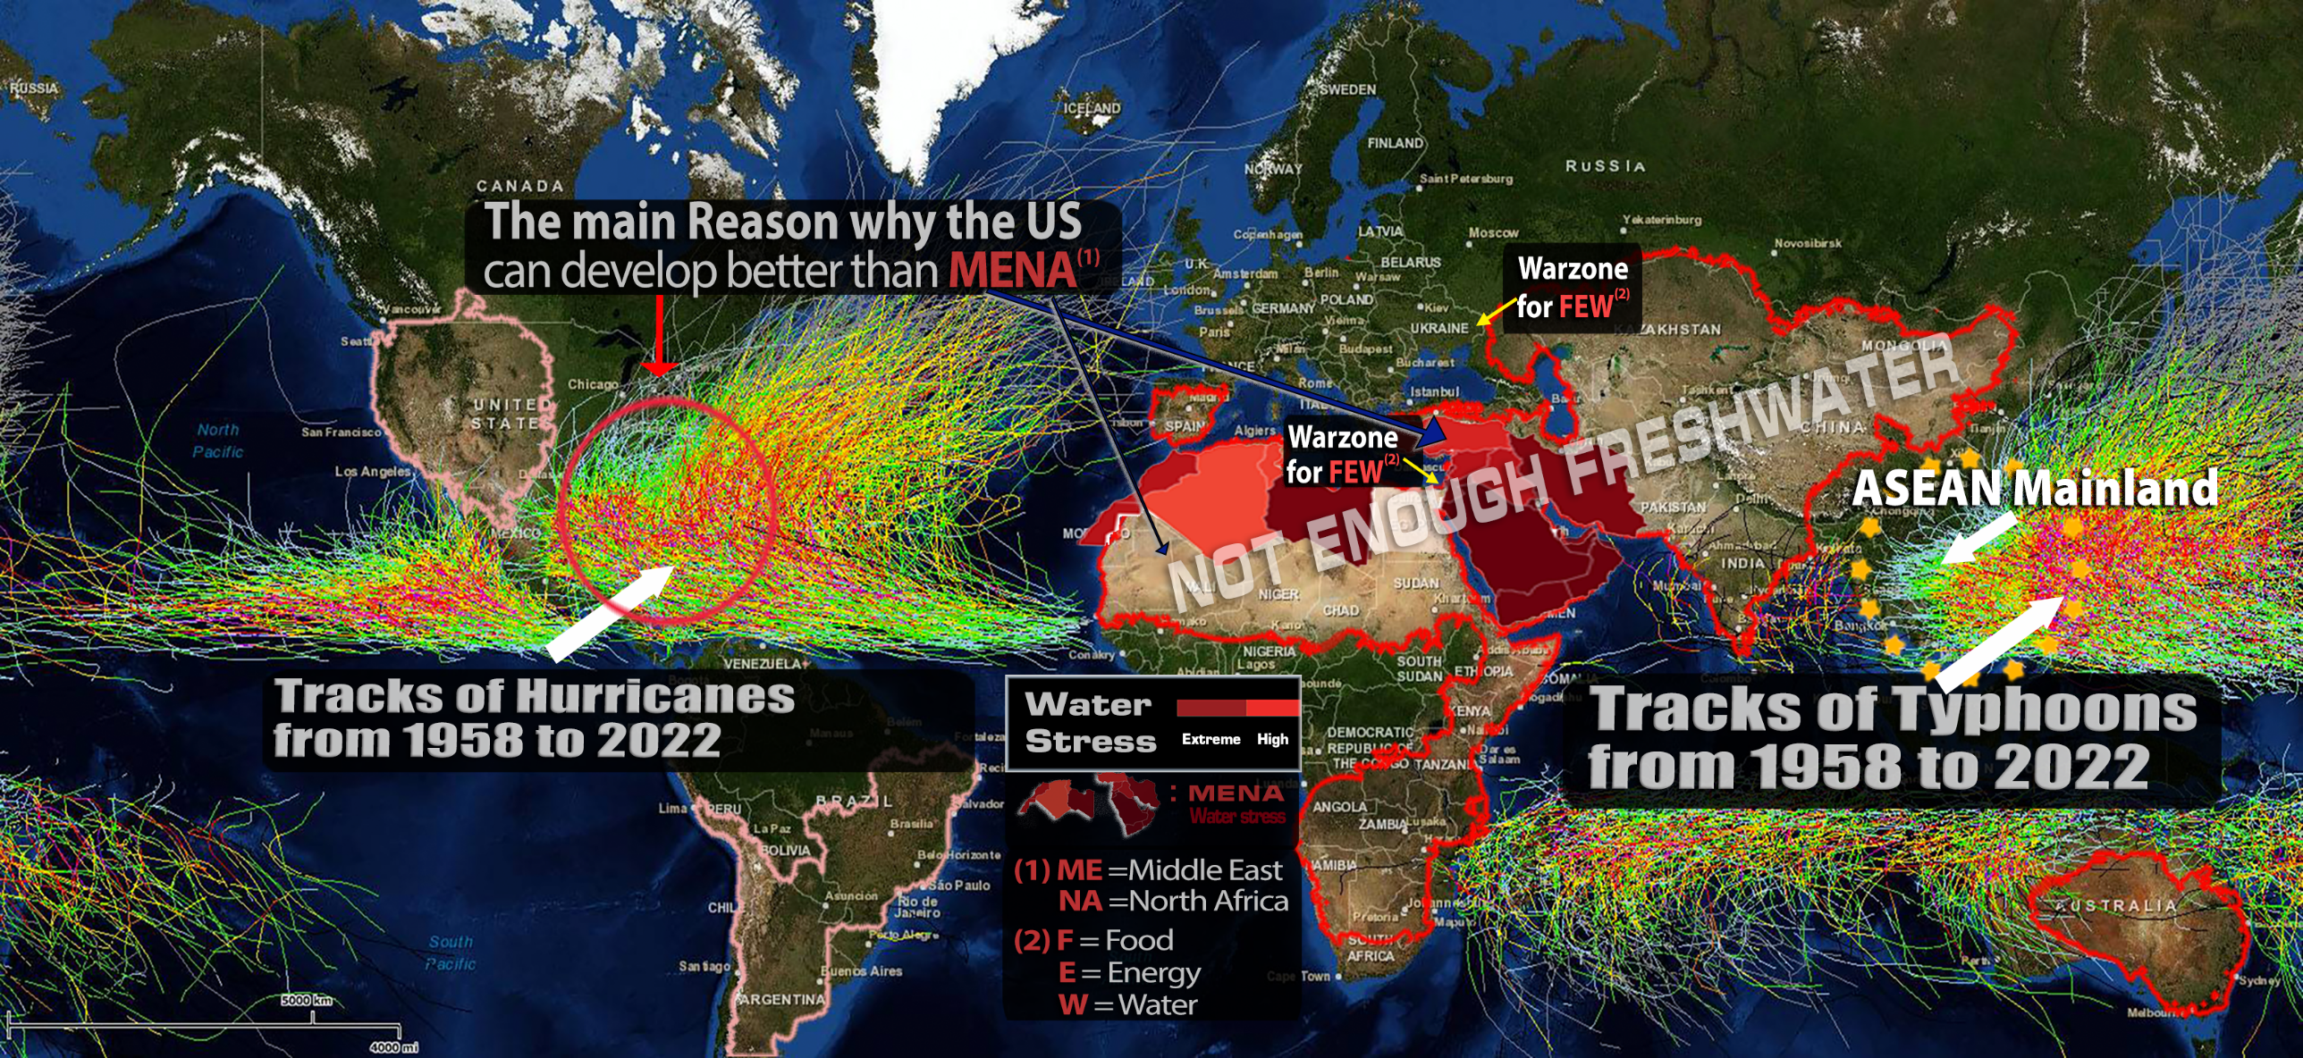
ASEAN Mainland, “Humanity’s Last Hope”
Canada, US, Russia, Europe, N&E Asia
Longer and colder winters, irregular summers
Tropical Zone
Hotter Dry season and wetter monsoon seasons.
Globally: Climate is Collapsing heading to Cataclysm (abrupt event)
Solution: Constant* Energy and water transfers (Laws of thermodynamics)
* extended periods and over large areas is a critical goal for global development & cataclysm mitigation.
ToC
Notes:
Map of the world:
Situation: USA, Russia, EU, China, Taiwan, and Japan.
Increased Climate catastrophes
More flood, longer and colder winters, extended drought, tornadoes, Hurricanes, Typhoons, Earthquakes…
Solution: ASEAN Mainland as a beacon of hope for addressing these critical global challenges: latest updates.
Facts:
Dr. A. Egon Cholakian:
Earth Save Science Collaborative, LinkedIn, Youtube
John Ahn, PhD, MBA, (US of origin Vietnam) and thousands if independent scientists and researchers. Creative society, Youtube, TikTok
Events:
YouTube
NASA, CIA
More details on: Global Risks Assessment and Solution.

Slide 23
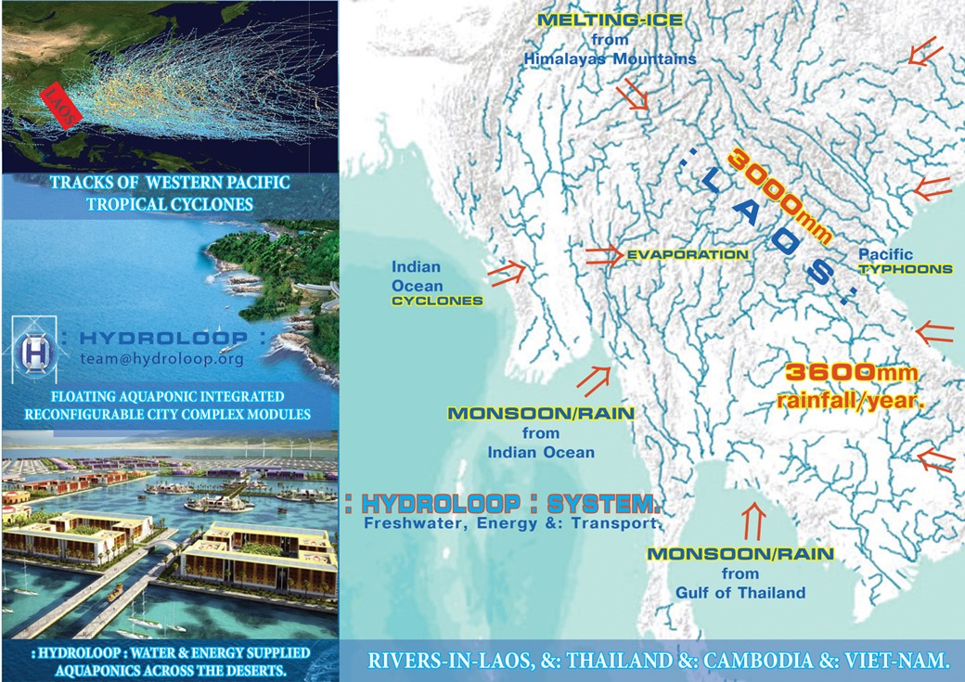
Not only Typhoons…
Mekong tributaries in Laos
13 rivers
In Thailand
8 rivers
Groundwater: >600 km³, renewable
Enough to:
Upgradable to World Kitchen
Build a Clean transport system
Solve UNSDG & avoid cataclysm
ASEAN
(mainland)
Average rainfall in ASEAN Mainland
From Multiple sources
Modern technology can double the rainfall
Successful US Air Force cloud seedings (1966-1972).
”Humanity’s Last Hope”
ToC
Notes:
The provision of water to farms, cities, and industries has the potential to transform ASEAN Mainland and its neighbouring countries into a significant reserve, positioning them as the new “World Food Basket.”
Average annual rainfall in ASEAN Mainland. The year when there are more Typhoons making landfall in Viet Nam, the annual rainfall in ASEAN Mainland could exceed 4,000mm. Operation Popeye, also known as Project Controlled Weather Popeye / Motorpool / Intermediary-Compatriot, was a military cloud-seeding project carried out by the U.S. Air Force during the Vietnam War. The operation ran from 1966, until 1972¹². The highly classified program aimed to extend the monsoon season over specific areas of the Ho Chi Minh Trail (Laos) to disrupt North Vietnamese military supplies by softening road surfaces and causing landslides¹. The goal of the operation was to extend days of rainfall by about 30 to 45 days each monsoon season¹.
Laos, a country known for its lush landscapes, is crisscrossed by a vast network of rivers that teem with life. These rivers play an essential role in the Mekong Basin, contributing 35 percent of the Mekong River’s flow¹. Let’s dive into the details:
Rivers in Laos
Laos boasts numerous rivers, and here are some notable ones:
Mekong River: The mighty Mekong flows through Laos, shaping its geography and providing sustenance to communities along its banks.
Nam Khan: A tributary of the Mekong, the Nam Khan meanders through lush forests and picturesque valleys.
Nam Ou: Another Mekong tributary, the Nam Ou, winds its way through dramatic limestone karsts and traditional villages.
Nam Ngum: This reservoir-fed river is essential for hydroelectric power generation and water supply.
Nam Tha: The Nam Tha River flows through northern Laos, sustaining agriculture and ecosystems.
Runoff Quantity
Estimating runoff is crucial for understanding hydrological conditions. In Vientiane City, Laos, researchers have used the NRCS Runoff Method and GIS mapping to assess direct runoff from storm rainfall. This calculation aids in designing drainage networks and flood management². The study revealed varying hydrologic conditions across different areas within the city.
Thailand has several tributaries that contribute to the Mekong River. The main Thai tributaries of the Mekong are:
Ruak River - joins the Mekong in Thailand
Kok River - also joins the Mekong in Thailand
Ing River - another tributary joining the Mekong in Thailand
Mun River - flows into the Mekong at Khong Chiam in Ubon Ratchathani
Chi River - joins the Mun River in Thailand
Lam Dom Noi - merges with the Mun River
Lam Takhong - joins the Mun River
Tonlé Sap River - joins the Mekong in Cambodia but extends into Thailand¹.
These rivers play a crucial role in the ecology and economy of the region, contributing to the Mekong’s overall flow and supporting local communities.

Slide 24
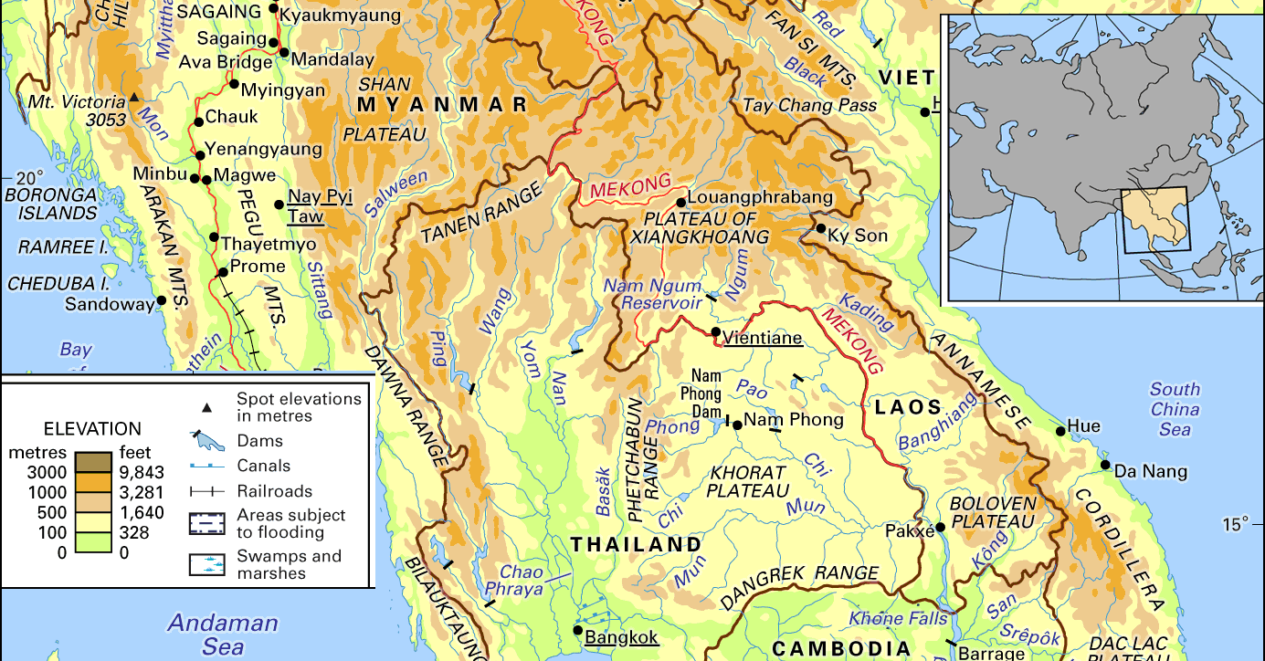
ASEAN
(mainland)
Mountain Chains in ASEAN Mainland
More Kinetic and potential energies (500 to 2000m)
Which is also the hight of Vertical farming without pumping cost (pipeline).
Ideal for Cataclysm preparedness in case prevention measures failure.
ToC
Notes:
Laos Topography plays an important role:
The mountain chains in Laos, specifically the Annamese Cordillera, with their elevations spanning from 500 to 2598 meters, provide significant kinetic and potential energy. This altitude range accommodates a considerable scope for vertical farming, thereby eliminating the need for extra pumping costs when utilizing a pipeline system.
The highest elevation in Laos is Phou Bia, which stands at an altitude of 2,819 meters (9,249 feet)¹². This mountain is located in the Annamese Cordillera, at the southern limit of the Xiangkhoang Plateau in Xaisomboun Province². Due to its high elevation, the climate around Phou Bia is often cold and cloudy².
The Coriolis Effect: a phenomenon that describes the apparent deflection of objects moving in a straight path relative to the Earth’s surface due to the Earth’s rotation, the Himalaya Mountain Chains on the Top.
The concept of utilizing mountain chains in the ASEAN mainland for various purposes, including vertical farming and cataclysm preparedness:
Mountain Chains and Energy Potential:
Mountain chains offer significant kinetic and potential energy due to their elevation. The height range you mentioned (500 to 2000 meters) corresponds to substantial gravitational potential energy.
This energy can be harnessed through technologies like hydroelectric power plants, where water flows downhill, driving turbines and generating electricity.
Vertical Farming:
Vertical farming involves cultivating crops in vertically stacked layers or vertically inclined surfaces.
The natural elevation of mountain chains provides an ideal setting for vertical farming without the need for additional pumping costs.
Benefits include efficient land use, reduced water consumption, and controlled environments for year-round crop production.
Cataclysm Preparedness:
In case prevention measures fail (such as natural disaster mitigation), mountain chains can serve as strategic locations for emergency response and resilience.
Elevated areas can house evacuation centers, communication infrastructure, and emergency supply storage.
Additionally, vertical farming on these slopes can provide food security during crises.

Slide 25
ASEAN Mainland deep Groundwater
Primary Water Cycle (PWC)
Larger than
global oil reserve
Over 600 km³
renewable
Pilot project in Laos
Expand to neighbours
until reaching MENA
and deploy worldwide
exportable to Space
and Beyond
More
ToC
Notes:
► ASEAN Mainland Groundwater is located under ASEAN Mainland basin, stretching from southern China, Thailand, Laos, Vietnam, to Cambodia (subject to mapping). It is estimated to contain more than 600 cubic kilometres of top-quality pure drinking water, larger than current oil reserve of 595 km³
The lake is rechargeable from the bottom (1st water cycle) and from the top (2nd cycle), completely renewable with a level higher than any non-renewable groundwater, capable of supplying billions of people for a long time. But how can ASEAN Mainland access this abundant resource and share it with its neighbors? The answer is the Hydroloop™ System, powered by geothermal energy, is a revolutionary project that aims to supply water from ASEAN Mainland via pipelines that can also transport goods and people around the world. ► The Hydroloop™ system, Water delivery and Power Generation without High-Voltage Transmission Lines for geothermal expansion From under ASEAN Mainland basin and above, ASEAN Mainland can transfer and distribute its water, by gravity and kinetic push-pull force concept, accelerated by Geothermal, to as far as MENA and Africa at low pumping cost allowing electricity production at the destination without transmission lines to supply both electricity and water to the large-scale Geothermal plants across MENA and other desert regions. With enough water and energy, the region can focus on development, not on conflicts. Smart-Grid by Nigh-Day Power Balancing Act During the night, (for example Saudi Arabia), electricity can power pumps: - to increase the speed and volume of water (with coldness/heat storage) from daytime regions for Global Food and Water Securities. - to accelerate the Hydroloop™ speed of Clean Transport System (goods & people) Daytime regions experience increased electricity production as the night-time region pumps raise water speed. This is part of TOTRADE Hydroloop™ System of Smart-Grid without transmission line. UNSDG Implementation ASEAN Mainland is the last resort for implementing the UNSDG and ending the escalating war. Without the above projects serious consideration may lead the world to WW3.

Slide 26
Lao rivers development as model
Maximum use of Water
Begins with 1 river
By Pipelines
End-Point Energy generation
Endless Water supply
Coldness transfer
Full scale smart farming
Large scale industrialization
Export the excess
ToC
Notes:
Prototype:
Start with one river: Nam Ou River with already completed 7 cascades dams
- Shifting from the failed transmission line installation because it’s very expensive, loss of energy, and many substations.
- To The Hydroloop System:
Clean transportation, recreation (more tourists), water and energy supplies (more industries, urbanisation, clean and healthy lifestyle…) Capable of solving all the world’s problems and swift transition to Type I civilization with large-scale space exploration.

Slide 27
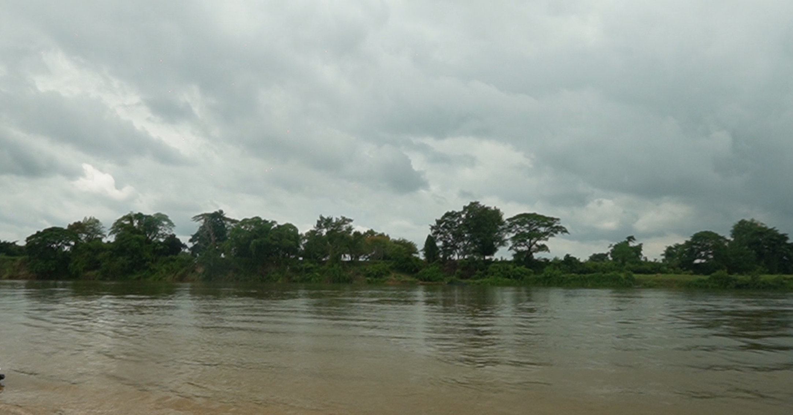
Maximum use of Water
On both river banks
Water by Pipelines from dam
End-Point Energy generation
Endless Water supply
Coldness transfer
Riverview properties
Full scale smart farming
Large scale industrialization
Space programs
Top up with groundwater
Export the excess
ToC
Notes:
Prototype:
Start with one river: Nam Ou River with already completed 7 cascades dams
- Shifting from the failed transmission line installation because it’s very expensive, loss of energy, and many substations.
- To The Hydroloop System:
Clean transportation, recreation (more tourists), water and energy supplies (more industries, urbanisation, clean and healthy lifestyle…) Capable of solving all the world’s problems and swift transition to Type I civilization with large-scale space exploration.

Slide 28
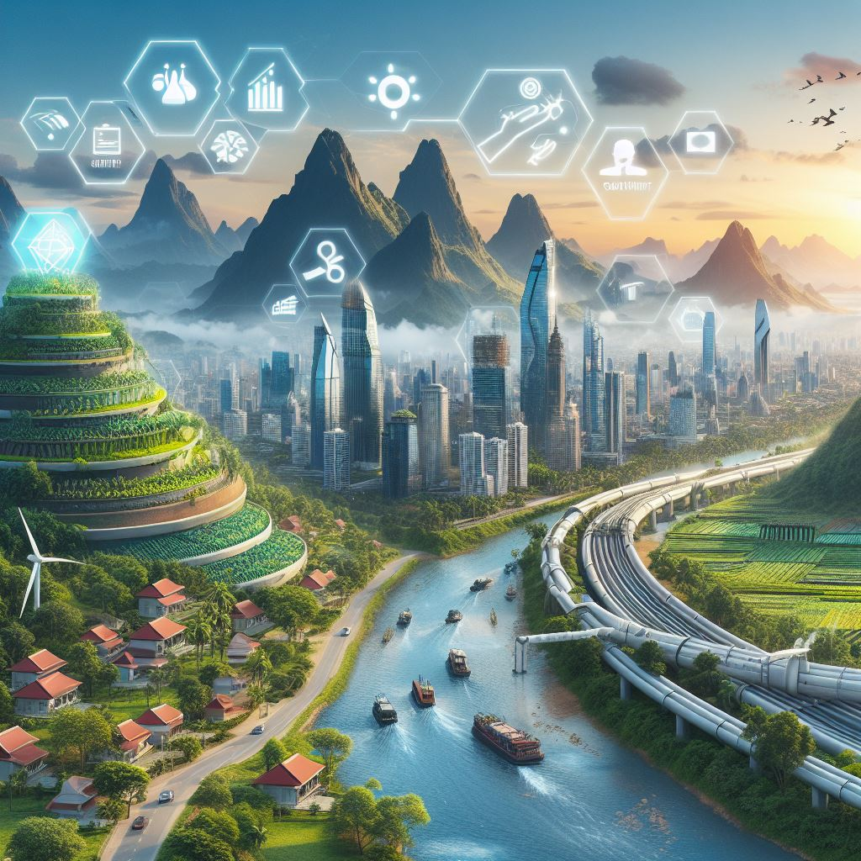
Fresh and alive supply chain
Clean Living
Fresher and alive food
Cooled by freshwater
AI management system
High altitude
Tropical climate
Less Global risk exposure
ToC
AI generated image
Notes:
Large-Scale Land-based Horizontal farming
Enhanced water and energy resources have the potential to foster the development of new industries, and promote urbanization, and tourism… facilitating a clean, healthy lifestyle. Deployment: any river in Laos, Thailand, and across the world where freshwater is abundance.
Furthermore, the availability of fresh plants and food, still ripening on trees, along with medicinal trees accessible around the clock, significantly contributes to the well-being of affluent consumers. These resources, available at their doorstep, underscore the benefits of sustainable and healthy living.

Slide 29
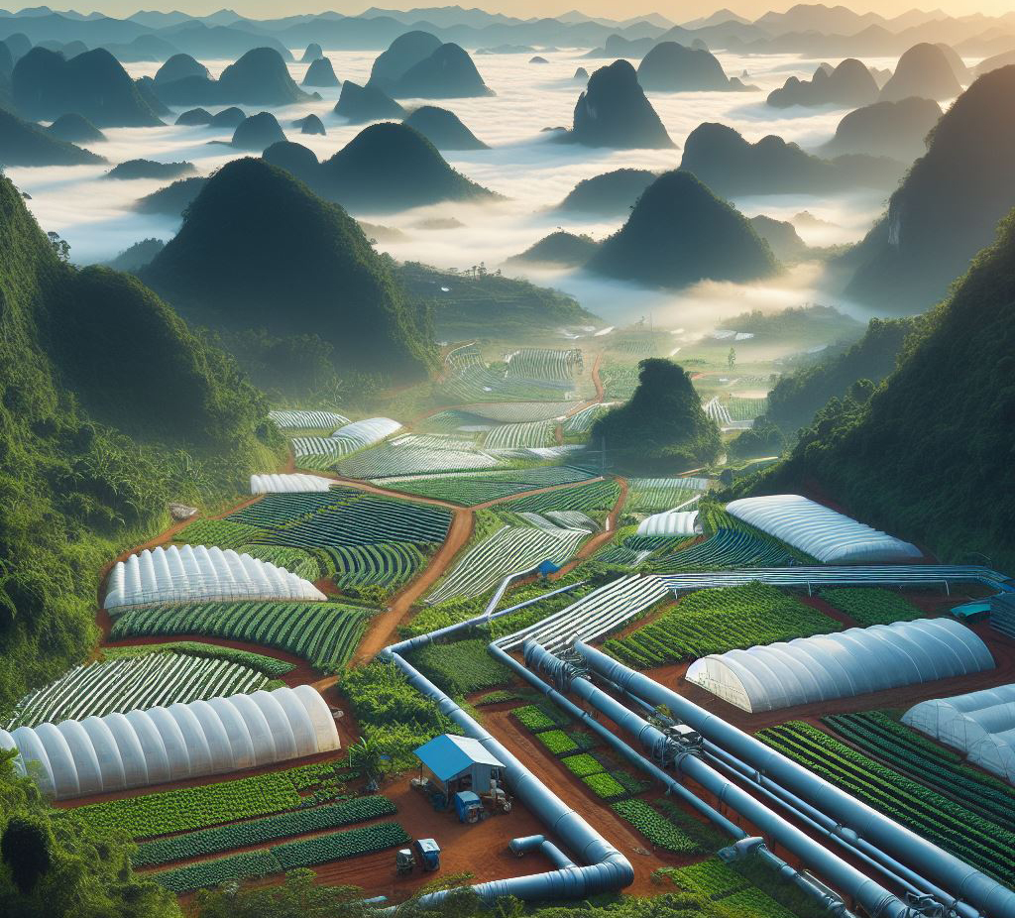
From Farm to Kitchen
Large-Scale farming
Fresher and alive food
Cooled by freshwater
AI management system
Elevating (Jacking) for extra floors
High altitude (flood avoidance)
Tropical climate
Supply other Greenhouses
ToC
AI generated image
Notes:
Large-Scale Land-based Horizontal farming
Enhanced water and energy resources have the potential to foster the development of new industries, and promote urbanization, and tourism… facilitating a clean, healthy lifestyle. Deployment: any river in Laos, Thailand, and across the world where freshwater is abundance.
Furthermore, the availability of fresh plants and food, still ripening on trees, along with medicinal trees accessible around the clock, significantly contributes to the well-being of affluent consumers. These resources, available at their doorstep, underscore the benefits of sustainable and healthy living.

Slide 30
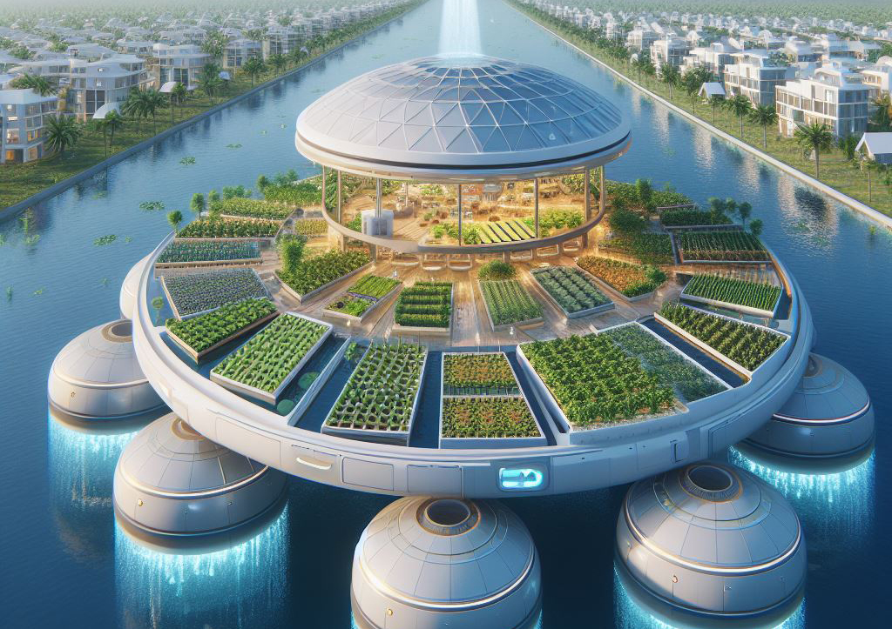
Floatable Greenhouses
Local Materials
Expandable
Water cooling
Flood/Drought resilient
Water protection
Intermediary scale farming
ToC
Notes:
Concept:
The Floatable Single Floor Greenhouse is an Carbon-Negative innovative design aimed at addressing both budget constraints, flood and drought prevention, and the need for expandability. Here are the key features:
Affordability and Local Materials:
The greenhouse is intentionally designed to be low-budget, utilizing materials that are readily available within the local community.
By leveraging locally sourced components, construction costs are minimized, making it accessible to a wider range of growers.
Expandability:
The greenhouse’s modular design allows for easy expansion. As your needs evolve or your crop variety increases, you can seamlessly add additional sections.
Whether you’re cultivating vegetables, herbs, or flowers, the expandable nature of this greenhouse ensures flexibility.
Prolonged Growing Period:
The primary goal of the Floatable Single Floor Greenhouse is to extend the growing season.
By providing a controlled environment, it allows for planting earlier in the spring and harvesting later into the fall.
The greenhouse’s design ensures optimal light exposure, temperature regulation, and protection from adverse weather conditions.
In summary, this innovative greenhouse combines affordability, adaptability, and extended growing capabilities, making it an excellent choice for resource-conscious farmers and gardeners.

Slide 31
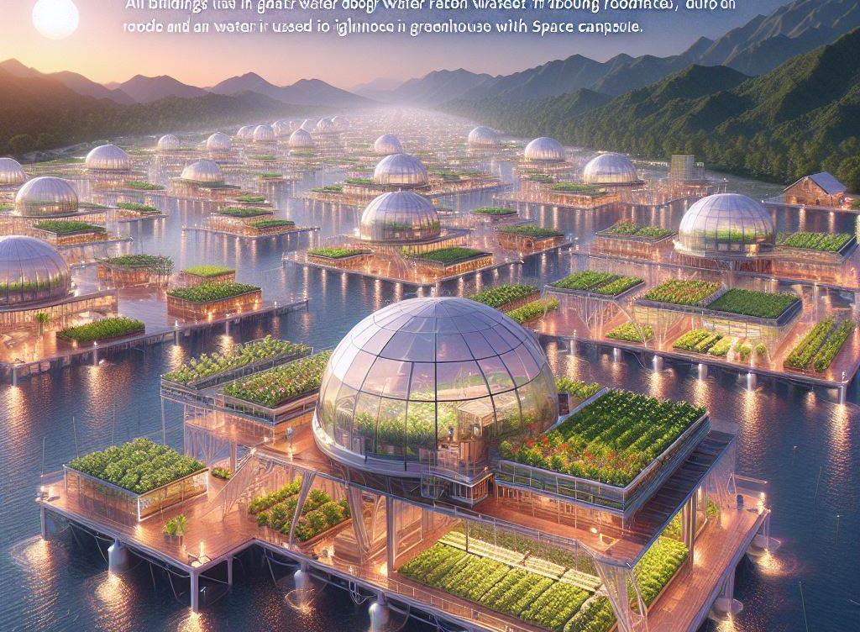
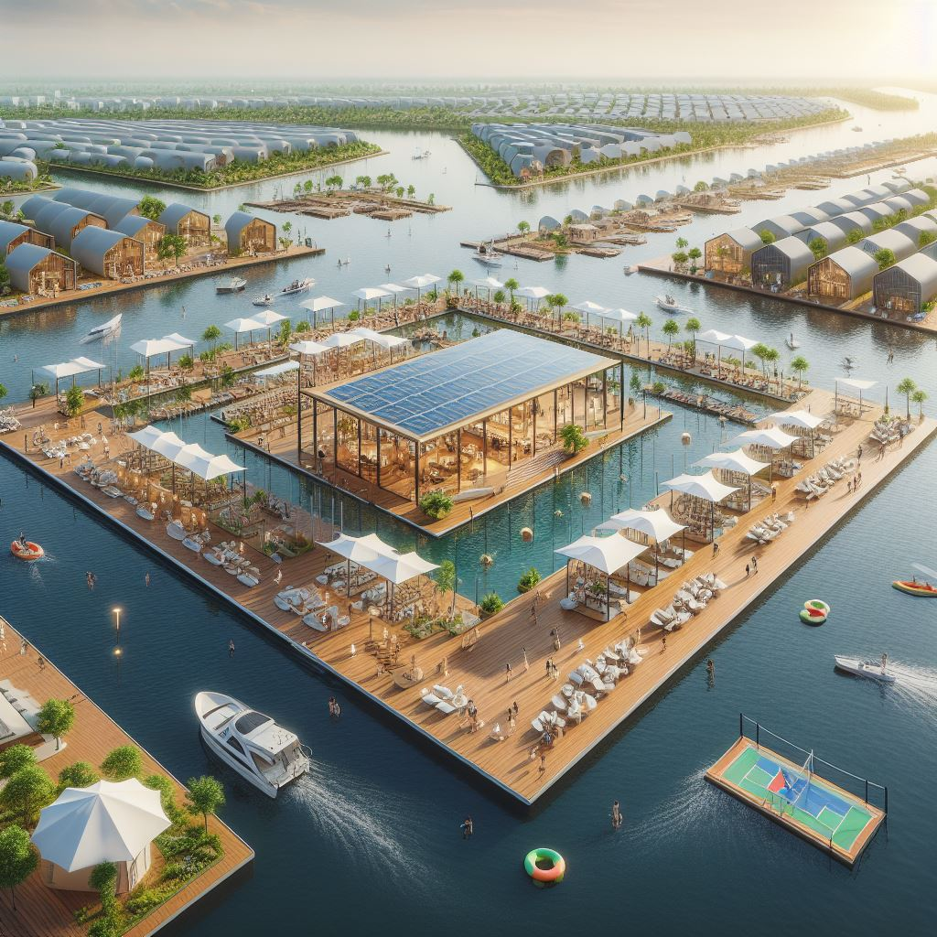
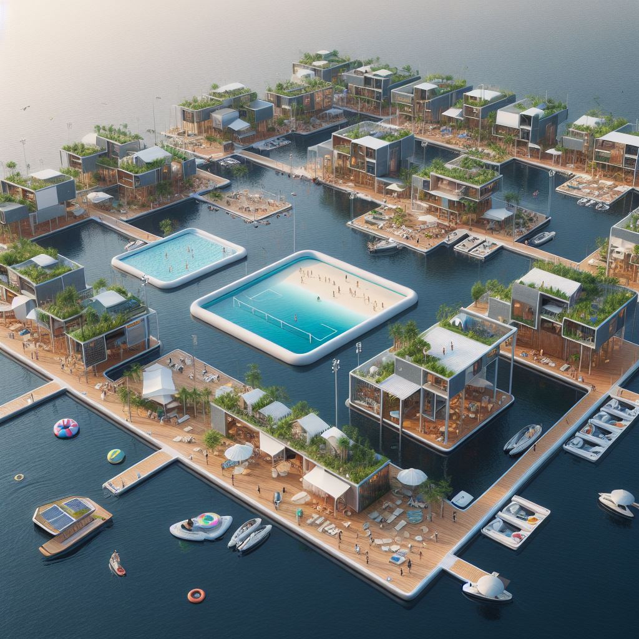
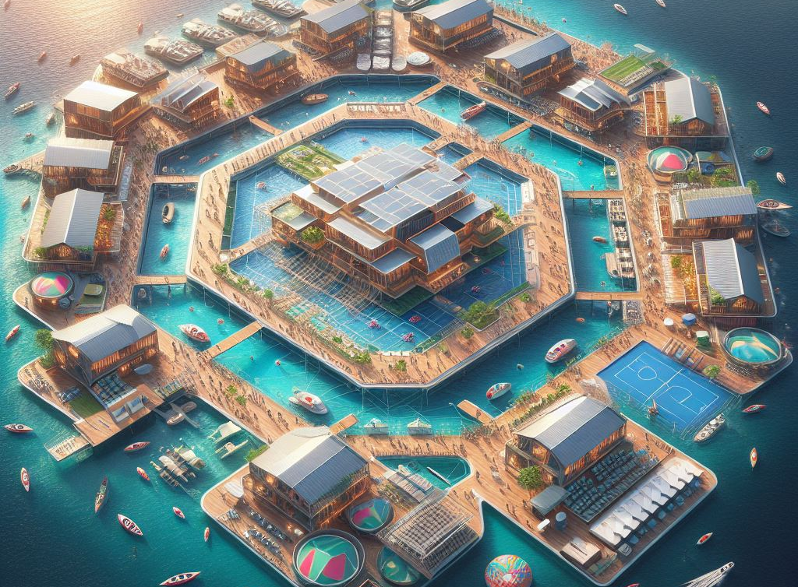
Reservoir Max ROI
Groundwater exchange
Transparent Solar cells
Water cooled buildings
Fresh and Alive Plants
Aquaculture
Water recreation
] The Hydroloop System
ToC
Notes:
Concepts for the Nam Gnum Reservoir:
The primary goal is to maximize the Return on Investment (ROI) for the Nam Gnum Reservoir. The concepts are based on a Carbon-Negative innovative design that addresses budget constraints, flood and drought prevention, and the need for expandability (toward Cataclysm preparedness and prevention). Here are the key features:
Affordability and Use of Local and Regional Materials:
The greenhouse is designed with a medium budget in mind, utilizing materials that are readily available within the local community. By leveraging locally sourced components, construction costs are minimized, making the project accessible to a broader range of investors.
Expandability:
The greenhouse’s modular design allows for easy expansion toward Cataclysm preparedness and prevention to add different modules, reconfigurable to facilitate logistics based on events. As your needs evolve or your crop variety increases, you can seamlessly add additional sections. Whether you’re cultivating vegetables, herbs, or flowers, the expandable nature of this greenhouse ensures flexibility.
Fresh and Alive Supply Chain Concept:
The primary goal of the Floatable Single Floor Greenhouse is to extend the growing season all-year round. By providing a controlled environment, it allows for year-round availability of fruits, vegetables, fish, crustaceans, and other ingredients. The greenhouse’s design ensures optimal light exposure (day and night), temperature regulation, and protection from adverse weather conditions. Ingredients are supplied by a “From Farm to Table” system, allowing for an uninterrupted supply chain.
Maximizing Consumer Retention:
Accommodation: All budget on-site accommodation merging with existing availability.
Entertainment: Water sports, day life activities, nightlife, shopping with green and carbon-negative design, in opposition to widespread concrete shopping.
R&D and Workshop Experiences: Visitor packages include R&D, workshops on green technology, carbon-negative, cooking class, sustainable living, deforestation workshop, local fauna and flora preservation, fire and pollution prevention, water management, energy management, exhibition, AI, IoT, and more.
In summary, this innovative greenhouse combines affordability, adaptability, and extended growing capabilities, making it an excellent choice for resource-conscious investors, farmers and gardeners. It’s not just a greenhouse, but a comprehensive solution for sustainable and profitable farming with sustainability in mind.

Slide 32
Water Reservoir
Hydroloop System implementation
Research and Development for
ASEAN UNSDGs implementation
Global Risks mitigation
ToC
Notes:
Concepts for Water Reservoir:
The primary goal is to maximize the Return on Investment (ROI) for Dam Reservoir. The concepts are based on a Carbon-Negative innovative design that addresses budget constraints, flood and drought prevention, and the need for expandability (toward Cataclysm preparedness and prevention). Here are the key features:
Affordability and Use of Local and Regional Materials:
The greenhouse is designed with a medium budget in mind, utilizing materials that are readily available within the local community. By leveraging locally sourced components, construction costs are minimized, making the project accessible to a broader range of investors.
Expandability:
The greenhouse’s modular design allows for easy expansion toward Cataclysm preparedness and prevention to add different modules, reconfigurable to facilitate logistics based on events. As your needs evolve or your crop variety increases, you can seamlessly add additional sections. Whether you’re cultivating vegetables, herbs, or flowers, the expandable nature of this greenhouse ensures flexibility.
Fresh and Alive Supply Chain Concept:
The primary goal of the Floatable Single Floor Greenhouse is to extend the growing season. By providing a controlled environment, it allows for year-round availability of fruits, vegetables, fish, crustaceans, and other ingredients. The greenhouse’s design ensures optimal light exposure, temperature regulation, and protection from adverse weather conditions. Ingredients are supplied by a “From Farm to Table” system, allowing for an uninterrupted supply chain.
Maximizing Consumer Retention:
Accommodation: All budget on-site accommodation merging with existing availability.
Entertainment: Water sports, day life activities, nightlife, shopping with green and carbon-negative design, in opposition to widespread concrete shopping.
R&D and Workshop Experiences: Visitor packages include R&D, workshops on green technology, carbon-negative, cooking class, sustainable living, deforestation workshop, local fauna and flora preservation, fire and pollution prevention, water management, energy management, exhibition, AI, IoT, and more.
In summary, this innovative greenhouse combines affordability, adaptability, and extended growing capabilities, making it an excellent choice for resource-conscious investors, farmers and gardeners. It’s not just a greenhouse, but a comprehensive solution for sustainable and profitable farming with sustainability in mind.

Slide 33
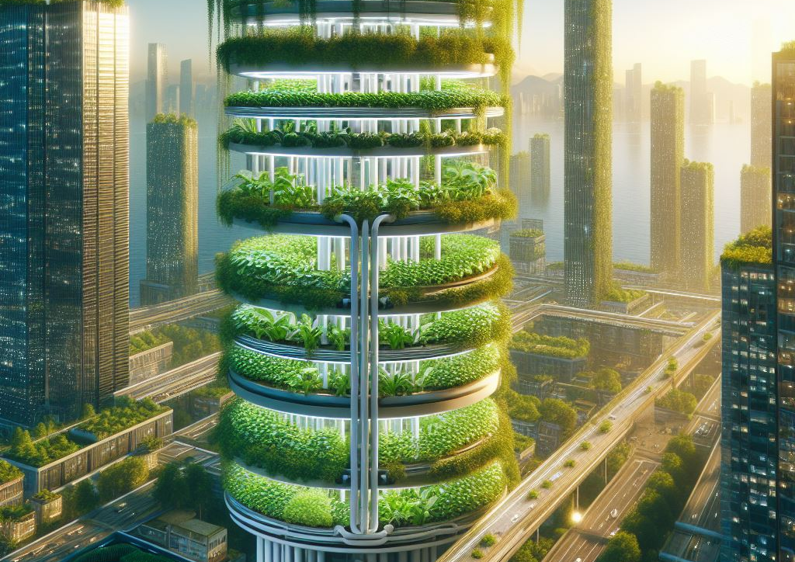
Skyscraper greenhouses
The Hydroloop System Vertical Farming
Cheap water and energy
Supply green walls and roofs
Improve air quality
Reduce heat
Low logistics cost
Create local jobs
Less plastic packaging
Fresher and alive food
Increase tourism
Low Industrialization costs
ToC
Notes:
These Carbon-Negative skyscraper greenhouses are designed for big budget to ascend vertically, with each floor serving a specific purpose.
The ground floor is dedicated to educational workshops with aquaculture, fostering a thriving aquatic ecosystem. Imagine shimmering pools teeming with fish and aquatic plants.
From the second floor upward, stackable smart farming greenhouses take centre stage. These modular structures house crops, herbs, mushrooms, and even small fruit trees. Their vertical arrangement maximizes space efficiency.
Space capsules on each floor serve as workstations for staff members. These transparent pods provide panoramic views of the lush greenery and allow workers to monitor plant health, adjust climate conditions, and tend to crops.
Cooling Mechanism:
The entire complex utilizes an ingenious cooling system.
Rainwater harvesting from the rooftop is a primary source of cooling. As rain cascades down the building’s exterior, it cools the greenhouse walls and nourishes the plants.
The water cycle continues: Excess rainwater is collected and pumped back up to the rooftop, ensuring a sustainable loop.
Evaporative cooling further moderates the internal temperature. Water misters release fine droplets, which absorb heat and create a refreshing microclimate.
The combination of rainwater and evaporative cooling maintains optimal conditions for plant growth while keeping the interior comfortable for staff.
The Hydroloop™ System: supplying water, cooling, and nutrients controlled by IoT.
Transparency and Connection:
The greenhouse walls are predominantly made of transparent materials, such as glass or polycarbonate. This allows sunlight to flood the interior, promoting photosynthesis.
Staff members can observe the lush greenery from their space capsules, fostering a sense of connection with nature.
The building’s transparency also invites visitors and tourists to witness the magic of sustainable agriculture in action.
Eco-Friendly Practices:
The greenhouses are powered by renewable energy sources, such as solar panels integrated into the rooftop.
Vertical gardens adorn the exterior, providing additional insulation and enhancing biodiversity.
The aquaculture system supports a balanced ecosystem, where fish waste fertilizes the plants, and plants filter the water.
Community Engagement:
These skyscraper greenhouses are not just functional; they’re also community hubs.
The ground floor hosts educational workshops, teaching visitors about aquaculture, sustainable farming, and environmental stewardship.
Rooftop cafes offer panoramic views of the city and the thriving green oasis below.
In summary, our vision combines cutting-edge technology, ecological consciousness, and architectural elegance. These skyscraper greenhouses stand as beacons of sustainable living, inviting people to coexist harmoniously with nature while reaping the benefits of fresh and alive produce and aquaculture.

Slide 34
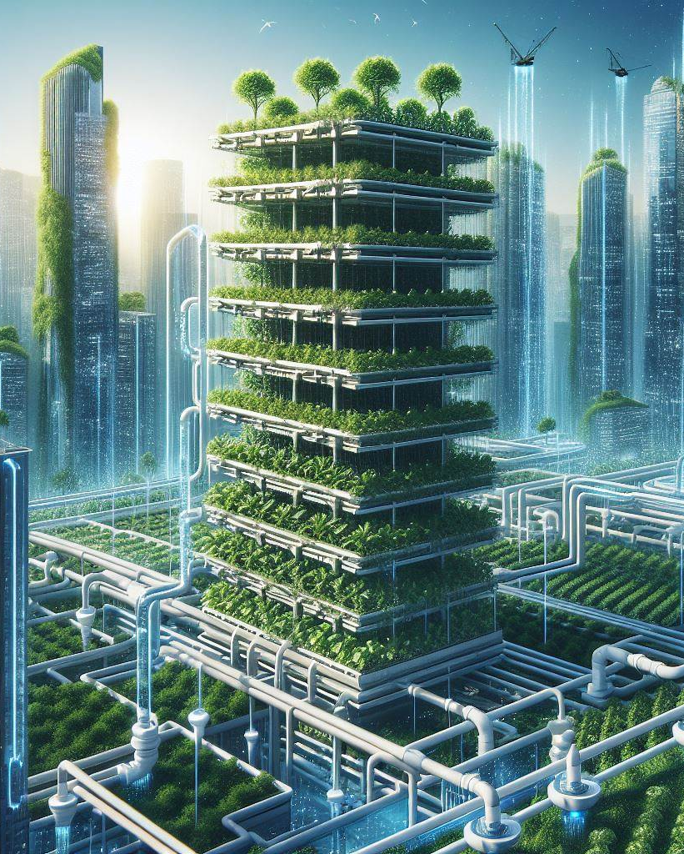
Vertical Farming
Land use efficiency
reduce the urban heat island
Flood and drought prevention
High Pressure water available
Fire prevention system
Continuous supply by Large-Scale farming
Videos
Carbon-Negative
ToC
Notes:
Fresher and alive food, therefore, increase health
Land use efficiency
green walls and roofs as air-conditioning
reduce the urban heat island effect
improve air quality by absorbing more CO2 and filter the air
More water available to clean the dust particles and extinguish fires
decrease the need for food plastic packaging by delivering food fresh and alive using recyclable trays
The ground floor and basements are designed for flood prevention

Slide 35
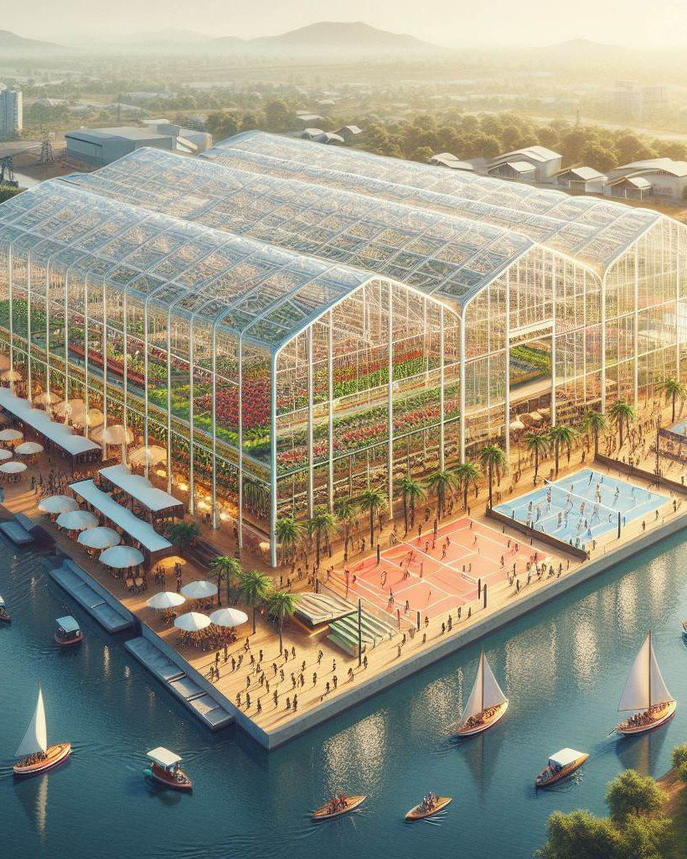
The Hydroloop System
Experience the Bounty of Nature
Supplied by Large-scale Smart Farming
Cooled by freshwater
Pick fresh and alive by visitors
Entertainment, Cooking-class
Videos
Yearly Exposition
ToC
Notes:
Fresher and alive food, therefore, increase health
Land use efficiency
green walls and roofs as air-conditioning
reduce the urban heat island effect
improve air quality by absorbing more CO2 and filter the air
More water available to clean the dust particles and extinguish fires
decrease the need for food plastic packaging by delivering food fresh and alive using recyclable trays
The ground floor and basements are designed for flood prevention

Slide 36
The Hydroloop System
Sport
Cultural
Entertainment
Yearly Exposition
ToC
Notes:
Fresher and alive food, therefore, increase health
Land use efficiency
green walls and roofs as air-conditioning
reduce the urban heat island effect
improve air quality by absorbing more CO2 and filter the air
More water available to clean the dust particles and extinguish fires
decrease the need for food plastic packaging by delivering food fresh and alive using recyclable trays
The ground floor and basements are designed for flood prevention

Slide 37
Carbon-Negative Expo
ToC
Notes:
Fresher and alive food, therefore, increase health
Land use efficiency
green walls and roofs as air-conditioning
reduce the urban heat island effect
improve air quality by absorbing more CO2 and filter the air
More water available to clean the dust particles and extinguish fires
decrease the need for food plastic packaging by delivering food fresh and alive using recyclable trays
The ground floor and basements are designed for flood prevention

Slide 38
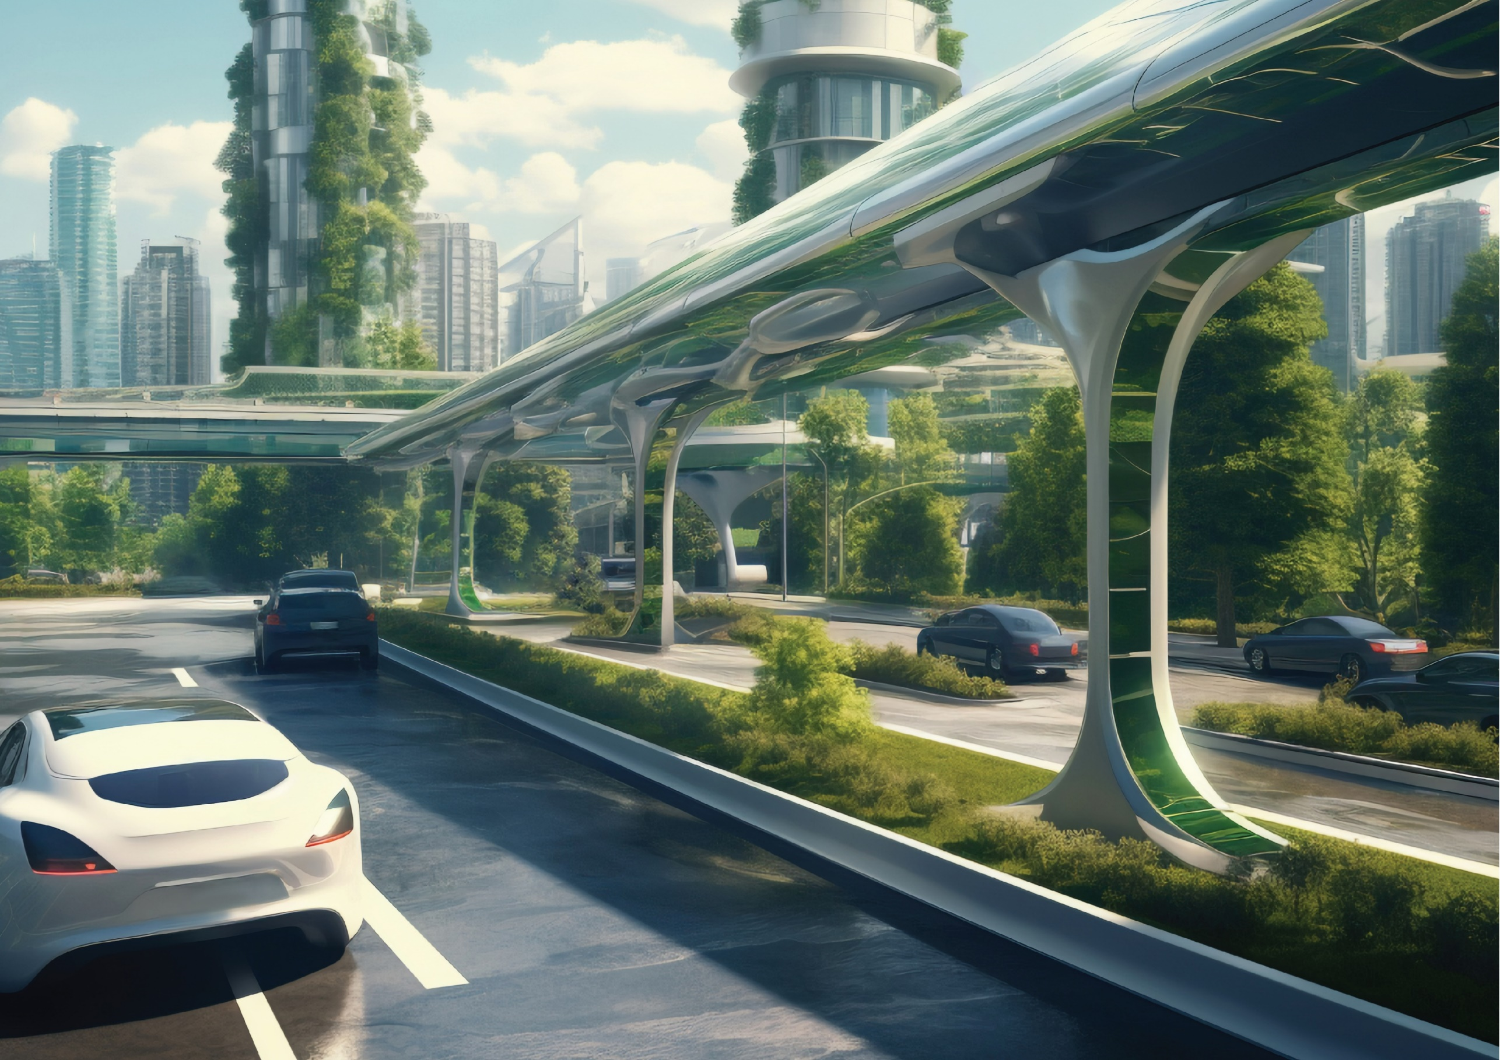
The Hydroloop™ System
clean transportation system
Move pressurized water 365 days / year
Transporting people and goods
Energy gain (gravity and kinetic)
can generate electricity at endpoint
Flood and fire control (no need of pump)
Heat effects reversal
Air purification (more plants)
ToC
Notes:
Hyperloop and Hydroloop are not the same trademark.
Hyperloop is a trademark of Space Exploration Technologies Corp¹. It refers to a proposed high-speed transportation system for both passengers and freight². The concept was documented by Elon Musk in a 2013 white paper² but never materialised and was very dangerous.
On the other hand, Hydroloop is a sustainable energy and water distribution solution that leverages geothermal energy to supply electricity and water constantly. It also aids in the transportation of goods and people. The system generates electricity at the end-point (no high voltage transmission lines) and distributes water to Smart Farming operations, which cultivate a variety of produce and aquatic life, for human consumption, recreation, cooling and heating, etc... The used water is then recycled with a portion to feed the geothermal power plants to energize the Hydroloop™ System, thus completing the cycle and/or starting a new loop. This project aligns with the United Nations’ 17 Sustainable Development Goals (UNSDG) making it The World Solution and allowing the construction of a Space Elevator from a 150km tall bona fide Spaceport tower filled with desert sand and water, safeguarded by hempcrete (possible by water distribution across the deserts) for infinite exploration.

Slide 39
ToC
Notes:
Hyperloop and Hydroloop are not the same trademark.
Hyperloop is a trademark of Space Exploration Technologies Corp¹. It refers to a proposed high-speed transportation system for both passengers and freight². The concept was documented by Elon Musk in a 2013 white paper² but never materialised and was very dangerous.
On the other hand, Hydroloop is a sustainable energy and water distribution solution that leverages geothermal energy to supply electricity and water constantly. It also aids in the transportation of goods and people. The system generates electricity at the end-point (no high voltage transmission lines) and distributes water to Smart Farming operations, which cultivate a variety of produce and aquatic life, for human consumption, recreation, cooling and heating, etc... The used water is then recycled with a portion to feed the geothermal power plants to energize the Hydroloop™ System, thus completing the cycle and/or starting a new loop. This project aligns with the United Nations’ 17 Sustainable Development Goals (UNSDG) making it The World Solution and allowing the construction of a Space Elevator from a 150km tall bona fide Spaceport tower filled with desert sand and water, safeguarded by hempcrete (possible by water distribution across the deserts) for infinite exploration.

Slide 40
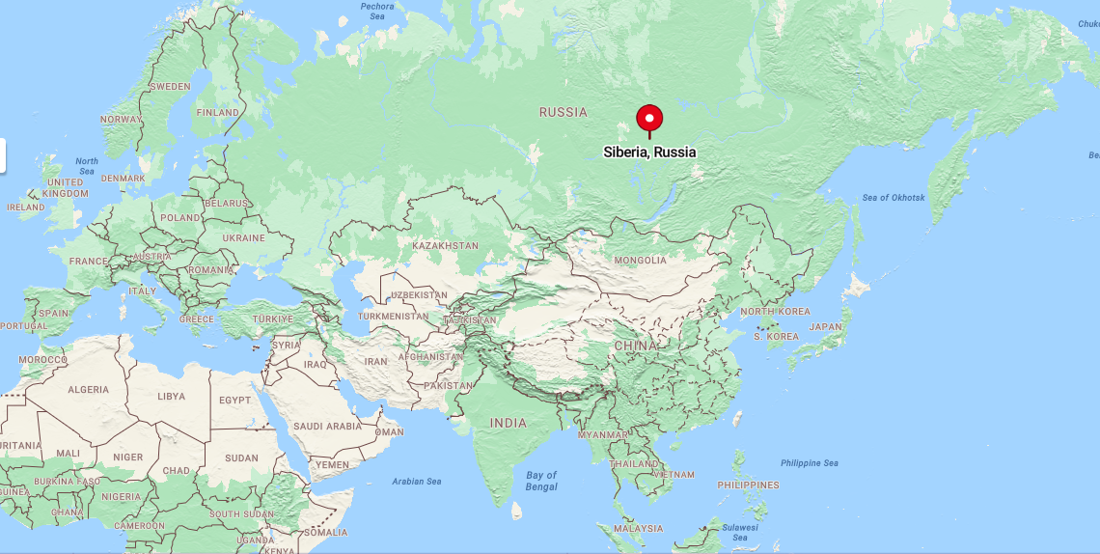
Cover all ASEAN Mainland and Oceania, expand via
Route 1: to China, Mongolia, Siberia, down to Türkiye, Iraq, Saudi Arabia and backward route to ASEAN Mainland.
Route 2: to Myanmar, Bangladesh, India, Pakistan, Iran, MENA, and Africa. Backward route to ASEAN Mainland.
Both routes have two separate hot/cold water pipelines that are interconnected with valves.
ToC
Notes:
Distributing hot water through pipelines has several advantages:
Protection from external elements: Water transported through pipelines is less likely to be contaminated by external elements such as dust, dirt, and debris. This is because the pipeline is a closed system that is not exposed to the environment.
Faster travel time: Water can travel faster through pipelines than through other methods of transportation such as open channels. This is because pipelines are pressurized, which allows water to move more quickly and efficiently. Additionally, pipelines can transport water up and down hills without the need for pumps.
Increased water speed: With the same pressure, smaller pipes can increase water speeds. This is because the smaller diameter of the pipe creates less friction, which allows water to flow more quickly.
Allow exploration of freezing Siberia: With hot water available, and a transport system, heat transfer will allow an extended number of days of mining operations in Siberia per year.
In addition to the mentioned benefits,
The System Can be upgraded to transport cargo and people as a potential transition to a clean transportation system. Goods and people can travel even if there is a volcanic eruption, deep freeze, tornado, hurricane, typhoon, desert storm, forest fire… and other types of risks that the system is designed to withstand.

Slide 41
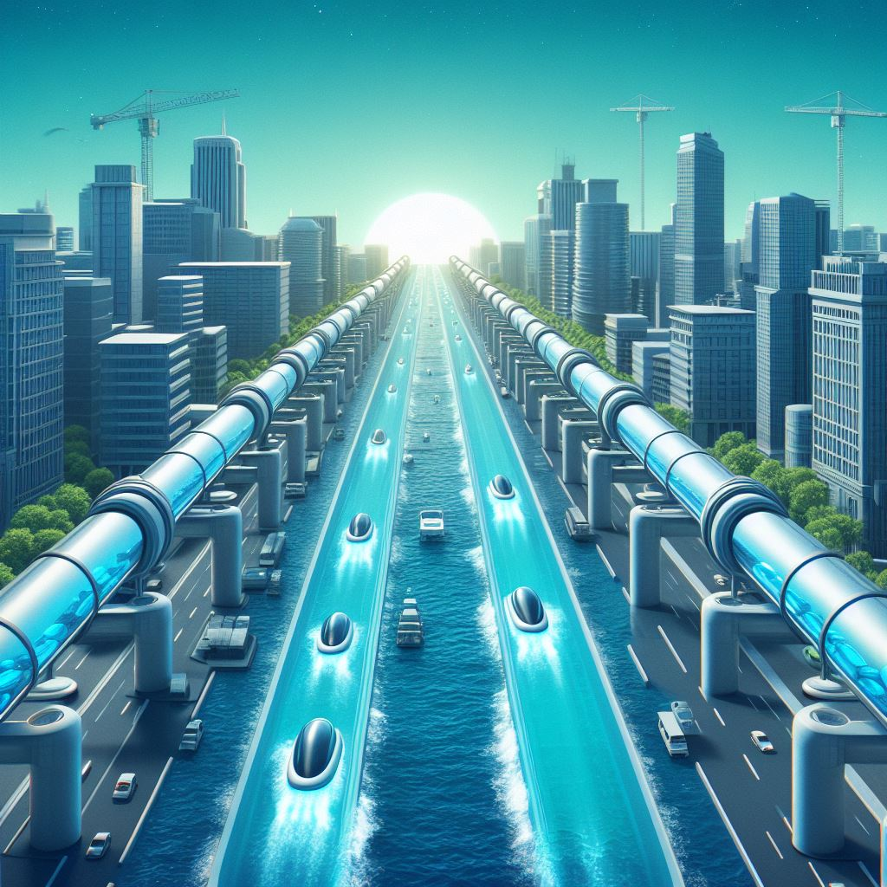
The Hydroloop™ System
clean transportation system
Move water 365 days / year globally
Maximize water conservation
Transporting people and goods
Energy: gravity and kinetic
can generate electricity at endpoint
Sea level control (Type I)
Global temperature control (Type I)
Emergency freshwater storage
Cataclysm prevention (Type I)
ToC
Notes:
A Hydroloop System is a clean transportation system using water using gravity and kinetic energy with an anti-seismic system. The image shows a futuristic cityscape with a network of tubes carrying water capsules that transport people and goods. The tubes are supported by pillars that have seismic isolation systems and energy dissipation devices. The tubes also have shape memory alloy devices and shock transmitters that help them adapt to seismic events. The image has a blue and green color scheme that reflects the water theme and the environmental benefits of the system.

Slide 42
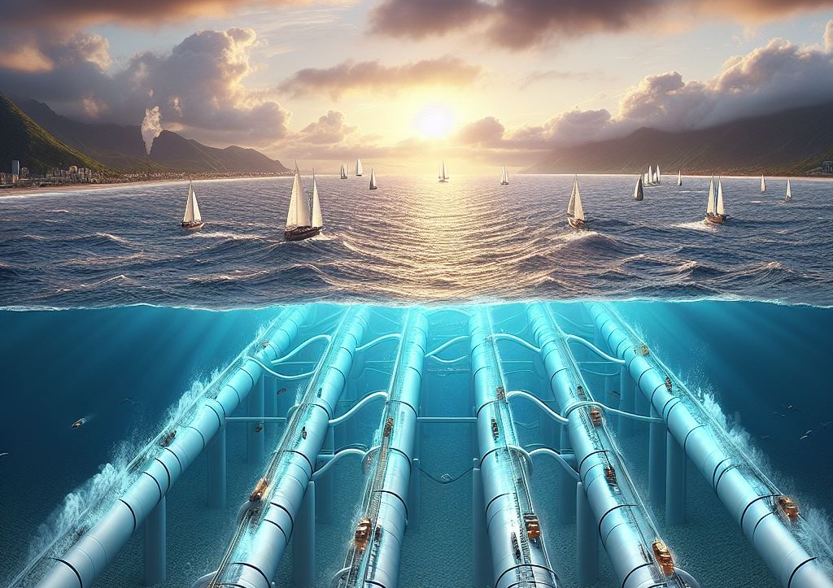
The Hydroloop™ System
Ocean heat/coldness harness
Power gain system
Ocean and tubes with same pressure
Emergency freshwater storage
Exploit the entire Planet Energy (Type I)
ToC
Notes:
A Hydroloop System is a proposed mode of transportation that uses a sealed pressurized tube to transport people and goods at high speeds. The system can be extended to run under the oceans as well. The Hydroloop System can be designed to maintain the pressure inside the pipe at the same or higher level than the ocean pressure by using safety valves. This ensures that the system is safe and efficient. The pods can travel using different routes with lower pressure.
In addition to transportation, the Hydroloop System can also be used to cool warm areas by utilizing the coldness of the deep oceans. This can be achieved by installing a heat exchanger in the system that extracts the coldness from the deep oceans and transfers it to the warm areas. For example, the MENA region can benefit from this technology.

Slide 43
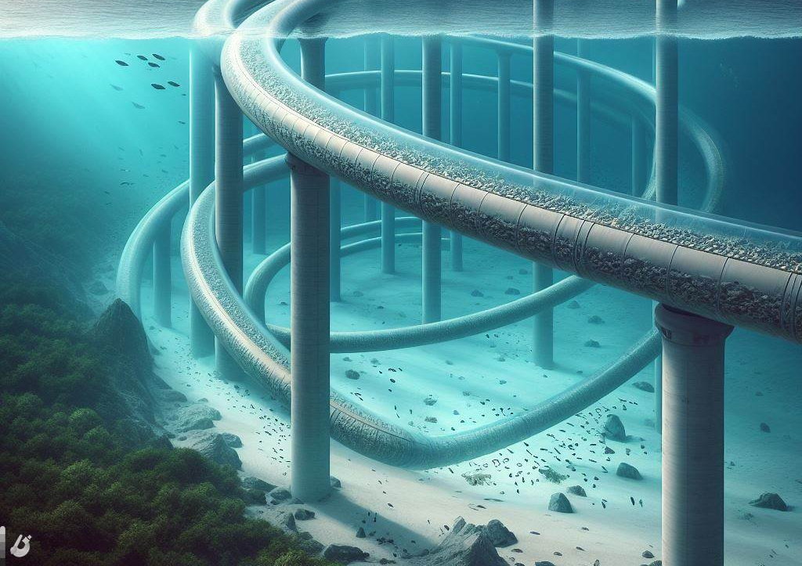
Hydroloop™ heat exchange System
Cyclone control
Global air temperature control
planet’s climate control
First Locations
South China Sea
Indian Ocean
Other Locations
The rest
ToC
Notes:
The Hydroloop Heat Exchange System is a heat exchange technology that transfers heat with the ocean coldness from the deep oceans to cool warm areas.
The Hydroloop Heat Exchange System can increase the number of cyclones, therefore a natural desalination system with The Hydroloop applications.
The Hydroloop system is a thermal expansion regulator.
Increase freshwater production and increase kinetic energy for more electricity production.
Increase Ocean evaporation while decreasing land air temperature increasing more chances for condensation, therefore creating more cyclones and rainfalls. This is a cheaper and more sustainable alternative to desalination plants
The Hydroloop Heat Exchange System allows Civilisation to control a planet’s climate, avoiding glacial period and snowball effect.
The Hydroloop system uses a large tube to decrease speed (stations, dispatches) and a narrow tube to increase speed (different routes).

Slide 44
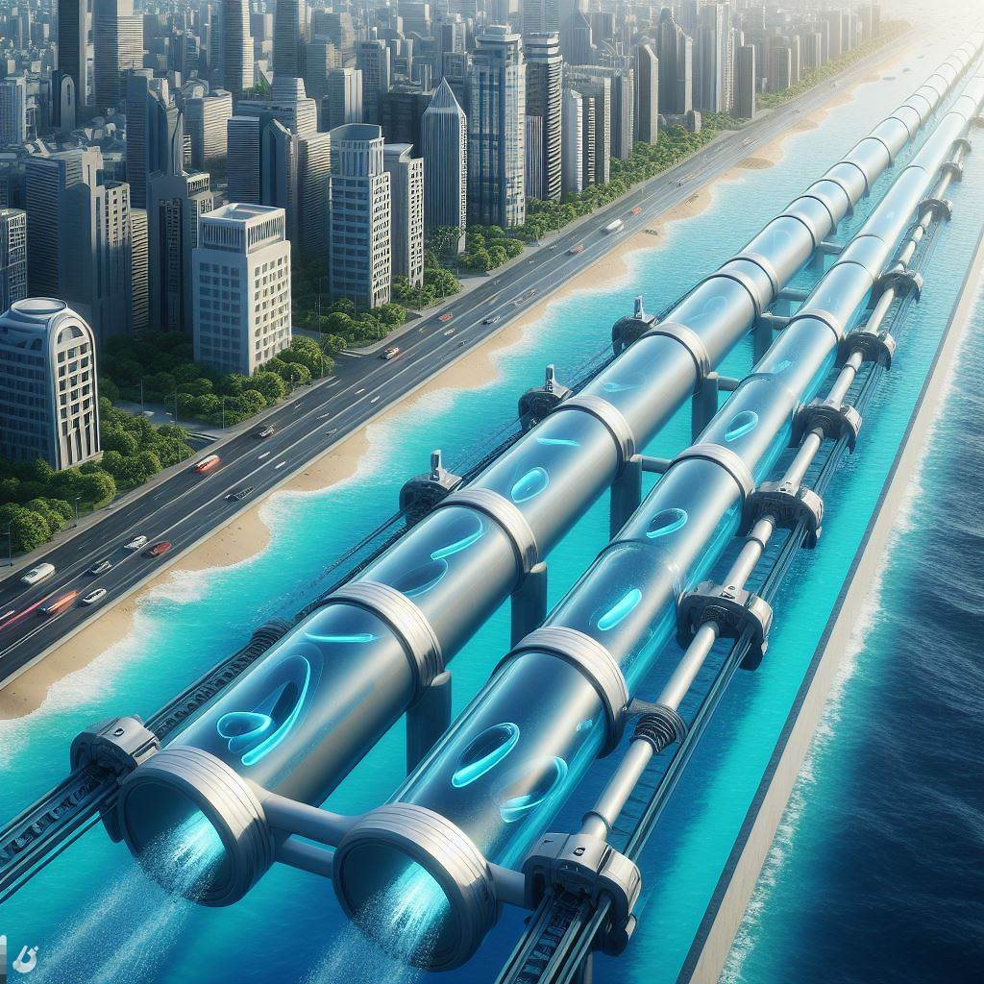
The Hydroloop™ System
Buried along the coastlines
Water distribution 24/7 & emergency storage
Heat/coldness transfer (climate regulator)
Reduce A/C energy consumption
Serve as coastal erosion protection and extend coastlines (using desert sand)
ToC
Notes:
24/7 Smart Solutions for Transport, Water Delivery, and Energy Production
The Hydroloop™ System is a sustainable energy and water distribution solution that leverages geothermal energy to supply electricity and water constantly. It also aids in the transportation of goods and people. The system generates electricity and distributes water to Smart Farming operations, which cultivate a variety of produce and aquatic life, and for human consumption. The used water is then recycled and directed back to the geothermal power source to energize the Hydroloop™ System to complete the cycle or prepare it to start again creating greater pressure. Employing AI-controlled valves, the loop is designed to navigate diverse terrains and topographies. It can ascend and descend slopes, enabling it to traverse from the Indian Sea Coast, cover the entirety of India, and return.
This picture depicts The Hydroloop System buried by the coastline avoiding any environmental and accidental damages.

Slide 45
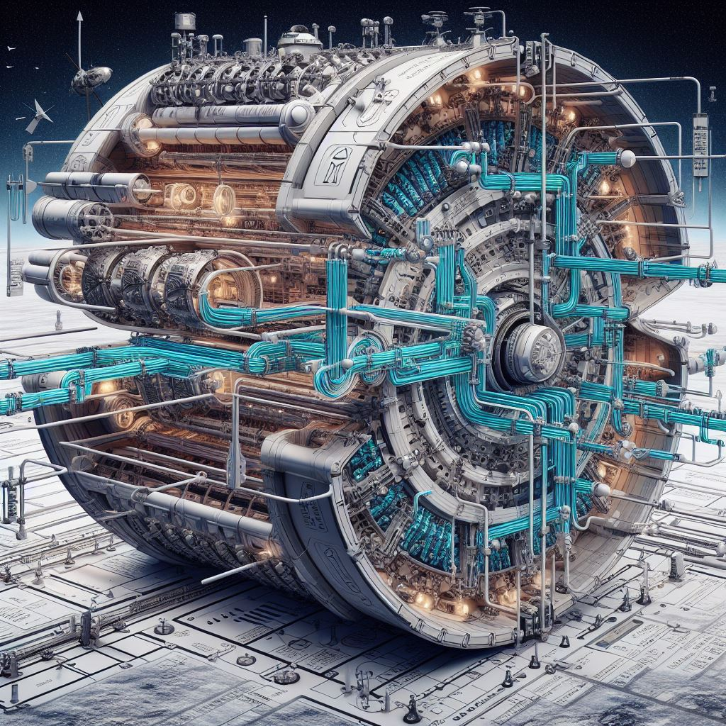
Space programs
Water as energy storage
No water, huge temperature fluctuation
Water circulation, even temperature
ToC
Notes:
A system of the Hydroloop deployment in a spaceship with no gravity. The Hydroloop is a network of pipes that transport water using kinetic energy, pressure, and temperature differences. The pipes are connected to various devices that use water for different purposes, such as cooling, heating, drinking, cleaning, and growing plants, and feeding lives. The system is designed to be efficient, sustainable, and adaptable to different environments. The image shows a cross-section of the spaceship, with the Hydroloop pipes in front to capture energy from space and distribute it along the walls and the ceiling. The pipes are color-coded according to the temperature and pressure of the water. The image also shows some of the devices that are connected to the Hydroloop, such as a water dispenser, a shower, a radiator, and a turbine.

Slide 46
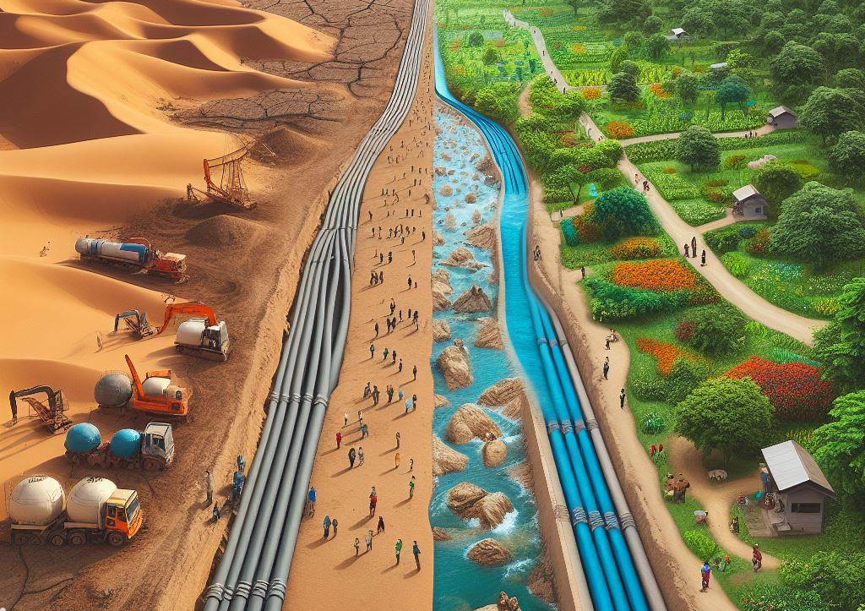
The Hydroloop™ System
Hyperloop alternative
No external energy
Energy gain system
distribute water
temperature control
ToC
Notes:
Rather than investing in current technologies such as trains, airlines, rockets, wind turbines, solar panels, and environmentally harmful dams, which will become obsolete with the return of the glacial period, a super volcanic eruption, asteroid, cataclysmic event… our focus should shift towards the innovation of future technologies. These new technologies should be capable of addressing global crises such as floods, droughts, fires, cosmic threats, the return of glaciers, the return of the glacial period, a super volcanic eruption, asteroids, cataclysmic events, pandemics, bank runs, underperforming bonds, and shortfalls in the return on investment for pension and insurance funds. The goal is to generate substantial physical wealth that can meet the needs of all individuals and organizations.
Two major Materials for The Hydroloop
Hempcrete, also known as hemplime, is a biocomposite material that is used for building and insulation¹. It’s known for its elasticity and resistance to stress-induced cracking and breaking². Unlike concrete, hempcrete is not brittle and does not require expansion joints¹². It continues to absorb carbon throughout its life, which can reduce surface cracking³. So, while no material is completely immune to expansion and cracking under certain conditions, hempcrete is designed to be more resilient and less prone to these issues compared to traditional concrete¹²³.
Glass Fiber Reinforced Polymer (GFRP) is a type of fiber-reinforced polymer where the reinforcement fiber is specifically glass fiber. The polymer is usually an epoxy, vinyl ester, or polyester thermosetting plastic. GFRPs are commonly used in a wide variety of industries, including the automotive, boat, and construction industries¹.
Here are some key points about GFRP:
Composition: GFRP is made by blending a fiber matrix with traditional fiber-reinforced polymers, forming fiberglass or glass-reinforced polymer¹.
Usage: GFRP is used in infrastructure and construction systems due to its high strength-to-weight ratio¹. It’s also used for rehabilitating many structures, including bridge decks, modular structures, concrete structures, and precast structures¹.
Advantages: GFRP is cost-effective compared to carbon fiber-reinforced polymer, corrosion-resistant, and flexible in application¹. It’s a great option for harsh environments, such as coastal structures¹.
Disadvantages: GFRP has some temperature restrictions and requires experienced engineers for design and application¹. This is not an issue in The Hydroloop System as water regulate GFRP temperature.
In summary, GFRP is a versatile and durable material that offers significant advantages over traditional construction materials like steel and concrete for building the Hydroloop System.

Slide 47
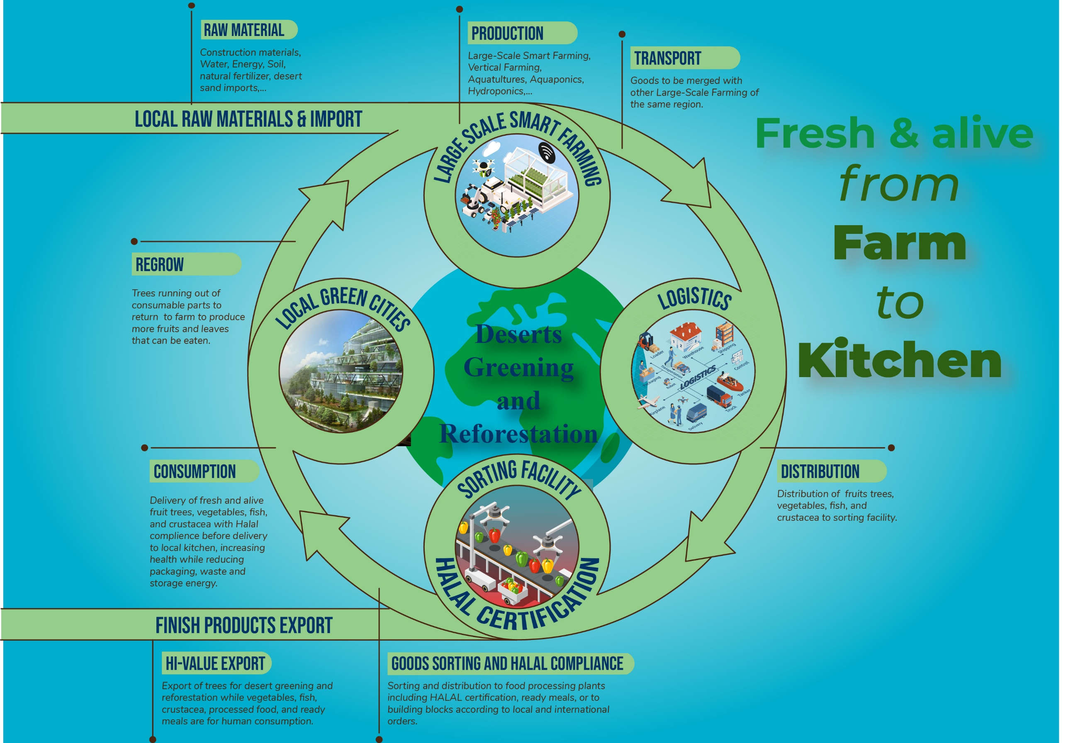
Trees to reduce cataclysm
quadrillions in number
To process and store water
To transfer energy
ToC
Notes:
Increase trees by quadrillions to store and process water. And transfer energy that otherwise will cause cataclysm No intensive plastic packaging, using the Carbon-Negative Hydroloop for logistics, and with geothermal, provide electricity and water, export goods (food, trees, water, and energy) and services globally and beyond.

Slide 48
Enhanced multilateralism cooperation
Private institutions
Government
Finance
Co-operator
Example for Laos
LAOINTER.com
Philanthropists
Education
Objective
Fast track IPO process
Low operation cost
Pre-diversified for investors
totrade.co
Cooperation chart:
totrade.co/chart
Simplify Operations
Fast-tracking the projects
International cooperation
Carbon-Negative operations
TOTRADE, HYDROLOOP and Hydroloop represent the commercial identities of TOTRADE LTD. This company is globally registered under The Crown with the registration number 13431000. The official address of TOTRADE LTD is International House, 36-38 Cornhill, City Of London. Web: totrade.co
ToC
Notes:
Enhanced multilateralism cooperation refers to the strengthening of international collaboration to address global challenges like USNDGs, with Global Crisis, and swift progress to Type I Civilization. This concept is increasingly important in today’s interconnected world, where issues such as climate change, pandemics, and economic crises transcend national borders.
There are several key aspects to enhancing multilateral cooperation:
Utilitarian Cooperation: This involves countries working together to minimize negative spillover effects and maximize positive ones. It also includes the provision of global public goods¹.
Inclusive Global Cooperation: This is about making international cooperation more representative and inclusive². For instance, the United Nations Secretary-General António Guterres has called for a revitalized international cooperation that is effective, representative, and inclusive².
Shared Values and Ethical Goals: Cooperation should not only be based on self-interest but also on shared values and ethical goals¹. An example of this is the COVID-19 Vaccine Global Access (COVAX) proposal, which argues for equitable global vaccine deployment¹.
Avoiding Duplication: A coordinated approach between multilateral platforms can help increase their impact, including by sharing good practice for collaboration, exploring areas for joint work, and avoiding duplication³.
In summary, enhanced multilateralism cooperation is about strengthening international collaboration to effectively address global challenges, making it more representative and inclusive, and grounding it in shared values and ethical goals¹²³. It’s a complex but necessary endeavor in our increasingly interconnected world.
This is how to implement the project, first in Laos then implement onto other ASEAN countries, and the rest of the world.

Slide 49
Hydroloop Prototype
By totrade.co
ToC
Notes:
Here’s a list of various products and their associated water footprints, which reflect the total volume of water used in their production:
Household Items:
Car: 52,000–83,000 liters
Leather Shoes: 8,000 liters
Smartphone: 12,760 liters
Jeans (cotton): 10,850 liters
Bed Sheet (cotton): 9,750 liters
T-shirt (cotton): 2,720 liters
Paper (1 piece; A4): 5.1 liters
Food:
Chocolate: 17,200 liters²
Beef: 15,400 liters²
Sheep Meat: 10,400 liters²
Pork: 6,000 liters²
Avocado: 2,000 liters²
Almonds, Cashews, Pistachios, Lamb and Mutton, Walnuts, Prunes (dried plums), Goat³
Industrial Products:
Automobiles: The water footprint varies depending on the size and complexity of the vehicle but is generally significant due to the metal, plastic, and other materials required.
Factories: Industrial processes can have a large water footprint, especially in sectors like textiles, paper, and chemicals.
These figures illustrate the hidden water that goes into everyday products, emphasizing the importance of water conservation and efficient usage across all sectors. Remember, the water footprint includes not just the direct water used in manufacturing but also the indirect water used in the entire production chain.

Slide 50
Water Recycling System
For each Mekong tributary
Recharged from PWC, more water
More products, more GDP
Cleaner water exits the system
And many more benefits
With more and cleaner water available
Ensure environmental and economic benefits
Consistent supply increase trees, food, clean energy, and industrial productions, a benchmark for global water management.
ToC
Notes:
The benefits of a Water Recycling System, especially when applied to each Mekong tributary and recharged from Primary Water Cycle:
Water Recycling System: Water recycling systems offer numerous advantages:
Sustainability: They help sustain the freshwater supply by reducing the demand on freshwater sources.
Economic Efficiency: The cost of producing recycled water can be lower than treating, processing, and consuming new water.
Environmental Protection: They reduce the strain on rivers, lakes, and aquifers, ensuring these ecosystems remain intact for future generations.
Pollution Reduction: By treating and reusing wastewater, we can reduce the amount of pollution that enters our waterways.
Energy Savings: The process of recycling water often requires less energy than other water supply methods⁵.
For each Mekong tributary: Applying a water recycling system to each tributary of the Mekong River could have significant regional benefits. It could help manage water resources more effectively, support local ecosystems, and contribute to the sustainable development of the region.
Recharged from Primary Water Cycle, more water: Recharging the system with PWC can increase the availability of water. This could lead to more efficient water use, mitigate Cataclysmic events, and a more resilient water supply system.
More products, more GDP: Increased water availability can boost productivity in various sectors, including agriculture and industry. This can lead to the production of more goods and services, contributing to economic growth⁶¹⁰.
Cleaner water exits the system: A well-designed water recycling system ensures that the water exiting the system is cleaner than when it entered. This can improve the quality of local water sources, benefit aquatic life, and reduce health risks associated with poor water quality.
And many more benefits: Other benefits include enhancing wetlands, reducing pollution, saving energy, and conserving water. It can also stimulate innovation, create employment opportunities, and drive economic growth in regions facing water stress and environmental challenges.
In summary, a Water Recycling System, especially when applied to each Mekong tributary and recharged from Primary Water Cycle (deep groundwater), can offer a wide range of environmental, economic, and social benefits. It represents a sustainable and efficient approach to managing water resources. However, it’s important to note that the successful implementation of such a system requires careful planning, management, and adherence to safety and quality standards.

Slide 51
Consistent
Water supply
Geothermal
Quickly scalable
Global benchmark
Hydrogen abundance
The Hydroloop™ System
global water, electricity, & hydrogen supply
Clean energy and transport system
Quickly Scalable
Benefit both environment and economy
climate emergency mitigation
Global benchmark
Quickly scalable Global Benchmark
It’s not about economic advantages for ASEAN alone, but Global.
It’s about teamwork for Humanity Survival (Humanity’s Last Hope) and Global Progress (Type I Civilization).
ToC
Notes:
In conclusion, the implementation of a Water Recycling System for the Mekong tributaries is a transformative initiative that promises substantial environmental and economic benefits. By harnessing the power of PWC (Primary Water Cycle) recharging, the system ensures a consistent supply of water, which is pivotal for increasing food, clean energy, and industrial productions. This, in turn, leads to a rise in product output, contributing positively to the GDP. Moreover, the system’s design guarantees that the water exiting is cleaner, reflecting a commitment to ecological sustainability. Overall, this innovative approach exemplifies a harmonious balance between progress and preservation, setting a benchmark for global water management projects.

Slide 52
Hydrogen & Oxygen affordability
Global hydrogen & Oxygen supply
Benefit both environment and economy
climate emergency mitigation
Quickly Scalable Global benchmark
Cheap supply for Space Programs
Quickly scalable Global Benchmark
Large-Scale Space Program is within Reach
Humanity’s Last Hope Initiative
and Progress toward Type I Civilization
ToC
Notes:
Large-Scale Hydrogen (H2) & Oxygen (O2) Production Initiative: as part of the Hydroloop™ Technology
Hydrogen & Oxygen production presents a promising avenue for clean energy that also implement Cataclysm delays and prevention, yet its traditional methods often clash with environmental sustainability, particularly in water-stressed regions. For every kilogram of hydrogen generated, nine kilograms of water are typically consumed, posing a challenge in maintaining ecological balance. However, the integration of hydrogen & Oxygen production with innovative systems like Hydroloop™ offers a transformative solution.
The Hydroloop™ process revolutionizes hydrogen production by leveraging greywater, a relatively clean wastewater source. Initially, greywater is introduced into geothermal hotspots, such as hot springs and the Primary Water Cycle. Here, it undergoes a transformative journey: heated to high pressures, it ascends as steam, tapping into Earth's natural energy reservoirs. This steam, under pressure, propels the Hydroloop™ System, facilitating efficient long-distance energy transmission.
As the steam cools and condenses into liquid, it becomes a valuable resource for local Hydroloop™ networks, replenishing reservoirs and powering nearby communities. This dual-purpose utilization optimizes resource efficiency while minimizing environmental impact. Moreover, the heat exchange process within the Hydroloop™ system purifies the water, ensuring its safety for consumption by eliminating harmful bacteria.
Beyond its environmental benefits, the Hydroloop™ system holds immense potential for hydrogen fuel production, alleviating logistical burdens and fostering sustainable energy practices. By tapping into natural water and gas reservoirs, hydrogen can be generated on a vast scale, contributing significantly to a net-zero carbon footprint.
Why Laos? Exploring the Potential of Hydroloop™ in Laos
Laos emerges as a prime candidate for pioneering Hydroloop™ technology, boasting unique characteristics that align seamlessly with its implementation:
1. Size and Development: With a landmass akin to the UK, Laos offers expansive territory for large-scale infrastructure experimentation. Its relatively undeveloped status provides a fertile ground for innovative solutions without the constraints of existing infrastructure.
2. Affordable Land: Land costs in Laos are notably lower compared to many other nations, facilitating cost-effective implementation of large-scale projects. This affordability eliminates financial barriers, fostering accelerated progress in technological deployment.
3. Tropical Climate: Laos's tropical climate proves advantageous for geothermal energy utilization, a cornerstone of the Hydroloop™ system. Consistent temperature gradients in the ground enhance energy efficiency, maximizing the potential for sustainable energy production.
4. Freshwater Abundance: Abundant freshwater resources, both surface and subterranean, position Laos as an ideal hub for sustaining Hydroloop™ operations. This water abundance not only supports hydrogen production but also facilitates cost-effective logistics for water, energy, and food distribution.
5. Proximity to China: Laos's strategic proximity to China streamlines access to essential materials and labor, expediting the prototyping process. Collaboration with China offers unparalleled opportunities for knowledge exchange and technological advancement.
6. Low Natural Disasters: Compared to other regions, Laos experiences minimal natural disasters, ensuring stability for long-term infrastructure projects. This resilience safeguards Hydroloop™ installations, fostering sustained operational efficiency.
In essence, Laos represents a fertile ground for realizing the full potential of Hydroloop™ technology, driving forward the transition towards a sustainable, hydrogen-powered future.

Slide 53
Documents/Links
Web: totrade.co
This file: PowerPoint, PDF
PDF: China Housing One billion people
PDF: LAO PDR FDI Protocol
Global issues:
Climate Emergency: totrade.co/climate
History of cataclysm: totrade.co/cataclysm
Laws of the Universe: totrade.co/laws
White Paper: totrade.co/paper
Global Solution:
totrade.co/solution, totrade.co/solpdf
Solution PowerPoint: totrade.co/pwp
Space by 2050: totrade.co/spaceby50
Communication: totrade.co/solcom
To Join us: totrade.co/form
Using SharePoint: totrade.co/sharepoint
By Teams: totrade.co/chart
Partners
China Belt and Road Initiatives (BRI), English, German.
Cataclysms classified
CIA declassified history of Cataclysm:
Sanitized, video, Original: totrade.co/cataclysm
Company
Company Official Records
POA: Totrade Legal to :man
Trademarks
Directors CV
PDF: Thone
Social Media
LinkedIn
Facebook
TikTok
Scan for Latest Update
team@365.totrade.co
ToC
Notes:
For decades, a book titled “True Adam & Eve Story: The History of Cataclysm” has been shrouded in mystery and speculation. The CIA classified it in 1966 before anyone had a chance to read it, and it remained a tightly-guarded secret until recently. Thanks to a Freedom of Information Act (FOIA) request, the CIA recently released 57 pages of the book’s 284 pages — though those pages have been “sanitized”. But why does the CIA think this book is so dangerous that it has been kept out of the public eye for so long?
CIA declassified History of Cataclysm: declassified under freedom of information act, after sanitized.
Original
Video
The Adam and Eve Story: The History of Cataclysms. A recently declassified document discusses the topic of lost ancient human civilizations, and cataclysms that occurred on earth thousands of years ago – causing them to vanish from the earth and without explanation.

Slide 54
Team Workshop: MS365 datacenter
365.totrade.co for Enterprises, Government, financiers, investors…
Carbon Negative System Teams in action across ASEAN for “Humanity’s Last Hope” initiative with a swift progress towards a Type I Civilization:
AGRI: Agriculture, Team, agri@totrade.co*.
AHF: Animal Husbandry and Fisheries, Team, ahf@totrade.co.
FOR: Forestry for global Reforestation, Team, for@totrade.co.
FIP: Financial Investment and Procurement, Team, fip@totrade.co.
ICC: International Cooperation & Collaboration, Team, icc@totrade.co.
IEC: Irrigation, electricity, clean transport, Team, iec@totrade.co.
IPO: International Trading, IPO, Team, ipo@totrade.co.
ITC: Information Technology (for Operators Team), Team, itc@totrade.co.
LMD: Land Management & Development, Team, lmd@totrade.co.
PIC: Projects Inventory & Catalogues, Team, pic@totrade.co.
RDSS: Research and Development, Scientific Studies, Team, rdss@totrade.co.
RDC: Rural Development and Cooperatives, Team, rdc@totrade.co.
TPP: Technical Promotion and Processing, Team, tpp@totrade.co.
*Email sent to team will be forwarded to members.
ToC
Notes:
For decades, a book titled “True Adam & Eve Story” has been shrouded in mystery and speculation. The CIA classified it in 1966 before anyone had a chance to read it, and it remained a tightly-guarded secret until recently. Thanks to a Freedom of Information Act (FOIA) request, the CIA recently released 57 pages of the book’s 284 pages — though those pages have been “sanitized”. But why does the CIA think this book is so dangerous that it has been kept out of the public eye for so long?
CIA declassified History of Cataclysm: declassified under freedom of information act, after sanitized.
Original
Video
The Adam and Eve Story: The History of Cataclysms. A recently declassified document discusses the topic of lost ancient human civilizations, and cataclysms that occurred on earth thousands of years ago – causing them to vanish from the earth and without explanation.

