Slide 1
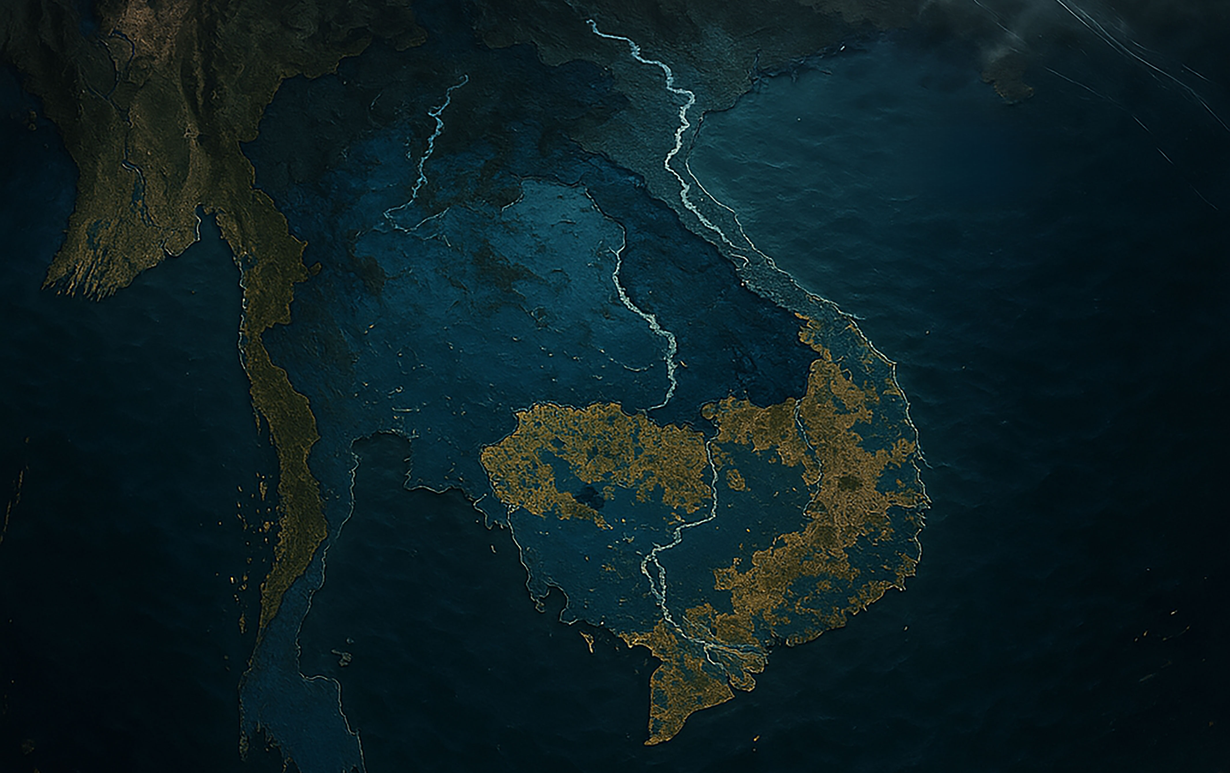




#UGDMN
Ultimate
Global
Disaster
Mitigation
Nexus
Advance Feasibility Study
&
Business Plan
Earth Climate and Geological Risks
From
Galactic Cosmic Rays (GCRs)
&
The Sun
By
:man:
of (know as)
: Phouthone-Thone: Siharath.
: VESSEL: PHOUTHONE-THONE: SIHARATH
for
totrade.co
team@totrade.co
Latest
totrade.co/cr
Notes:
UGDMN WORKING PAPER
#UGDMN means Ultimate Global Disaster Mitigation Nexus
It is an advanced Feasibility Study and Business Plan Earth Climate and Geological Risks from Galactic Cosmic Rays (GCRs) and The SunInstead of Outdated Climate Hansenism which will be explained later at first.
By the man, going by
: Phouthone-Thone: Siharath.
totrade.co
team@totrade.co

Slide 2
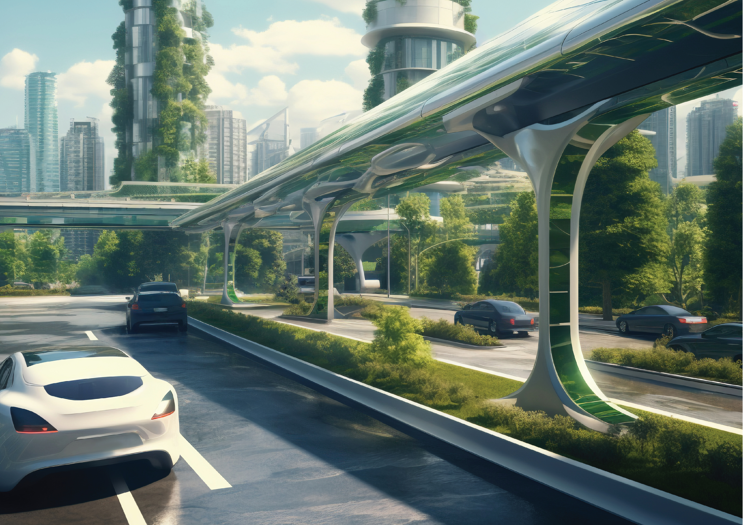

Table of Contents [ToC]
Climate Hensenism 4
Climate Realism 5
Galactic Cosmic Rays (GCRs) 7
GCRs Multi-Millenia Wavelength 9
GCRs Surge Effects on Lightning 10
GCRs Surge increase Fruit 11
GCRs Surge: Effects on Earth Interior 12
GCRs Triggered Next Cataclysm 14
Notes:
Table of Contents:
Climate Hensenism 4
Climate Realism 5
Galactic Cosmic Rays (GCRs) 7
GCRs Multi-Millenia Wavelength 9
GCRs Surge Effects on Lightning 10
GCRs Surge increase Fruit 11
GCRs Surge: Effects on Earth Interior 12
GCRs Triggered Next Cataclysm 14

Slide 3
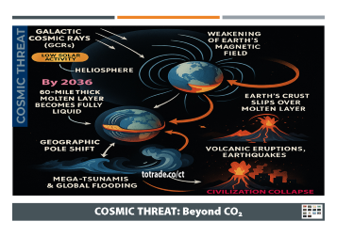
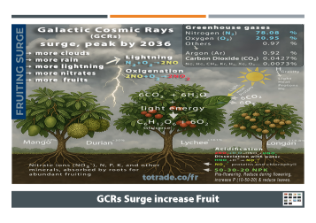
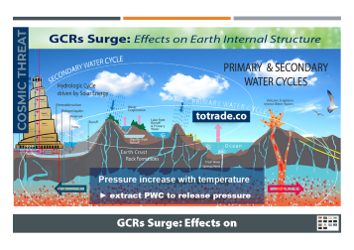
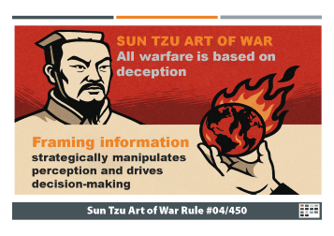
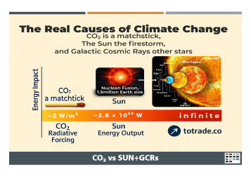
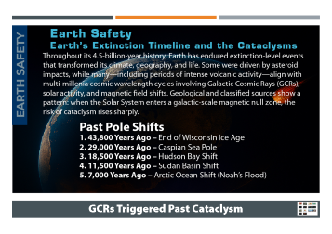

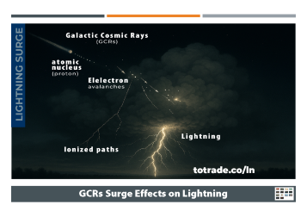

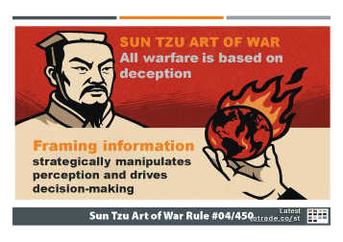
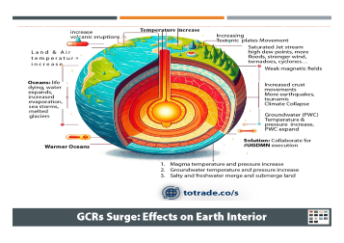
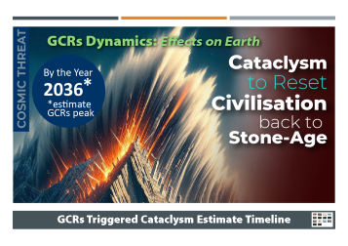
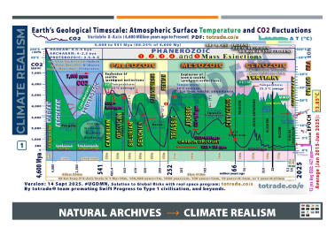
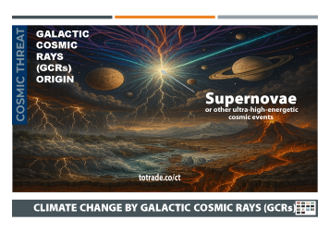

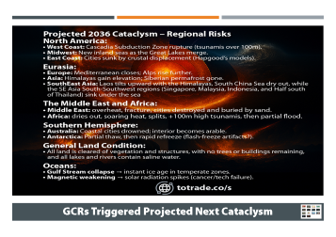
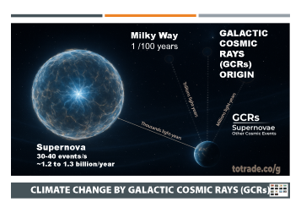


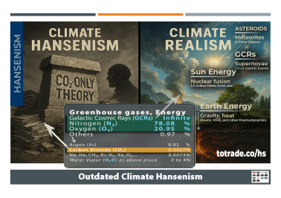
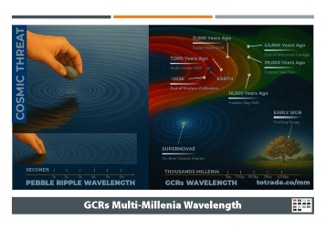

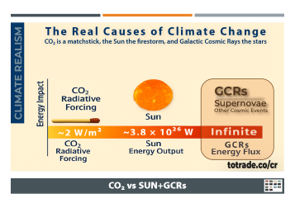




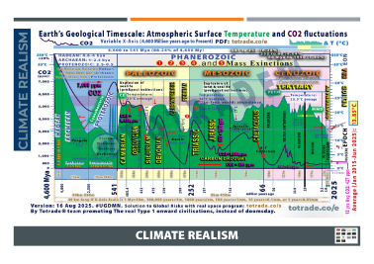
Notes:
Slides
Just 12 slides to reload the fresh knowledge about Climate Risks.
1. Hensenism
2. Climate Realism
3. GCRs origins
4. GCRs Effects
5. GCRs Wavelength
6. GCRs on Lightning
7. GCRs on Trees
8. GCRs on Earth Interior
9. Consequences

Slide 4
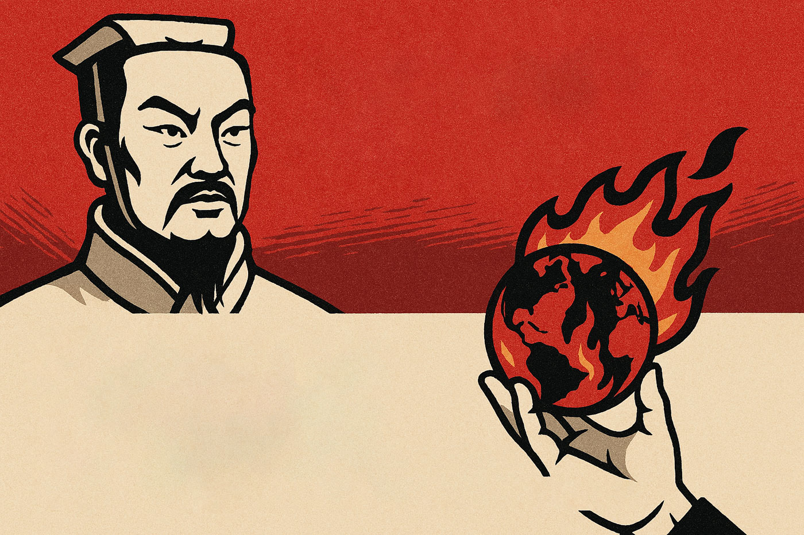


SUN TZU ART OF WAR
All warfare is based on deception
Framing information strategically manipulates perception and drives decision-making
Latest
totrade.co/st
Sun Tzu Art of War Rule #04/450
Notes:
SUN TZU ART OF WAR ( (Rule #4/450)
Sun Tzu said all warfare is based on deception.
Today, exaggerated climate alarmism shapes perception and policy. Coercive green ideology imposed on poor nations functions as corporate colonialism.
Through resource extraction, debt traps, land grabs, and by corrupting dictators under weak leadership, the affluent financial powers fund their corporate allies to exploit while framing humanity as its own enemy totrade.co/rome, deepen banking and corporate dependency, driving division, inequality, poverty, and conflict by pretending to save the planet.
EXAMPLES OF DATA MANIPULATION:
A. Tree-ring Natural Archive, youtu.be/K_8xd0LCeRQ?t=195
Chart based on tree-ring density data compiled by Keith Briffa and colleagues across the Northern Hemisphere reconstructed temperatures back to 1400. It showed:
• Large variability with no steady warming trend
• Peak warmth in the 1930s
• Cooling into the early 1990s, ending below the six-century average
B. Ice Core & Sediment Layers Natural Archives, youtube.com/jP8nz0cVbzQ&t=181s
Temperature reconstruction using ice core data from Greenland shown in orange, sediment layers from the tropical passer straight in Indonesia shown in black so it's not a regional thing.
The match is remarkably close and tell the same old story: rapid and abrupt warming after the end of last glaciation by cataclysm 7,000 Years Ago – Arctic Ocean Shift, Noah’s Flood, totrade.co/e, a peak about 6,000 years ago, then an overall decline since.
Let's wait how Climate Alarmism in the North Hemisphere will feel their Global Warming in winter.
The IPCC faced results that contradicted its warming narrative of Sun Tzu–style deceptive warfare and shifted to alternative methods more manipulable to favor alarmist claims.
Communication to Top Financial Powers:
If you believe your cataclysm preparedness is secure, think again.
Current strategies depend on fragile systems, misleading narratives, and hidden dependencies. True security demands funding solutions that protect people and resources, while enabling rapid post-cataclysm recovery and accelerating progress toward a Type I Civilization—without regressing to a Stone Age. Invest in #UGDMN to build resilience that is real, scalable, and rapid globally transformative.

Slide 5
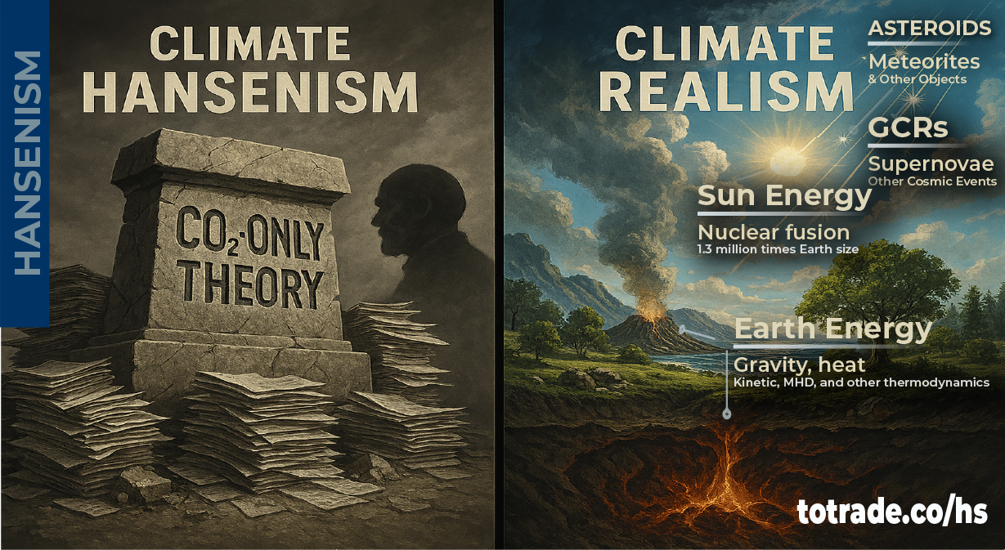
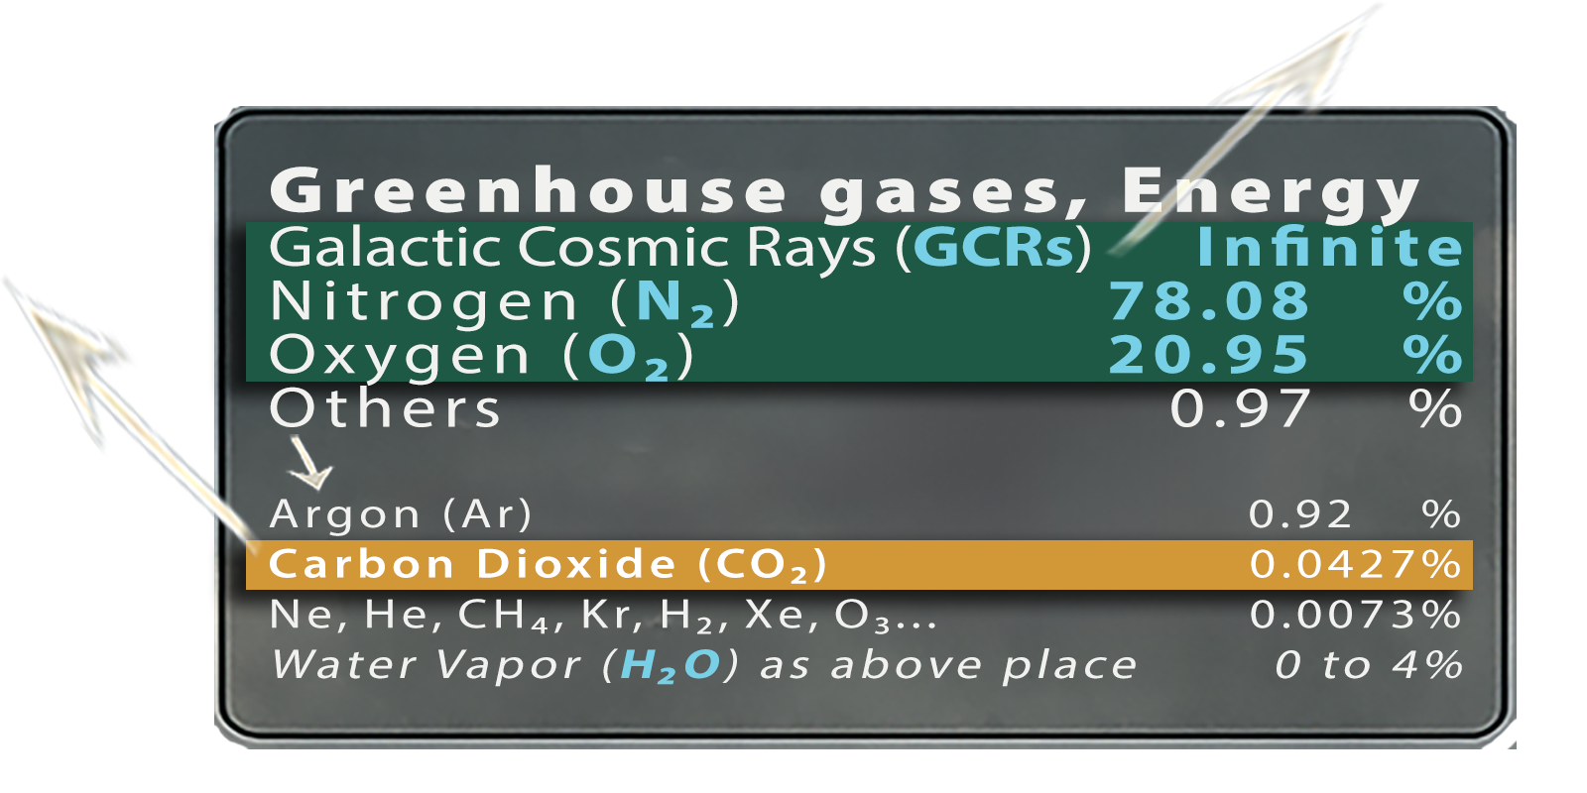

Outdated Climate Hansenism
Notes:
Climate Hansenism vs. Real Drivers
• Hansenism frames CO₂ as the main cause of climate change
• Promotes carbon taxes, emission caps, and CO₂-centric education
• Ignores real drivers: Galactic Cosmic Rays (GCRs), solar variability, tectonic shifts
• CO₂ is only 0.04% of the atmosphere—chemically inert, used by plants
• GCRs trigger ionization, lightning, tectonic shifts, and cataclysms
• Energy comparison:
– CO₂ = matchstick
– Sun = firestorm
– GCRs = all nuclear bombs + Sun + stars
• Hansenism fails to explain abrupt cataclysms
Final line:
CO₂ is not the cause. GCRs and solar forces are. Prepare with UGDMN.
🔗 FS & BP: totrade.co/pdf | totrade.co/biz based on True Science: totrade.co/g and Earth History: totrade.co/e | totrade.co/h Solutions: totrade.co/s | totrade.co/p | totrade.co/m Call: totrade.co/ca | Join: totrade.co/join PPT: totrade.co/cr | Biz Plan: totrade.co/bp

Slide 6
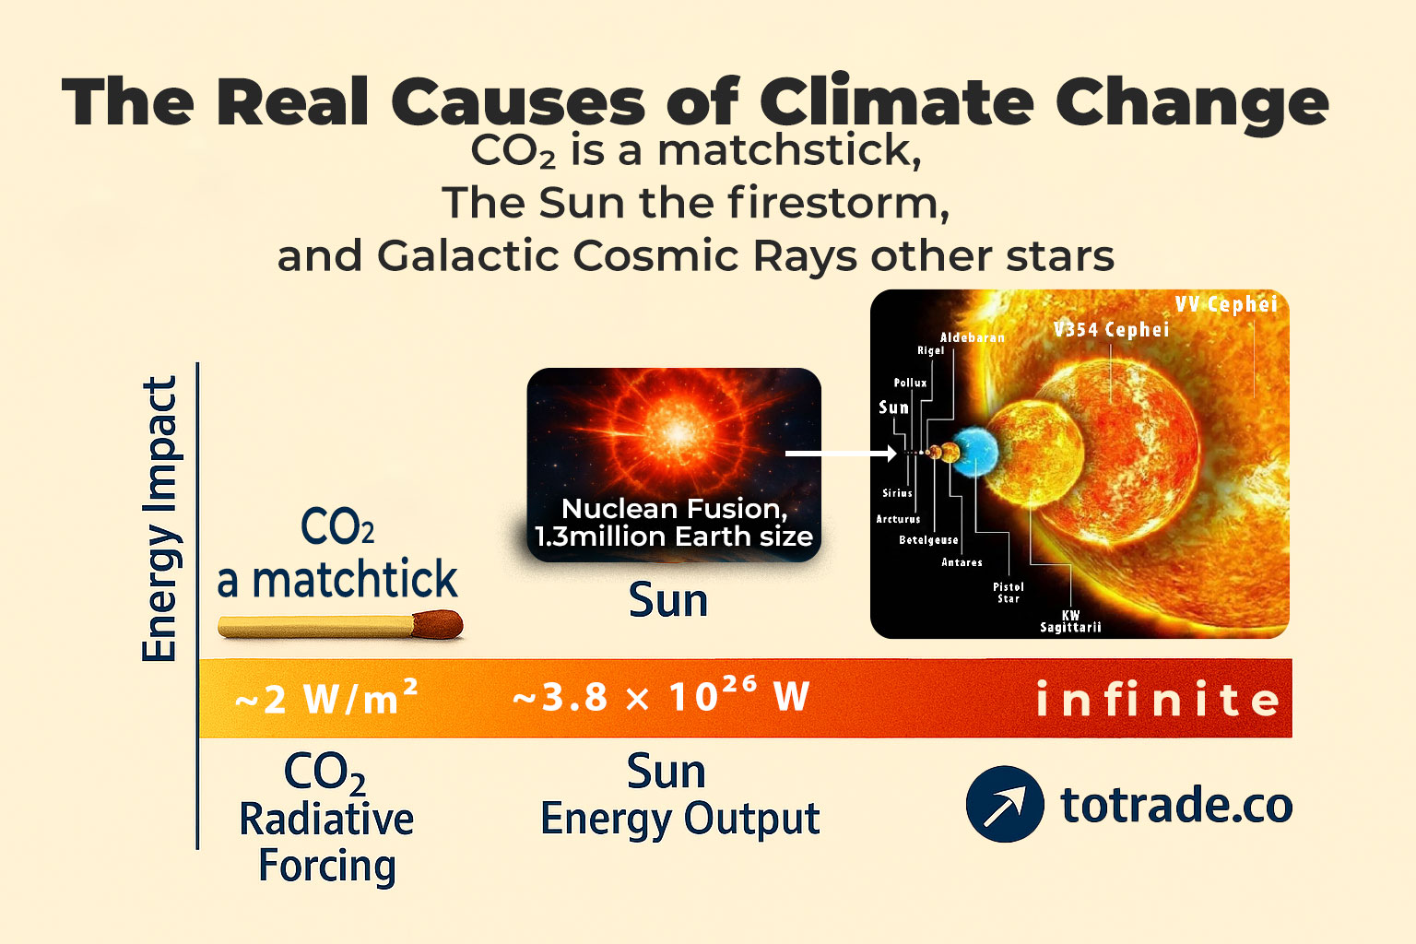
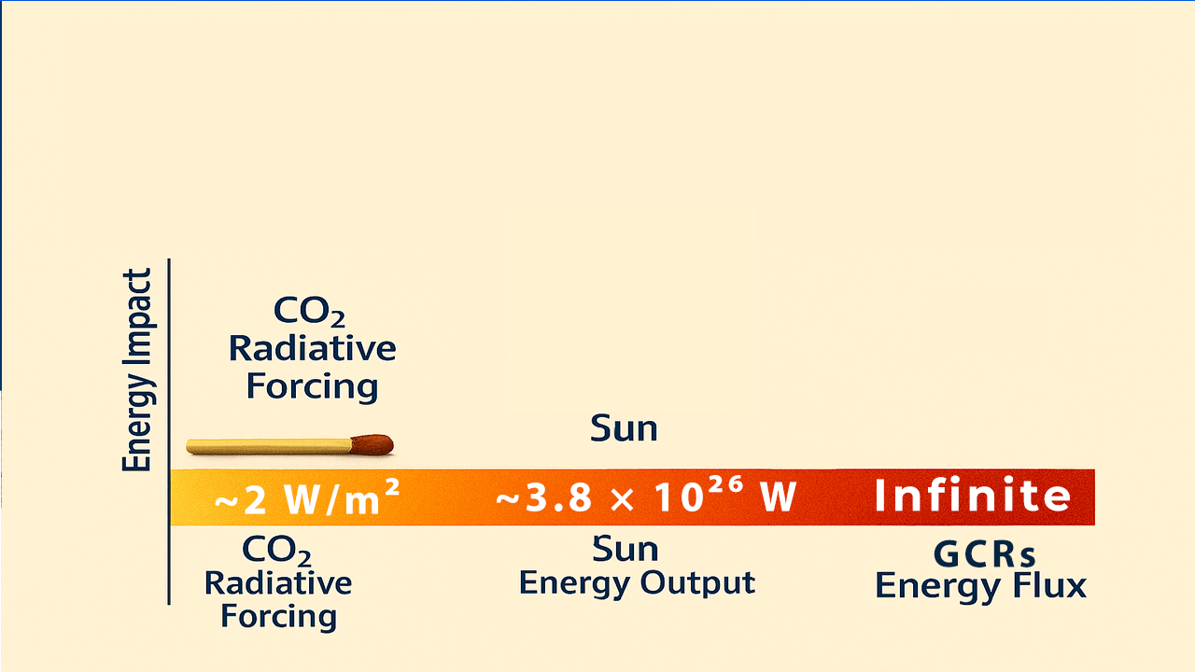
CO₂ vs SUN+GCRs
Notes:
The real causes of Climate Change aren’t what you’ve been told.
CO₂ is only 0.04% of the atmosphere—an inert trace gas.
The real drivers are solar and infinite cosmic forces shaping Earth’s climate and interior.
Order of Influences:
• CO₂: Plant Photosynthesis.
• Sun: Plant Photosynthesis. ➙ Lightning ➙ Planets (Atmosphere & Interior) ➙ Solar System.
• GCRs: Plant Grow ➙ Lightning ➙ Planets (Atmosphere & Interior) ➙ Solar System ➙ Galaxies➙ Universe…
In comparison for boiling 10 liters of water:
• Using CO₂ is like using a matchstick.
• The Sun is like using a firestorm.
• GCRs are like using all nuclear bombs and the Sun combined.
Energy Comparison
• CO₂ Radiative Forcing: ~2 W/m² (nearly invisible on Sun Energy scale)
• Sun Energy Output: ~3.8 × 10²⁶ W (nearly invisible on GCRs Energy scale)
• GCRs Energy Flux: Infinite orders of magnitude beyond CO₂ and even the Sun, influencing entire galaxies and the Universe...
Science: totrade.co/g
History: totrade.co/e | totrade.co/h
Solution: totrade.co/p | totrade.co/s | totrade.co/m
Call to Action: totrade.co/ca
PDF: totrade.co/biz | totrade.co/pdf
PowerPoint: Climate Realism, totrade.co/cr
#UGDMN #ClimateRealism #Cataclysm #GCR #SunEnergy

Slide 7
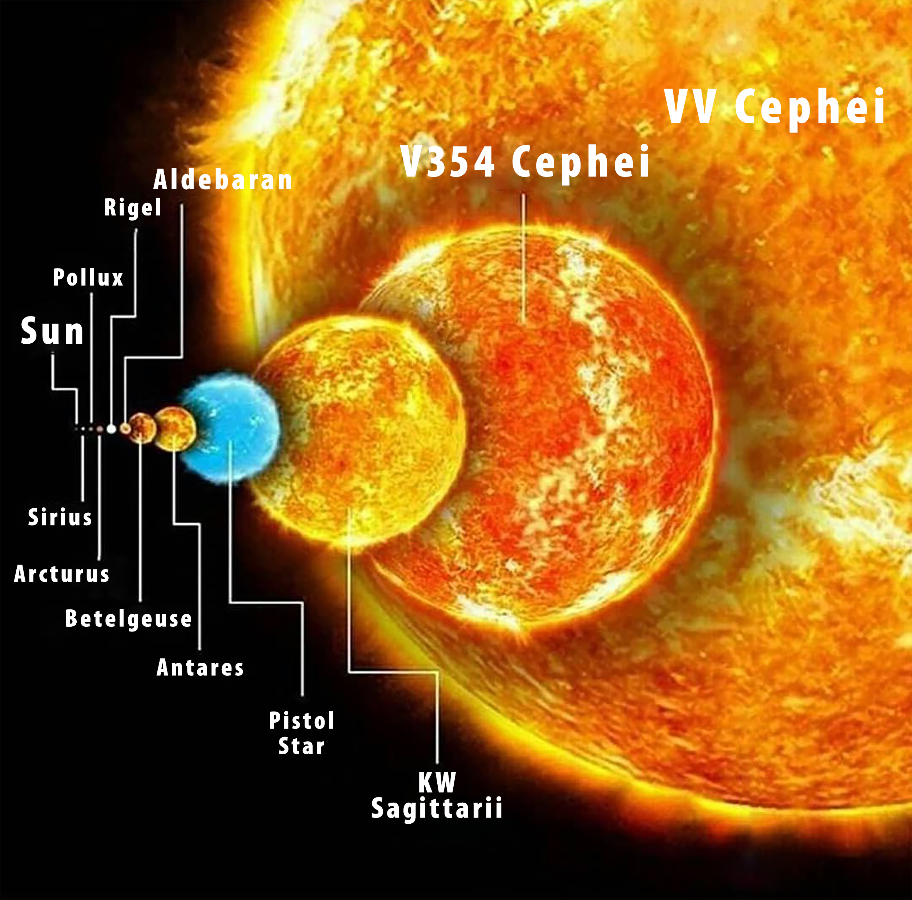


The Real Causes of Climate Change
CO₂ is a matchstick, the Sun the firestorm, and Galactic Cosmic Rays other stars
CO₂ vs SUN+GCRs
Notes:
The real causes of Climate Change aren’t what you’ve been told.
CO₂ is only 0.04% of the atmosphere—an inert trace gas.
The real drivers are solar and infinite cosmic forces shaping Earth’s climate and interior.
Milky Way has around 100–400 billion stars. Most are red dwarfs. Only a small fraction are like our Sun.
Observable universe has around 2 trillion galaxies. Each holds billions to trillions of stars.
Estimated total: ~1×10²⁴ stars. That’s 1 septillion.
You’re looking at a number with 24 zeros. Example:
1,000,000,000,000,000,000,000,000
This estimate changes as telescopes improve. James Webb already increased galaxy count from 200 billion to 2 trillion.
Order of Influences:
• CO₂: Plant Photosynthesis.
• Sun: Plant Photosynthesis. ➙ Lightning ➙ Planets (Atmosphere & Interior) ➙ Solar System.
• GCRs: Plant Grow ➙ Lightning ➙ Planets (Atmosphere & Interior) ➙ Solar System ➙ Galaxies➙ Universe…
In comparison for boiling 10 liters of water:
• Using CO₂ is like using a matchstick.
• The Sun is like using a firestorm.
• GCRs are like using all nuclear bombs and the Sun combined.
Energy Comparison
• CO₂ Radiative Forcing: ~2 W/m² (nearly invisible on Sun Energy scale)
• Sun Energy Output: ~3.8 × 10²⁶ W (nearly invisible on GCRs Energy scale)
• GCRs Energy Flux: Infinite orders of magnitude beyond CO₂ and even the Sun, influencing entire galaxies and the Universe...
Science: totrade.co/g
History: totrade.co/e | totrade.co/h
Solution: totrade.co/p | totrade.co/s | totrade.co/m
Call to Action: totrade.co/ca
PDF: totrade.co/biz | totrade.co/pdf
PowerPoint: Climate Realism, totrade.co/cr
#UGDMN #ClimateRealism #Cataclysm #GCR #SunEnergy

Slide 8
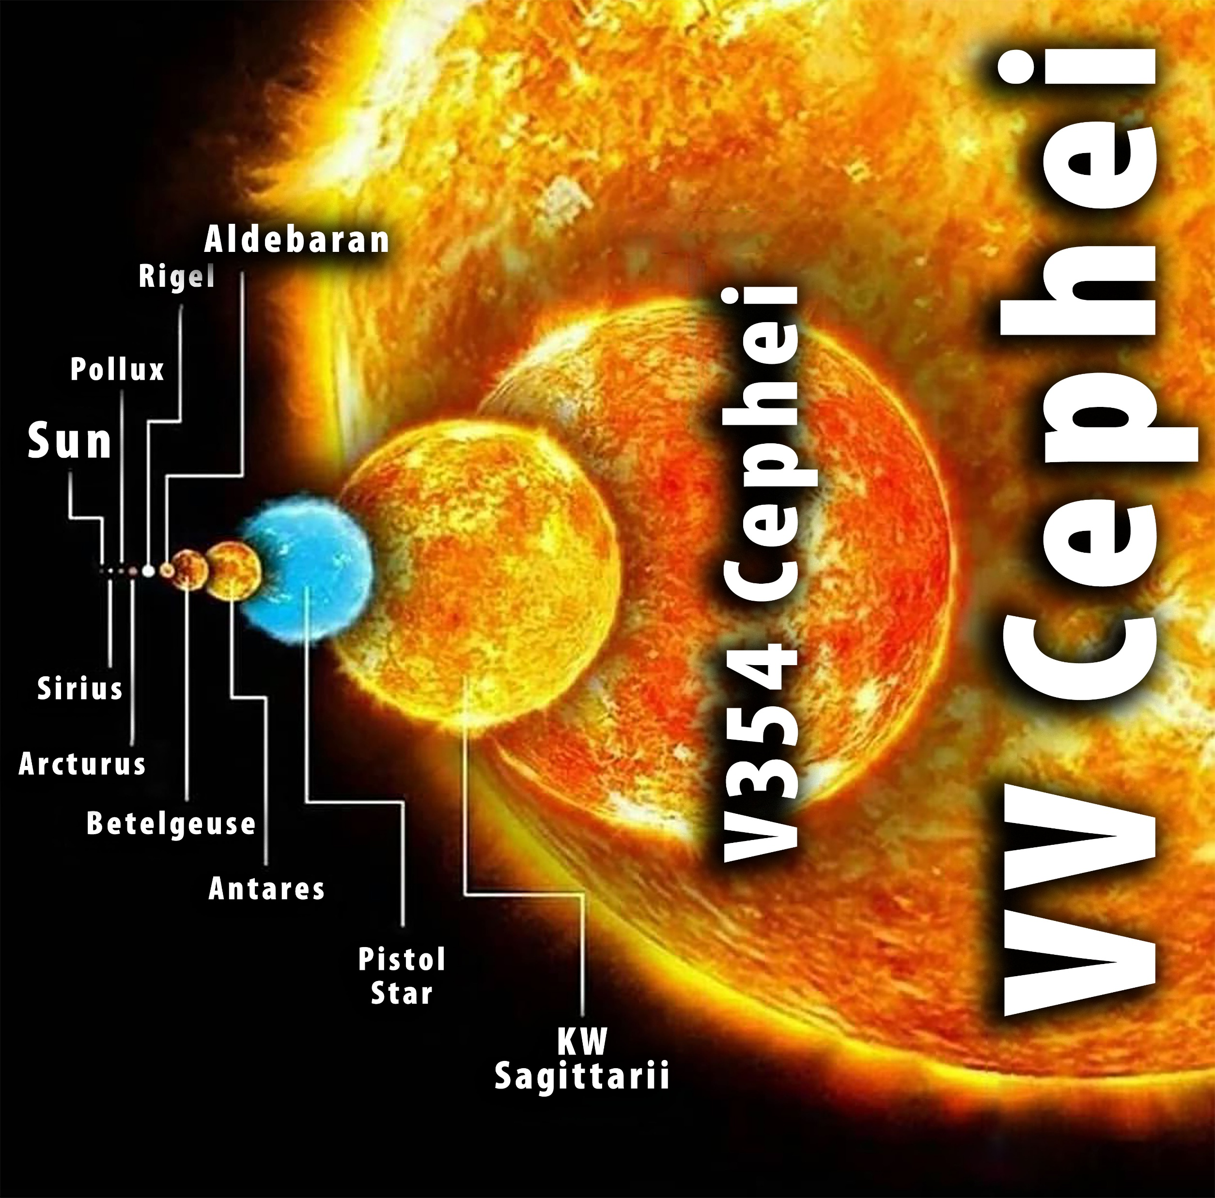

V354 Cephei
Cepheus Red supergiant
Luminosity: up to 250,000× Sun
Emits deep-space GCRs affecting Earth
V V Cephei
~1,050× Sun
GCR exceeds Sun
Cosmic reactor influencing climate and tectonics
CO₂ vs SUN+GCRs
Notes:
The Sun and other Stars Comparison
V354 Cephei is a red supergiant star in the constellation Cepheus. Here's how it compares to the Sun:
• Size: V354 Cephei’s radius is estimated between 685 and 1,250 times that of the Sun. If placed at the center of our solar system, it would extend between the orbits of Mars and Jupiter. [en.wikipedia.org]
• Luminosity: Estimates range from 71,000 to 250,000 times the Sun’s luminosity. The Sun emits ~3.8 × 10²⁶ watts. V354 Cephei’s output is multiple orders of magnitude higher, depending on its exact radius and temperature. [handwiki.org]
• Temperature: Around 3,615 K, cooler than the Sun (~5,778 K), but its massive size compensates with extreme energy output.
• Distance: Located ~8,900 to 13,000 light-years from Earth.
• Type: Classified as M2.5 Iab to M3.5 Ib, an irregular variable star. Its brightness changes over time.
Summary
V354 Cephei is a cosmic giant. Compared to the Sun, it’s colder but vastly larger and more luminous. It’s one of the largest known stars in the Milky Way. Its Galactic Cosmic Rays (GCRs) contribute to deep space energy flux affecting Earth’s climate and tectonics.
V V Cephei
A is one of the largest known stars in the galaxy. Here's how it compares to the Sun:
• Size: V V Cephei A is about 1,050 times the radius of the Sun. If the Sun’s radius is ~696,340 km, V V Cephei A stretches close to the orbit of Jupiter.
• Energy Output: The Sun emits ~3.8 × 10²⁶ watts through nuclear fusion. VV Cephei’s energy output is orders of magnitude higher, due to its massive surface area and stellar mass. Using the Stefan-Boltzmann Law, luminosity increases with the square of radius and the fourth power of temperature. Even if VV Cephei is cooler (red supergiant), its size alone makes its luminosity vastly greater.
• Impact: V V Cephei’s Galactic Cosmic Rays (GCRs) reach Earth. These rays influence climate, tectonics, and atmospheric ionization. Compared to the Sun, VV Cephei is a cosmic reactor—a supernova-scale energy source.
Summary
The Sun is powerful. VV Cephei is colossal. Its energy output dwarfs the Sun’s. It’s not just bigger—it’s a different scale of cosmic influence.

Slide 9
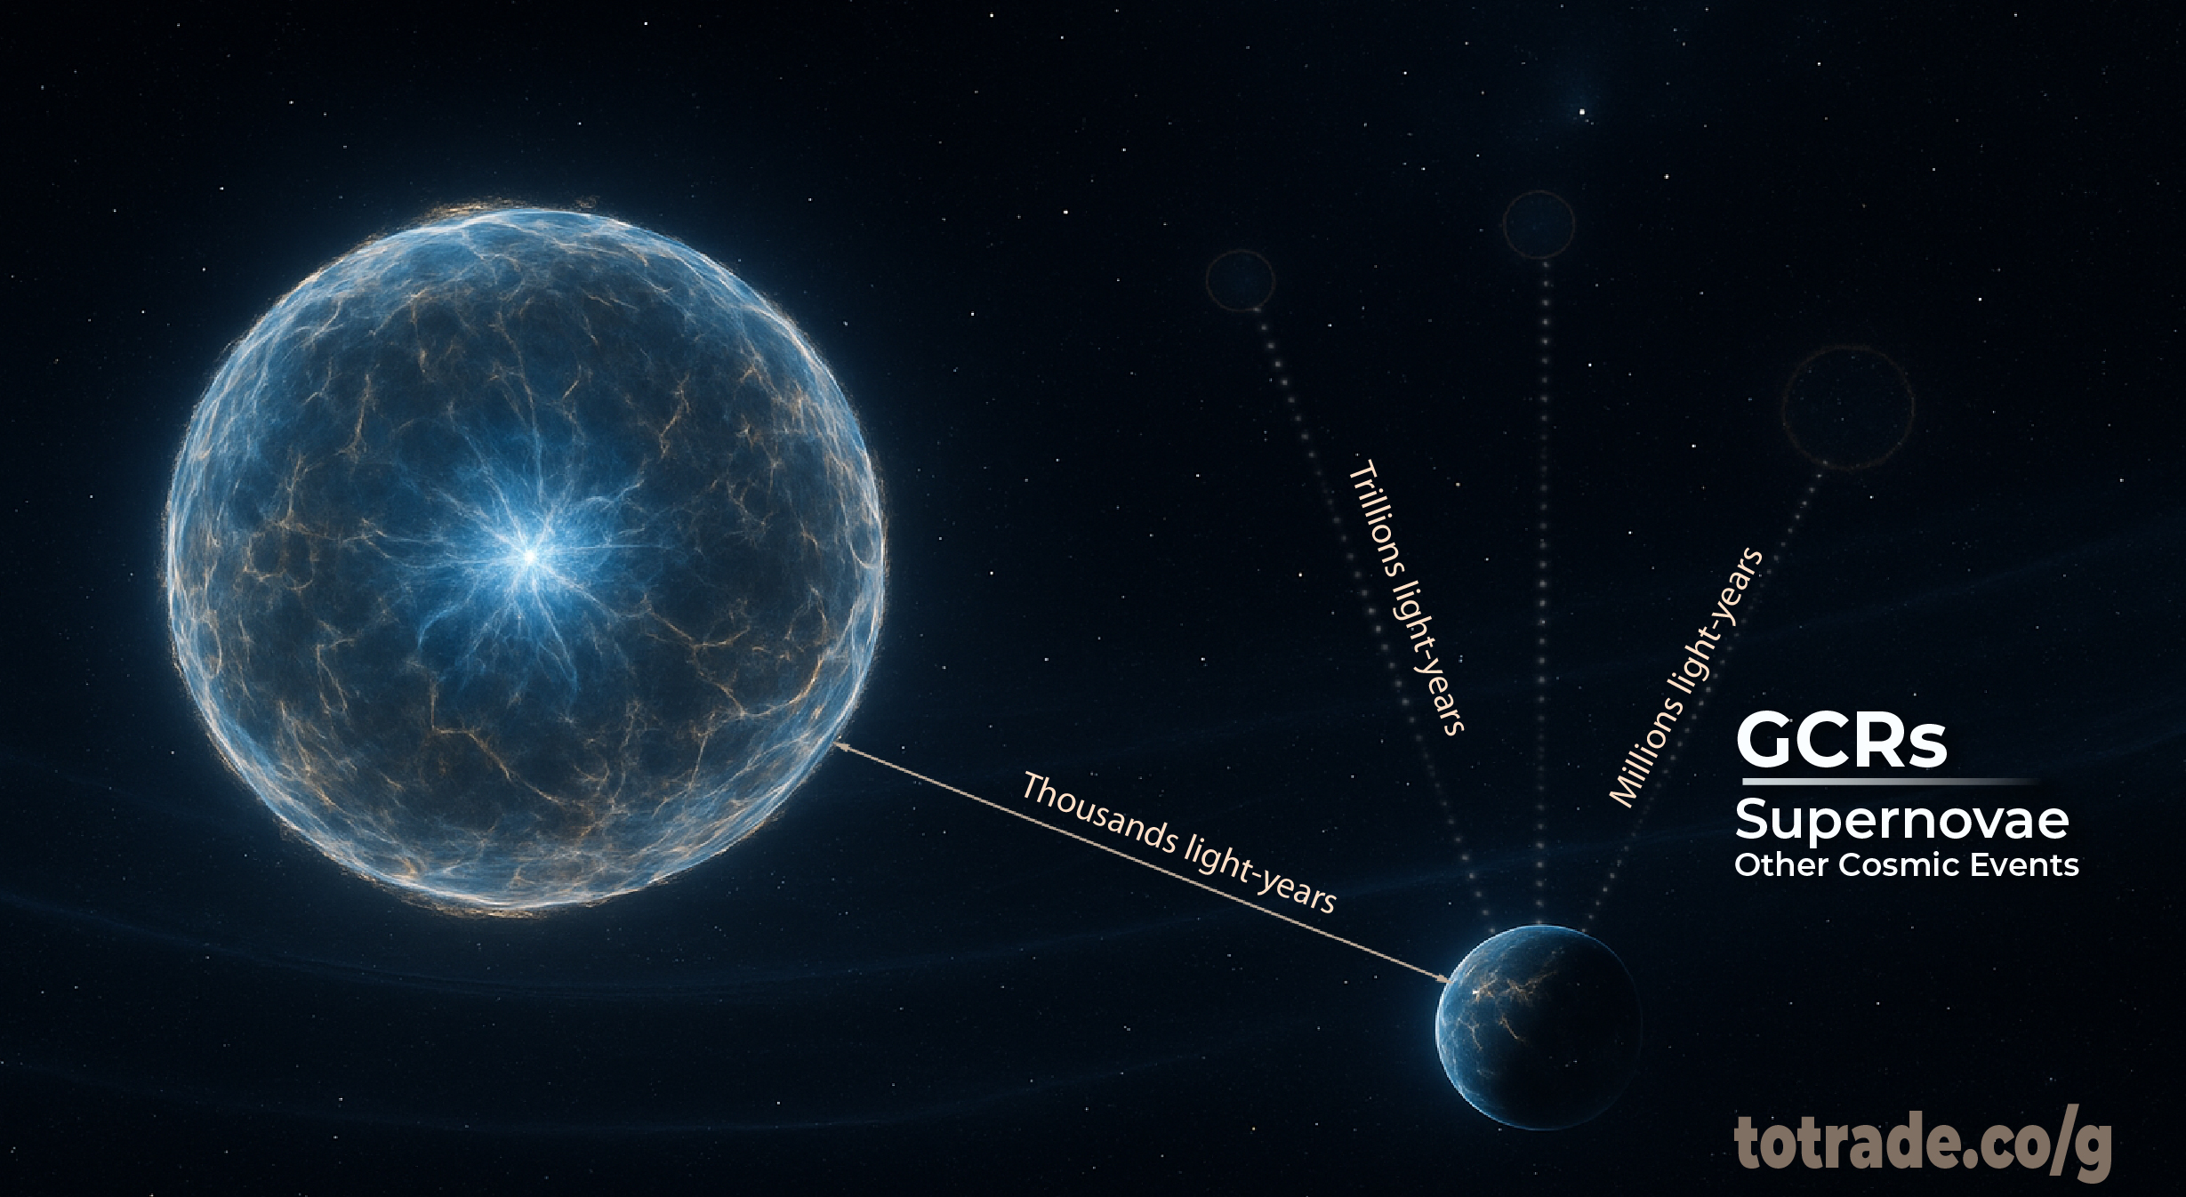
Milky Way
1 /100 years
GALACTIC
COSMIC
RAYS
(GCRs)
ORIGIN
Supernova
30-40 events/s
~1.2 to 1.3 billion/year
CLIMATE CHANGE BY GALACTIC COSMIC RAYS (GCRs)
Notes:
Galactic Scale of the Incoming Cataclysm
• The Milky Way contains 100–400 billion stars.
• The observable universe contains ~1×10²² to 1×10²⁴ stars across ~100–500 billion galaxies[1].
• 1×10²² Ten sextillion is 1 followed by 21 zeros., or 10 million quadrillion, 1 quadrillion = 10¹⁵ (1 follows by 14 zeros)
Supernovae Rate:
• In the Milky Way, about 1 supernova every 100 years[2].
• In the observable universe, 30–40 supernovae explode every second—that’s ~1.2 to 1.3 billion per year[3][4].
• Each supernova sends Galactic Cosmic Rays (GCRs) racing toward Earth at near light speed. These GCRs organize into long-wave energy tides—millennia apart.
• Earth is entering a galactic magnetic null zone, where shielding weakens. Models project a major GCR crest around 2036.
• This crest is already triggering:
• Tectonic pressure → totrade.co/q
• Lightning surges → totrade.co/ln
• Mass fruiting → totrade.co/fr
• Solar energy drops → totrade.co/sm
• Water cycle disruptions → totrade.co/fl
• Atmospheric shifts → totrade.co/wd
Conclusion
The scale is cosmic. The threat is real. The solution is #UGDMN.
Let me know if you want this translated to Lao or formatted for UN, investor, or government briefings.
References
[1] www.sciencenewstoday.org
[2] astronomy.stackexchange.com
[3] www.astronomy.com
[4] www.astronomy.com

Slide 10
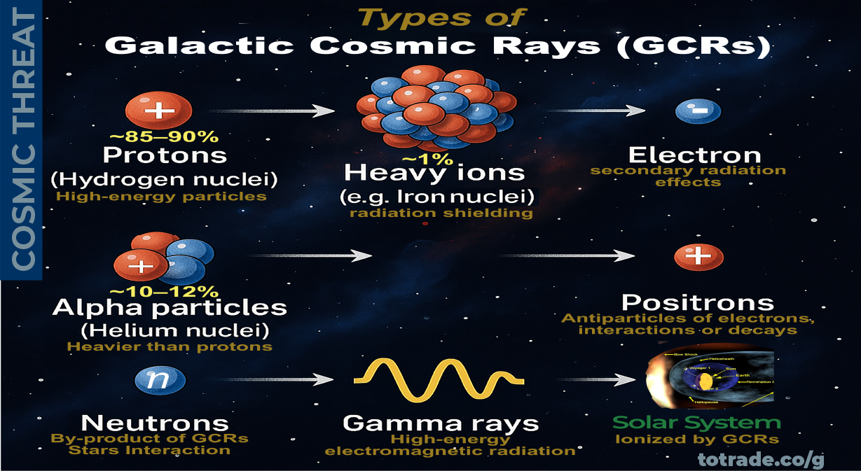
CLIMATE CHANGE BY GALACTIC COSMIC RAYS (GCRs)
Notes:
Types of Galactic Cosmic Rays (GCRs)
^{1. Protons (Hydrogen nuclei)}
• Most abundant components of GCRs (85090%)
• High-energy particles that can penetrate spacecraft, earth’s atmosphere, and interior
2. Alpha articles (Helium nuclei)
• Comprise about 10–12% of GCRs
• Heavier and more energetic than protons
^{3. Heavy Ions}
• Nuclei of elements heavier than helium (e.g., carbon, oxygen, iron)
^{• Make up ~1% of GCRs}
• Important for radiation shielding studies due to their high ionization potential
^{4. Electrons}
• Less abundant but still present
• Contribute to secondary radiation effects
^{5. Positrons}
^{• Antiparticles of electrons}
• Detected in cosmic ray spectra, often from interactions or decays
^{6. Gamma Rays}
• High-energy electromagnetic radiation, Earth Alert video: totrade.co/pt1.
• Often produced as secondary radiation from cosmic ray interactions with interstellar matter
^{7. Neutrons}
• Not directly part of GCRs due to their instability
• Produced as secondary particles when GCRs interact with Earth’s atmosphere or spacecraft materials, and Neutron Stars explosion.
Types of GCRs that produce more electromagnetism:
• Heavy Ions
High charge and mass. Strong electromagnetic interactions. Cause intense ionization and secondary particle showers. Example: Iron nuclei.
• Alpha Particles (Helium nuclei)
Double positive charge. Stronger electromagnetic effect than protons. Contribute to magnetic field disturbances.
• Electrons and Positrons
Lightweight, fast, and charged. Directly generate electromagnetic radiation. Important in synchrotron and bremsstrahlung processes.
• Gamma Rays
Pure electromagnetic radiation. Not charged particles but result from GCR interactions. Trigger electromagnetic cascades.
• Protons
Most abundant. Moderate electromagnetic effect due to single charge. Still significant due to volume.
Electromagnetic impact depends on charge, energy, and interaction medium. Heavy ions and gamma rays trigger the strongest effects.

Slide 11
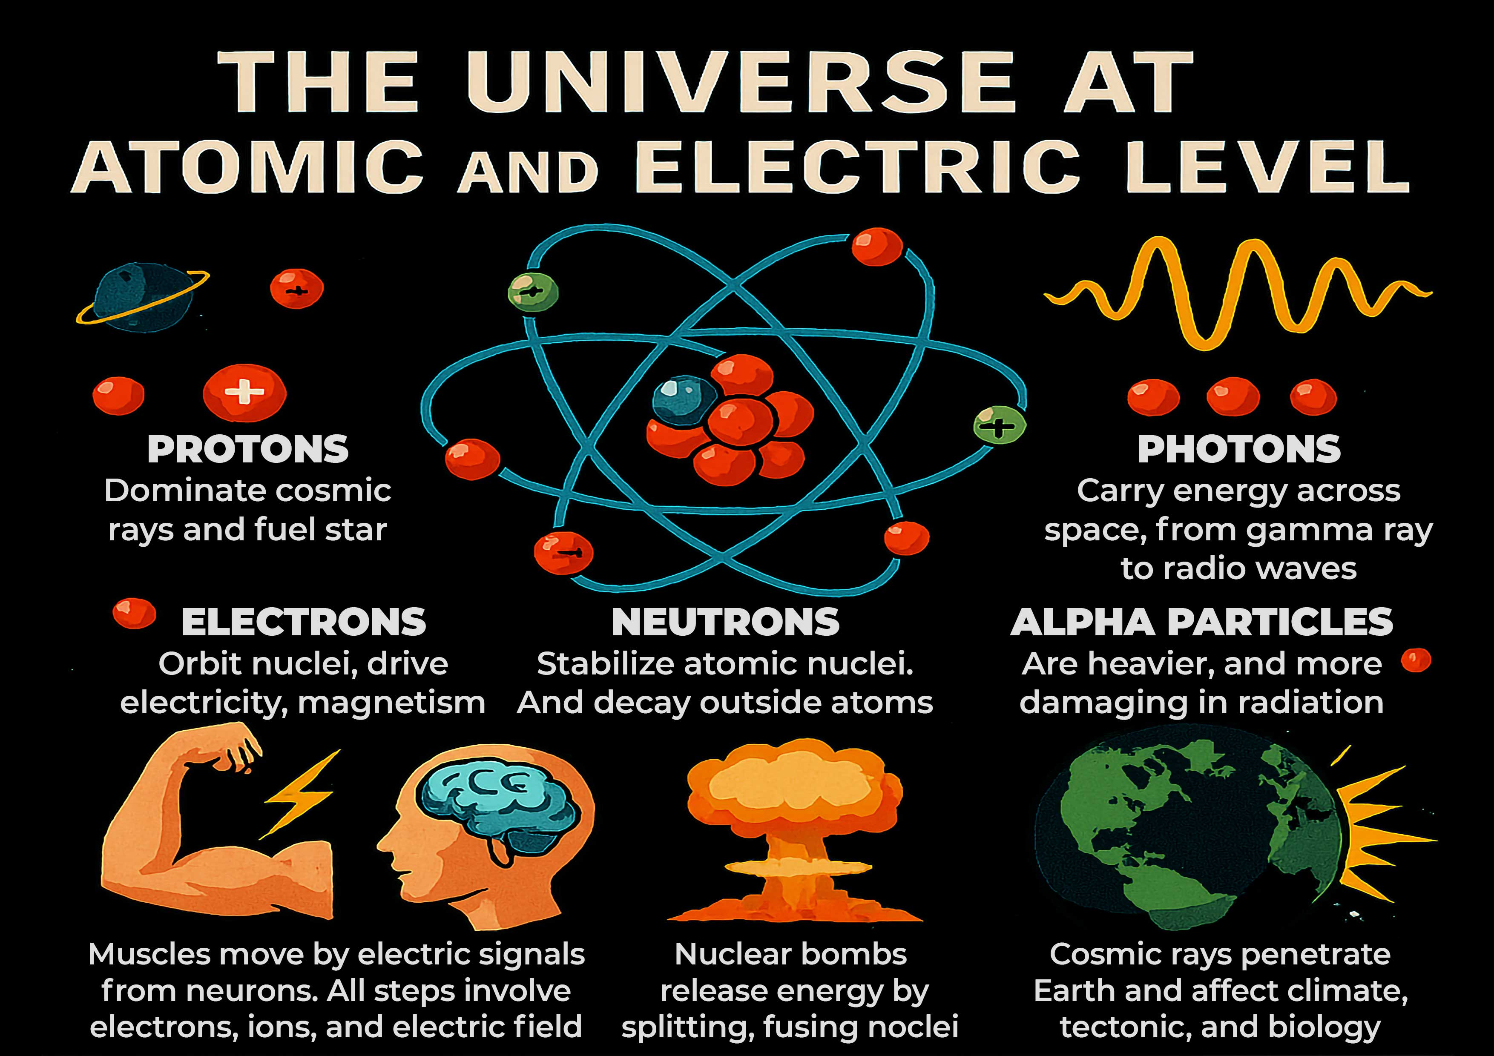
CLIMATE CHANGE BY GALACTIC COSMIC RAYS (GCRs)
Notes:
Electromagnetism, Gravity, and Cataclysm Effects
Slide content:
Foundations of Reality
• Electromagnetism holds atoms and molecules together
• Gravity organizes mass across space
• Without electromagnetism: no atoms, no stars, no magnetic shields
• Without gravity: no orbits, no galaxies, no structure
Technology Impact
• SSDs trap electrons using electric fields
• Smartphones rely on magnetic sensors and wireless charging
• Computers need magnetic shielding and electric logic gates
• GCRs override these systems—injecting high-energy particles that destabilize electronics
Biological Impact
• Muscles move via electric signals
• Brain functions through ion exchange
• Fingers stay attached by electromagnetic bonds
• Fingers don’t merge due to electron repulsion
Why Fingers Don’t Merge
• Electron clouds repel—preventing atomic merging
• Atomic bonds hold tissues together—electromagnetic attraction
• Your body is structured by particle interactions
Charged Particle Universe
• Universe runs on protons, electrons, photons, neutrons, alpha particles, heavy ions, positrons, gamma rays
• Energy flows through electric fields, magnetic fields, and radiation
• Cosmic rays affect climate, tectonics, and biology
• Every movement, thought, and explosion is particle interaction
Final line:
Electromagnetism is the glue. Gravity is the framework. GCRs disrupt both. Prepare systems from microchips to megastructures.

Slide 12
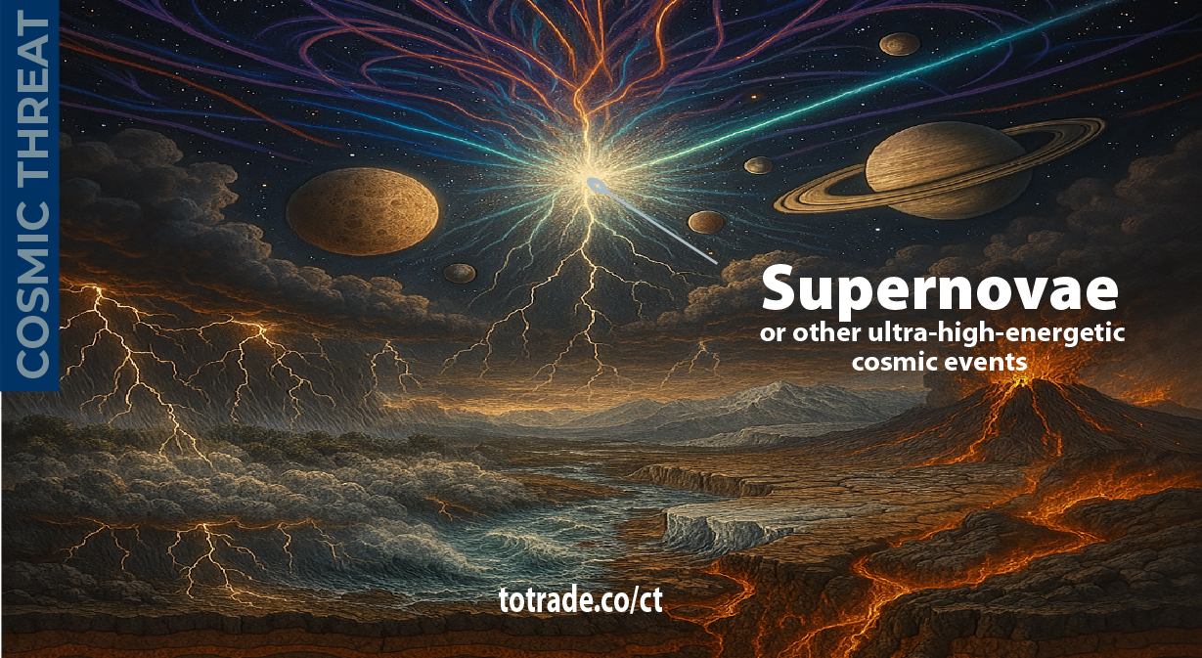
GALACTIC
COSMIC
RAYS
(GCRs)
ORIGIN
CLIMATE CHANGE BY GALACTIC COSMIC RAYS (GCRs)
Notes:
Origin and Impact of Ultra-High-Energetic Galactic Cosmic Rays
You are looking at one of the most critical cycles in Earth and Solar history.
Galactic Cosmic Rays, or GCRs, are ultra high-energy particles born from supernovae and other cosmic explosions.
They travel across the galaxy at nearly the speed of light and reach us in massive periodic waves, each lasting thousands of years.
Their intervals range from 5,000 to 35,000 years.
Each crest lasts about 22 years, with a peak period of 11 years before fading.
This pattern matches the Solar magnetic cycles that control radiation and magnetism on Earth.
Our Solar System is now entering a galactic magnetic null zone—a region where magnetic fields are weak, unstable, or reversed.
This zone is part of our 240-million-year orbit around the Galactic Plane.
The Solar System travels through space at about 828,000 km per hour, or 230 km per second.
At this speed, even small variations in the galactic environment have enormous effects.
When the Sun’s magnetic strength drops, Earth’s magnetic field also weakens.
This collapses our natural defense against the rising intensity of Galactic Cosmic Rays, expected to peak around 2036.
Resulting chain effects:
• Increased atmospheric ionization → extreme storms, lightning, and erratic climate
• Internal geodynamo instability → magnetic anomalies, pole excursions, and reversals
• Mantle stress buildup → megaquakes, volcanic super-eruptions, crustal shifts, and mega tsunamis
Reference links:
Science: totrade.co/g
History: totrade.co/e | totrade.co/h
Solutions: totrade.co/p totrade.co/s totrade.co/m
Call to Action: totrade.co/ca
PDF: totrade.co/pdf | totrade.co/biz

Slide 13
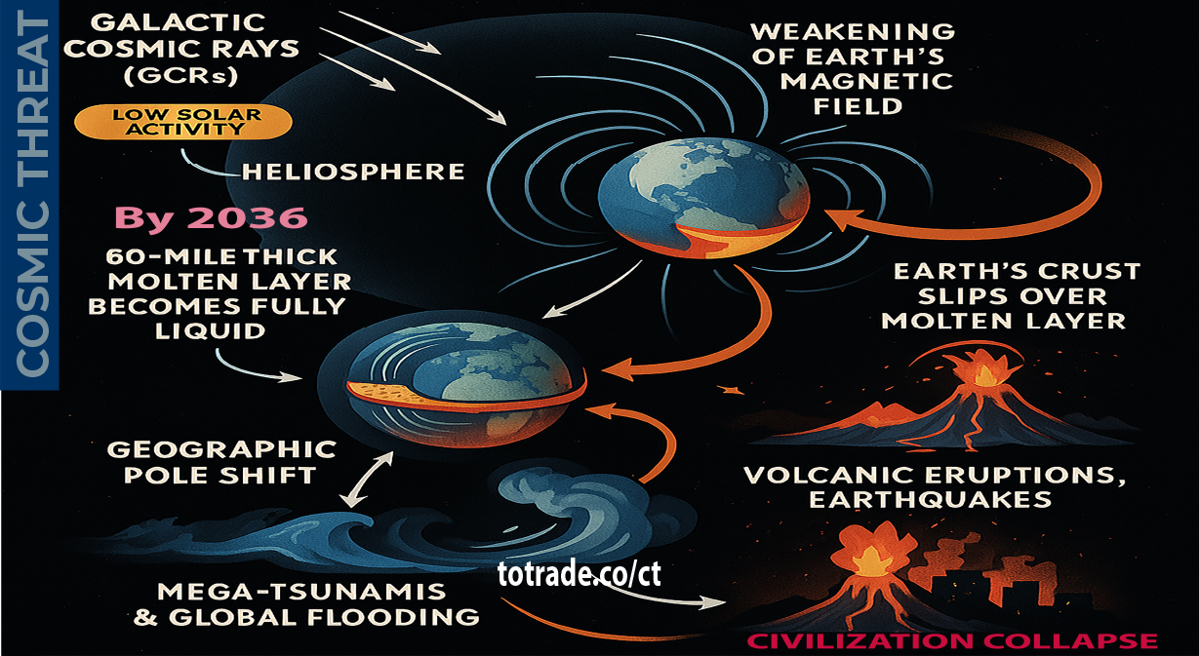
COSMIC THREAT: Beyond CO₂
Notes:
COSMIC THREAT: Beyond CO₂
The real climate driver and future cataclysms is Galactic Cosmic Rays (GCRs), not any greenhouse gases, especially not CO₂
As the Solar System enters a galactic magnetic null zone, solar activity drops, solar system heliosphere and Earth’s magnetic shield weakens. This opens the door for extreme GCR influx, energy levels far beyond anything on Earth.
Result:
• Molten layer beneath the crust liquefies
• The Crust slip → pole shift → megaquakes, supervolcanoes, mega-tsunamis
• Civilization collapse before global glaciation

Slide 14
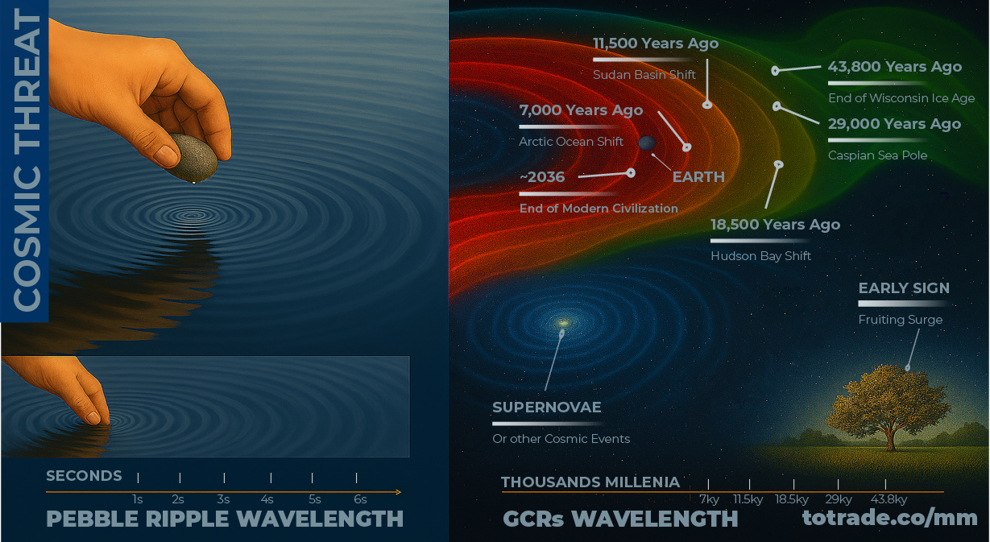
GCRs Multi-Millenia Wavelength
Notes:
Galactic Cosmic Rays (GCRs) are ultra high-energy particles from supernovae and other cosmic events, moving near light speed. They arrive in waves thousands of years apart, with cycles lasting 5,000 to 35,000 years. Each wave spans about 22 years, peaking around the middle. These surges align with Earth events such as major volcanic eruptions, pole shifts, mega tsunamis, rapid ice melt, crustal movement, and continent-altering floods.
Geological and historical evidence outlines a spread order of major events:
7,000 Years Ago – Arctic Ocean Shift (red);
11,500 Years Ago – Sudan Basin Shift (red-orange);
18,500 Years Ago – Hudson Bay Shift (orange);
29,000 Years Ago – Caspian Sea Pole (orange-green);
43,800 Years Ago – End of Wisconsin Ice Age (green).
Historical records show nature often signals GCR surges with unusual plant reproduction and heavy fruiting, driven by atmospheric shifts from rising GCR intensity.
Visual models depict overlapping wavefronts moving through space for millennia, each linked to past cataclysms.
Understanding their cycle offers a tool for long-range forecasting and planetary defense, critical before the next crest, expected around 2036.

Slide 15
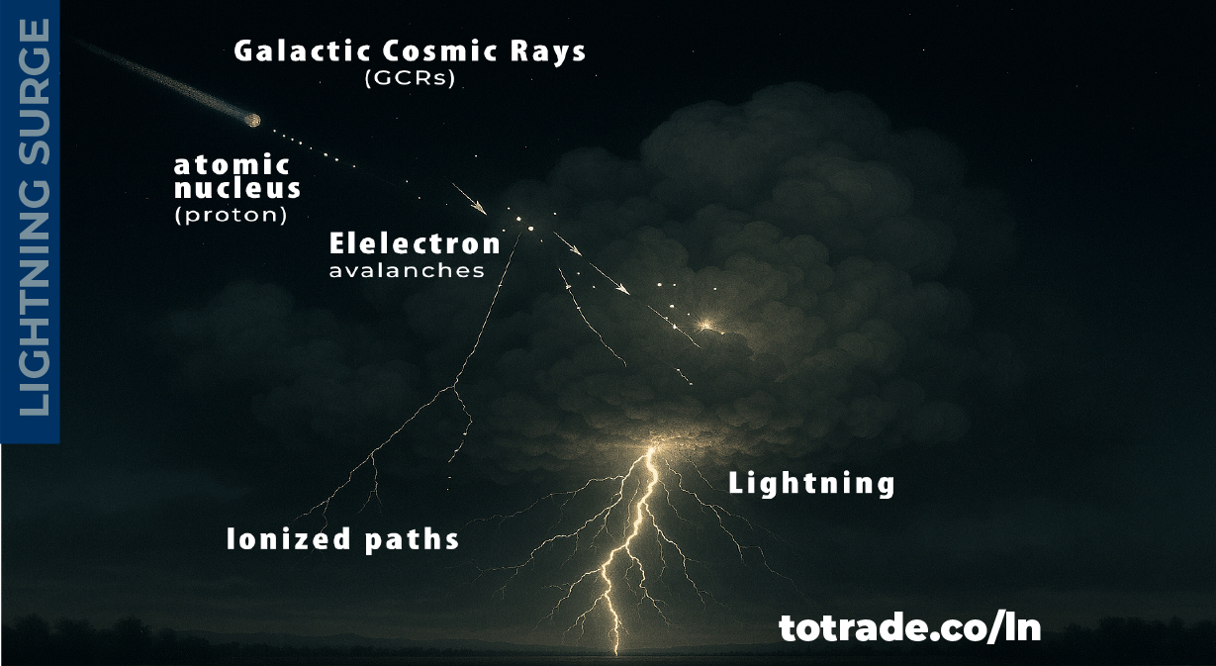
GCRs Surge Effects on Lightning
Notes:
🌿 GCRs Surge Effects on Lightning
Lightning triggered by Galactic Cosmic Rays (GCRs) involves high-energy particles from space hitting Earth’s atmosphere.
• GCRs are fast-moving atomic nuclei from beyond the solar system
• They collide with air molecules, creating particle showers
• These showers ionize the air, boosting conductivity
• Thunderclouds build strong electric fields
• Ionized paths help start electron avalanches
• Avalanches form stepped leaders, lightning channels
• Once channels connect charges, lightning strikes
This is the runaway breakdown model. It shows lightning can form in weaker fields than expected.
Galactic Cosmic Rays (GCR) Impact Briefing
1. Mechanism Summary
• GCRs are high-energy atomic nuclei from beyond the solar system
• GCRs collide with air molecules, creating particle showers
• GCRs Showers ionize the atmosphere, increasing conductivity
• Thunderclouds develop strong electric fields
• Ionized paths enable electron avalanches
• Avalanches form stepped leaders and lightning channels
• When channels connect charges, lightning strikes
2. Key Indicators
• Arctic lightning frequency surge
• Tropical fruiting anomalies
• Increased storm intensity and irregular precipitation
3. Timeline of Observed Changes
• Early 2010s: Arctic lightning ~100 strikes/year
• 2021: Arctic lightning >7,000 strikes/year
• 2025: Tropical regions show fruiting surges linked to GCR influence
4. Risk Implications
• Agriculture: Disrupted fruiting cycles, yield instability
• Climate: Increased lightning, storm volatility
• Ecosystems: Stress on species adaptation
Key Scientific Findings on Lightning and GCRs
[1] Lightning on the Rise: The Surprising Climate Link to More GCRs, totrade.co/ln1
[2] #UGDMN_Business_Plan, totrade.co/biz
[3] Damaging Lightning-Caused Wildfires Likely to Increase in a Few Years ...: totrade.co/ln2
[4] NASA Earthdata – “Cosmic Charges”
o Researchers found that Galactic Cosmic Rays (GCRs) play a significant role in triggering lightning by ionizing the atmosphere.
o Using data from the National Lightning Detection Network, a positive correlation was observed between cosmic ray intensity and lightning frequency. Read the full article: totrade.co/gcr1
[5] Frontiers in Physics – “Short-Term Lightning Response to Ground Level Enhancements”
o This peer-reviewed study analyzed three major cosmic ray events (GLEs) and found a statistically significant increase in global lightning activity within 20 minutes of each event. Read the study PDF: totrade.co/gcr2
[6] The Weather Network – “Mystery of Lightning’s Initial Spark”
o High-energy cosmic rays are helping initiate lightning discharges by overcoming the insulating properties of air. Read the article: totrade.co/gcr3
[7] Yale Environment 360 – “Lightning Strikes the Arctic”
o Reports a dramatic increase in lightning in the Arctic, from ~100 strikes/year in the early 2010s to over 7,000 in 2021 — a region that historically had almost none.
o Read more: totrade.co/gcr4, or totrade.co/ln3

Slide 16
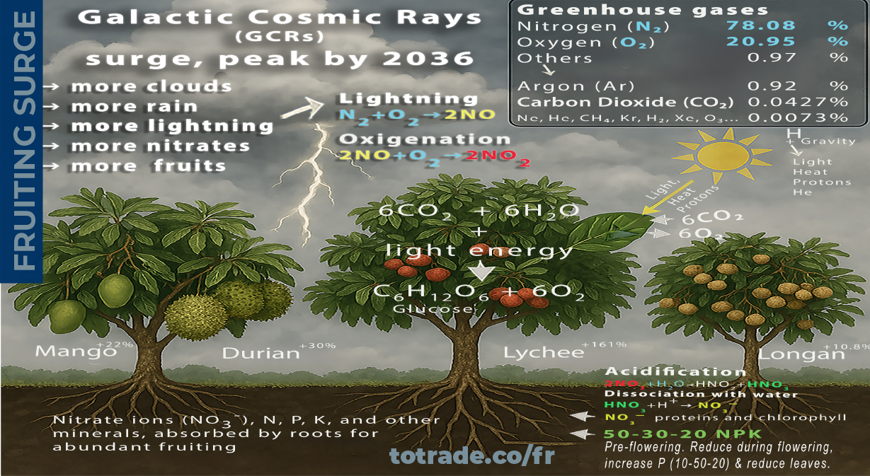
GCRs Surge increase Fruit
Notes:
🌿 GCRs Effects on Atmosphere
The surge of Galactic Cosmic Rays (GCRs), peak by 2036, enhance aerosol formation (cloud seeding), especially in the mid-troposphere, where cooler temperatures prevail.
More clouds increase rainfalls, totrade.co/fl, and lightning that converts atmospheric abundant nitrogen (N₂) and oxygen (O₂) into nitrate ions (NO₃¯).
The nitrate ions are used by plants to synthesize the building blocks of proteins, essential for various functions, including growth, development, fruiting, and defense against diseases, totrade.co/fr.
Enhanced rainfall and lightning often accompany storms, increasing atmospheric moisture, soil hydration, humidity levels, and lower surface temperature.
🔁 GCRs and N₂ Mechanism
Elemental nitrogen refers to the atom N, which is part of many biological molecules.
In nature, nitrogen exists as diatomic gas (N₂) , making up ~78% of Earth's atmosphere.
• Plants cannot use atmospheric N₂ directly.
• GCRs, H₂O convert N₂ into NO₃-, essential for:
• Amino acids (building blocks of proteins)
• Nucleic acids (DNA, RNA)
• Chlorophyll (photosynthesis pigment)
• Plant hormones (like cytokinin)
🔁 The Consequence
Durian yields up 30%, lychee up 161%, longan up 10.8%, mango up 22%, rambutan also up, and many fruits are also thriving such as lime, Papaya, Banana, Jackfruit, Mangosteen, Guava, Pomelo, Starfruit (Carambola), Dragon fruit (Pitaya), Passion fruit, Custard apple (Annona), Sapodilla (Chikoo), Coconut...
In rural Lao villages, fruit trees are flourishing without any human intervention. Locals often discard or sell fruits at steep discounts due to oversupply.
📽️ Proof: vt.tiktok.com/ZSBPFd8er

Slide 17
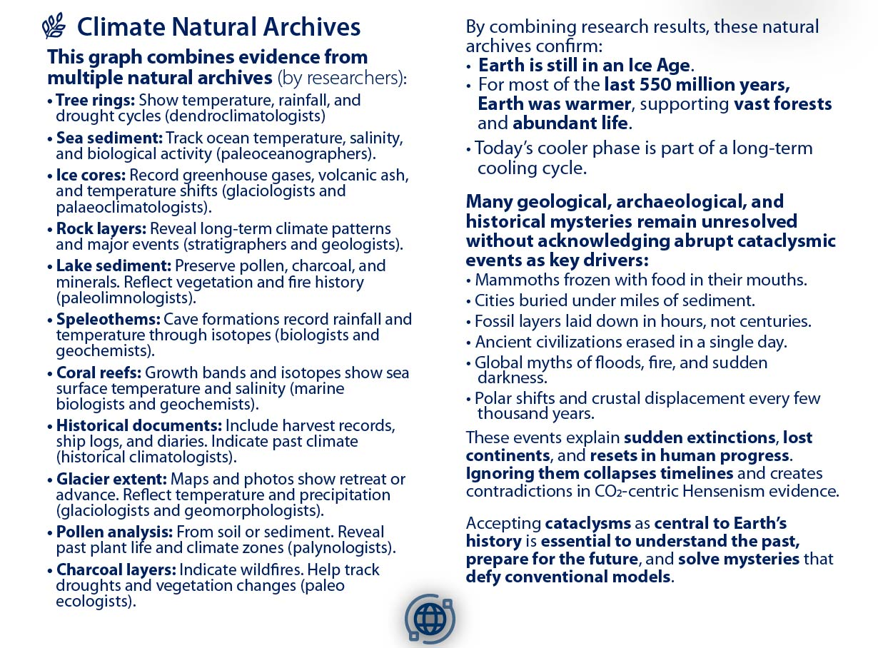

NATURAL ARCHIVES → CLIMATE REALISM
Notes:
This X-Axis variable graph is the combination of past climate studies by experts in their fields using natural archives through:
• Tree rings: Show temperature, rainfall, and drought cycles (dendroclimatologists)
• Sea sediment: Track ocean temperature, salinity, and biological activity (paleoceanographers).
• Ice cores: Record greenhouse gases, volcanic ash, and temperature shifts (glaciologists and palaeoclimatologists).
• Rock layers: Reveal long-term climate patterns and major events (stratigraphers and geologists).
• Lake sediment: Preserve pollen, charcoal, and minerals. Reflect vegetation and fire history (paleolimnologists).
• Speleothems: Cave formations record rainfall and temperature through isotopes (biologists and geochemists).
• Coral reefs: Growth bands and isotopes show sea surface temperature and salinity (marine biologists and geochemists).
• Historical documents: Include harvest records, ship logs, and diaries. Indicate past climate (historical climatologists).
• Glacier extent: Maps and photos show retreat or advance. Reflect temperature and precipitation (glaciologists and geomorphologists).
• Pollen analysis: From soil or sediment. Reveal past plant life and climate zones (palynologists).
• Charcoal layers: Indicate wildfires. Help track droughts and vegetation changes (paleo ecologists).
• Packrat middens: Preserve seeds and bones. Show local climate and ecosystem shifts (paleo ecologists and archaeologists).
Combining these studies, these archives confirm Earth is still in an Ice Age. For most of the last 550 million years, Earth was warmer, supporting vast forests and abundant life. Today’s cooler phase is part of a long-term cooling cycle.
Many geological, archaeological, and historical mysteries remain unresolved without acknowledging abrupt cataclysmic events as key drivers:
• Mammoths frozen with food in their mouths.
• Cities buried under miles of sediment.
• Fossil layers laid down in hours, not centuries.
• Ancient civilizations erased in a single day.
• Global myths of floods, fire, and sudden darkness.
• Polar shifts and crustal displacement every few thousand years.
These events explain sudden extinctions, lost continents, and resets in human progress. Ignoring them collapses timelines and creates contradictions in CO2-centric Hensenism evidence, totrade.co/hs
Accepting cataclysms as central to Earth’s history is essential to understand the past, prepare for the future, and solve mysteries that defy conventional models.
Ignoring natural cycles while pushing false climate narratives, like exaggerated heat records and cyclone claims, undermines credibility. The IPCC’s Climategate is a warning.
Imposing green ideology on poor nations through coercive climate policy is eco-colonialism. It forces decisions that harm people and economies to satisfy the environmental agenda of the affluent West.

Slide 18
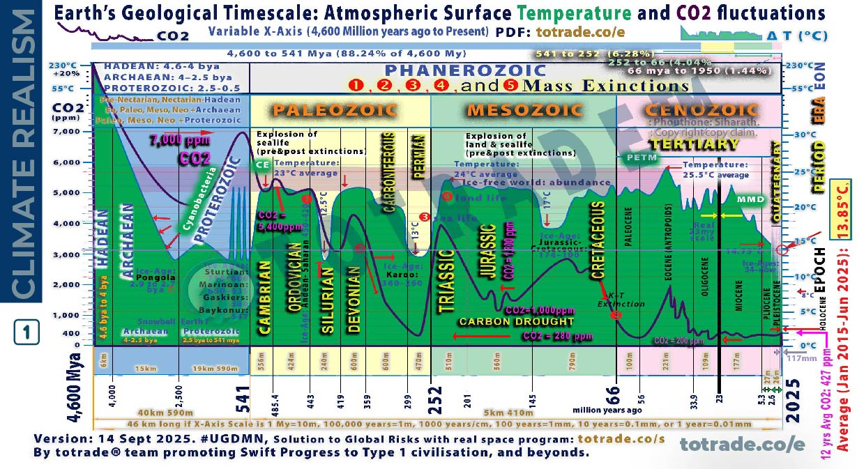
NATURAL ARCHIVES → CLIMATE REALISM
Notes:
This X-Axis variable graph is the combination of past climate studies by experts in their fields using natural archives through:
• Tree rings: Show temperature, rainfall, and drought cycles (dendroclimatologists)
• Sea sediment: Track ocean temperature, salinity, and biological activity (paleoceanographers).
• Ice cores: Record greenhouse gases, volcanic ash, and temperature shifts (glaciologists and palaeoclimatologists).
• Rock layers: Reveal long-term climate patterns and major events (stratigraphers and geologists).
• Lake sediment: Preserve pollen, charcoal, and minerals. Reflect vegetation and fire history (paleolimnologists).
• Speleothems: Cave formations record rainfall and temperature through isotopes (biologists and geochemists).
• Coral reefs: Growth bands and isotopes show sea surface temperature and salinity (marine biologists and geochemists).
• Historical documents: Include harvest records, ship logs, and diaries. Indicate past climate (historical climatologists).
• Glacier extent: Maps and photos show retreat or advance. Reflect temperature and precipitation (glaciologists and geomorphologists).
• Pollen analysis: From soil or sediment. Reveal past plant life and climate zones (palynologists).
• Charcoal layers: Indicate wildfires. Help track droughts and vegetation changes (paleo ecologists).
• Packrat middens: Preserve seeds and bones. Show local climate and ecosystem shifts (paleo ecologists and archaeologists).
Combining these studies, these archives confirm Earth is still in an Ice Age. For most of the last 550 million years, Earth was warmer, supporting vast forests and abundant life. Today’s cooler phase is part of a long-term cooling cycle.
Many geological, archaeological, and historical mysteries remain unresolved without acknowledging abrupt cataclysmic events as key drivers:
• Mammoths frozen with food in their mouths.
• Cities buried under miles of sediment.
• Fossil layers laid down in hours, not centuries.
• Ancient civilizations erased in a single day.
• Global myths of floods, fire, and sudden darkness.
• Polar shifts and crustal displacement every few thousand years.
These events explain sudden extinctions, lost continents, and resets in human progress. Ignoring them collapses timelines and creates contradictions in CO2-centric Hensenism evidence, totrade.co/hs
Accepting cataclysms as central to Earth’s history is essential to understand the past, prepare for the future, and solve mysteries that defy conventional models.
Ignoring natural cycles while pushing false climate narratives, like exaggerated heat records and cyclone claims, undermines credibility. The IPCC’s Climategate is a warning.
Imposing green ideology on poor nations through coercive climate policy is eco-colonialism. It forces decisions that harm people and economies to satisfy the environmental agenda of the affluent West.

Slide 19
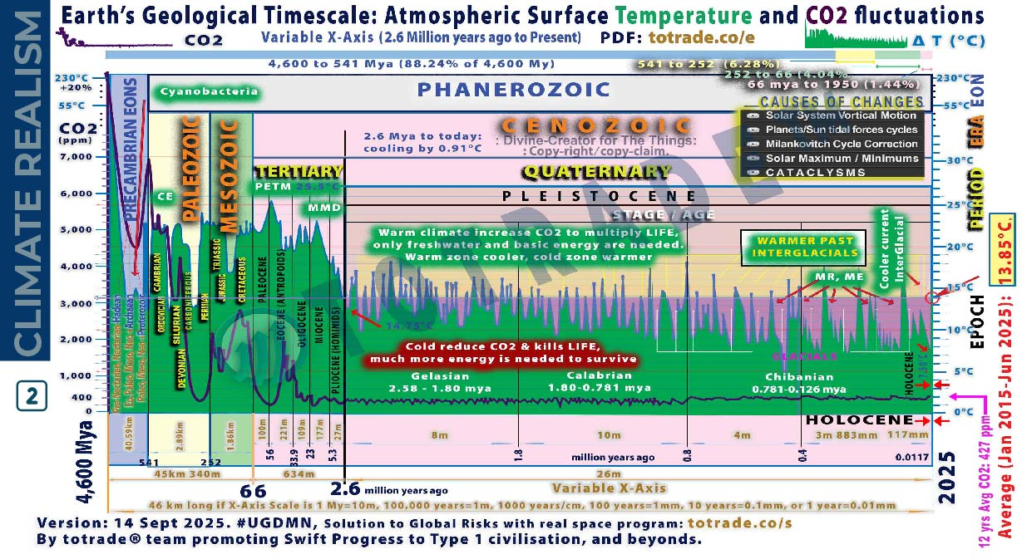

NATURAL ARCHIVES → CLIMATE REALISM
Notes:
This graph combines evidence from multiple natural archives as previous slides but between 2.6 Mya to 11,700 ya
Earth’s climate change from 2.6 million years ago to the Holocene, integrating natural archives and cataclysmic events.
Natural archives show gradual shifts:
Tree rings, ice cores, lake and sea sediments, speleothems, coral reefs, pollen, charcoal, and rock layers confirm glacial–interglacial cycles. These cycles were driven by orbital changes (Milankovitch cycles), solar activity, and abrupt Galactic Cosmic Rays flux (GCRs). Temperature fluctuated ±5°C globally.
Cataclysmic events caused abrupt shifts:
The lithosphere rotated over the mantle in 6–12 hours. This repositioned poles to the Torrid Zone. Oceans and atmosphere continued rotating eastward at 1,037 mph. Supersonic winds and floods buried continents. Ice caps melted. New ones formed. Entire civilizations vanished. Fossil records show sudden extinctions. Mammoths froze instantly. Sedimentary layers show rapid deposition. Tiahuanaco was buried and later uplifted 12,500 feet.
Key transitions:
• 2.6 million years ago: Start of Pleistocene. Ice sheets expanded.
• 29,000 years ago: End of Wisconsin glaciation.
• 18,500 years ago: Hudson Bay polar shift.
• 11,500 years ago: Laurentian ice cap collapse. Global flood. Start of Holocene.
• 7,000 years ago: Noah’s flood. Arctic Ocean moved to North Pole.
• Today: Arctic era continues. Next shift expected ~2036.
Conclusion:
Natural archives show patterns. Cataclysms explain abrupt transitions. Climate change is not linear. It’s cyclical, sudden, and global. We must prepare.
📄 PDF: totrade.co/biz | totrade.co/pdf
📊 PowerPoint:
• Climate Realism: totrade.co/cr
• Business Plan: totrade.co/bp

Slide 20
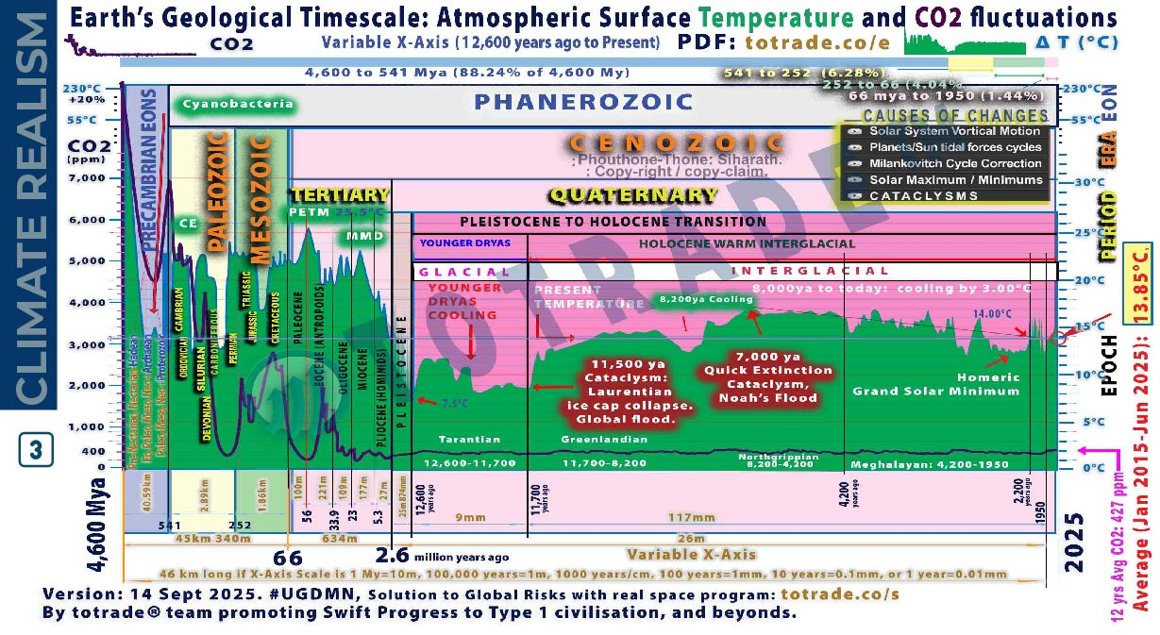
NATURAL ARCHIVES → CLIMATE REALISM
Notes:
This graph shows climate shifts from 11.7kya to 4.2kya, with abrupt and gradual phases confirmed by natural archives and cataclysmic evidence.
Younger Dryas Cooling
• Sudden return to glacial conditions around 12,900 years ago
• Caused by freshwater influx disrupting ocean currents
• Ended ~11,700 years ago with rapid warming
11,500 ya: Laurentian Ice Cap Collapse
• Triggered global flood
• Massive crustal shift repositioned poles
• Sudden climate reset marked start of Holocene
Holocene Climatic Optimum
(11,700–8,200 years ago)
• Warm, stable climate
• Forests expanded
• Agriculture began
8,200 years ago Cooling
• Abrupt drop in temperature
• Linked to meltwater pulse and ocean disruption
• Affected early civilizations
7,000 years ago: Noah’s Flood
• Arctic Ocean moved to North Pole
• Crust shifted again
• Global inundation and tectonic upheaval
• Less than 1% of life survived
Homeric Grand Solar Minimum
• Occurred during late Holocene
• Reduced solar activity
• Contributed to cooling trend
8,000 years ago to today: 3°C Cooling
• Gradual decline in global temperature
• Driven by orbital cycles and solar variation
• Stabilized ecosystems and enabled civilization growth
This period shows how cataclysms and cosmic forces shaped climate more than CO₂.
Conclusion:
Natural archives show patterns. Cataclysms explain abrupt transitions. Climate change is not linear. It’s cyclical, sudden, and global. We must prepare.
📄 PDF: totrade.co/biz | totrade.co/pdf
📊 PowerPoint:
• Climate Realism: totrade.co/cr
• Business Plan: totrade.co/bp

Slide 21
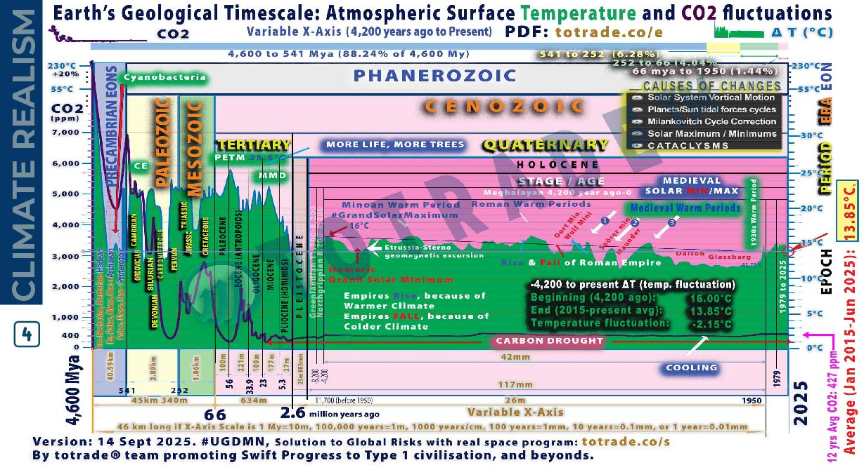
NATURAL ARCHIVES → CLIMATE REALISM
Notes:
This graph shows climate shifts between 4200 years ago and 1950, Earth’s climate shifted through solar cycles and abrupt cooling events. Natural archives and historical records confirm this.
• Homeric Grand Solar Minimum (~2800–2600 BCE)
Solar output dropped. Tree rings and ice cores show cooling. Crop failures and societal stress in Mesopotamia and Egypt. Linked to the 4.200year ago event that collapsed Akkadian and Old Kingdom Egypt.
• Roman Warm Period (~250 BCE–400 CE)
Global temperature rose ~+1°C above Holocene average. Confirmed by grape cultivation in Britain and Alpine glacier retreat. Enabled Roman expansion, trade, and population growth.
• Medieval Warm Period (~950–1250 CE)
Temperature rose +0.5 to +1.0°C. Tree rings and lake sediments confirm warming in Europe, Greenland, and parts of Asia. Norse settled Greenland. Vineyards expanded north. Monsoon patterns shifted.
• Oort Minimum (~1040–1080 CE)
Solar activity dropped. Cooling resumed. Tree rings show reduced growth. Glaciers advanced in Europe.
• Wolf Minimum (~1280–1350 CE)
Marked start of Little Ice Age. Cooling intensified. Crop yields fell. Famines spread across Europe and Asia.
• Spörer Minimum (~1460–1550 CE)
One of the coldest periods. Tree rings and ice cores show sharp cooling. Glaciers expanded. Harsh winters. Population decline in some regions.
• Maunder Minimum (~1645–1715 CE)
Deepest cold of Little Ice Age. Sunspot records show near-zero activity. Europe saw frozen rivers, failed harvests, and mass starvation. ΔT ~ -1.0°C.
• Dalton Minimum (~1790–1830 CE)
Solar activity dropped again. Cooling ~ -0.5°C. Tambora eruption (1815) amplified effects.
“Year Without a Summer” (1816). Global crop failures.
• Glassberg Minimum (~1870–1900 CE)
Final cooling phase before modern warming. Confirmed by glacier advance and tree ring contraction. Cold winters in Europe and North America.
• 1930s Warm Period
Global temperature rose ~+0.3°C. Dust Bowl in US. Arctic ice retreated. Confirmed by instrumental records and historical observations.
Conclusion:
Natural archives show patterns. Cataclysms explain abrupt transitions. Climate change is not linear. It’s cyclical, sudden, and global. We must prepare.
🔗 Science: totrade.co/g
📜 History: totrade.co/e | totrade.co/h
📄 PDF: totrade.co/biz | totrade.co/pdf
📊 PowerPoint:
• Climate Realism: totrade.co/cr
• Business Plan: totrade.co/bp

Slide 22
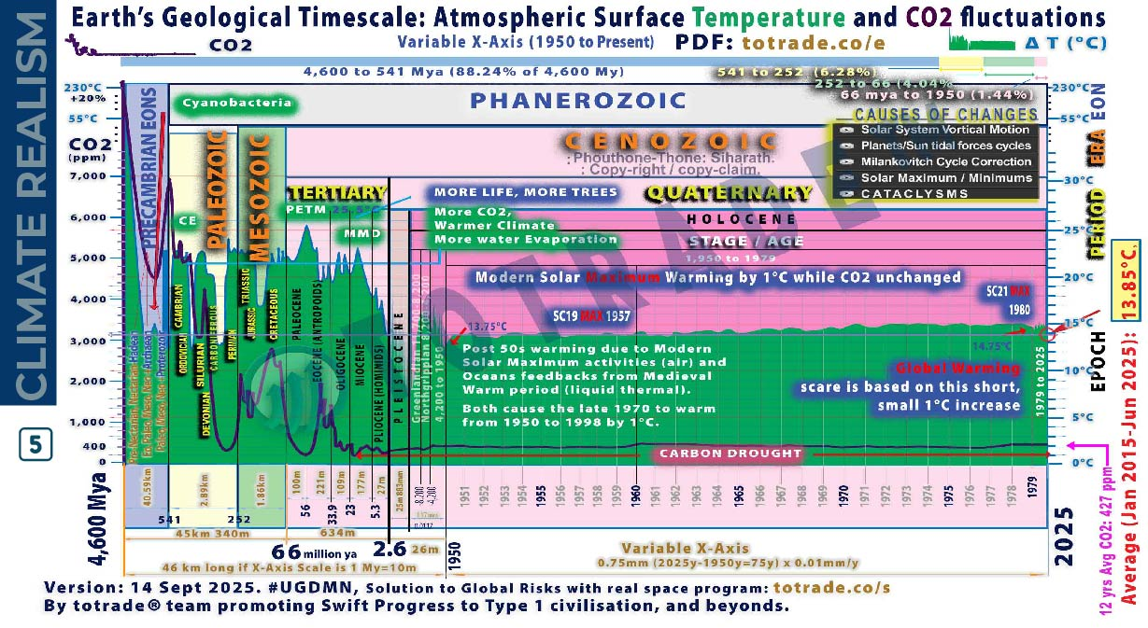
NATURAL ARCHIVES → CLIMATE REALISM
Notes:
This graph shows climate shifts between 1950 and 1979, Earth’s climate shifted through solar cycles. Natural archives and historical records confirm this.
“Climate Change” between 1950 and 1979, now incorporating the surge in Galactic Cosmic Rays (GCRs) and lightning observations:
• Modern Solar Maximum Warming by 1°C while CO₂ unchanged.
Solar activity peaked. Sunspot counts rose. Earth warmed ~1°C. CO₂ remained near 315 ppm. Warming was solar-driven, not CO₂-induced.
• Warmer Climate, More Water Evaporation, releasing More CO₂,
CO₂ began rising slowly. Warmer air held more moisture. Evaporation increased. Cloud formation and precipitation patterns shifted. Oceans retained more heat.
• Post-50s Warming: Air and Ocean Feedback
Air warmed from solar maximum. Oceans released stored heat from Medieval Warm Period. Liquid thermal inertia amplified warming. Combined feedback raised global temperature.
• GCRs Start to Surge
NASA research confirmed GCRs influence lightning frequency. Chronis found increased lightning linked to cosmic ray flux. GCRs electrify the atmosphere, triggering more discharges. This marks a shift in Earth’s electrical environment.
• 1950–1998 Warming: +1°C
Late 1970s marked acceleration. Solar and ocean feedbacks caused ~1°C rise. No tipping point. No CO₂ spike. No cataclysm.
• Global Warming Scare
Based on short-term data. Graph shows only 0.75mm X-axis out of 46km total scale. Misleading scale exaggerates impact. Real climate change spans millions of years.
Conclusion:
Natural archives show patterns. Cataclysms explain abrupt transitions. Climate change is not linear. It’s cyclical, sudden, and global. We must prepare.

Slide 23
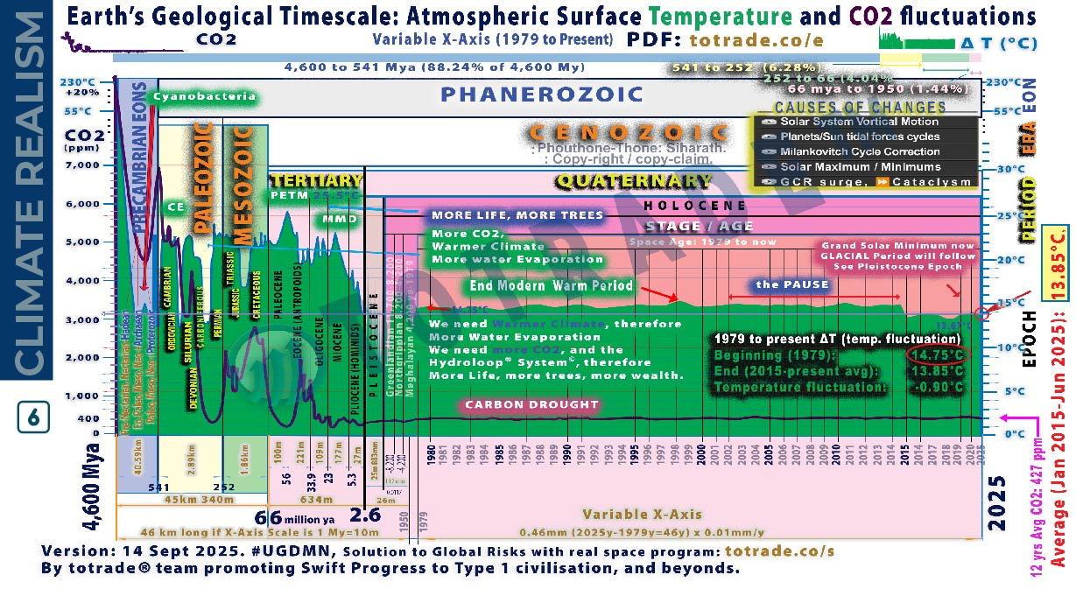
NATURAL ARCHIVES → CLIMATE REALISM
Notes:
This graph shows climate shifts between 1976 and 2025, Earth’s climate shifted through solar cycles. Natural archives and historical records confirm this.
Between 1979 and 2025, Earth’s climate shifted under declining solar activity and rising cosmic influences:
• Solar activity declined. See totrade.co/sm.
Japan universities linked this to increased lightning. See totrade.co/ln5.
• Galactic Cosmic Rays surged.
GCRs triggered cloud formation.
CERN CLOUD confirmed. See totrade.co/gc.
GCRs also increased lightning. Confirmed by NASA Earthdata (totrade.co/gcr1),
Frontiers in Physics (totrade.co/gcr2),
Climate Cosmos (totrade.co/ln1),
The Weather Network (totrade.co/gcr3),
and Yale Environment 360 (totrade.co/gcr4).
• Lightning spikes marked the surge.
Atmospheric ionization increased. Electrical storms intensified.
• IPCC manipulated data to hide the decline.
Climategate exposed suppression of cooling trends.
• The pause between 2002–2014
Global temperature stabilized. No warming. CO₂ continued rising.
• 2014–2018: Temperature declined by 0.90°C
Confirmed by satellite and ocean data. Cooling trend ignored in mainstream reports.
• 2018–2025: Continued cooling
UAH January 2025 report shows global temperature anomaly at +0.46°C, down from +0.62°C in December 2024.
Trend since 1978: +0.15°C per decade. But recent years show decline due to La Niña and reduced solar activity.
Datagraver confirms monthly anomalies and 10-year moving average show cooling since 2016, totrade.co/dg.
Conclusion:
Natural archives show patterns. Cataclysms explain abrupt transitions. Climate change is not linear. It’s cyclical, sudden, and global. We must prepare.

Slide 24
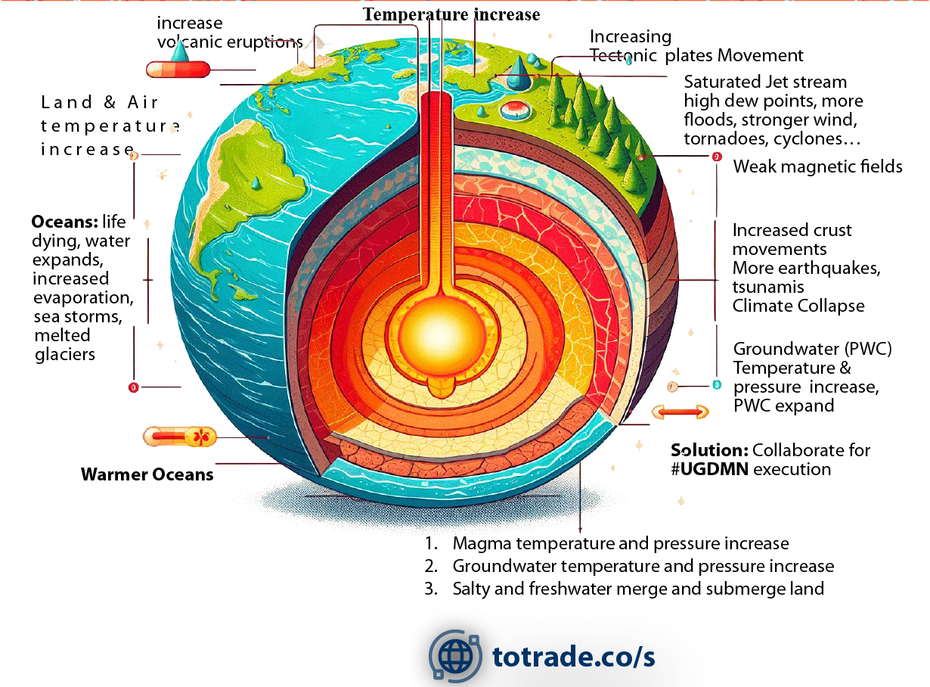
GCRs Surge: Effects on Earth Interior
Notes:
Galactic Cosmic Rays (GCRs) influence Earth’s interior and related systems:
• Magma heats up and pressure rises, increasing volcanic activity.
• Groundwater temperature and pressure rise, destabilizing subsurface systems.
• Salty and freshwater layers mix, submerging land areas.
• Tectonic plates move faster, raising earthquake and tsunami risks.
• Weakening magnetic fields reduce Earth’s shielding, amplifying GCR effects.
• Crust movements intensify, driving seismic instability.
Linked surface impacts:
• Warmer oceans expand, melt glaciers, and fuel stronger storms.
• Jet stream saturation raises dew points, causing floods, tornadoes, and cyclones.
• Combined effects push toward climate collapse.

Slide 25
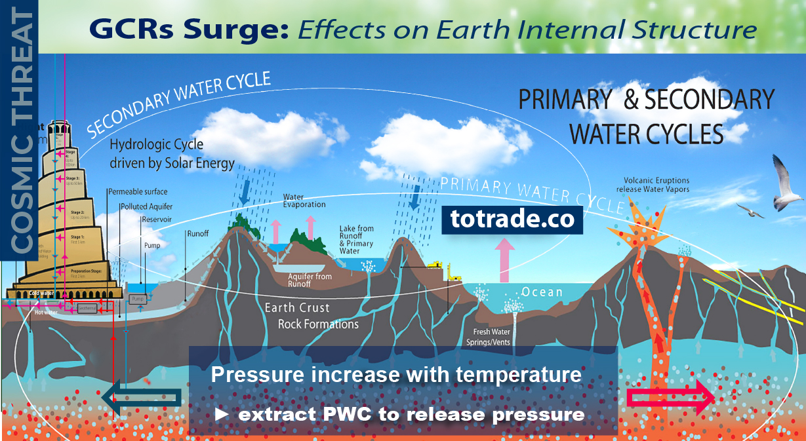
GCRs Surge: Effects on
Notes:
Galactic Cosmic Rays (GCRs) influence Earth’s interior and related systems:
• Magma heats up and pressure rises, increasing volcanic activity.
• Groundwater temperature and pressure rise, destabilizing subsurface systems.
• Salty and freshwater layers mix, submerging land areas.
• Tectonic plates move faster, raising earthquake and tsunami risks.
• Weakening magnetic fields reduce Earth’s shielding, amplifying GCR effects.
• Crust movements intensify, driving seismic instability.
Linked surface impacts:
• Warmer oceans expand, melt glaciers, and fuel stronger storms.
• Jet stream saturation raises dew points, causing floods, tornadoes, and cyclones.
• Combined effects push toward climate collapse.
The image also mentions UGDMN execution as a mitigation strategy.

Slide 26
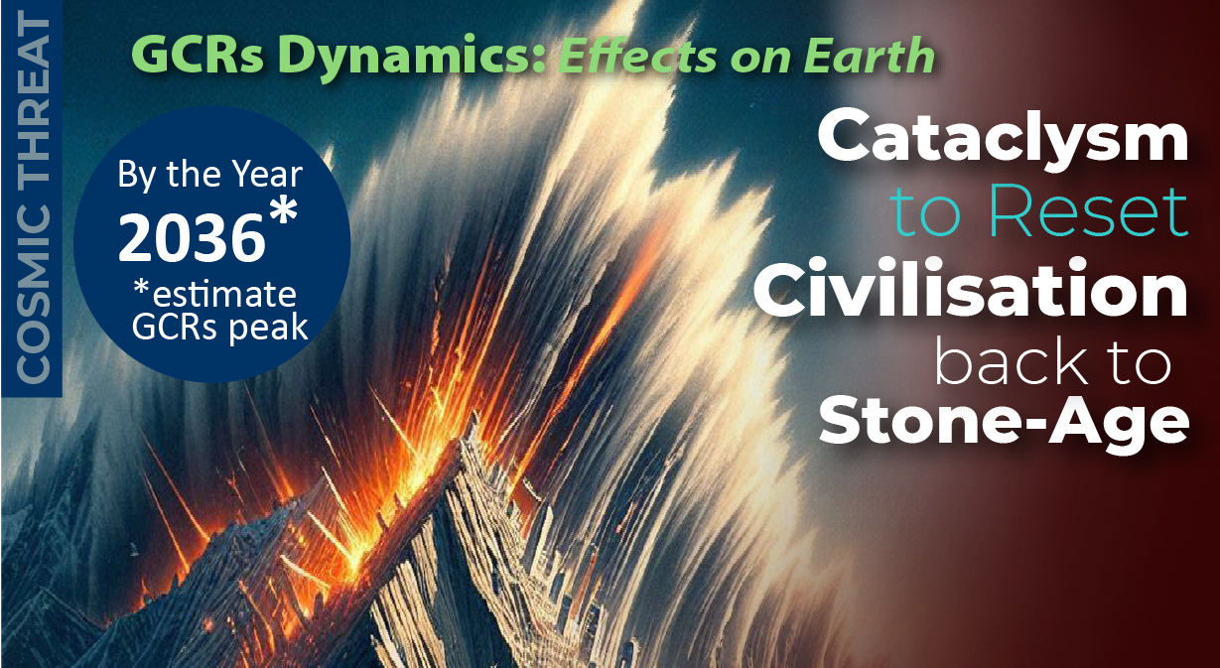
GCRs Triggered Cataclysm Estimate Timeline
Notes:
Global Risk Assessment & Feasibility Studies
Beyond CO₂: Galactic Cosmic Rays and Cataclysms
• Recent extreme rainfall anomalies (bit.ly/ttfloods) signal deeper drivers beyond CO₂.
• CERN’s CLOUD experiment shows GCRs influence aerosol formation and cloud seeding, altering climate systems.
• Rising Galactic Cosmic Rays (GCRs), on multi-millennial cycles, are peaking toward ~2036, linked to solar activity decline.
• Mainstream focus on CO₂ masks the real risk: GCR-driven atmospheric and geophysical instability.
Why it matters:
• GCR surge destabilizes Earth’s interior → pressure buildup → supervolcanoes, megaquakes, crust slippage.
• Consequences: continent-scale floods, infrastructure collapse, cultural and technological loss, followed by global glaciation.
Cyclic cataclysms from Earth’s crustal displacement:
Mechanism
• A semi-molten layer 60–120 miles deep acts as lubricant.
• Off-axis ice caps build centrifugal stress.
• Magnetic and electrical disruption lets the crust slip.
• Poles shift into the Torrid Zone within hours, triggering upheaval.
Effects
• Supersonic winds over 1,500 km/h shred life and structures.
• Oceans race inland as walls of water miles high.
• Quakes split continents; molten rock floods lowlands.
• Flash-freezing locks life and mud in place.
Global Reach
• Americas drowned, burned, frozen.
• Europe and Asia devastated by sea, wind, quakes.
• Africa partly spared, split in half, and shaken.
• Antarctica and Greenland shift to equator; melting raises seas 150+ m.
• Survivors hide in mountains; civilization erased.
Parallels
• Myths of Noah, Vishnu, Osiris, Utnapishtim reflect earlier resets.
• Cuvier (1812) noted sudden global catastrophes.
• Later scholars tied legends, fossils, geology to recurring events.
Evidence
• Alaska, Siberia, North America bone beds show sudden freezing.
• Grand Canyon and Badlands strata record repeated floods.
• Ice cap growth drives instability.
Pattern
• Cycle repeats every few thousand years.
• Last five mapped over 35,000+ years.
• Next shift near 2036, tied to solar-cosmic change.
Outcome
• Oceans lay new mud layers.
• ASEAN and Australia emerge temperate refuges.
• Civilization resets to Stone Age.
This synthesis of geology, myth, and cataclysmology shows civilization ends in cycles of crustal displacement.

Slide 27
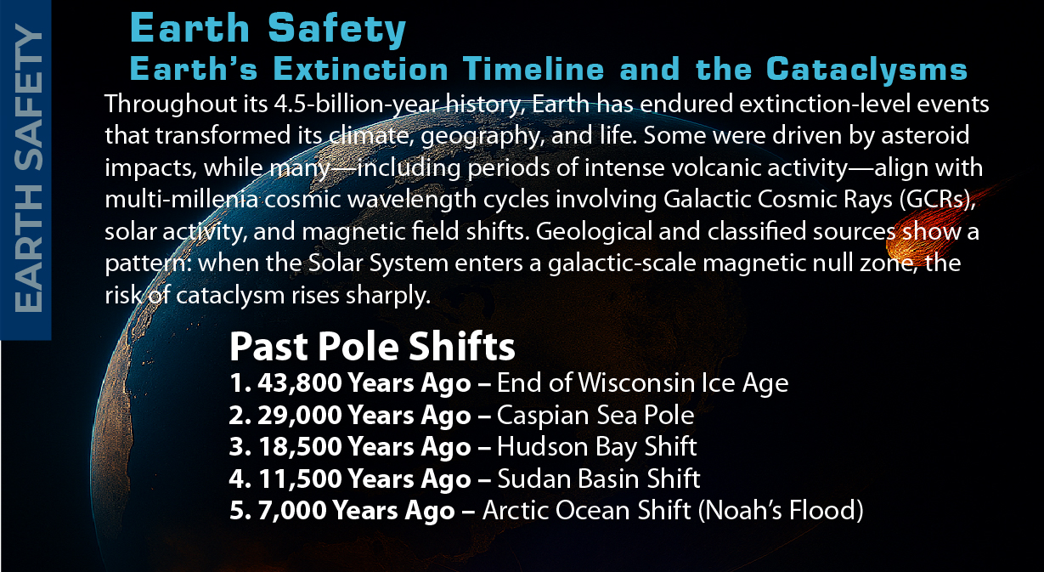
GCRs Triggered Past Cataclysm
Notes:
Global Risk Assessment & Feasibility Studies
Beyond CO₂: Galactic Cosmic Rays and Cataclysms
By studying world history of cataclysms, we see that mega projects not built to withstand them signal failed leadership—and will drive citizens into collapse. totrade.co/ct
The Americans, more strategic, use the petrodollar—exchanging cheap paper for OPEC oil—to build sanctuaries and shield their citizens. totrade.co/ug1
• Recent extreme rainfall anomalies (bit.ly/ttfloods) signal deeper drivers beyond CO₂.
• CERN’s CLOUD experiment shows GCRs influence aerosol formation and cloud seeding, altering climate systems.
• Rising Galactic Cosmic Rays (GCRs), on multi-millennial cycles, are peaking toward ~2036, linked to solar activity decline.
• Mainstream focus on CO₂ masks the real risk: GCR-driven atmospheric and geophysical instability.
Why it matters:
• GCR surge destabilizes Earth’s interior → pressure buildup → supervolcanoes, megaquakes, crust slippage.
• Consequences: continent-scale floods, infrastructure collapse, cultural and technological loss, followed by global glaciation.
Cyclic cataclysms from Earth’s crustal displacement:
Mechanism
• A semi-molten layer 60–120 miles deep acts as lubricant.
• Off-axis ice caps build centrifugal stress.
• Magnetic and electrical disruption lets the crust slip.
• Poles shift into the Torrid Zone within hours, triggering upheaval.
Effects
• Supersonic winds over 1,500 km/h shred life and structures.
• Oceans race inland as walls of water miles high.
• Quakes split continents; molten rock floods lowlands.
• Flash-freezing locks life and mud in place.
Global Reach
• Americas drowned, burned, frozen.
• Europe and Asia devastated by sea, wind, quakes.
• Africa partly spared, split in half, and shaken.
• Antarctica and Greenland shift to equator; melting raises seas 150+ m.
• Survivors hide in mountains; civilization erased.
Parallels
• Myths of Noah, Vishnu, Osiris, Utnapishtim reflect earlier resets.
• Cuvier (1812) noted sudden global catastrophes.
• Later scholars tied legends, fossils, geology to recurring events.
Evidence
• Alaska, Siberia, North America bone beds show sudden freezing.
• Grand Canyon and Badlands strata record repeated floods.
• Ice cap growth drives instability.
Pattern
• Cycle repeats every few thousand years.
• Last five mapped over 35,000+ years.
• Next shift near 2036, tied to solar-cosmic change.
Outcome
• Oceans lay new mud layers.
• ASEAN and Australia emerge temperate refuges.
• Civilization resets to Stone Age.
This synthesis of geology, myth, and cataclysmology shows civilization ends in cycles of crustal displacement.

Slide 28
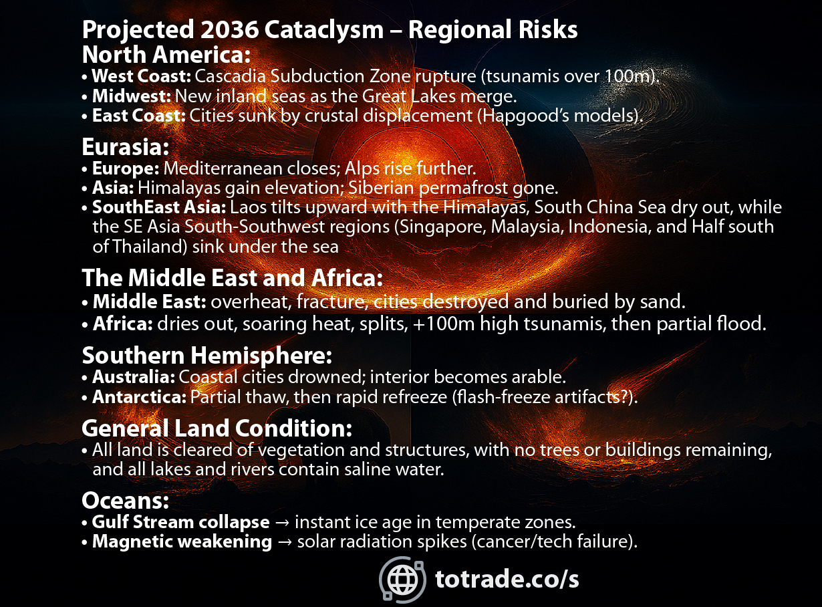
GCRs Triggered Projected Next Cataclysm
Notes:
Global Risk Assessment & Feasibility Studies
Beyond CO₂: Galactic Cosmic Rays and Cataclysms
• Recent extreme rainfall anomalies (bit.ly/ttfloods) signal deeper drivers beyond CO₂.
• CERN’s CLOUD experiment shows GCRs influence aerosol formation and cloud seeding, altering climate systems.
• Rising Galactic Cosmic Rays (GCRs), on multi-millennial cycles, are peaking toward ~2036, linked to solar activity decline.
• Mainstream focus on CO₂ masks the real risk: GCR-driven atmospheric and geophysical instability.
Why it matters:
• GCR surge destabilizes Earth’s interior → pressure buildup → supervolcanoes, megaquakes, crust slippage.
• Consequences: continent-scale floods, infrastructure collapse, cultural and technological loss, followed by global glaciation.
Cyclic cataclysms from Earth’s crustal displacement:
Mechanism
• A semi-molten layer 60–120 miles deep acts as lubricant.
• Off-axis ice caps build centrifugal stress.
• Magnetic and electrical disruption lets the crust slip.
• Poles shift into the Torrid Zone within hours, triggering upheaval.
Effects
• Supersonic winds over 1,500 km/h shred life and structures.
• Oceans race inland as walls of water miles high.
• Quakes split continents; molten rock floods lowlands.
• Flash-freezing locks life and mud in place.
Global Reach
• Americas drowned, burned, frozen.
• Europe and Asia devastated by sea, wind, quakes.
• Africa partly spared, split in half, and shaken.
• Antarctica and Greenland shift to equator; melting raises seas 150+ m.
• Survivors hide in mountains; civilization erased.
Parallels
• Myths of Noah, Vishnu, Osiris, Utnapishtim reflect earlier resets.
• Cuvier (1812) noted sudden global catastrophes.
• Later scholars tied legends, fossils, geology to recurring events.
Evidence
• Alaska, Siberia, North America bone beds show sudden freezing.
• Grand Canyon and Badlands strata record repeated floods.
• Ice cap growth drives instability.
Pattern
• Cycle repeats every few thousand years.
• Last five mapped over 35,000+ years.
• Next shift near 2036, tied to solar-cosmic change.
Outcome
• Oceans lay new mud layers.
• ASEAN and Australia emerge temperate refuges.
• Civilization resets to Stone Age.
This synthesis of geology, myth, and cataclysmology shows civilization ends in cycles of crustal displacement.

Slide 29
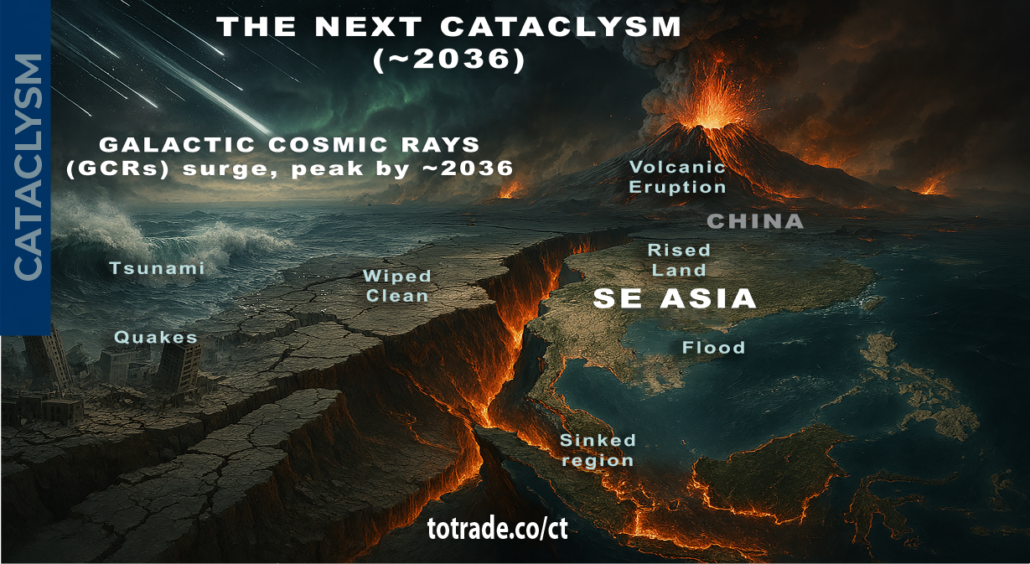
GCRs Triggered Projected Next Cataclysm
Notes:
GCR Surge and Global Disruption
Slide content:
• GCRs are intensifying. Peak expected around 2036
• GCRs trigger aerosol formation and cloud seeding
• This accelerates the Secondary Water Cycle (SWC): more rain, storms, floods
• Tectonic shifts disrupt the Primary Water Cycle (PWC): oceans destabilize, water pushed upward
• SE Asia map shows coastline and ecosystem changes
Observation Indicators:
• Intense rain, lightning, flooding, abnormal fruiting
• Deep GCR penetration into atmosphere and crust
• Strong ionization of atmospheric layers
• More 8+ magnitude earthquakes from MHD shifts
• Unusual volcanic activity
• Global floods, mega-tsunamis, abrupt glaciation
Historical Insights:
• Cataclysms are cyclical, every few thousand years
• Last major event: 11,500 years ago
• Evidence: Grand Canyon, frozen mammoths, ancient ruins
• Events unfold in hours—not centuries
• Driven by MHD instability and crustal energy release
Call to Action:
• Prepare infrastructure for water cycle collapse
• Safeguard trees and technology
• Train populations for post-cataclysm survival
• Understand cosmic, geological, and climate forces
Final line:
We have little choice. The challenge: not only to survive but to evolve.

Slide 30
GCRs → Galaxies
Null Zone: totrade.co/gn
NASA: totrade.co/ns1
GCRs → Solar Activity
SILSO, Sunspots: totrade.co/sm
GCRs → Lightning:
NASA Earthdata: totrade.co/gcr1
Frontiers in Physics: totrade.co/gcr2
Climate Cosmos: totrade.co/ln1
The Weather Network: totrade.co/gcr3
Yale Environment 360: totrade.co/gcr4
GCRs → Cloud Formation:
CERN CLOUD: totrade.co/gc
SUN → Lightning:
Japan Universities: totrade.co/ln5
CIA Classified → Cataclysm:
Sanitized Video: totrade.co/cia1
Sanitized Doc: totrade.co/cia3
Unclassified → Cataclysm:
Full History:
totrade.co/ct | totrade.co/h
Earth Temperature & CO₂ Graph:
totrade.co/e
References
Notes:
All files are online and regularly updated
This Documentation
Climate Realism: totrade.co/cr
Supplements
Website: totrade.co

Slide 31

Natural Archives→ Earth History
[1] Columbia University: Dinosaurs survived when CO2 was extremely high, why can't humans: totrade.co/co2a
[2] PHYS: Dinosaurs survived CO2 extremely high: totrade.co/co2b
[3] Oxygen and CO2 level during Mesozoic Jurassic-Triassic Cretaceous: totrade.co/co2c
[4] Middle Miocene disruption: totrade.co/co2d
[5] Middle Miocene Climate Optimum: totrade.co/co2e
[6] What Pliocene Epoch Teach us about future warming Earth: totrade.co/co2f
[7] From The Roman Empire: Warm during the Rise of Roman Empire: totrade.co/co2g
References
Notes:
All files are online and regularly updated
This Documentation
Climate Realism: totrade.co/cr
Supplements
Website: totrade.co

Slide 32
Feasibility Study & Business Plan
🔗 SCIENCE: GCRs, Lightning, Fruiting: totrade.co/g
📜 HISTORY: Earth: totrade.co/e | Cataclysm: totrade.co/h
💡 SOLUTION
#UGDMN: totrade.co/s
Products: totrade.co/p
Multilateral Partnership: totrade.co/m
✅ Call to Action: totrade.co/ca
📄 PDF: totrade.co/biz | totrade.co/pdf
Presentation
Climate Realism: totrade.co/cr (This file)
Business Plan: totrade.co/bp
Documentation
Notes:
All files are online and regularly updated
Feasibility Study & Business Plan
🔗 SCIENCE: GCRs, Lightning, Fruiting: totrade.co/g
📜 HISTORY: Earth: totrade.co/e | Cataclysm: totrade.co/h
💡 SOLUTION
#UGDMN: totrade.co/s
Products: totrade.co/p
Multilateral Partnership: totrade.co/m
✅ Call to Action: totrade.co/ca
📄 PDF: totrade.co/biz | totrade.co/pdf
Presentation
Climate Realism: totrade.co/cr (This file)
Business Plan: totrade.co/bp

